Slide 1

Flatbook a presentation of team 8
Rem0 Röthlisberger, Eric Lagger, Vincent Hofer, Dean Klopsch, Aebi Ryan

Slide 2

Roadmap
Rem0 Röthlisberger, Eric Lagger, Vincent Hofer, Dean Klopsch, Aebi Ryan
System as is – use cases
Scenario
Discussion

Slide 3
System as is – use cases
Rem0 Röthlisberger, Eric Lagger, Vincent Hofer, Dean Klopsch, Aebi Ryan
Fancy Graphic with all the use cases

Slide 4
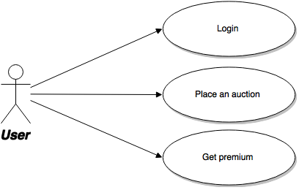
Scenario – Placing a new auction
Rem0 Röthlisberger, Eric Lagger, Vincent Hofer, Dean Klopsch, Aebi Ryan
Notes:
Login with a non premium user (ese: John Wayne)
Place a new auction
Look at the index and don‘t be statisfied with the ranking of the ad
Get Premium and show the message in the inbox. As well as the index page, we should now be ranked first!

Slide 5
Interaktion mit Abowd & Beale's Modell
Rem0 Röthlisberger, Eric Lagger, Vincent Hofer, Dean Klopsch, Aebi Ryan
Notes:
Login from Google, go to the newly placed ad and place a bid on it.
Wait

Slide 6
Interaktion mit Abowd & Beale's Modell
Rem0 Röthlisberger, Eric Lagger, Vincent Hofer, Dean Klopsch, Aebi Ryan
Notes:
Login and place a new bid for the same ad

Slide 7
Interaktion mit Abowd & Beale's Modell
Rem0 Röthlisberger, Eric Lagger, Vincent Hofer, Dean Klopsch, Aebi Ryan
Notes:
Login again from Google, check your mailbox and go to the ad place a new bid.

Slide 8
Interaktion mit Abowd & Beale's Modell
Rem0 Röthlisberger, Eric Lagger, Vincent Hofer, Dean Klopsch, Aebi Ryan
Notes:
Change the auctionEndDate in the database and reload the page. Show message, that you won the auction

Slide 9


Questions
Rem0 Röthlisberger, Eric Lagger, Vincent Hofer, Dean Klopsch, Aebi Ryan

Slide 10

Rem0 Röthlisberger, Eric Lagger, Vincent Hofer, Dean Klopsch, Aebi Ryan

