Slide 1

Flatbook the realest real estate A presentation of team 8
Rem0 Röthlisberger, Eric Lagger, Vincent Hofer, Dean Klopsch, Aebi Ryan

Slide 2

Roadmap
Rem0 Röthlisberger, Eric Lagger, Vincent Hofer, Dean Klopsch, Aebi Ryan
About us
System as is – use cases
Scenario
Why us
Questions / Discussion

Slide 3
The Team
Rem0 Röthlisberger, Eric Lagger, Vincent Hofer, Dean Klopsch, Aebi Ryan
Remo Röthlisberger
Ryan Aebi
Dean Klopsch
Vincent Hofer
Eric Lagger

Slide 4
The Gathering
Rem0 Röthlisberger, Eric Lagger, Vincent Hofer, Dean Klopsch, Aebi Ryan
University of Bern
Long sleepless nights
A mix for creativity and productivity

Slide 5
The Project
Rem0 Röthlisberger, Eric Lagger, Vincent Hofer, Dean Klopsch, Aebi Ryan
Originally flat finder
Very common problem set

Slide 6
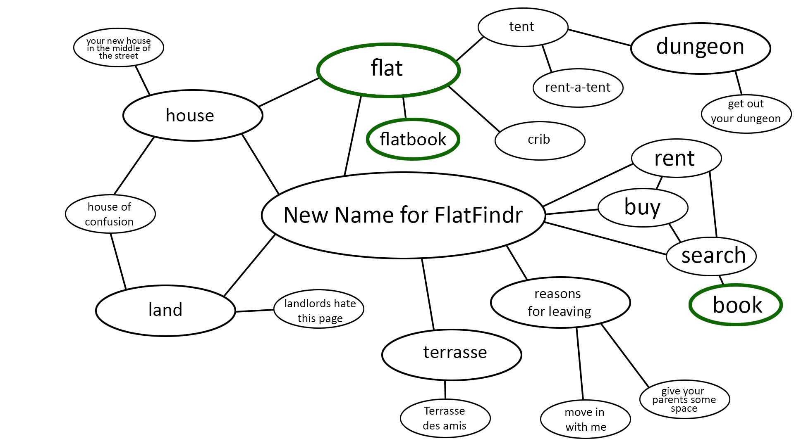

Slide 7
System as is
Rem0 Röthlisberger, Eric Lagger, Vincent Hofer, Dean Klopsch, Aebi Ryan
Implemented requested functionality
Based on the FlatFindr project
Short overview on the next 2 slides

Slide 8
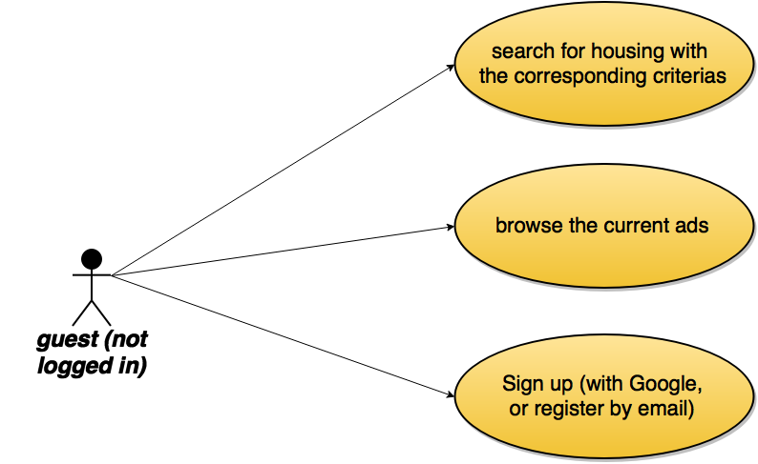
Rem0 Röthlisberger, Eric Lagger, Vincent Hofer, Dean Klopsch, Aebi Ryan

Slide 9
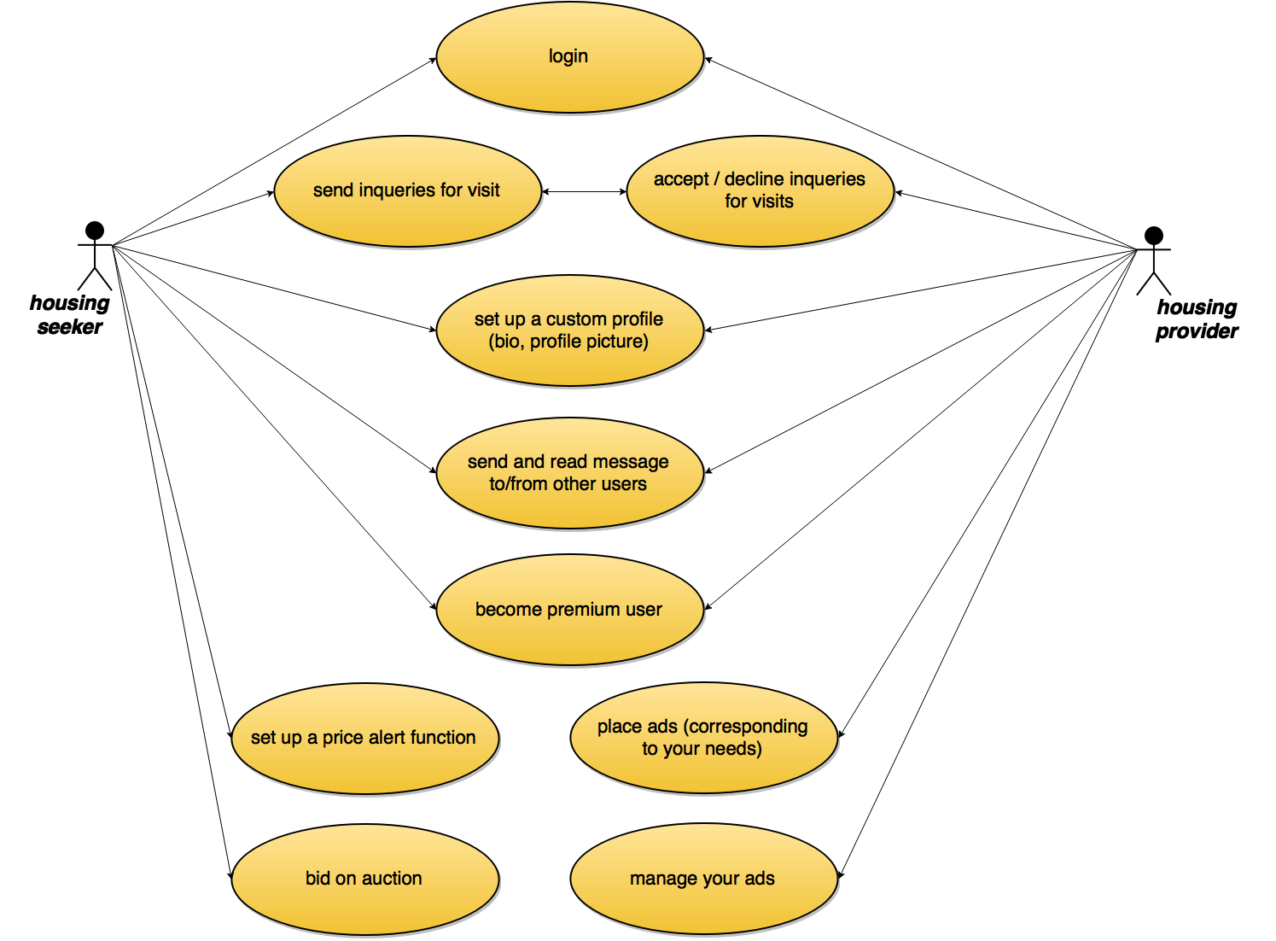
Rem0 Röthlisberger, Eric Lagger, Vincent Hofer, Dean Klopsch, Aebi Ryan

Slide 10
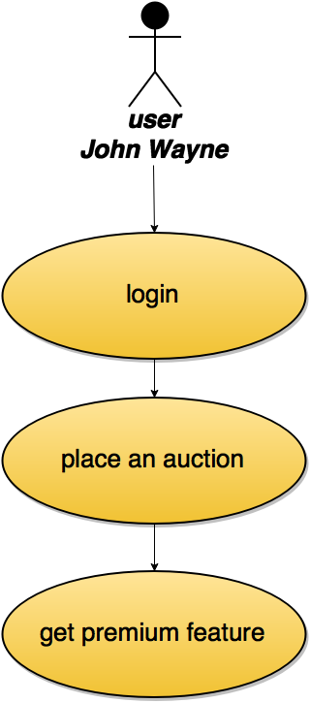
Scenario Placing a new auction
Rem0 Röthlisberger, Eric Lagger, Vincent Hofer, Dean Klopsch, Aebi Ryan
Place a new auction of type apartment
Evaluate the current ranking
Decide to get the premium feature
Notes:
Login with a non premium user (ese: John Wayne)
Place a new auction
Look at the index and don‘t be statisfied with the ranking of the ad
Get Premium and show the message in the inbox. As well as the index page, we should now be ranked first!

Slide 11
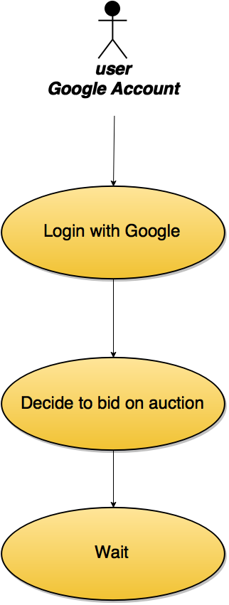
Scenario – Login with Google and make a bid on an auction
Rem0 Röthlisberger, Eric Lagger, Vincent Hofer, Dean Klopsch, Aebi Ryan
Login with your Google account
Decide to make a bid on the just created auction
Notes:
Login from Google, go to the newly placed ad and place a bid on it.
Wait

Slide 12
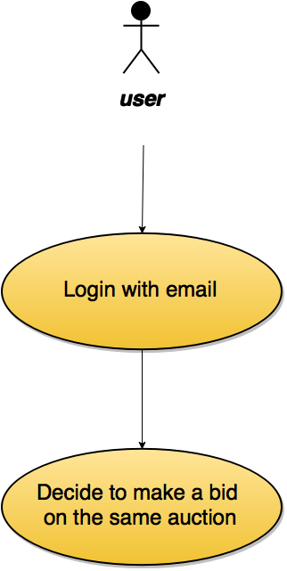
Scenario – Get overbidden by other user
Rem0 Röthlisberger, Eric Lagger, Vincent Hofer, Dean Klopsch, Aebi Ryan
Login with another user
Decide to make a higher bid on the same ad
Notes:
Login and place a new bid for the same ad

Slide 13
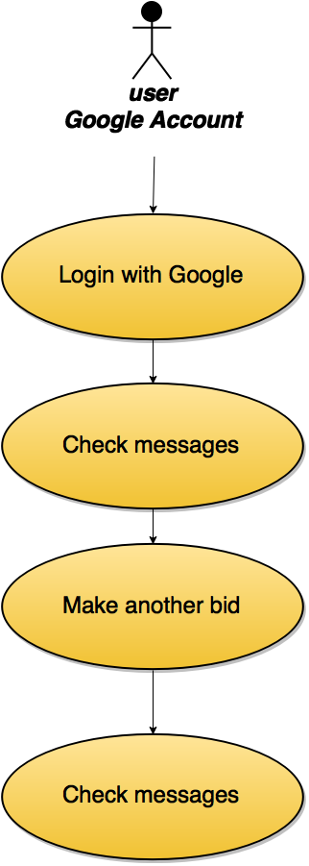
Sceanrio – Make another bid and wait for the confirmation message
Rem0 Röthlisberger, Eric Lagger, Vincent Hofer, Dean Klopsch, Aebi Ryan
Login with the Google Account
Check messages and decide to place a higher bid
Wait for the auction to end
Notes:
Login again from Google, check your mailbox and go to the ad place a new bid.
Wait for the auction to end
Change the auctionEndDate in the database and reload the page. Show message, that you won the auction

Slide 14
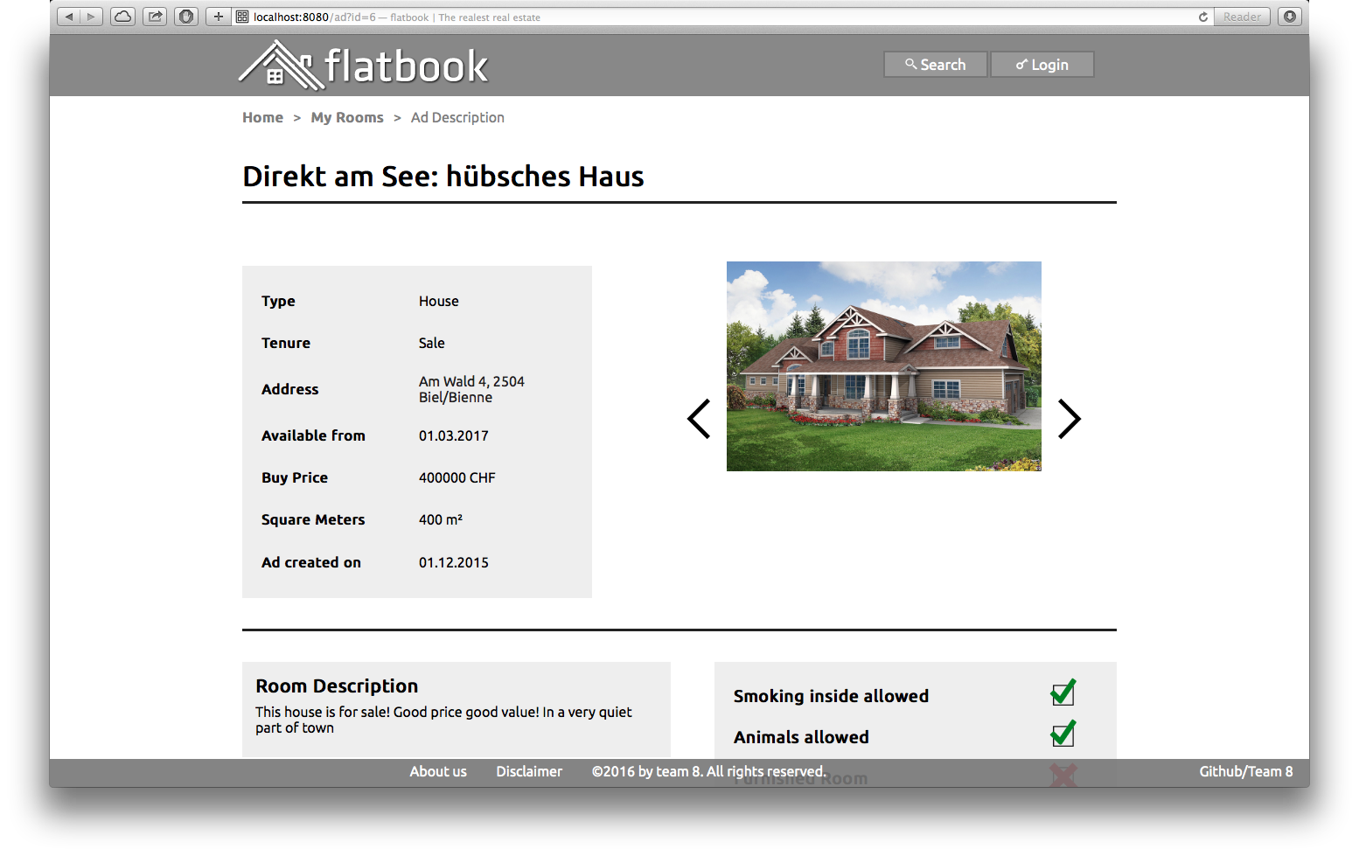
Demo
Rem0 Röthlisberger, Eric Lagger, Vincent Hofer, Dean Klopsch, Aebi Ryan
Notes:
Without further do, let‘s work through the scenario

Slide 15
Why us?
Rem0 Röthlisberger, Eric Lagger, Vincent Hofer, Dean Klopsch, Aebi Ryan
Our team
The products -> The client -> The developers
Ask us!
Contact us!

Slide 16
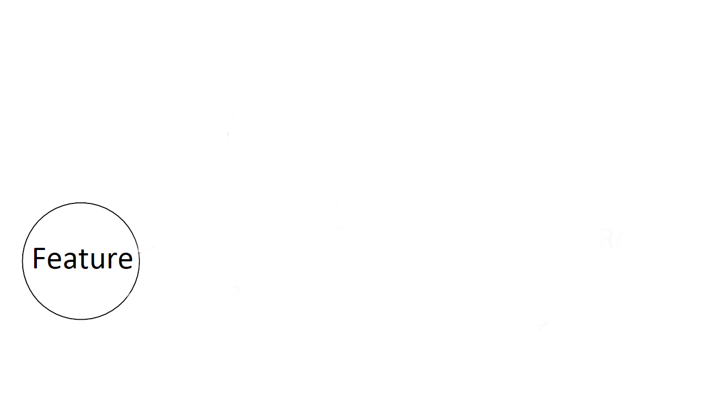
Code quality
Rem0 Röthlisberger, Eric Lagger, Vincent Hofer, Dean Klopsch, Aebi Ryan

Slide 17
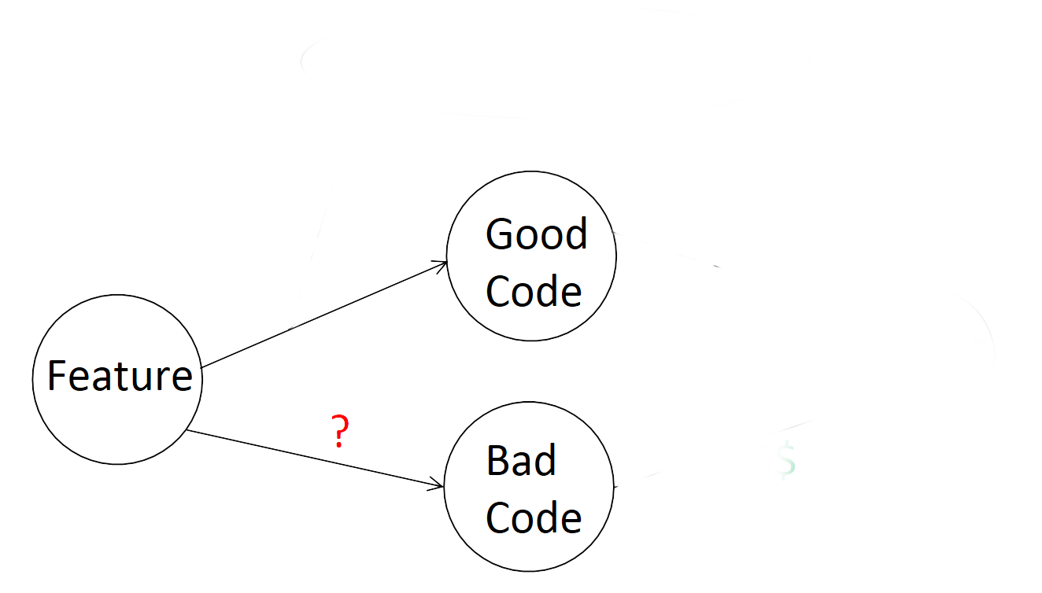
Code quality
Rem0 Röthlisberger, Eric Lagger, Vincent Hofer, Dean Klopsch, Aebi Ryan

Slide 18
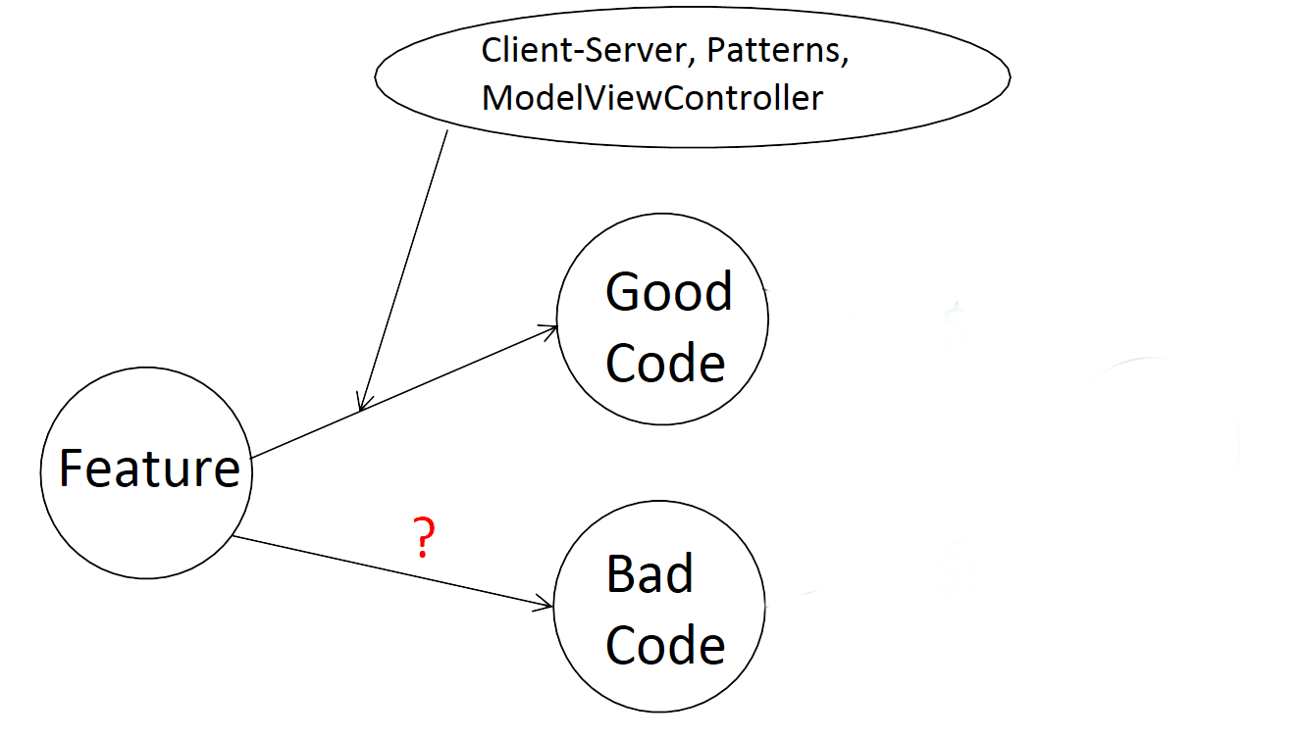
Code quality
Rem0 Röthlisberger, Eric Lagger, Vincent Hofer, Dean Klopsch, Aebi Ryan

Slide 19
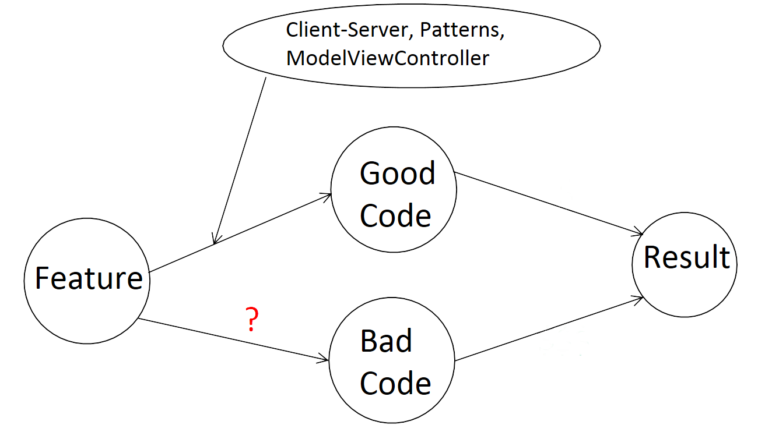
Code quality
Rem0 Röthlisberger, Eric Lagger, Vincent Hofer, Dean Klopsch, Aebi Ryan

Slide 20

Code quality
Rem0 Röthlisberger, Eric Lagger, Vincent Hofer, Dean Klopsch, Aebi Ryan

Slide 21
Good code pays off in the long run!
Rem0 Röthlisberger, Eric Lagger, Vincent Hofer, Dean Klopsch, Aebi Ryan

Slide 22
Why us?
Rem0 Röthlisberger, Eric Lagger, Vincent Hofer, Dean Klopsch, Aebi Ryan
Our team
The products -> The client -> The developers
Ask us!
Contact us!

Slide 23


Questions?
Rem0 Röthlisberger, Eric Lagger, Vincent Hofer, Dean Klopsch, Aebi Ryan

