Slide 1

Anitrans
ESE 2017-TEAM 2
Jan Eich, Renda Badar, Albana Jaha and Dardana Jaha

Slide 2
Table of contents
Features
Demo of the product
Development process
Highlights and challenges
Questions

Slide 3

Features
Animal transport
Create/Edit trips
Assign driver and vehicle

Slide 4

Demo of the product

Slide 5


Development process
Team Meetings
Customer Meetings
Github
Whatsapp group
Dropbox

Slide 6
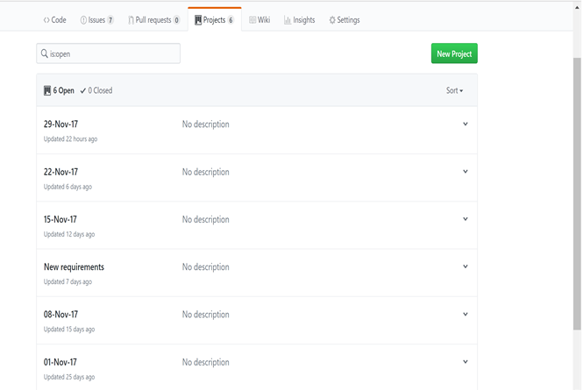
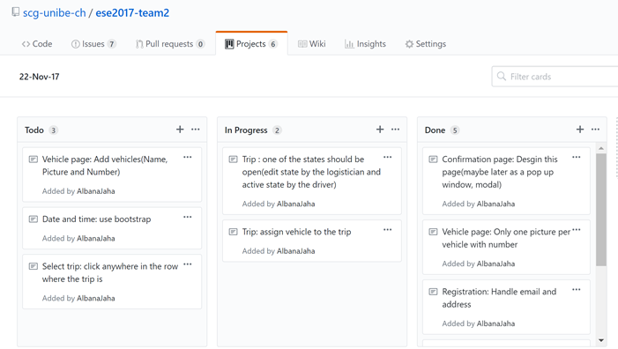
Development process
Projects tool: Github Project
Notes:
Our development process became much easier after we started using Github Project

Slide 7
Highlights and challenges
Communication within the team
Assign tasks to team members
Time management
Using the Spring framework
Customer requests
Help from assistant

Slide 8
Questions?

Slide 9


