Slide 1

Course Organization
Haidar Osman
http://scg.unibe.ch/staff/Osman
ESE 2016

Slide 2
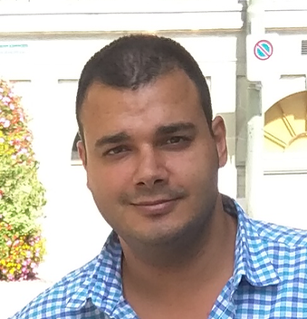
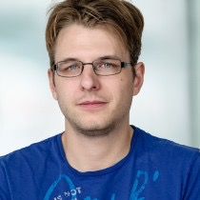
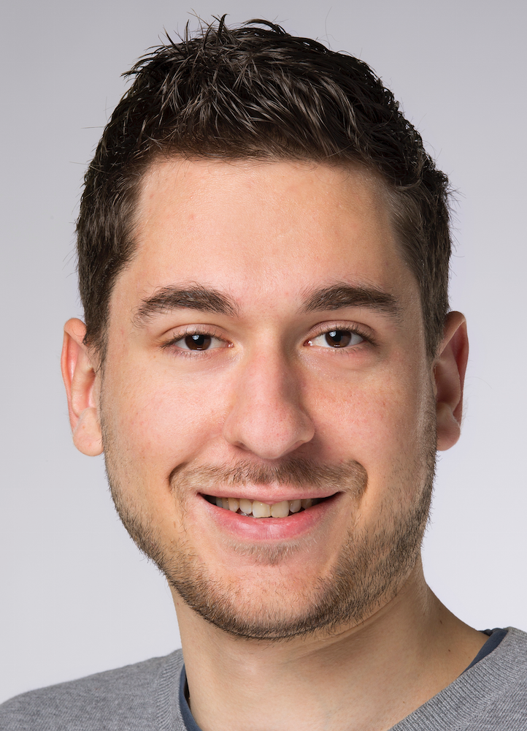
When?
Lecture: Wednesday 14:15 - 16:00
Exercise : Wednesday 16:15 - 17:00
Who?
Haidar Osman
Claudio Corrodi
Manuel Leuenberger

Slide 3







Project
Project: Website for Real Estate
Platform: J2EE
Frameworks & Tools: Spring (MVC, Data, Security), Maven, MySql, Git
Customer: ESE Assistants
Team size: 4/5 members

Slide 4

Grading
Final Grade
60% Final Exam
40% Project
Project Evaluation
code, design, functionality, usability, documentation, presentation

Slide 5
Links
Lectures: http://scg.unibe.ch/teaching/ese
Project Material: https://github.com/scg-unibe-ch/ese2016
Project Schedule: https://github.com/scg-unibe-ch/ese2016/wiki
Communication: https://piazza.com/unibe.ch/fall2016/ese2016

