Slide 1


Haidar Osman
http://scg.unibe.ch/staff/Osman
ESE 2016

Slide 2

Maven is a Build Tool
Compile
…
Run Tests
Deploy
Generate JavaDoc
Notes:
- IDEs also can build projects. But first, not all developers use the same IDE. You might use Eclipse, somebody else might use netbeans. The idea is to abstract the build process from the IDE by creating a unified approach to building projects. Second, you want an automated way to achieve the build goals using commands, and not only GUI. This way, the build process can be integrated with other builds or continuous integration scripts.

Slide 3
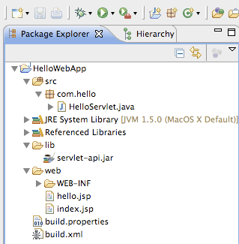
Maven is a
Dependency Management Tool
Notes:
This is a normal project structure in eclipse. A closer look shows that there is a

Slide 4
Maven is a
Dependency Management Tool
Notes:
a directory called lib. It contains all the libraries we use in our project as Jars. Of course, putting the Jars there is not enough, you have to add them to the class path and then they will be added

Slide 5
Maven is a
Dependency Management Tool
Notes:
a directory called lib. It contains all the libraries we use in our project as Jars. Of course, putting the Jars there is not enough, you have to add them to the class path and then they will be added the referenced libraries and only then, the libraries and frameworks can be used. Now
what happens if you want to upgrade a specific library to a newer version, you have to ….
What happens if a specific library itself depends on other jars. Then you have to manually get the Jars and put them in your project

Slide 6
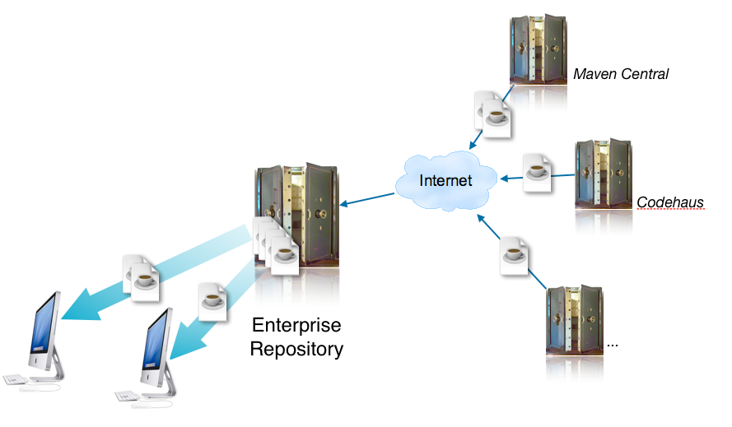
Maven is a
Dependency Management Tool
https://community.oracle.com/docs/DOC-982921
Notes:
You can specify in Maven what dependencies you want and it will automatically grab them from their sources and add them to your class path. This process is transitive. In other words, maven will grab the dependencies of your dependencies and so on.
Also upgrading a dependency is no more than increasing the version number of that dependency, as we will see later.

Slide 7
mvn archetype:generate (Create a new project)
-DartifactId=demo-app (with this name)
-DgroupId=ch.unibe.scg (with this package prefix)
-DarchetypeArtifactId=maven-archetype-quickstart (using this template)
Notes:
mvn archetype:generate -DartifactId=demo-app -DgroupId=ch.unibe.scg -DarchetypeArtifactId=maven-archetype-quickstart

Slide 8
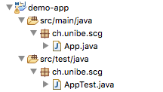

Slide 9
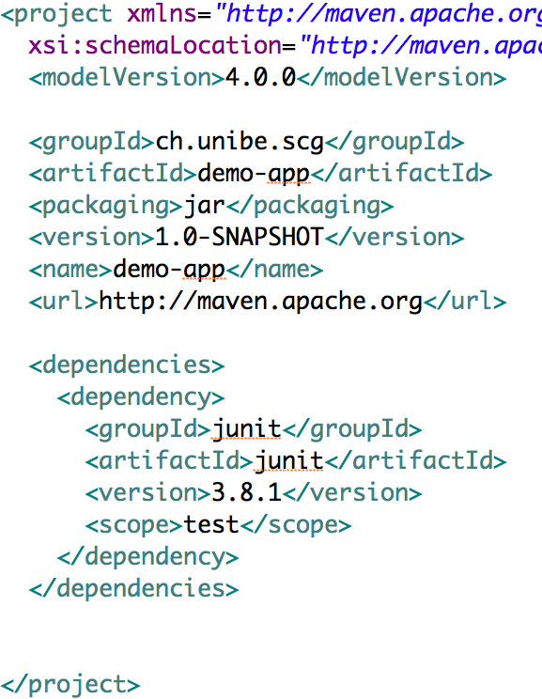

Slide 10
Project
Description
Dependencies

Slide 11
Maven Phases
mvn compile (compiles the project)
mvn test (runs the test cases)
mvn package (creates a JAR or WAR file)

Slide 12
Maven Phases
mvn compile (compiles the project)
mvn test (runs the test cases)
mvn package (creates a JAR or WAR file)
compile
…
test
…
package

Slide 13

Maven Phases
mvn compile (compiles the project)
mvn test (runs the test cases)
mvn package (creates a JAR or WAR file)
compile
…
test
…
package

Slide 14
Project
Description
Dependencies
Plugins

Slide 15
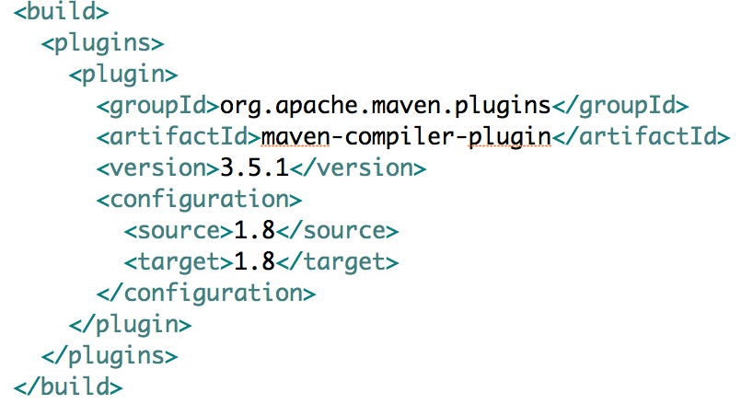

Slide 16

Archetype

Slide 17
Archetype
Create
Project
POM.xml
Project Structure

Slide 18

Archetype
Create
Retrieve Dependencies
Project
POM.xml
Project Structure

Slide 19

Archetype
Create
Retrieve Dependencies
Project
Build
POM.xml
Project Structure

Slide 20
Archetype
Create
Retrieve Dependencies
Project
Build
POM.xml
Project Structure
Plugins

Slide 21

Archetype
Create
Retrieve Dependencies
Artifact
Project
Build
POM.xml
Project Structure
Plugins

Slide 22
Useful Links
Create a maven project:
http://maven.apache.org/archetype/maven-archetype-plugin/usage.html
Maven in 5 mins:
http://maven.apache.org/guides/getting-started/maven-in-five-minutes.html
Understand the build process:
https://maven.apache.org/guides/introduction/introduction-to-the-lifecycle.html
A Good Tutorial:
https://www.youtube.com/playlist?list=PL92E89440B7BFD0F6

