Slide 1
Introduction to Java Microservices Part 3 : Microservices Infrastructure
Evolution from classic monolith application to microservices
with Spring Boot / Spring Cloud / JPA / NoSQL / Kafka / CQRS

Slide 2
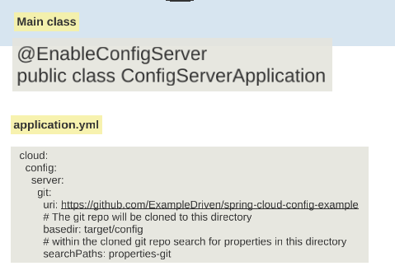
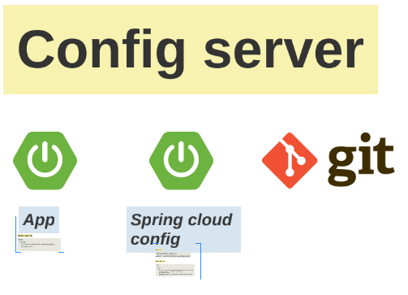
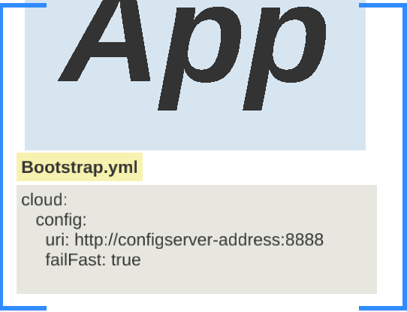
Microservices Infrastructure
API Gateway
Services Registry
Configuration Service
Feign Client

Slide 3
Simple Demo Monolith Application
UI Layer
API Gateway
Exposed REST
Feign REST
User Service
Email
Service
Services Registry
DB
DB

