Slide 1
Introduction to Java Microservices Part 1 : Classic Monolith
Evolution from classic monolith application to microservices
with Spring Boot / Spring Cloud / JPA / NoSQL / Kafka / CQRS

Slide 2
Monolithic Architecture Benefits
Application Server
Well known “classic” architecture approach
Easy to design
Easy to understand
Easy to debug
Easy to deploy
Easy to scale
Easy to maintain
Good to start new Proof of Concept projects
Good for small-to-mid size applications)
Good for single development team
User Interface
Business Logic
Data/ORM
Relational
DB

Slide 3
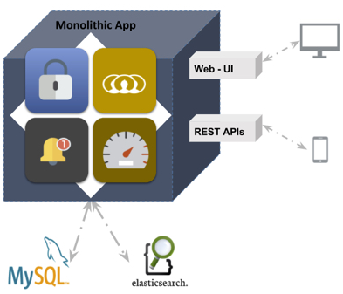
Monolithic Architecture Drawbacks
The large monolithic code base can be difficult to understand and modify because of complex dependencies
Large code base slows down the IDE
Large applications start and work slowly.
Continuous Delivery is difficult because long build/test/deploy cycle
Because all modules are running within the same process, a bug in any module, such as a memory leak, can potentially bring down the entire process.
A monolithic architecture forces developers to be married to the technology stack which was chosen at the start of development
Development scaling requires significant coordination efforts
Vertical application scaling can be costly and not always possible because of expensive hardware.
Horizontal scaling might be difficult because of expensive high availability (HA) technologies and complex load balancing
Requires long term commitment to a technology stack

Slide 4
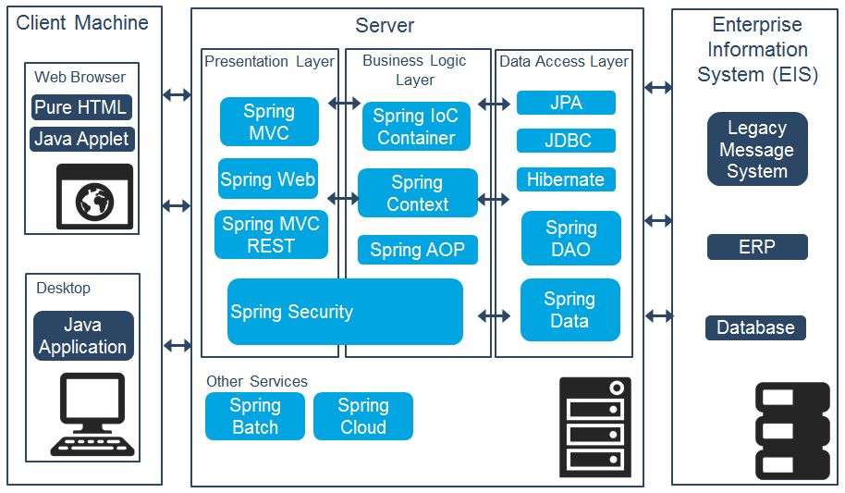
Heavyweight Monolith Spring Stack

Slide 5
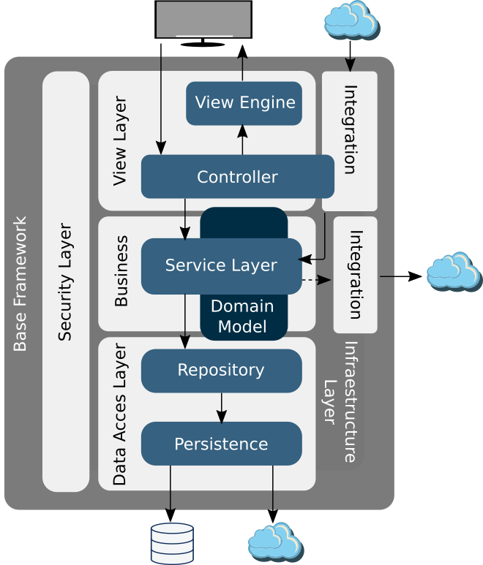
Demo App Architecture

Slide 6
Simple Demo Monolith Application
Spring Boot with Embedded Tomcat
User REST Controller
User Service Layer
DI + Config
User CRUD Repository
H2 Database

Slide 7
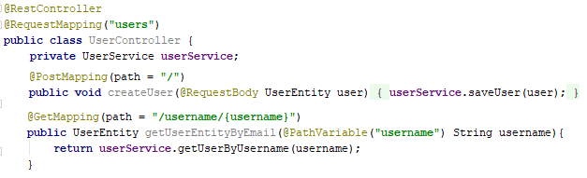
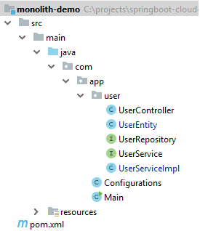
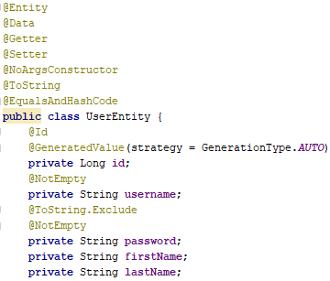
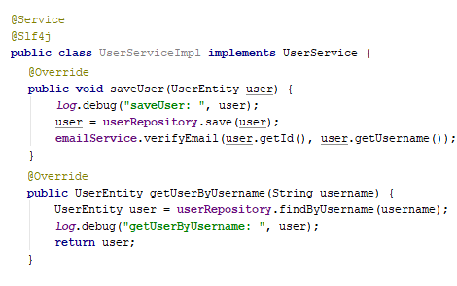
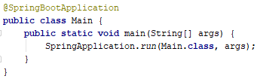
Application Structure
REST Controller
Data Entity
User Service

Slide 8
Spring Boot

Slide 9
Controller/Service/Repository
myview <-> MyController <- MyService <- MyDAO
^
|
MyHelper
Controllers handled the view resolving.
Services handled mapping from dto-s to model objects for view and vice versa,
DAO-s handled database transactions and,
Helpers handled everything else including validation.
Service layer provides code modularity, the business logic and rules are specified in the service layer which in turn calls DAO layer ,the DAO layer is then only responsible for interacting with DB.
you get to make a clear distinction between web type activity best done in the controller and generic business logic that is not web-related. You can test service-related business logic separately from controller logic
you get to specify transaction behavior so if you have calls to multiple data access objects you can specify that they occur within the same transaction
Repository encapsulates the details of the persistence layer and provide a CRUD interface for a single entity.
Business Rules
Business rules are an important part of the business domain.
They define data validation and other constraints that need
to be applied on domain objects in specific business process
scenarios. Business rules typically fall into the following categories:
Data validation
Data transformation
Business decision-making
Process routing (work-flow logic)

Slide 10
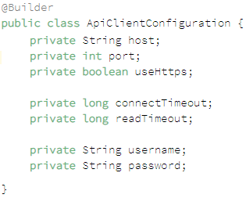
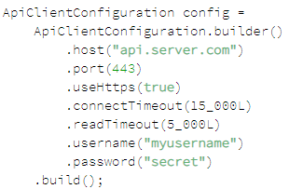
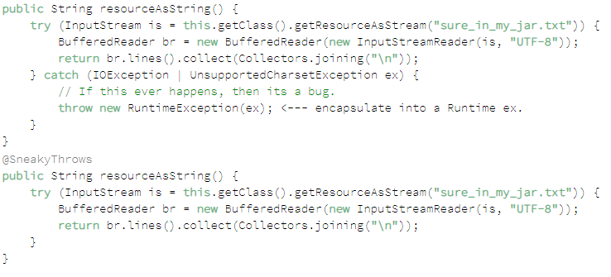
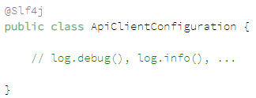

Lombok
Getters/Setters, Constructors
Lazy Getter
ToString:
EqualsAndHashCode:

