Slide 1

Introduction to Java Microservices Part 1 : Classic Monolith
Evolution from classic monolith application to microservices
with Spring Boot / Spring Cloud / JPA / NoSQL / Kafka / CQRS

Slide 2

Training Goals
The goal of this training is to review modern approaches to build and support distributed applications and services.
Find the best ways to make fast and efficient:
Development process
And the software
Become familiar with most popular Spring services
Touch Cloud technologies
Review CQRS pattern
Make acquaintance with Docker and Kubernetes

Slide 3

We are building brand new internet service
I would like to propose you a small game. Imagine that we work together in a startup. We have the idea to build new service that will allow people to travel together cheap and convenient. We have to integrate car sharing, hotel booking, flight search engine, blog and customer support services.
Let’s think how to reach a success.
How people will interact with your service?
What programming languages/technologies do you like to use?
What database?
How are you going to release & deploy it? How often?
How many people to hire? How many teams?
What Software Development Methodology to use?
How we will extend our system in 3 years?
What if our technologies become legacy?
What if we have competitors who are going to go live with their product in a half year?

Slide 4
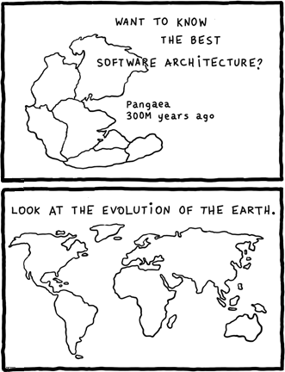
Monolith vs Microservices
The monolithic architecture pattern is the traditional architectural style. The monolith application built as a single, autonomous unit. While this style has been an integral part of many businesses, its numerous limitations and issues are motivating more and more to make the switch to microservices.
The main idea behind microservices is that some types of applications are easier to build and maintain when they are broken down into many small pieces that work together. Each component has its own small team working on it so they are completely decoupled and separated from each other, allowing each service to run its own unique process and communicate autonomously without having to rely on the other teams or applications as a whole.

Slide 5
Monolithic Architecture Benefits
Application Server
Well known “classic” architecture approach
Easy to design
Easy to understand
Easy to debug
Easy to deploy
Easy to scale
Easy to maintain
Good to start new Proof of Concept projects
Good for small-to-mid size applications)
Good for single development team
User Interface
Business Logic
Data/ORM
Relational
DB

Slide 6

Monolithic Architecture Drawbacks
The large monolithic code base can be difficult to understand and modify because of complex dependencies
Large code base slows down the IDE
Large applications start and work slowly.
Continuous Delivery is difficult because long build/test/deploy cycle
Because all modules are running within the same process, a bug in any module, such as a memory leak, can potentially bring down the entire process.
A monolithic architecture forces developers to be married to the technology stack which was chosen at the start of development
Development scaling requires significant coordination efforts
Vertical application scaling can be costly and not always possible because of expensive hardware.
Horizontal scaling might be difficult because of expensive high availability (HA) technologies and complex load balancing
Requires long term commitment to a technology stack

Slide 7
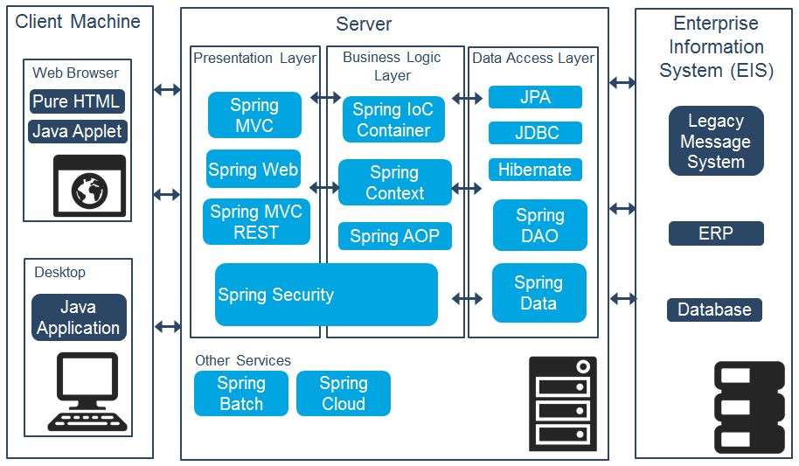
Heavyweight Monolith & Spring Stack

Slide 8
Simple Demo Monolith Application
Spring Boot with Embedded Tomcat
Lets start with some simple example of monolithic service
It will not be complex but we can easily split it to (at least two) microservices
We will not implement UI part because microservices is about backend
Database doesn’t matter. Let’s use H2 to setup environment quickly.
The same Spring services will be reused later, when monolith will be split to microservices.
REST Controller
Service Layer
DI + Config
CRUD Repository
H2 Database

Slide 9
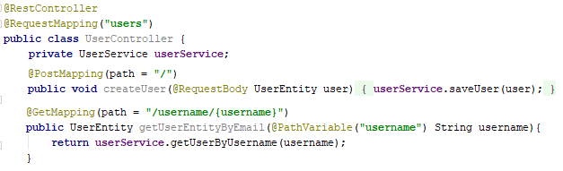
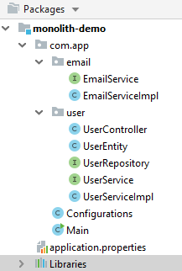
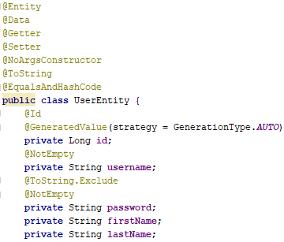
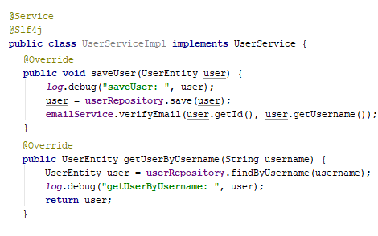
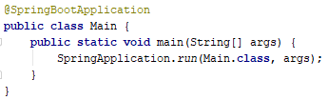
Application Structure
REST Controller
Data Entity
User Service

Slide 10
Application Structure
Real applications are complex. In our training we will just mimic real services.
User service is about creating and query user data.
Email service should send activation email when new user is created.
In following trainings we will split this application in two parts.

Slide 11
Run Application
You can use Maven 3 or Gradle to build and run the application
Also you can run it from your IDE as standard main application
Call gradle bootRun or mvn spring-boot:run
To test application you can use some REST client like Restlet Client
. ____ _ __ _ _
/\\ / ___'_ __ _ _(_)_ __ __ _ \ \ \ \
( ( )\___ | '_ | '_| | '_ \/ _` | \ \ \ \
\\/ ___)| |_)| | | | | || (_| | ) ) ) )
' |____| .__|_| |_|_| |_\__, | / / / /
=========|_|==============|___/=/_/_/_/
:: Spring Boot :: (v2.1.6.RELEASE)
2019-07-19 22:03:29.903 INFO 3448 --- [ main] com.app.Main : Starting Main on DESKTOP-C5N7SHO with PID 3448 (C:\projects\springboot-cloud-demo-one\user-service\target\classes started by user in C:\projects\springboot-cloud-demo-one\user-service)
2019-07-19 22:03:29.942 INFO 3448 --- [ main] com.app.Main
2019-07-19 22:03:54.466 INFO 3448 --- [ main] o.s.b.w.embedded.tomcat.TomcatWebServer : Tomcat started on port(s): 8081 (http) with context path ''
2019-07-19 22:03:54.477 INFO 3448 --- [ main] com.app.Main : Started Main in 26.751 seconds (JVM running for 29.685)

Slide 12
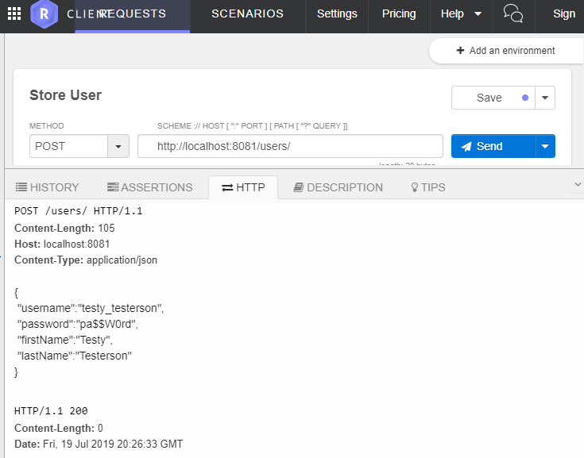
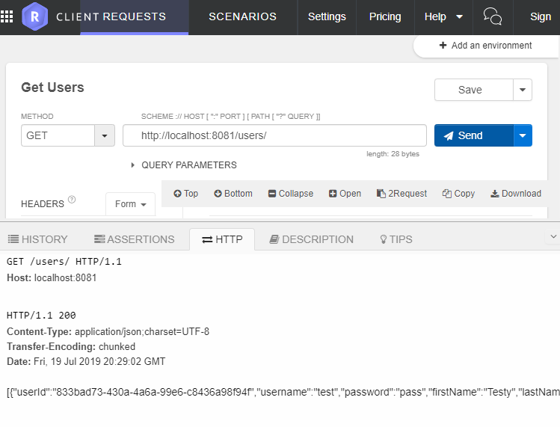
Test Application
To create user you should send HTTP POST to:
http://localhost:8081/users/ {"username":"testy_testerson", "password":"pa$$W0rd", "firstName":"Testy", "lastName":"Testerson"}
To list all users you should send HTTP GET to:
http://localhost:8081/users/

