Slide 1
Introduction to Java Microservices Part 2 : Spring Services
Evolution from classic monolith application to microservices
with Spring Boot / Spring Cloud / JPA / NoSQL / Kafka / CQRS

Slide 2
Spring Boot

Slide 3
Controller/Service/Repository
myview <-> MyController <- MyService <- MyDAO
^
|
MyHelper
Controllers handled the view resolving.
Services handled mapping from dto-s to model objects for view and vice versa,
DAO-s handled database transactions and,
Helpers handled everything else including validation.
Service layer provides code modularity, the business logic and rules are specified in the service layer which in turn calls DAO layer ,the DAO layer is then only responsible for interacting with DB.
you get to make a clear distinction between web type activity best done in the controller and generic business logic that is not web-related. You can test service-related business logic separately from controller logic
you get to specify transaction behavior so if you have calls to multiple data access objects you can specify that they occur within the same transaction
Repository encapsulates the details of the persistence layer and provide a CRUD interface for a single entity.
Business Rules
Business rules are an important part of the business domain.
They define data validation and other constraints that need
to be applied on domain objects in specific business process
scenarios. Business rules typically fall into the following categories:
Data validation
Data transformation
Business decision-making
Process routing (work-flow logic)

Slide 4
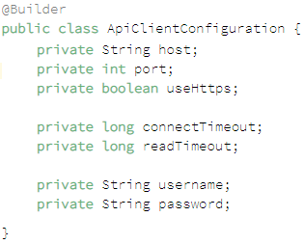
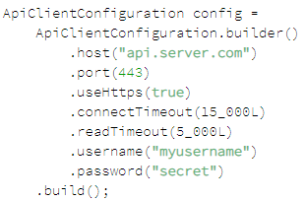
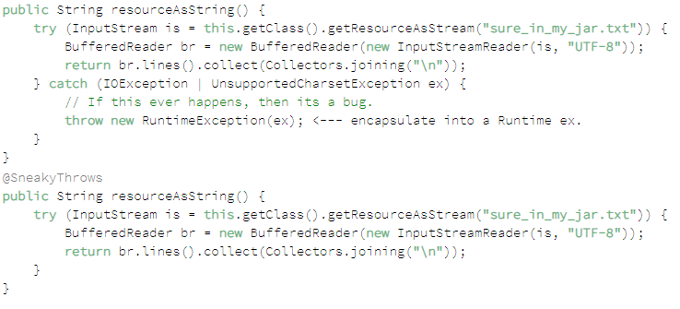
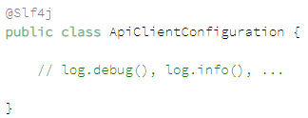

Lombok
Getters/Setters, Constructors
Lazy Getter
ToString:
EqualsAndHashCode:

