Slide 1
2/17 Math 470 Cross Validation
Sarah Goodyear

Slide 2
Definition
Cross validation: resampling method used to assess model performance by training on subsets
Uses:
Maximize model performance
Evaluate different machine learning methods
Hyperparameter tuning
Provides a reliable estimate for model performance
Helps prevent overfitting

Slide 3
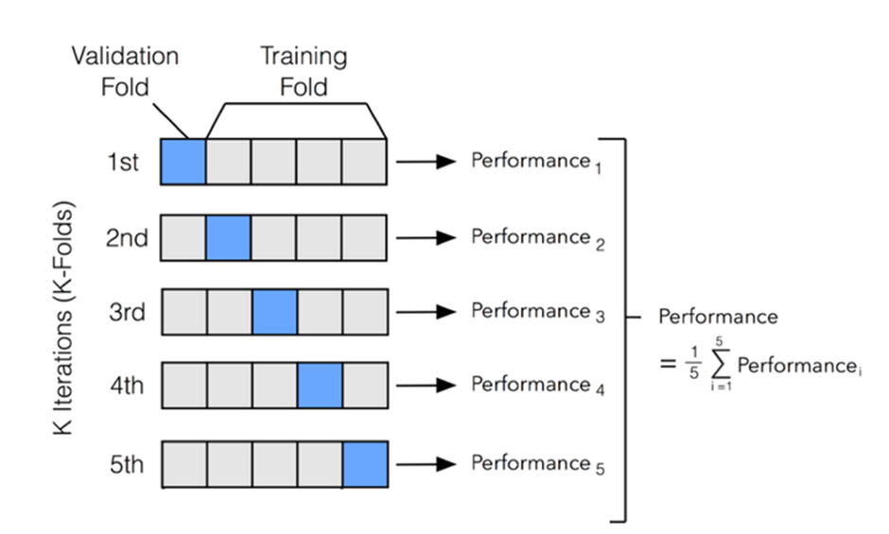
K-Fold Cross Validation
Dataset divided into k folds
Model trained on k-1 folds for each fold
Tested on remaining fold
Repeated k times
Commonly k=5 or k=10
Advantage: reduces bias
Disadvantage: computationally expensive for large datasets

Slide 4
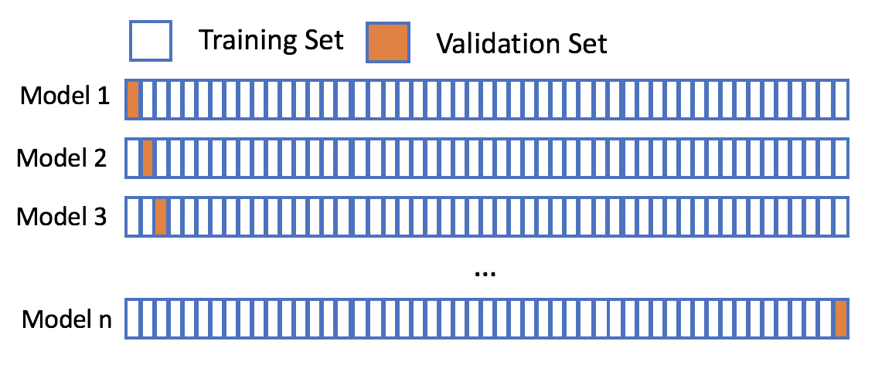
Leave One Out Cross Validation
Special case of k-fold where k=n
Advantage: maximizes training data
Disadvantage: computationally expensive if n is large

Slide 5
Benefits
Improved model performance evaluation than a single train-test split
Better generalization from testing on multiple sets
Bias-variance trade-off: dilemma of balancing bias (underfitting) and variance (overfitting) for optimal model performance
Bias and variance have inverse relation
Cross validation helps balance this

