Slide 1
BCO-DMO Metadata Evaluation and Improvement
John Kozimor
Sean Gordon
The HDF Group

Slide 2
Agenda
Compare Metadata Evaluation Techniques
RAD Approach
TRAD Approach
Quick Eval Reports
GeoTraces Metadata RAD Report (Summer ESIP)
GeoTraces Updated Metadata RAD Report (October)
Goals for November Workshop?

Slide 3
Terminology
Collection: A group of metadata records, commonly organized by a data center, organization or project and often stored in a database or web accessible folder.
Concept : General term for describing a documentation entity (e.g. Title, Revision Date, Process Step, Spatial Extent).
Dialect : A particular form of the documentation language that is specific to a community (e.g. DIF, CSDGM, EML, ECHO).
Recommendation: A set of concepts that a group believes is required for achieving a documentation goal.
Profile: A set of concepts required to support a particular documentation need or use case for a recommendation.

Slide 4
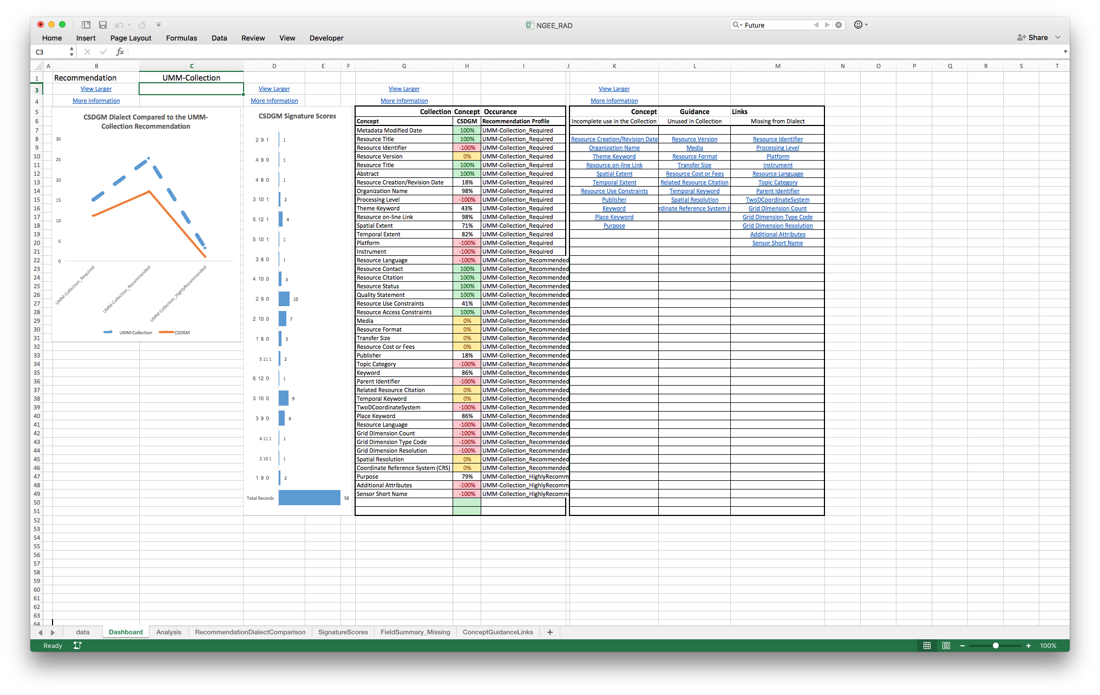
Recommendations Analysis Dashboard
Exploratory metadata evaluation tool.
Enables metadata for a single dialect to be easily evaluated using multiple recommendation (eg. CSW, DataCite).
Designed to run on subset of metadata records (processing limitations).
Provides a nice dashboard interface with 4 different displays.
Requires a data sheet, which at this time can only be created by HDF metadata team.
data.ucar.edu
Sharable Metadata
Metadata
Documentation
Notes:
Dashboard Display
Recommendation / Dialect Comparison Graph
Signature Scores Chart
Results Summary Table
Concept Guidance Table

Slide 5
Prioritizing Metadata Improvement
What recommendations are most important to your organization?
a) DataCite, b) DCAT, c) DIF, d) CSW, e) LTER
What recommendation profiles are most important to your organization?
Not all recommendations are required
http://wiki.esipfed.org/index.php/Documentation_Recommendations

Slide 6
Next Steps
Use the RAD to decide what recommendation profiles (DataCite 4.0 Optional, LTER_Discovery, ISO-1 Mandatory)?
Decide what collections are to be analyzed.
multiple dialects and collections okay
Complete collections are best

Slide 7
Questions, Comments?
data.ucar.edu
Reach me offline at: scgordon@hdfgroup.org
Sharable Metadata
Metadata
Thanks!tion

