Slide 1
BCO-DMO Metadata Evaluation and Workshop Planning
John Kozimor
Sean Gordon
The HDF Group

Slide 2
Agenda
GeoTraces Metadata RAD Report (Summer ESIP)
GeoTraces Updated Metadata RAD Report (October)
Goals for November Workshop?

Slide 3
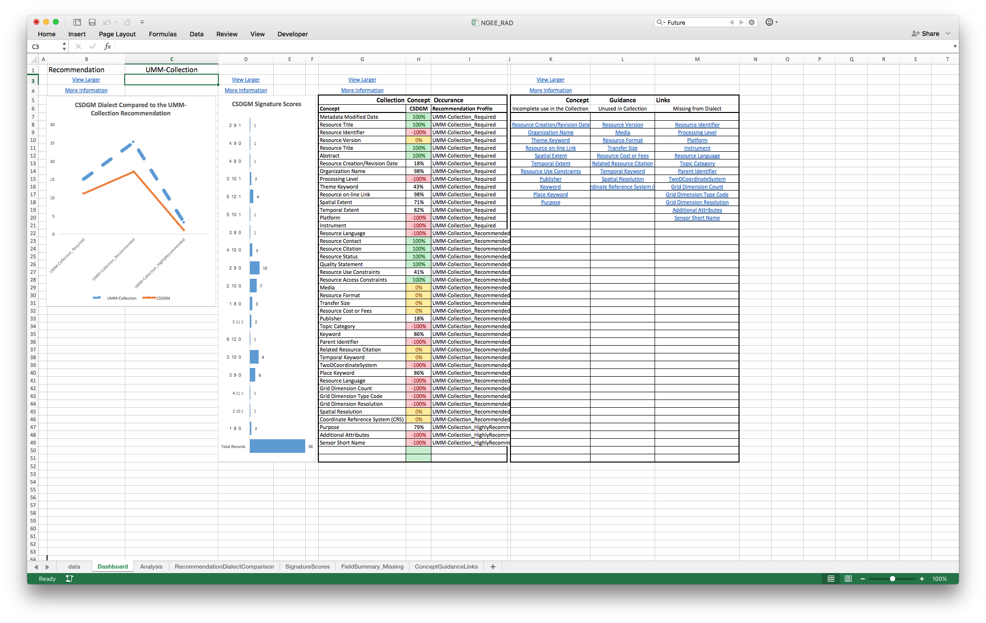
Recommendations Analysis Dashboard
Exploratory metadata evaluation tool.
Enables metadata for a single dialect to be easily evaluated using multiple recommendation (eg. CSW, DataCite).
Designed to run on subset of metadata records (processing limitations).
Provides a nice dashboard interface with 4 different displays.
Requires a data sheet, which at this time can only be created by HDF metadata team.
data.ucar.edu
Sharable Metadata
Metadata
Documentation
Notes:
Dashboard Display
Recommendation / Dialect Comparison Graph
Signature Scores Chart
Results Summary Table
Concept Guidance Table

Slide 4
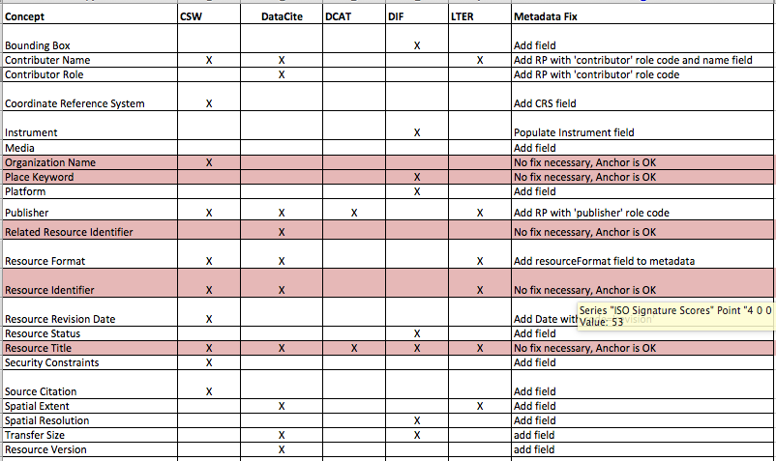
GeoTraces Evaluation – Summer 2016
Collection: GeoTraces metadata collection
Dialect: ISO 19115
Recs: CSW, DataCite, DCAT, DIF, LTER
22 concepts missing in some degree from GeoTraces
5 concepts that use anchors (red) were falsely flagged as missing. These concepts are fine.

Slide 5
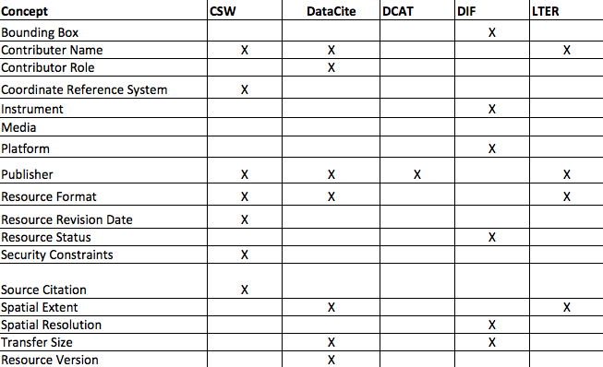
GeoTraces Evaluation – Summer 2016
Collection: GeoTraces metadata collection
Dialect: ISO 19115
Recs: CSW, DataCite, DCAT, DIF, LTER
17 concepts missing in some degree from GeoTraces
7 CSW
7 DataCite
1 DCAT
6 DIF
4 LTER
What concepts do I fix first?

Slide 6
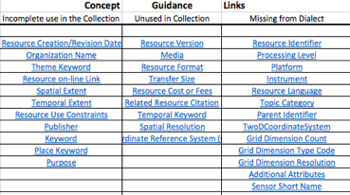
Where are the elements in my dialect?

Slide 7
Prioritizing Metadata Improvement
What recommendations are most important to your organization?
a) DataCite, b) DCAT, c) DIF, d) CSW, e) LTER
What recommendation profiles are most important to your organization?
- Not all recommendations are required
What concepts are missing from the most metadata records?
Fix the concept missing in 90% of your records before the concept missing in 7% if they are part of the same profile.
What concepts are missing from the most recommendations?
Improve completeness score for multiple recommendations by fixing 1 concept.
http://wiki.esipfed.org/index.php/Documentation_Recommendations

Slide 8
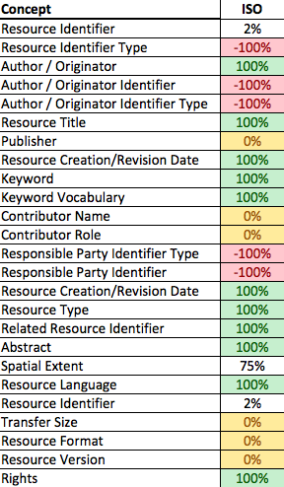
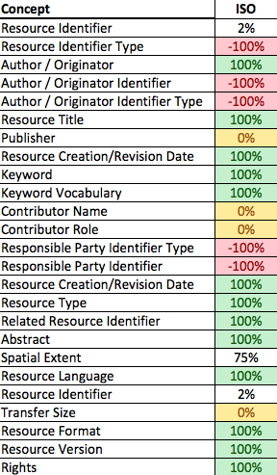
GeoTraces Metadata Evaluation
DataCite Discovery
Summer 2016
DataCite Discovery
Oct 2016

Slide 9
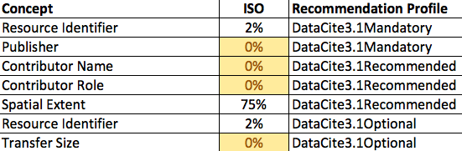
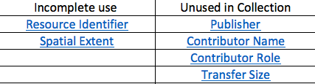
GeoTraces Metadata Improvement
Incomplete or Missing DataCite Concepts
What concepts should be updated?
Concept Guidance Links
How to fix incomplete or unused concepts?

Slide 10
Goals for November Meeting
Workshop Scope
What metadata collections
GeoTraces or other selection
What recommendation (DataCite, DCAT, DIF)?
Which profiles are a priority?
Pre Workshop Action Items
Improve GeoTraces and resubmit a day or two before John arrives
Run a metadata evaluation for GeoTraces
Workshop Deliverables
Updated RAD spreadsheet and datasheet
More xml collections up to complete holdings, prefer complete collections
Workshop Focus
RAD Spreadsheet review
ISO improvement support

