Slide 1
BCO-DMO Metadata Evaluation and Improvement
John Kozimor
Sean Gordon
The HDF Group

Slide 2
Agenda
Compare Metadata Evaluation Techniques
RAD Approach
TRAD Approach
Quick Eval Reports
GeoTraces Metadata RAD Report (Summer ESIP)
GeoTraces Updated Metadata RAD Report (October)
Goals for November Workshop?

Slide 3
Terminology
Collection: A group of metadata records, commonly organized by a data center, organization or project and often stored in a database or web accessible folder.
Concept : General term for describing a documentation entity (e.g. Title, Revision Date, Process Step, Spatial Extent).
Dialect : A particular form of the documentation language that is specific to a community (e.g. DIF, CSDGM, EML, ECHO).
Recommendation: A set of concepts that a group believes is required for achieving a documentation goal.
Profile: A set of concepts required to support a particular documentation need or use case for a recommendation.

Slide 4
Evaluation & Improvement Tools/Technique
Comparison Tools
Dialect, Recommendation, Dialect/Recommendation
Completeness Evaluation
Measure metadata completeness using a rubric approach.
Completeness Analysis
- Characterize and summarize the completeness results.
Completeness Results
Graphically driven quantitative guidance report based upon the completeness analysis.
Guidance
Detailed online guidance and examples for the dialects and recommendations considered in the assessment.

Slide 5
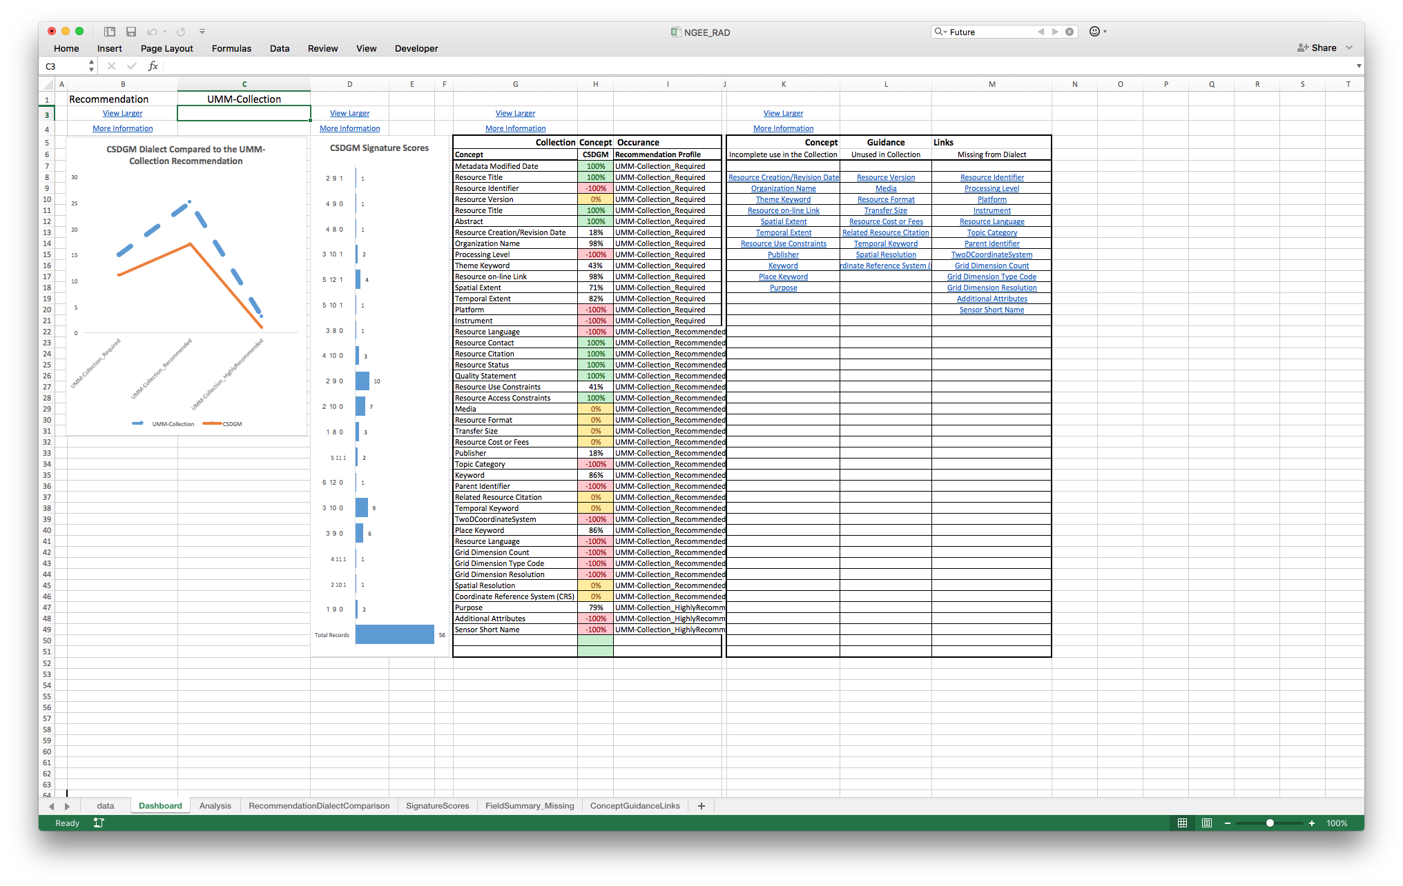
Recommendations Analysis Dashboard
Exploratory metadata evaluation tool.
Enables metadata for a single dialect to be easily evaluated using multiple recommendation (eg. CSW, DataCite).
Designed to run on subset of metadata records (processing limitations).
Provides a nice dashboard interface with 4 different displays.
Requires a data sheet, which at this time can only be created by HDF metadata team.
data.ucar.edu
Sharable Metadata
Metadata
Documentation
Notes:
Dashboard Display
Recommendation / Dialect Comparison Graph
Signature Scores Chart
Results Summary Table
Concept Guidance Table

Slide 6
RAD Preprocessing Workflow
Process:
1) Create dialect defintion xml file allCrosswalks.xml.
2) Create rubric XSL from dialect dialect definition xml file.
3) Evaluate metadata completeness using the rubric XSL. The rubric xsl tests for the existence all metadata fields for a specific dialect.
-The output of this XSL is a CSV files that identifies whether a field exists in the metadata and how many times the fields exists.
-Does the field exist in all records, in just a few records, or multiple times in many records.
4) Run python script to produce RAD Dashboard
5) Evaluate recommendation in the dashboard tab
-spreadsheet includes built in logic to evaluate completeness by any supported recommendation
-select recommendation from dashboard drop down selector.

Slide 7
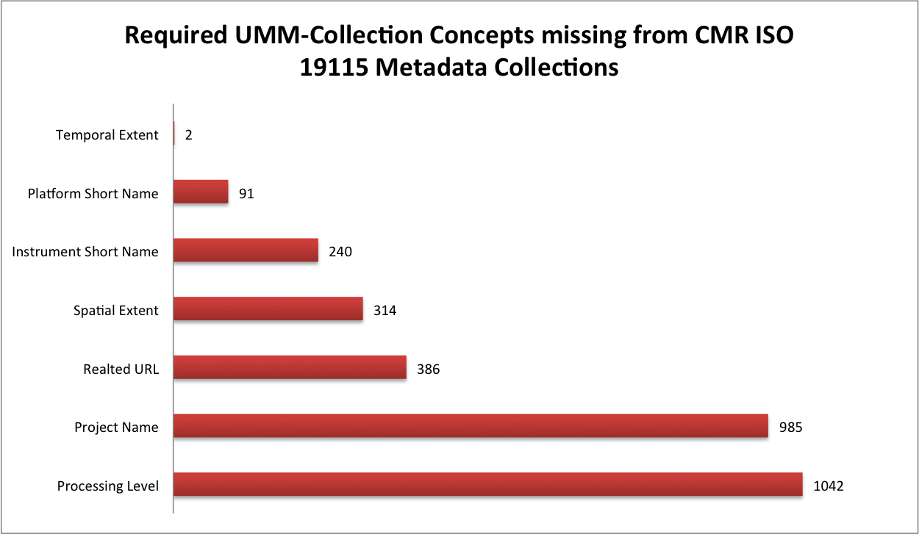
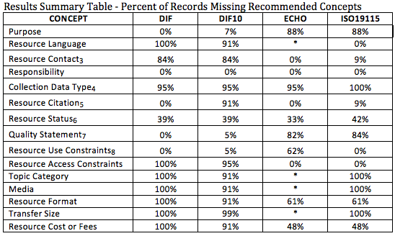
Traditional Evaluation Report
Comprehensive metadata completeness evaluation for multiple dialects and recommendations.
Designed to run on complete metadata collections of any size. (no processing limitations).
Deliverable is a comprehensive report which includes detailed analysis, supported by a variety of quantitative visualizations and a narrative interpretation of the results. Also, often includes an appendix with more detailed exploratory analysis.
This report may take weeks to compile and draft. It is more comprehensive, but less agile then the RAD report.

Slide 8
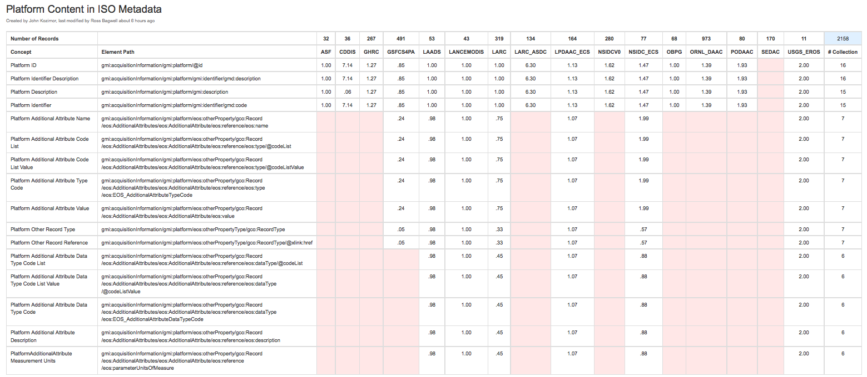
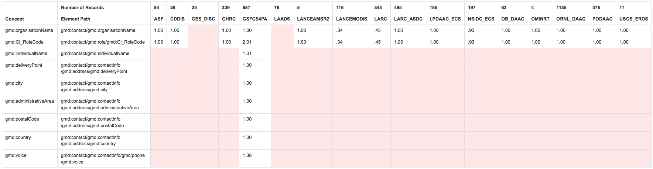
Quick Evaluation Report
Tool for characterizing the metadata fields used in collections.
Enables field usage to be compared across collections.
Identifies what fields organizations consider most important (bottom up user driven approach).
Provides a more granular view of the metadata. All fields in an object can be compared.
Occurrences of Metadata Contact Responsibility

Slide 9
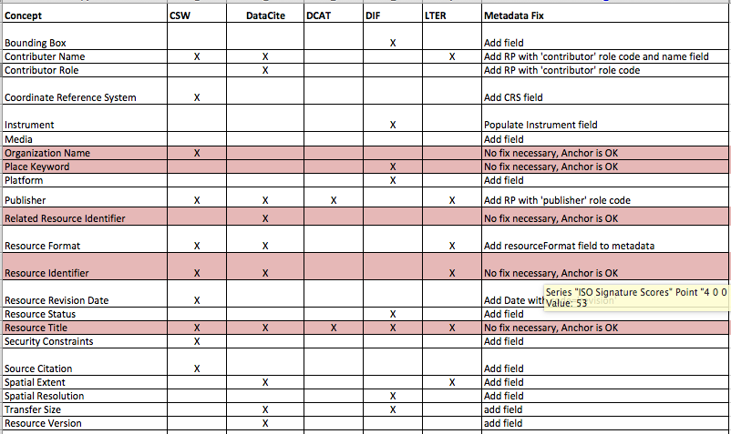
GeoTraces Evaluation – Summer 2016
Collection: GeoTraces metadata collection
Dialect: ISO 19115
Recs: CSW, DataCite, DCAT, DIF, LTER
22 concepts missing in some degree from GeoTraces
5 concepts that use anchors (red) were falsely flagged as missing. These concepts are fine.

Slide 10
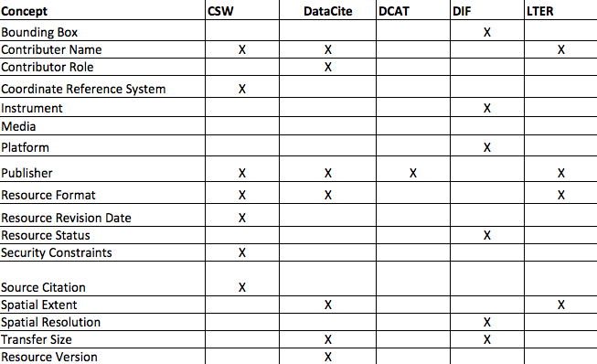
GeoTraces Evaluation – Summer 2016
Collection: GeoTraces metadata collection
Dialect: ISO 19115
Recs: CSW, DataCite, DCAT, DIF, LTER
17 concepts missing in some degree from GeoTraces
7 CSW
7 DataCite
1 DCAT
6 DIF
4 LTER
What concepts do I fix first?

Slide 11
Prioritizing Metadata Improvement
What recommendations are most important to your organization?
a) DataCite, b) DCAT, c) DIF, d) CSW, e) LTER
What recommendation profiles are most important to your organization?
- Not all recommendations are required
What concepts are missing from the most metadata records?
Fix the concept missing in 90% of your records before the concept missing in 7% if they are part of the same profile.
What concepts are missing from the most recommendations?
Improve completeness score for multiple recommendations by fixing 1 concept.
http://wiki.esipfed.org/index.php/Documentation_Recommendations

Slide 12
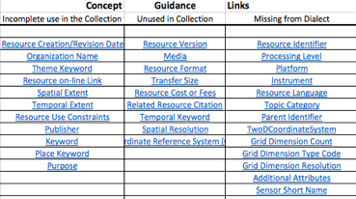
Metadata Improvement Guidance
How do I access online guidance for fixing missing concepts?
2. How do I identify which records are missing concepts?

Slide 13
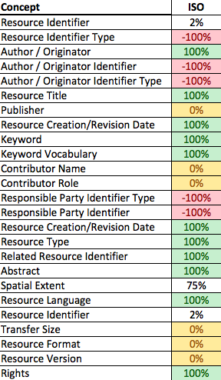
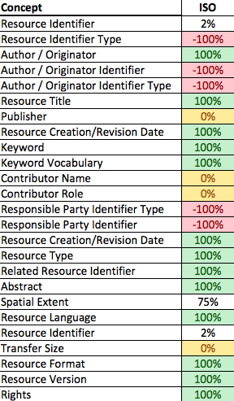
GeoTraces Metadata Evaluation
DataCite Discovery
Summer 2016
DataCite Discovery
Oct 2016

Slide 14
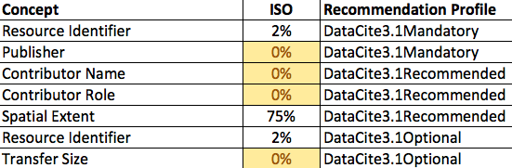
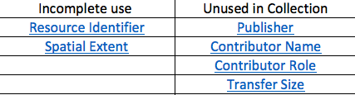
GeoTraces Metadata Improvement
Incomplete or Missing DataCite Concepts
What concepts should be updated?
Concept Guidance Links
How to fix incomplete or unused concepts?

Slide 15
Goals for November Meeting
Workshop Scope
What metadata collections
GeoTraces or other selection
What recommendation (DataCite, DCAT, DIF)?
Pre Workshop
Run a TRAD metadata evaluation for BCO-DMO metadata collections
Workshop Deliverables
TRAD evaluation spreadsheet
Summary results table
Missing concepts graphs
Updated RAD spreadsheet and datasheet
Workshop Focus
TRAD Spreadsheet review
RAD Spreadsheet review
ISO improvement support

Slide 16
How it works
Data table : A table that includes a row for each concept in each record that includes the collection name, the dialect, the record is documented in, the record name, and concept name
Recommendations table : Each recommendation is comprised of a number of profiles which are generally ordered by importance or necessity of the concepts included
Dialect Table: Each dialect is comprised of definitions for the concepts it includes.
Analysis: Each record is assessed for the concepts in each recommendation profile and is assigned a 1, 0, or -1 for contains, doesn’t contain, or cannot contain.

Slide 17
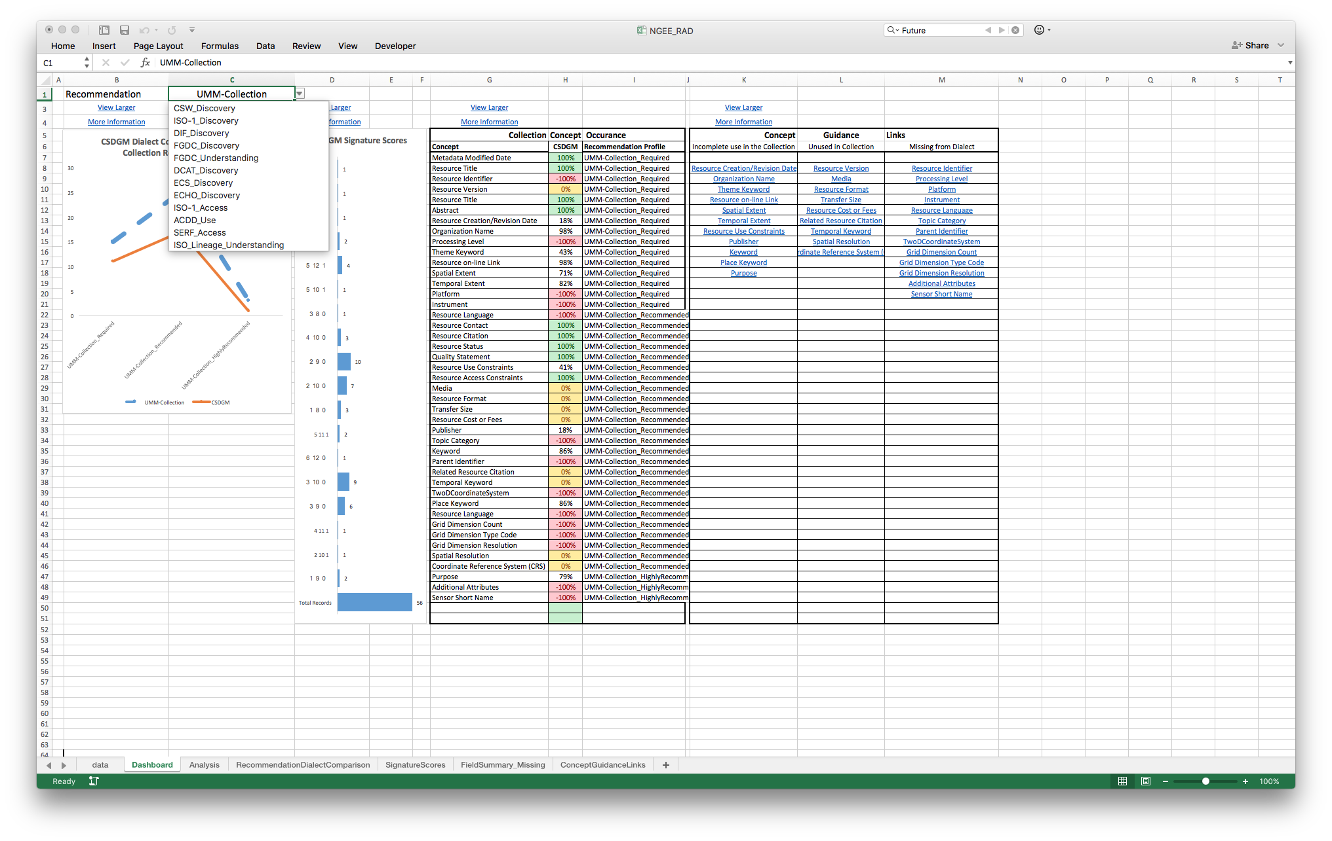
Pick a Recommendation, any Recommendation
data.ucar.edu
Sharable Metadata
Metadata
Documentation

Slide 18
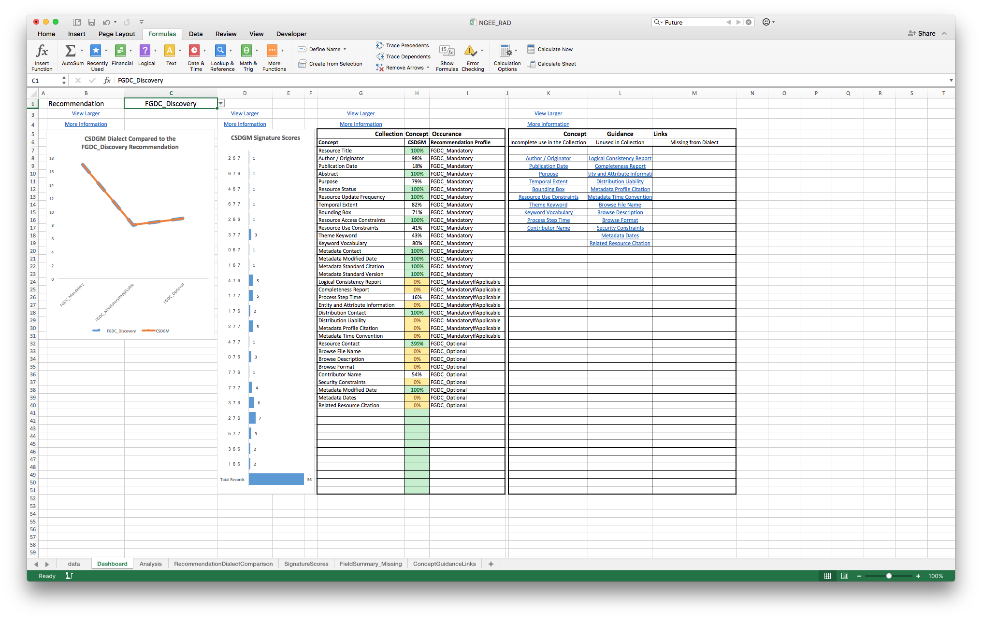
Recommendations Analysis
data.ucar.edu
Sharable Metadata
Metadata
Documentation

Slide 19
Recommendation / Dialect Comparison
data.ucar.edu
Sharable Metadata
Metadata
Documentation

Slide 20
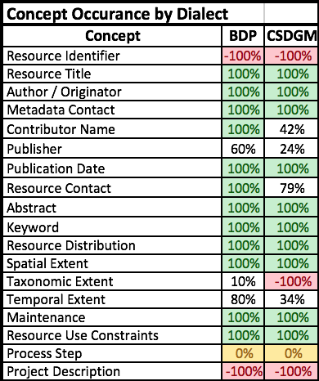
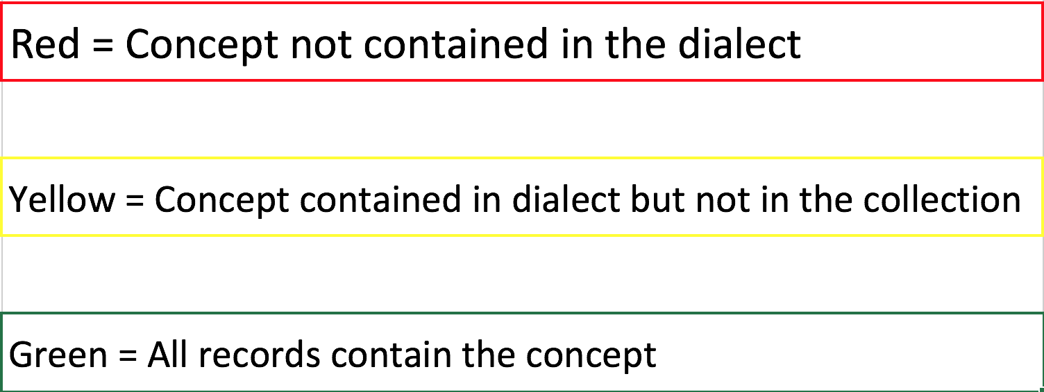
Field Summary
data.ucar.edu
Sharable Metadata
Metadata
Documentation

Slide 21
Signature Score Groups
data.ucar.edu
Sharable Metadata
Metadata
Documentation

Slide 22
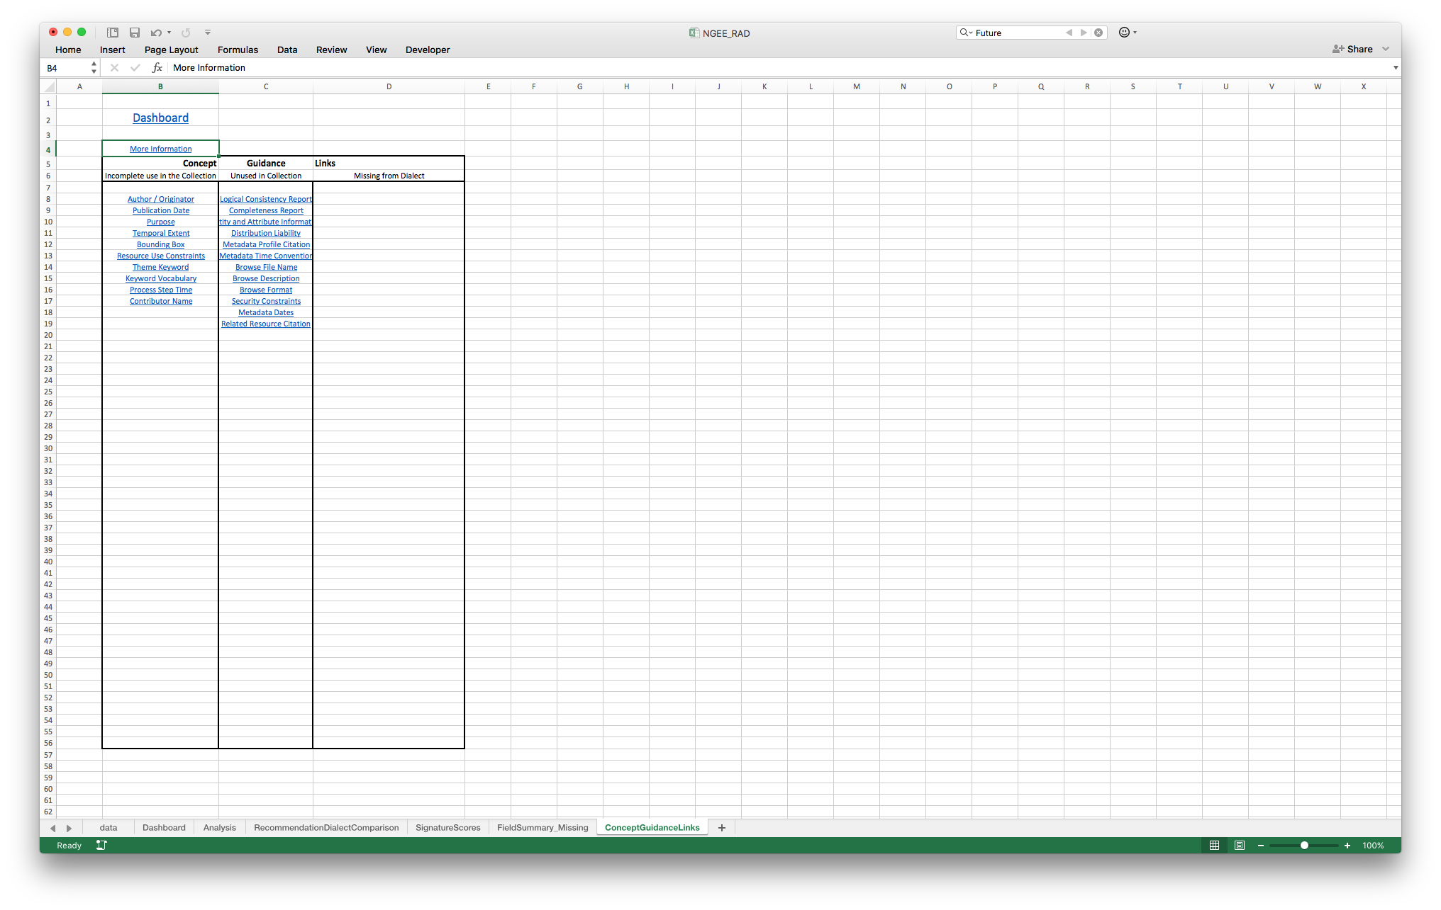
Concept Guidance Links
data.ucar.edu
Sharable Metadata
Metadata
Documentation

Slide 23
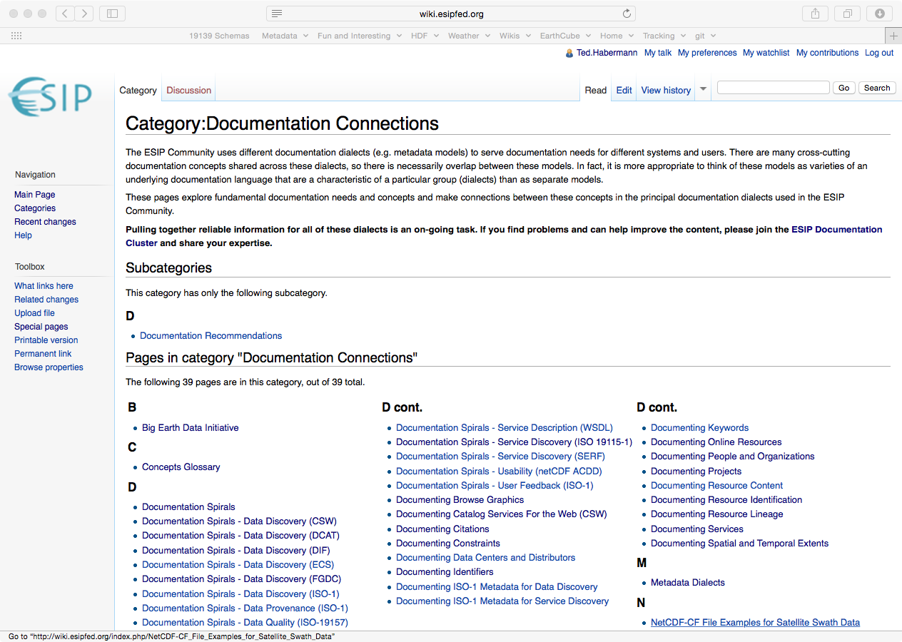
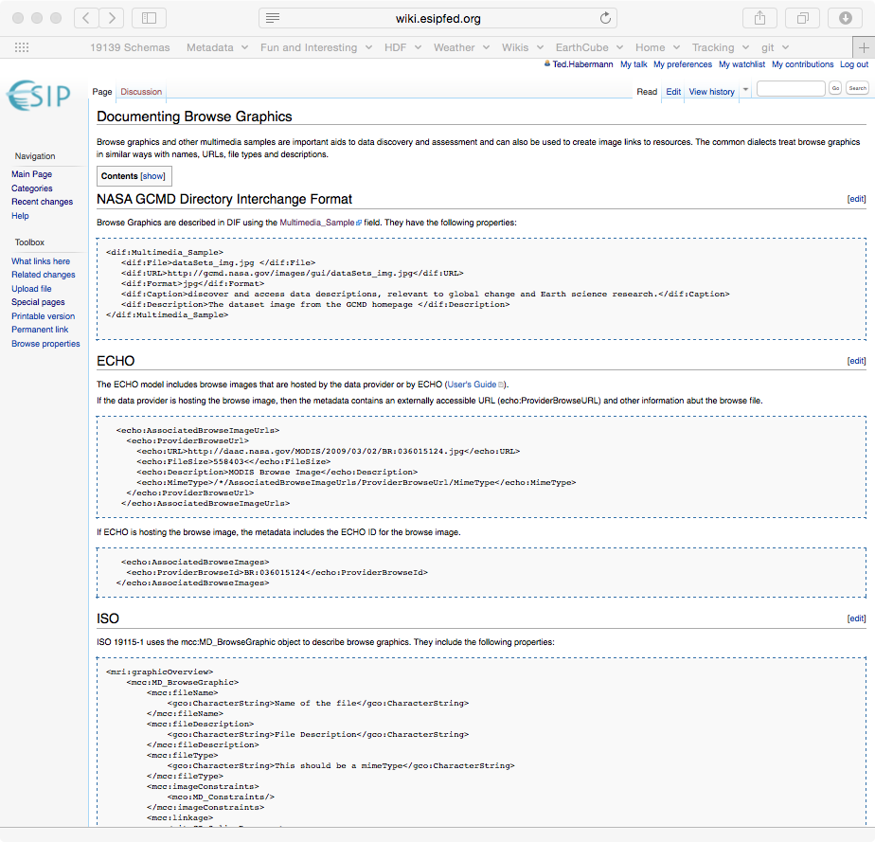
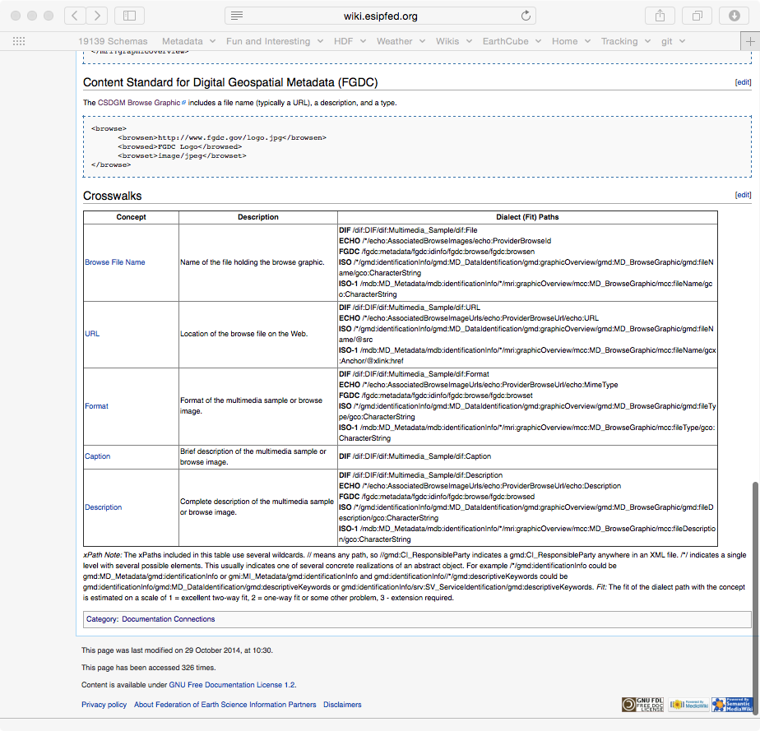
Guidance Documentation
data.ucar.edu
Sharable Metadata
Metadata
Documentation
http://wiki.esipfed.org/index.php/Category:Documentation_Connections

Slide 24
Questions, Comments?
data.ucar.edu
Reach me offline at: scgordon@hdfgroup.org
Sharable Metadata
Metadata
Thanks!tion

