Slide 1
Recommendation Analysis Dashboard
Sean Gordon
The HDF Group

Slide 2
Terminology
Collection: A group of metadata records, commonly organized by a data center, organization or project and often stored in a database or web accessible folder.
Concept : General term for describing a documentation entity (e.g. Title, Revision Date, Process Step, Spatial Extent).
Dialect : A particular form of the documentation language that is specific to a community (e.g. DIF, CSDGM, EML, ECHO).
Recommendation: A set of concepts that a group believes is required for achieving a documentation goal.
Level: A set of concepts required to support a particular documentation need or use case for a recommendation.

Slide 3
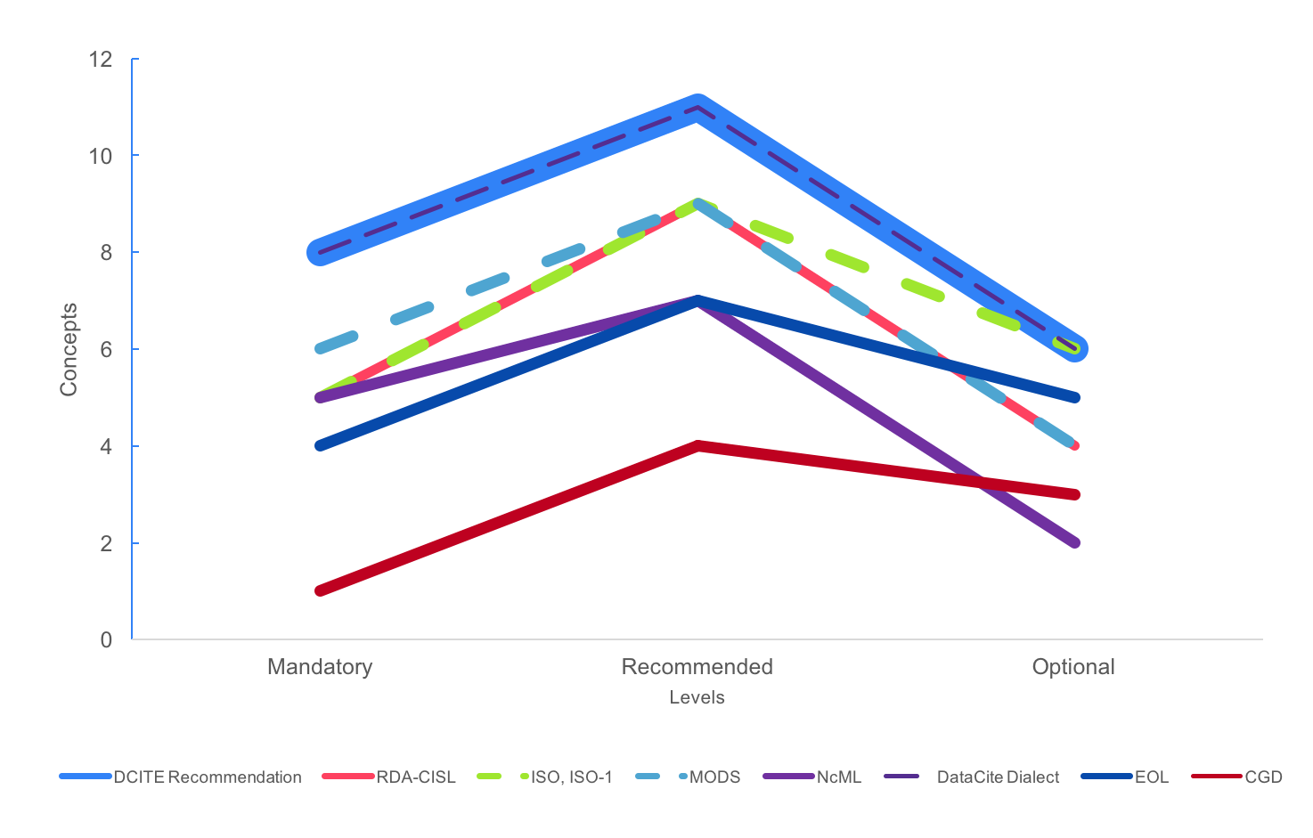
Recommendation Dialect Comparison
This graph compares the number of concepts included in the DataCite recommendations (recommendation maximum) to the maximum number of these concepts supported by the NCAR dialects (dialect maximum). The three levels of the DataCite recommendation (mandatory, recommended and optional) include 8, 11, and 6 concepts respectively as indicated by the upper line in the Figure below.
The difference between the Recommendation Maximum (8 11 6) and the Dialect Maximum e.g. RDA-CISL (5 9 4) indicates that there are three mandatory DataCite concepts that are missing from the RDA-CISL dialect, as well as two recommended concepts and two optional concepts.

Slide 4
Signature Score Groups
These results are presented as counts of records with identical completeness scores with respect to the recommendation. The completeness scores are given in terms of the number of elements that are missing from a record, so low scores are good.
When a recommendation includes multiple levels (e.g. Mandatory, Recommended, and Optional), the scores are given as a series of numbers, one for each level. These are termed signatures. Typically, many records are missing the same concepts and, therefore, have identical signatures.
The signature 2 3 1 indicates a metadata record that has been tested for three levels and is missing 2 mandatory, 3 recommended, and 1 optional concepts. This record is less complete than a record with a signature of 1 1 1 and more complete than a record with a signature of 3 4 3.

Slide 5
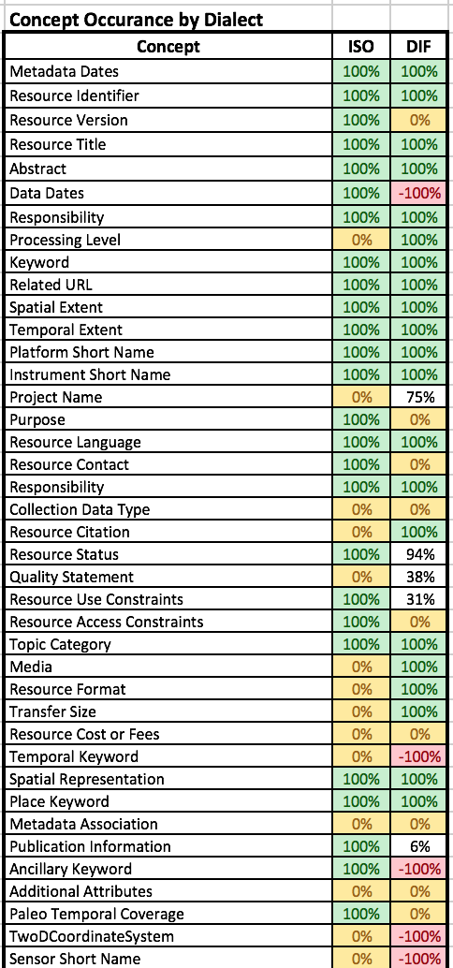
Field Summary
The visualization is comprised of rows for each recommendation concept and columns for each dialect. Cells are filled with a color or a percentage. The percentage is how many records in the sample set contain that concept.
Green represents 100%. Yellow represents 0%, a concept that the dialect contains but is not in any record in the sample set for that dialect. Red represents a concept missing from the dialect. The table is intended to show not only how complete a dialect is for a recommendation, as well as how complete the records are with respect to the dialect maxima.

Slide 6
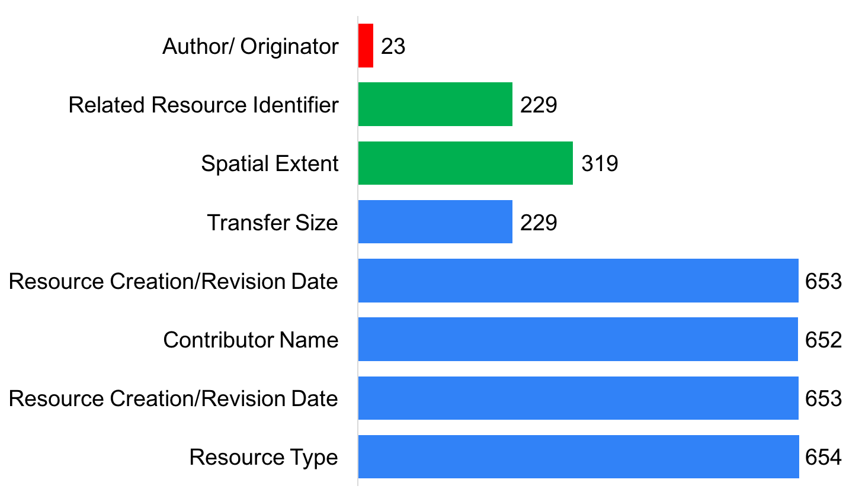
Incomplete Concepts
We provide charts for each dialect showing how many records are missing a concept and what level the concept belongs to. These charts are intended to help identify the most important and most attainable goals to maximize results for each iteration towards improvement.
If the concept is missing from 95% of records but it is from the Optional level of the DataCite recommendation it should be lower priority than a Mandatory concept missing in only 50% of records. The Mandatory level is red, the Recommended level is green, and the optional level is blue.*
*all blue and more than just incomplete concepts. Above is the goal

Slide 7
Guidance Links
This forthcoming output is a table of links to the ESIP Documentation Cluster Wiki Pages that show examples of how the collections incomplete or unused concept is written in different metadata dialects. This is intended to be actionable guidance output so that the improvement process receives guidance on how to successfully improve an organizations collections of metadata.
Incomplete | Author/ Originator | Related Resource Identifier | Spatial Extent | Transfer Size | Resource Creation /Revision Date(2) | Contributor Name | Resource Type
Unused | Resource Format | Contributor Role

Slide 8
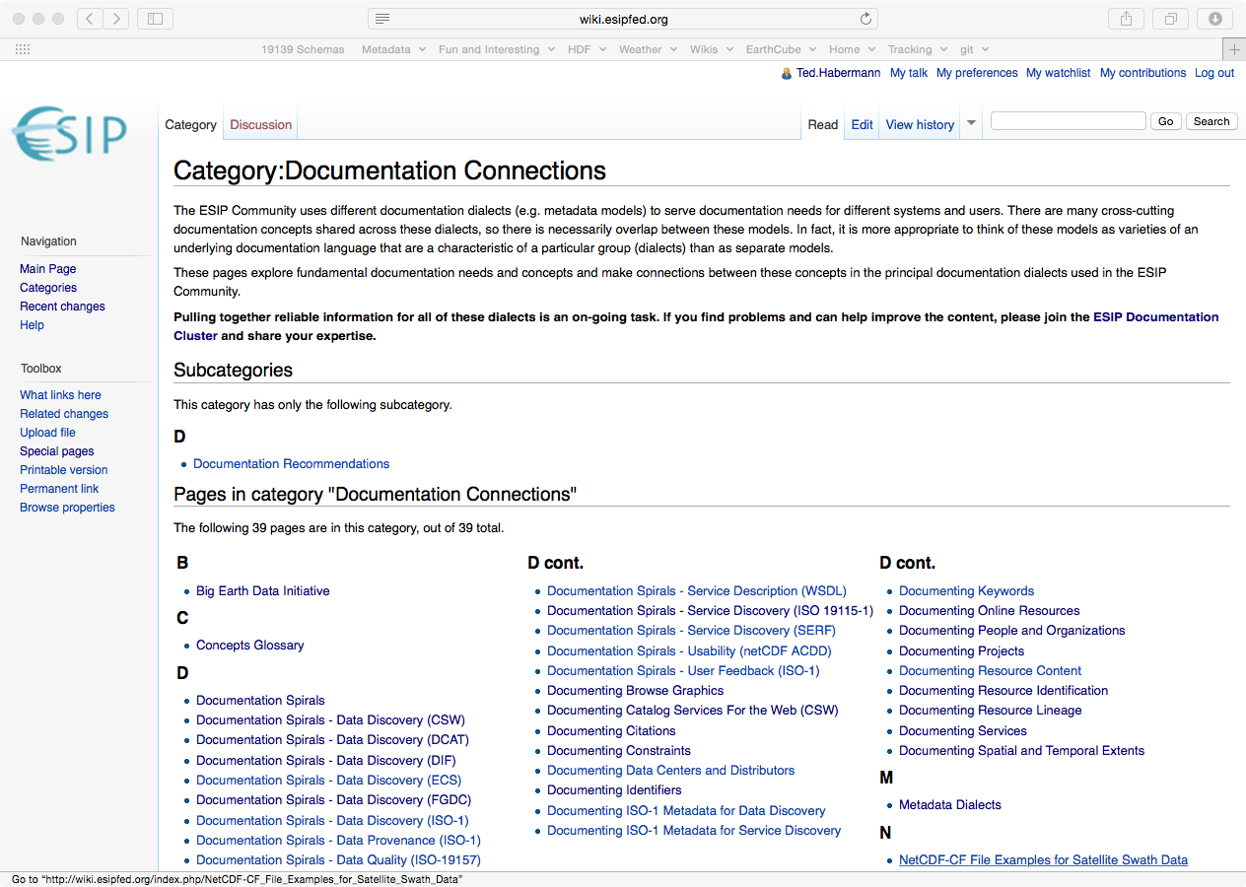
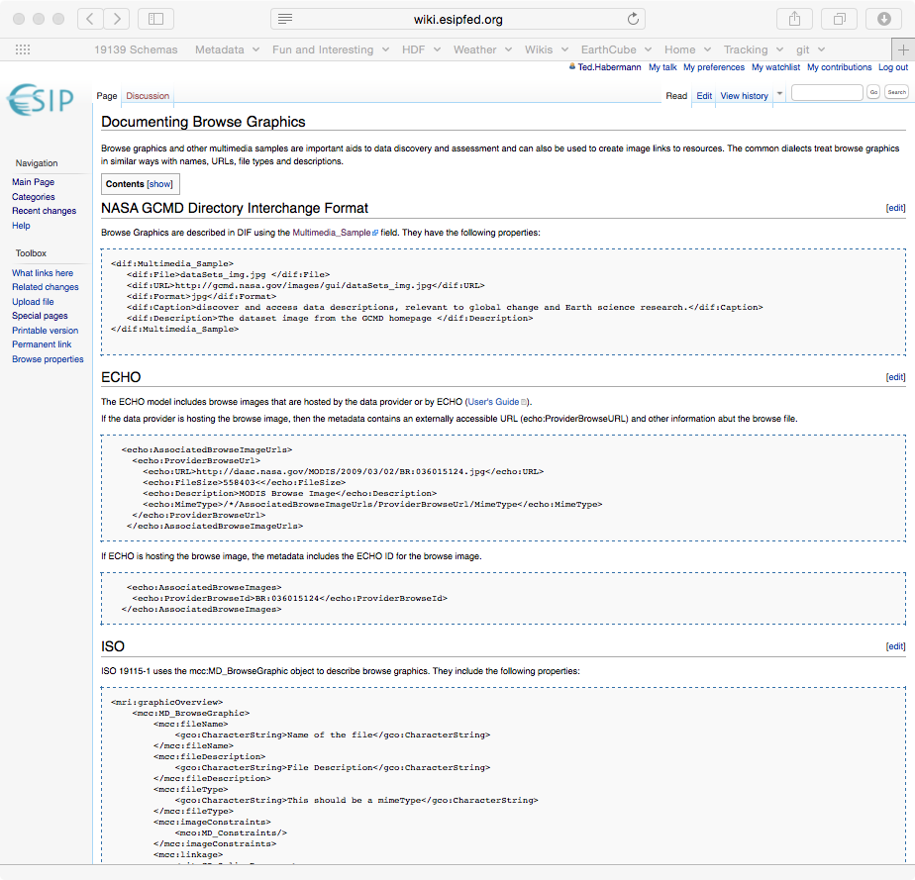
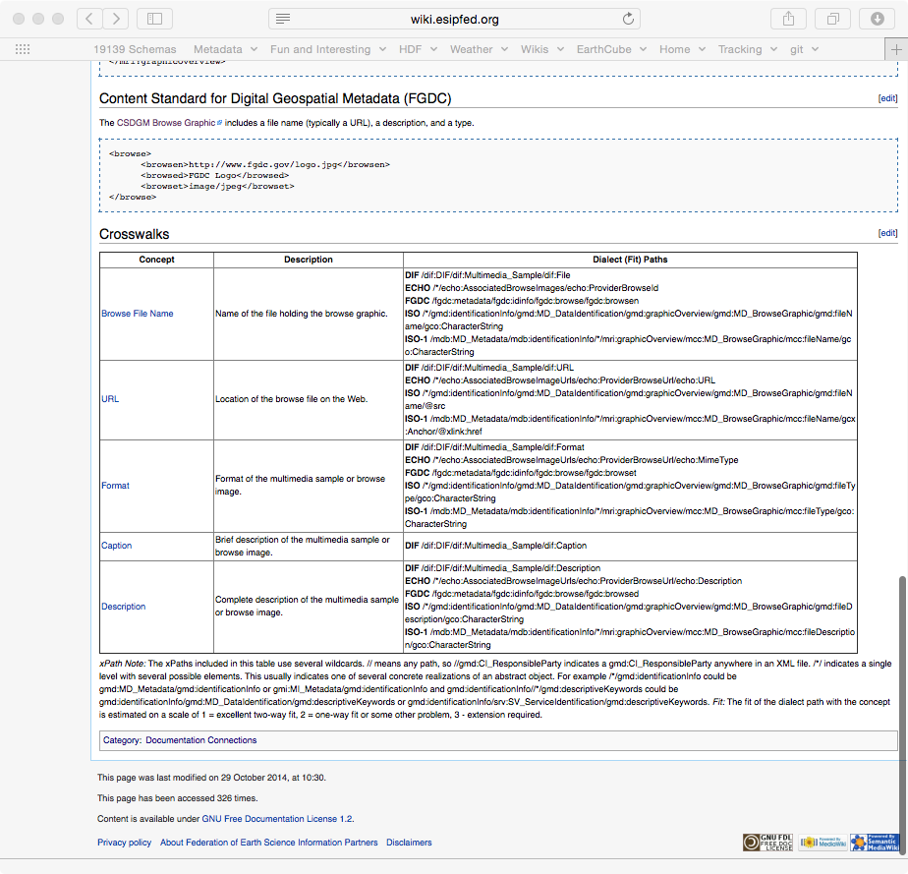
Guidance Documentation
data.ucar.edu
Sharable Metadata
Metadata
Documentation
http://wiki.esipfed.org/index.php/Category:Documentation_Connections

