Slide 1

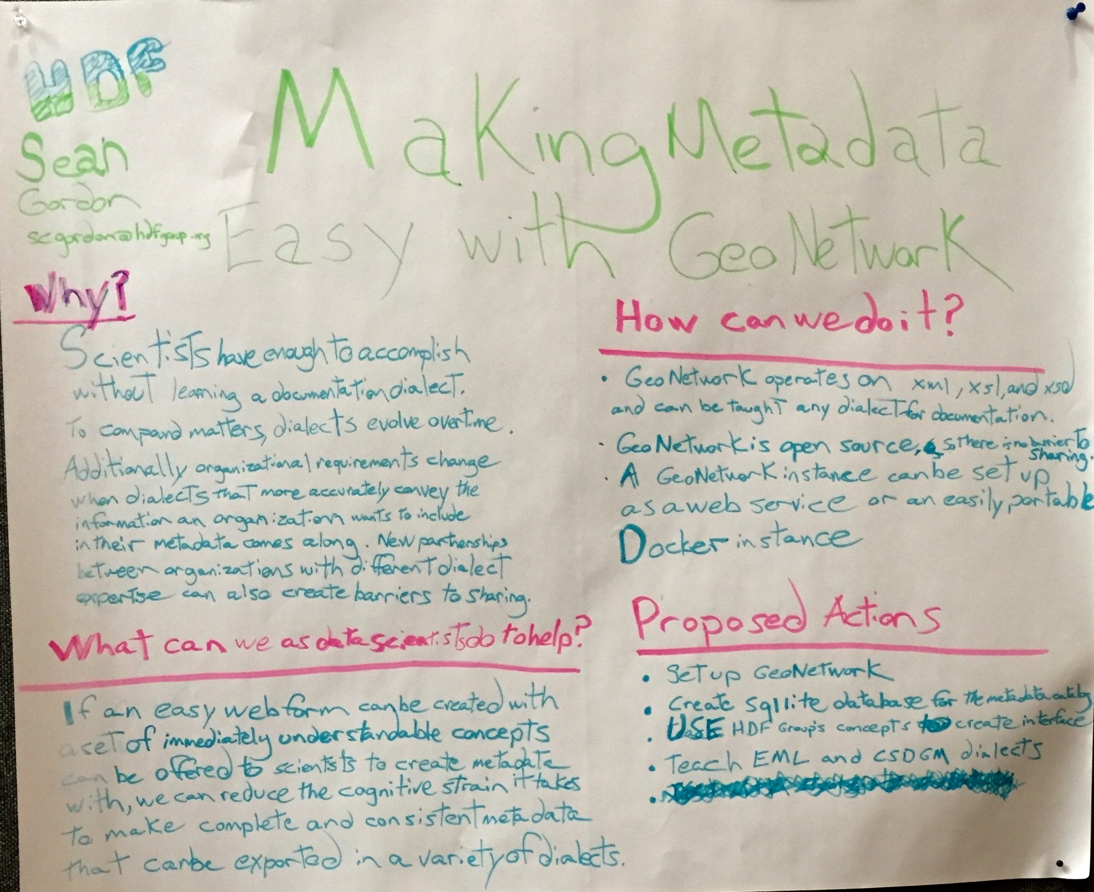
Making Metadata Easy
A Recommendations Based Approach To Documentation, Creation, Curation, And Analysis Using Geonetwork
FUNding Friday
Proposal
GeoNetwork is a standards based editor and catalog
Community recommendations facilitate quality metadata
Standards based documentation can be difficult to write well
By combining recommendations and GeoNetwork a webform can created for different recommendations
Statement Of Work
Tasks
Create GeoNetwork instance.
Explore integration of the Ecological Metadata Language and the Content Standard for Digital Geospatial Metadata dialects and HDF concepts.
Create webform for a recommendation using HDF concepts.
Make and edit metadata.
Deliverables
Poster Presentation at 2017 ESIP Winter Meeting.
Eye with QR code
Eye with QR code
shrtLink.url
shrtLink.url
Process
Research other GeoNetwork instances
Decide to focus on integration of recommendations
Implement a schema plugin for ISO 19115-3
Open Science and Open Source facilitate reproducible science

