Slide 1
NCAR Metadata Evaluation for the Data Stewardship Engineering Team
Sean Gordon, Lindsay Powers and
Ted Habermann
The HDF Group

Slide 2
Terminology
Collection: A group of metadata records, commonly organized by a data center, organization or project and often stored in a database or web accessible folder.
Concept : General term for describing a documentation entity (e.g. Title, Revision Date, Process Step, Spatial Extent).
Dialect : A particular form of the documentation language that is specific to a community (e.g. DIF, CSDGM, EML, ECHO).
Recommendation: A set of concepts that a group believes is required for achieving a documentation goal.
Level: A set of concepts required to support a particular documentation need or use case for a recommendation.
AGU 2015

Slide 3
NCAR Labs and the Dialects Analyzed
 | CGD | DataCite | EOL | ISO | MODS | netCDF | RDA-CISL
Atmospheric Chemistry Observations and Modeling (ACOM)
Climate & Global Dynamics (CGD) | X
Computational and Informational Systems Lab (CISL) |  |  |  |  |  |  | X
Earth Observing Lab (EOL) |  |  | X | X
High Altitude Observatory (HAO) |  | X
Integrated Information Services (IIS) |  |  |  |  | X
Mesoscale and Microscale Meteorology (MMM) |  | X
Research Applications Lab (RAL) |  |  |  |  |  | X
Unidata (UCP) |  | X |  | X
AGU 2015

Slide 4
Recommendation Dialect Comparison – How Does My Dialect Fit?
A chart comparing the concepts in the DataCite recommendation and the NCAR dialects.
A graph comparing the maximum number of concepts in each dialect compared to the recommendation.
A Recommendation/Dialect comparison that lists all concepts in the DataCite recommendation and NCAR dialects.
Tables that describe the concepts in the DataCite recommendation that are missing in the NCAR dialects.
AGU 2015

Slide 5
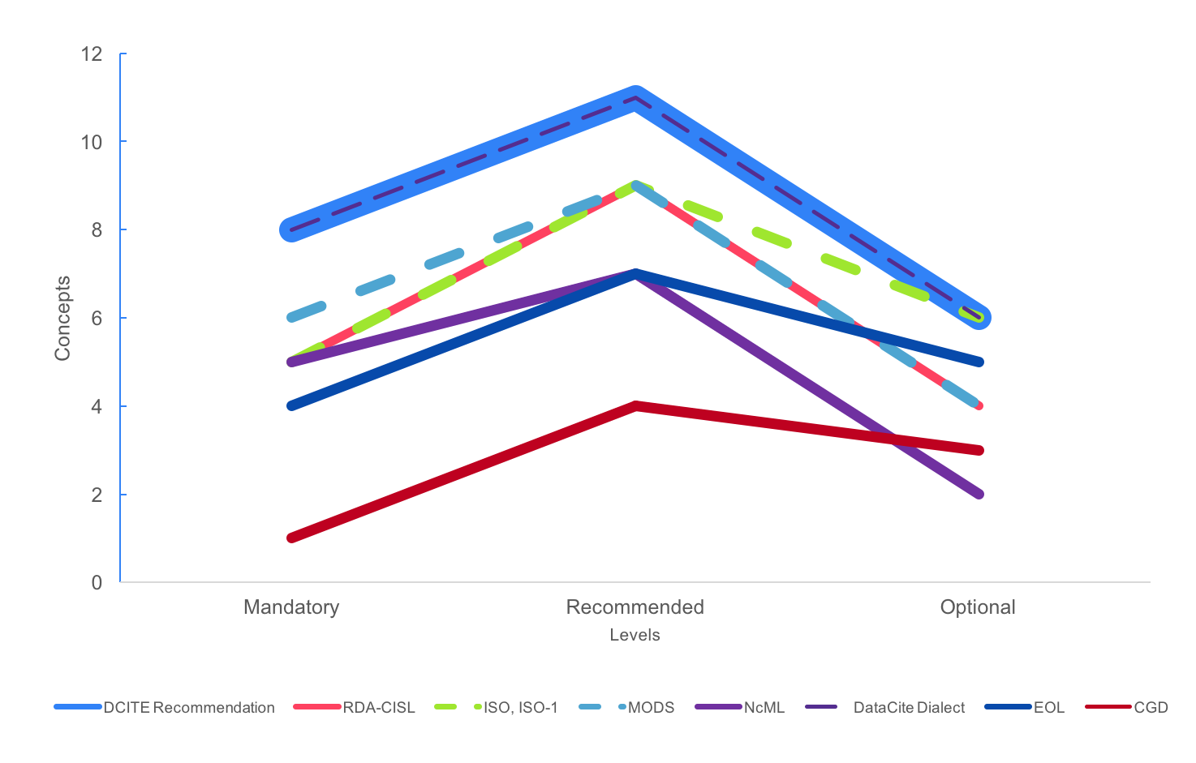
DataCite Recommendation Compared with NCAR Dialects
AGU 2015

Slide 6
Recommendation Dialect Comparison Report: Mandatory Level
Concept | Score | DCITE | RDA-CISL | ISO | MODS | netCDF | CGD | EOL
Author / Originator | 6
Author / Originator Identifier | 1
Author / Originator Identifier Type | 1
Publisher | 5
Resource Creation/ Revision Date | 6
Resource Identifier | 6
Resource Identifier Type | 2
Resource Title | 7
AGU 2015

Slide 7
Recommendation Dialect Comparison Report: Recommended Level
Concept | Score | DCITE | RDA-CISL | ISO | MODS | netCDF | CGD | EOL
Abstract | 7
Contributor Name | 7
Contributor Role | 6
Keyword Vocabulary | 5
Related Resource Identifier | 6
Resource Creation/ Revision Date | 6
Resource Type | 5
Responsible Party Identifier | 1
Responsible Party Identifier Type | 1
Spatial Extent | 6
Theme Keyword | 7
AGU 2015

Slide 8
Recommendation Dialect Comparison Report: Optional Level
Concept | Score | DCITE | RDA-CISL | ISO | MODS | netCDF | CGD | EOL
Resource Format | 6
Resource Identifier | 6
Resource Language | 4
Resource Version | 3
Rights | 5
Transfer Size | 4
AGU 2015

Slide 9
DataCite Concepts missing from NCAR Dialects
RDA-CISL
Missing Mandatory Concepts
Concept | Description
Author / Originator Identifier | A unique identifier for a resource author or originator
Author / Originator Identifier Type | The type of unique identifier for a resource author or originator
Resource Identifier Type | The type of identifier used to uniquely identify the resource.
Missing Recommended Concepts
Concept | Description
Responsible Party Identifier | A unique identifier for a person or an organization
Responsible Party Identifier Type | The type of a unique identifier for a person or an organization
Missing Optional Concepts
Concept | Description
Resource Language | The language of the resource.
Resource Version | Version of the cited resource
AGU 2015

Slide 10
Metadata Analysis – How Complete are my Metadata?
Record counts of each Signature Score group
Incomplete concepts grouped by signature for each dialect
Descriptions of unused concepts in each dialect
AGU 2015

Slide 11
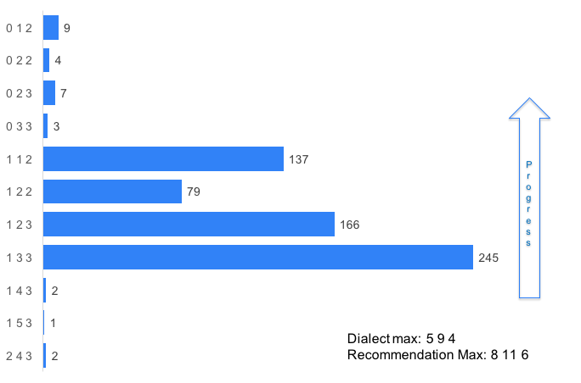
Signature Groups
RDA-CISL
AGU 2015

Slide 12
Incomplete Concepts by Signature
RDA-CISL
Signature | Incomplete Concepts
0 1 2 | The unused concepts (Resource Format, Contributor Role, and Rights)
0 2 2 | Spatial Extent
0 2 3 | Related Resource Identifier, Transfer Size
0 3 3 | Related Resource Identifier, Spatial Extent, Transfer Size
1 1 2 | Author / Originator
1 2 2 | Author / Originator, Spatial Extent
1 2 3 | Author / Originator, Related Resource Identifier, Transfer Size
1 3 3 | Author / Originator, Related Resource Identifier, Spatial Extent, Transfer Size
1 4 3 | Author / Originator, Contributor Name, Related Resource Identifier, Spatial Extent, Transfer Size
1 5 3 | Author / Originator, Contributor Name, Resource Type, Related Resource Identifier, Spatial Extent, Transfer Size
2 4 3 | Author / Originator, Resource Creation/Revision Date(2), Related Resource Identifier, Spatial Extent, Transfer Size
AGU 2015

Slide 13
Unused Concepts
RDA-CISL
Concept | Description
Resource Format | Format of the resource
Contributor Role | The role of any individuals or institutions that contributed to the creation of the data.
Rights | Information about rights held in and over the resource
AGU 2015

Slide 14
Specific Guidance – How Do I Improve My Metadata?
  A table to describe the dialects usage at NCAR in relation to the recommendation.
  An incomplete concepts chart for each dialect
  Guidance links for unused and incomplete concepts for each dialect
AGU 2015

Slide 15
Results Summary
 | DCITE | ISO | MODS | RDA-CISL | netCDF
Total Number of Records | 8 | 541 | 1297 | 655 | 4
Resource Identifier
Resource Identifier Type
Author / Originator |  | 97% |  | 4%
Author / Originator Identifier
Author / Originator Identifier Type
Resource Title
Publisher |  | 99.8% | 81%
Resource Creation/Revision Date | 75% | 97% | 8%
Theme Keyword
Keyword Vocabulary | 75% | 6% | 71%
Contributor Name |  | 99.8% | 89%
Contributor Role |  | 99.8% | 89%
Responsible Party Identifier Type
Responsible Party Identifier
Resource Creation/Revision Date | 75% | 97% | 9%
Resource Type
Related Resource Identifier | 63% | 3% | 60% | 35%
Abstract |  | 99.5% | 89%
Spatial Extent | 13% |  |  | 49%
Resource Language | 75% |  | 89%
Resource Identifier
Transfer Size | 25% |  |  | 35%
Resource Format | 75%
Resource Version | 13% | 6%
Rights | 63% | 6%
AGU 2015

Slide 16
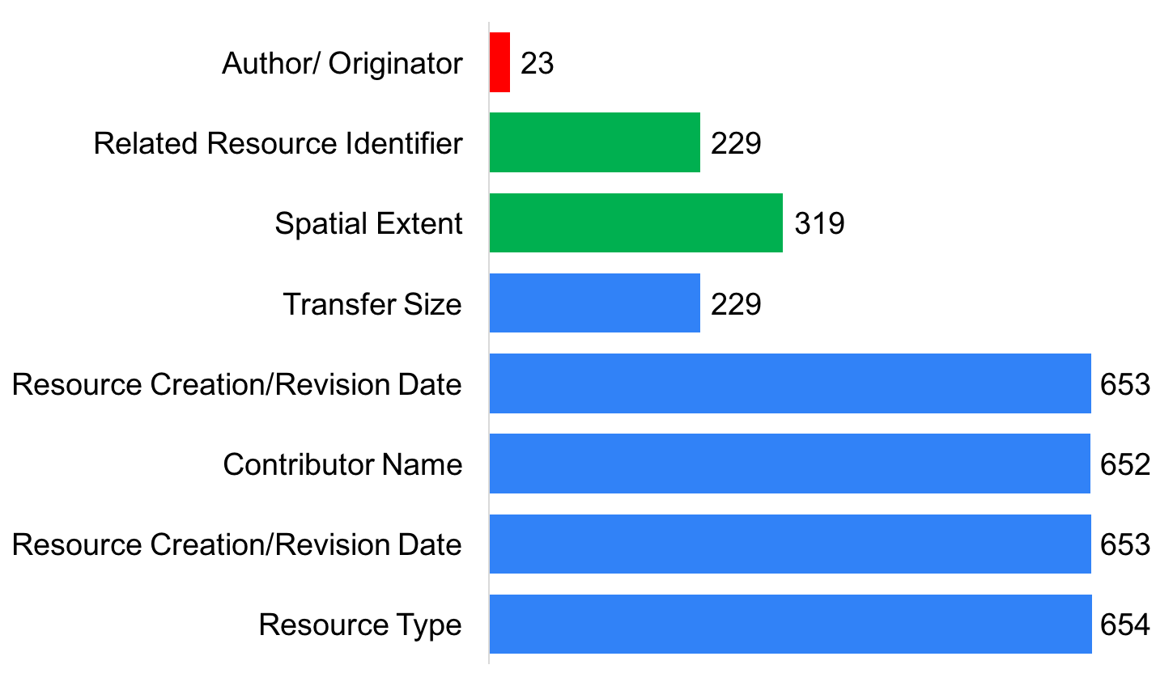
Incomplete Concepts
RDA-CISL
AGU 2015

Slide 17
Guidance Links
RDA-CISL
Incomplete | Author/ Originator | Related Resource Identifier | Spatial Extent | Transfer Size | Resource Creation /Revision Date(2) | Contributor Name | Resource Type
Unused | Resource Format | Contributor Role
AGU 2015

Slide 18
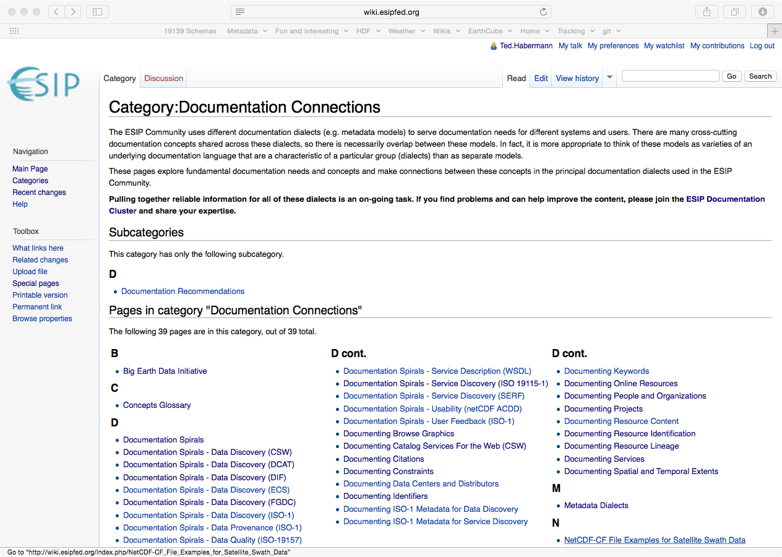
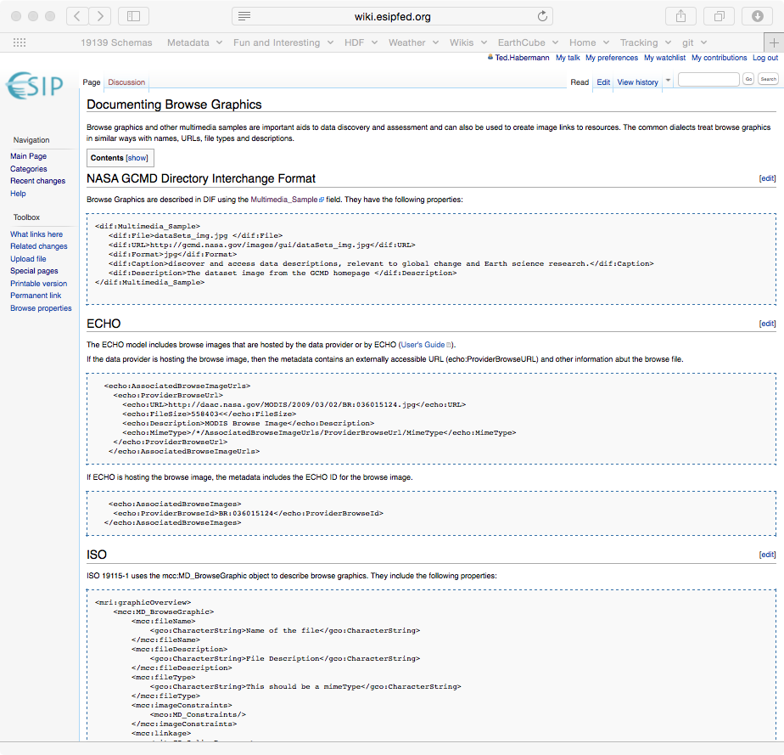
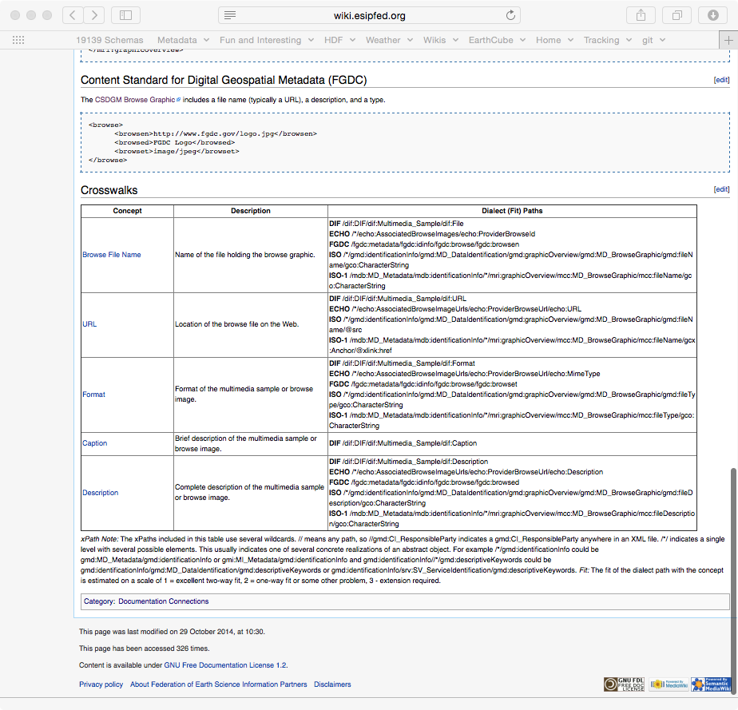
Guidance Documentation
data.ucar.edu
Sharable Metadata
Metadata
Documentation
http://wiki.esipfed.org/index.php/Category:Documentation_Connections

Slide 19
Suggestions
Build guidance documentation for which concepts are important for documenting model output, software, and models with particular focus on the components attached to the model.
Provide each lab with the support to be able to share their metadata in a way that allows them to retain control of the content to ensure quality of information.
This is a phased, iterative process.

Slide 20

Supported Iterative Process
Shared Metadata
Sharable Metadata
Metadata
Documentation
Documentation Need
Notes:
For nonNCAR

Slide 21
An Observation
The ISO 19115-1 Recommendation for Data Discovery is a closer fit with the metadata analyzed than the DataCite Recommendation for assessing completeness of documentation for the science conducted by labs at NCAR.

Slide 22
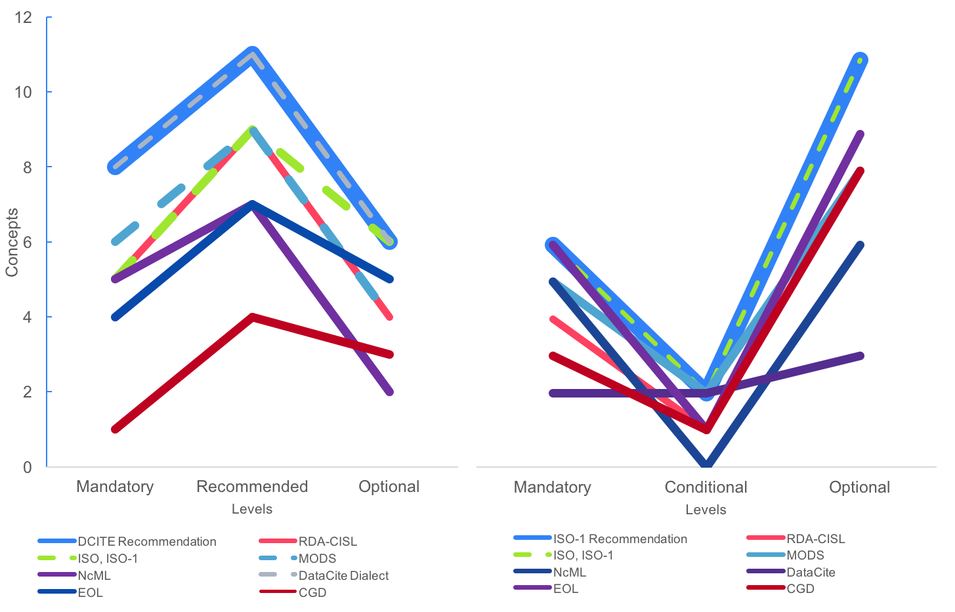
Recommendations Comparison –
What recommendation fits my science?

Slide 23
Thank You!

Slide 24
Questions/comments?

