Slide 1
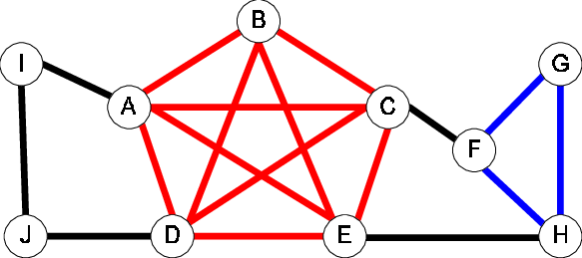
Exact solution to the max Clique
Robert Zanetti

Slide 2
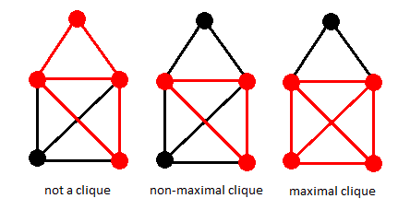
What is the max clique
In the simplest possible terms, the max clique problem seeks to find the largest group of vertices in an undirected graph in which each individual vertex is connected to every other individual vertex within the group. Some examples are below. This problem is important in social media analysis as well forensics using genetics.

Slide 3
Decision vs optimization problem
The decision problem for the Maximum Clique Problem is: Given an undirected graph G and an integer k, does G have a clique of size at least k?
The optimization problem for the Maximum Clique Problem is: Given an undirected graph G, find the largest clique in G (i.e., the clique with the maximum number of vertices).
Runtime: The worst-case time complexity of the Bron-Kerbosch algorithm is O(3^(n/3)) (used in the find_cliques method)

Slide 4
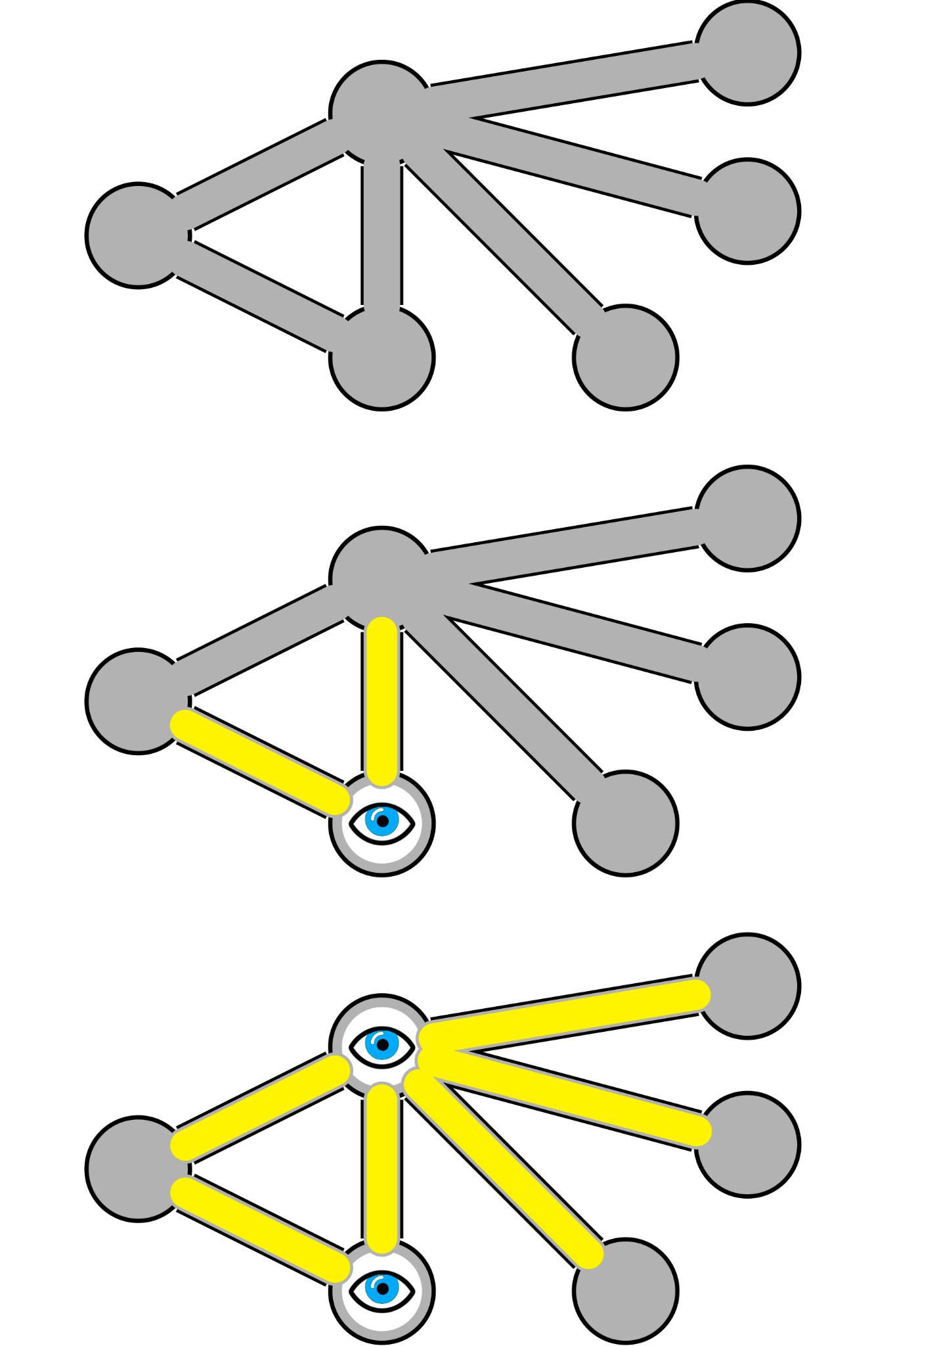
Reduction
Vertex cover problem:

Slide 5
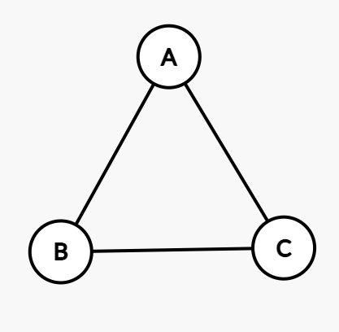
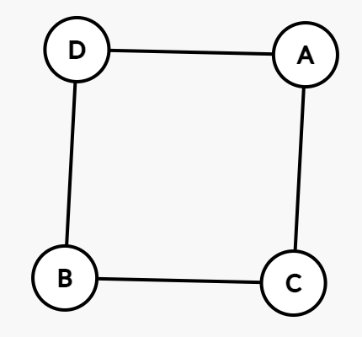
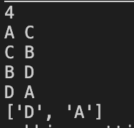
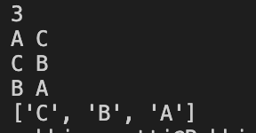
Program input
The input:
Output from my program:
3
A C
C B
B A
The input:
Output from my program:
4
A C
C B
B D
D A
Max clique would be any one of the sides in this case
Max clique would be the whole triangle in this case

Slide 6
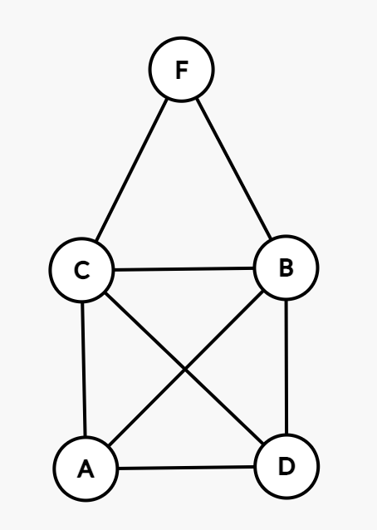
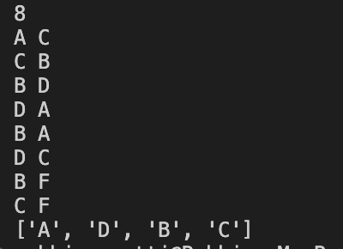
More complicated input
6 Cliques exist on this graph
8
A C
C B
B D
D A
B A
D C
B F
C F
The input:
Output from my program:

Slide 7
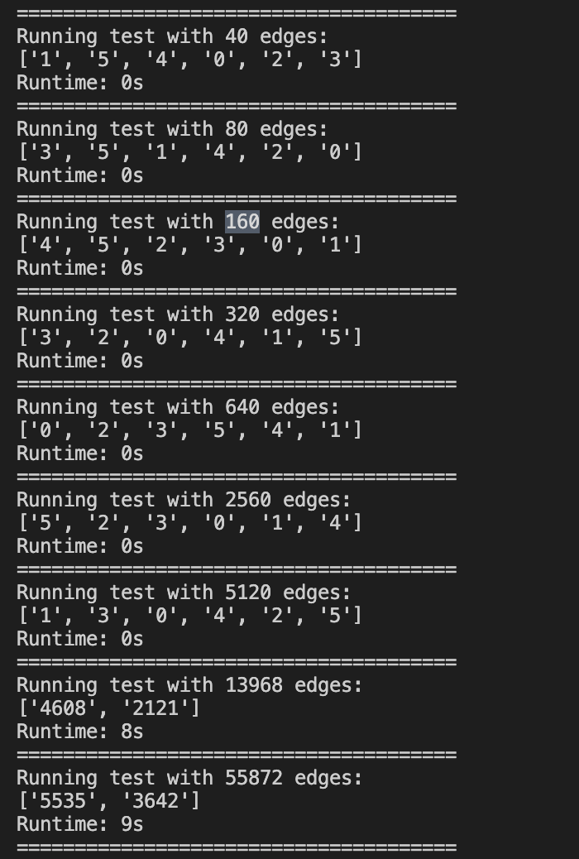
Inputs and corresponding runtimes

Slide 8
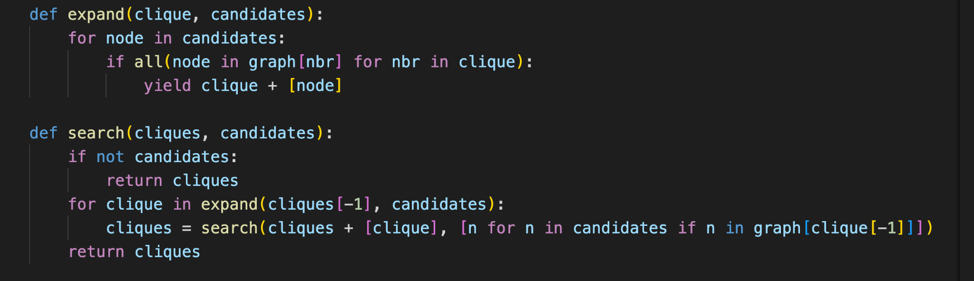
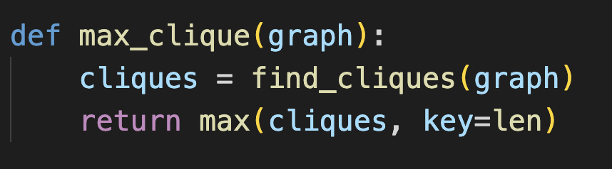
Sketch
find_cliques(graph): This function finds all the cliques in the graph using a depth-first search approach with backtracking. It has two nested functions: expand and search.
expand(clique, candidates): When called, This function generates new cliques by adding nodes from the candidates list to the given clique its building, only if the node is adjacent to all the nodes in the current clique.
search(cliques, candidates): This function is the main part of the depth-first search process. It takes the current list of cliques and a list of candidates for the max clique. It calls expand to generate new cliques and then recursively calls itself with the updated candidates list, which contains only the neighbors of the last node in the current clique. The search process stops when there are no more candidates left.
max_clique(graph): This function finds the maximum clique in the graph. It first calls find_cliques to get all the cliques, and then it returns the clique with the maximum length (i.e., the maximum clique).

Slide 9
sources
https://www.geeksforgeeks.org/introduction-and-approximate-solution-for-vertex-cover-problem/#
https://www.geeksforgeeks.org/maximal-clique-problem-recursive-solution/
https://mathworld.wolfram.com/MaximalClique.html
https://math.stackexchange.com/questions/758263/whats-maximal-clique

