Slide 1
CollabTunes
Divit Singh
Sanchit Chadha

Slide 2
Purpose and Target Audience
View and share music
Community of artists
Anyone with an interest in music

Slide 3
Features
User accounts and roles
Upload and download MP3/M4A files
Bidirectional collaboration
Comments
Activity/Event Feed
Twitter Feed
Chrome Browser Extension adds YouTube to MP3 conversion

Slide 4
Application and Extension Demo

Slide 5



Architecture - Frontend

Slide 6
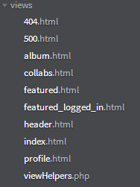
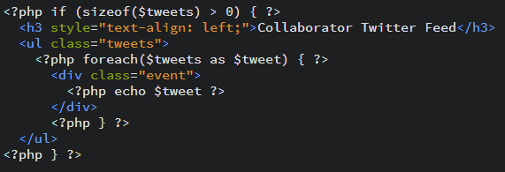
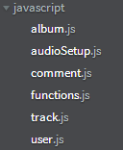
Frontend Example

Slide 7



Architecture - Backend

Slide 8
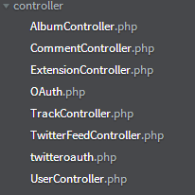
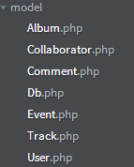
MVC Application Structure

Slide 9
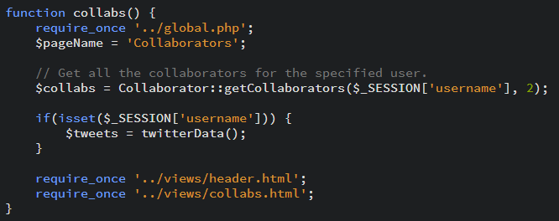
Backend Example

Slide 10
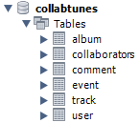
Database
Album contains album metadata
Collaborators contains bidirectional association between users
Comment contains all comment metadata for a user
Event contains all event types for a user
Track contains information about uploaded songs
User contains user profile and permissions

Slide 11
Architecture – Twitter API
Utilize the REST APIs of Twitter
https://dev.twitter.com/rest/public
Needed OAuth to communicate with API
https://github.com/abraham/twitteroauth
First OAuth library in PHP
Easy implementation of code
GET https://api.twitter.com/1.1/search/tweets.json
POST https://api.twitter.com/1.1/lists/members/create.json

Slide 12
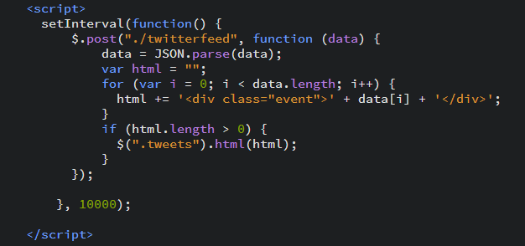
Dynamically Updating Twitter Feed

Slide 13
Architecture - Extension
Chrome Extension
youtubeinmp3.com API
JQuery and Bootstrap
JQuery Post and Get

Slide 14
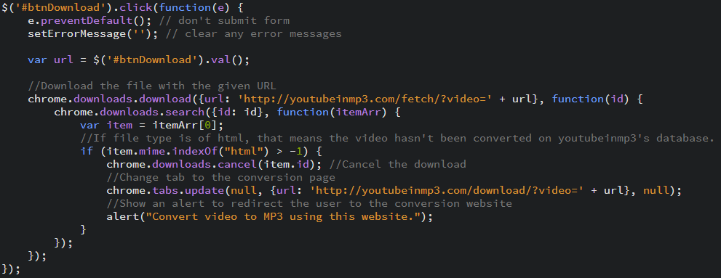
Browser Extension API Implementation

Slide 15
Questions?

