Slide 1
Ancestral Gene Block Reconstruction

Slide 2
Phylogenetic Tree
Representation of evolutionary relationships between a set of sequences/organisms
Nodes of tree represent species
Leaves --- contemporary species
Internal nodes ---- hypothetical ancestral species
Edges represent time of independent evolution
The topology of a tree
Notes:
----- Meeting Notes (04/23/15 21:03) -----
no edge length
topology
more interactive

Slide 3
Example
Common Ancestor
Ancestor of A & B
Ancestor of D & E
A
B
C
D
E
Contemporary Species
Notes:
----- Meeting Notes (04/30/15 16:33) -----
why binary
explanation speciation (dog breeds, primates) before tree

Slide 4
Questions…
How closely related are two species?
How long ago did two species diverge?

Slide 5
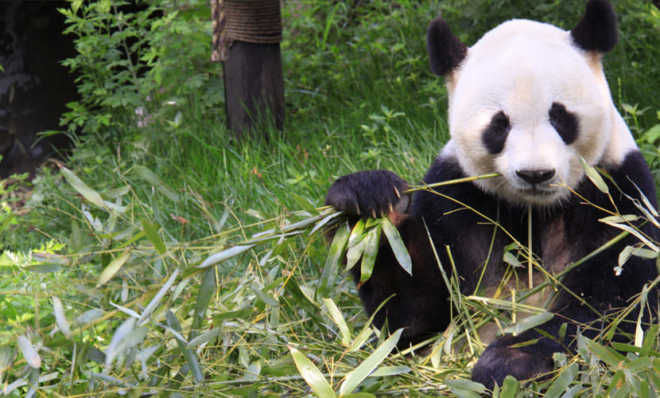
Giant Panda Riddle
Notes:
For roughly 100 years scientists were unable to figure out which family the giant panda belongs to
Giant pandas look like bears but have features that are unusual for bears and typical for raccoons, e.g., they do not hibernate

Slide 6
Is it a bear or a raccoon?
Bear
Red Panda (Raccoon)
Looks:
Shape
Size
Shaggy fur
Other:
Walking/climbing
Behaviors:
Eat bamboo
Method of gripping bamboo
Do not hibernate
Do not roar
Similar snout, teeth, paw features

Slide 7
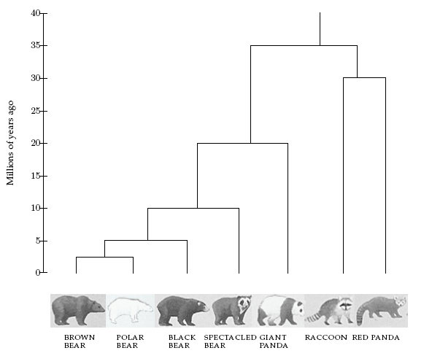
Survey says… Bear!

Slide 8
Characters & Character States
A character is some morphological/molecular trait which distinguishes between species
A character’s states are the different values a character can take on
Example: In our example, gene blocks are characters with many possible states
Notes:
----- Meeting Notes (04/23/15 21:03) -----
character independence-- at end
focus on nucleotides
too abstract
----- Meeting Notes (04/30/15 16:33) -----
every other bullet different color

Slide 9
Phylogenetic Tree Reconstruction
Input:
A tree topology
Gene block state assignments for contemporary species (leaves of tree)
Output:
Assignment of a gene block state to each ancestral species (interior node in tree)
Goal:
Gene block states assigned to ancestors best explain the gene block states of their descendants

Slide 10
Parsimony
Parsimony:
Unwillingness to spend money or resources
Scientific principle that things are usually connected or behave in simplest/most economical way
Notes:
----- Meeting Notes (04/23/15 21:03) -----
combine wiht [previous

Slide 11
Maximum Parsimony Approach
Main Idea:
Evolution is expensive
We want our tree to explain the observed states of the contemporary species with the minimum number of changes
Changes arise when there are differences between the character states of a parent and of a child
Maximize parsimony of tree by minimizing number of changes needed
Notes:
----- Meeting Notes (04/30/15 16:33) -----
think about if answers are wrong

Slide 12
Event Driven Model of Gene Block Evolution
In this model:
Splits
Deletions
Duplications
(A,B,C,D) → (A,B,C), (D)
(A,B,C,D) → (A,B,C)
(A,B,C,D) → (A,B,C,D,D)

Slide 13
DP Algorithm

Slide 14
Set possible assignments
Post order traversal
How do we determine the parent’s possible labels given the possible labels of its children?
SetPossibleLabels(Node n)
If n is not a leaf SetPossibleLabels(n.leftChild) SetPossibleLabels(n.rightChild) n.possibleLabels ← getAncestorLabel(n.leftChild, n.rightChild)

Slide 15
Determine possible assignments
Modification of dynamic programming algorithm for determining minimal edit script
Edit distance between two possible choices
Minimum number of events that need to occur to transform one choice into the other choice
Assign weights to events (allow for events that are more likely to “cost” less than events that are rare)
Any intermediate choice along the minimal edit script is a possible choice for the parent

Slide 16
Determine possible assignments
(A,B),(D,E)
(A,B,C),(D,E),(E)
(A,B),(D),(E)
(A,B),(D,E,E)
(A,B,C),(D,E)
(A,B,C),(D,E,E)
(A,B),(D),(E,E)
(A,B,C),(D),(E,E)
(A,B,C),(D),(E)

Slide 17
Determine possible assignments
All intermediates have same amount of total difference between two child choices
Determine edit distance score and intermediate choices along the edit path for each pair of child choices
getAncestorLabel(Child c1, Child c2)
PossibleChoices ← {} For each possible choice of child c1 For each possible choice of child c2 Determine score and intermediates of minimum edit script between c1 and c2 Add intermediates (as well as score/child choice info) to PossibleChoices set Return PossibleChoices

Slide 18
Set Final Choices From Root
Assign the root’s choice to be the choice with the lowest score of all possible choices for the root
Pre order traversal of tree assigning choices to children based off of choice assigned to parents

Slide 19
Example
Assignment 1
Assignment 2
AGA
AAA
AGA
AGA
AAA
AAG
AAG
AGA
AAA
AGG
AAG
AGA
AAA
AGG
Parsimony Score:
4
Parsimony Score:
5
More parsimonious Less parsimonious

Slide 20
Traditional Small Parsimony Problem
Input:
Rooted tree T with n leaves (tree topology)
Labeling c ∈ ∑ for each leaf
Output:
Labeling of internal nodes with character c ∈ ∑
Goal:
minimize L(T) = the total cost (number of mutations) needed to derive strings of nodes from their ancestors
Traditional Parsimony Problem
Notes:
----- Meeting Notes (04/23/15 21:03) -----
c character string

Slide 21
Fitch’s Algorithm
Step 1:
Post-order traversal
Find set of all possible states R_{v} of each node v…
Assign each leaf node v with label c to set R_{v} = {c}
For each internal node v with children u and w:
R_{v} = R_{u} ∩ R_{w} if R_{u} ∩ R_{w} ≠ ∅
R_{u} ∪ R_{w} otherwise
Step 2:
Pre-order traversal
Select final state r_{u} of each interior node u…
For each internal node u with parent v :
r_{u} = r_{v} if r_{v} ∈ R_{u}
arbitrary state ∈ R_{u} otherwise
Traditional Small Parsimony Problem
Notes:
----- Meeting Notes (04/23/15 21:03) -----
too much detail

Slide 22
Are all mutations created equal?
Goal of problem: find tree with maximum parsimony (minimum number of mutations)
Some mutations are more likely to occur than others – maybe they should contribute less to the overall parsimony score
If a mutation is more likely, give it less weight
A and G have similar shapes
C and T have similar shapes
Similar shape => easier to swap => more likely
Notes:
----- Meeting Notes (04/23/15 21:03) -----
detail about how mutations happen-- A->G

Slide 23
Weighted Small Parsimony
Input:
Rooted tree T with n leaves (tree topology)
Labeling c ∈ ∑ for each leaf
Penalty matrix S, where S[a,b] = penalty associated with pair of letters (a, b)
Output:
Labeling of internal nodes
Goal:
minimize L(T) = the total cost (weighted substitutions) over all edges in T
Traditional Parsimony Problem
Notes:
----- Meeting Notes (04/23/15 21:03) -----
replace alphabet symbol to A,T,G,C
lxl no
1 character strings
examples of same leaves good vs bad

Slide 24
Example Penalty Matrix
 | A | C | G | T
A | 0 | 2 | 1 | 2
C | 2 | 0 | 2 | 1
G | 1 | 2 | 0 | 2
T | 2 | 1 | 2 | 0
to
from
Notes:
Notice that if we swap a letter for itself, penalty is 0. If we swap a nucleotide for one of similar shape, penalty is 1. If we swap a nucleotide for one of different shape, penalty is 1

Slide 25
Recursive Algorithm
To find optimal labeling for tree T rooted at r:
For each a in ∑={A, C, G, T}:
Recursively find the optimal labeling for left subtree if label(left child) is set to a
Recursively find the optimal labeling for right subtree if label(right child) is set to a
For each (a,b,c) in ∑x∑x∑:
Calculate cost of tree if assign a to the root, b to the left child, and c to the right child

Slide 26
Recursive Definition
Let L(T_{v},a) be the optimal score for subtree of T rooted at v if label(v) is set to a
If tree is rooted at node r, the cost of the optimal solution is:
Notes:
----- Meeting Notes (04/23/15 21:03) -----
latexit -- allows you to type latex equations..
----- Meeting Notes (04/30/15 16:33) -----
write definition on board

Slide 27
Recursive Algorithm
Step 1:
Post-order traversal
Find score L(T_{v},a) for each node v and each state a…
Step 2:
Pre-order traversal
Select final state label(u) of each interior node u…
For root r, determine optimal label by finding value of a that minimizes L[r,a].
For each node v with children u, w:
Determine what pair of labels for u and w gave score corresponding to label(v)
Pass this information down to u and w
Traditional Small Parsimony Problem
Notes:
----- Meeting Notes (04/23/15 21:03) -----
too much detail

Slide 28
DP Algorithm- Initialization
Create matrix L (size |V| x |∑|)
L[v,α] = optimal score for T_{v} if node v was assigned state α
Create matrix C (size |V| x |∑|)
C[v,α] = pair of states (β_{u} , β_{w} ) where
Notes:
----- Meeting Notes (04/30/15 16:33) -----
too much going on --- split into 2 slides

Slide 29
DP Algorithm- Set scores
Postorder traversal
For each state α and each node v with children u and w:
Save states β_{u} and β_{w} that minimized partial score from u and w, respectively
Notes:
----- Meeting Notes (04/30/15 16:33) -----
too much going on --- split into 2 slides

Slide 30
DP Algorithm- Backtrace
Determine optimal label of root node r by finding minimum finding value of α that minimizes L[r,α]
Preorder traversal
Use optimal label of parent v to find corresponding values of β_{u} and β_{w}
Set label(u) = β_{u} and label(w) = β_{w}
Notes:
----- Meeting Notes (04/30/15 16:33) -----
too much going on --- split into 2 slides

Slide 31
A | 6
C | 5
G | 6
T | 6
A
C
G
T
C
9
A
C
G
T
A | 3
C | 4
G | 3
T | 5
A
C
G
T
A | 4
C | 1
G | 4
T | 1
C
 | A | C | G | T
A | 0 | 2 | 1 | 2
C | 2 | 0 | 2 | 1
G | 1 | 2 | 0 | 2
T | 2 | 1 | 2 | 0
5
C
A
C
G
T
A | 3
C | 2
G | 2
T | 3
8
C
3
A
C
G
T
A
C
G
T
A
C
G
T
A | ∞
C | 0
G | ∞
T | ∞
A | 0
C | ∞
G | ∞
T | ∞
A
C
G
T
A
C
G
T
A | ∞
C | 0
G | ∞
T | ∞
A | ∞
C | ∞
G | 0
T | ∞
A | ∞
C | ∞
G | ∞
T | 0
C
G
A
C
T
1
2
4
6
7
Notes:
Input: Rooted tree with n leaves.
Labeling of {A, C, T, G} for each leaf.
Penalty matrix
Leaf rules:
L(T_{v},a)= 0 if v is a leaf and label(v) = a
∞ if v is a leaf and label(v) ≠ a
First step – postorder traversal.. For each possible character, determine cost of left subtree if assign left child that character, and determine cost of right subtree if we assign right child that character.
If we assign parent A… here is the matrix of possible scores for assigning children all possible combos of labels
Second step – preorder traversal… Find min at root, then figure out where it came from

Slide 32
DP Algorithm
Let V be the list of nodes of T, in same order as postorder traversal of T
Let S be the list of possible states (from ∑)
Create |V|x l x l x l matrix C
C[v,a,b,c] = score for T_{v} if:
node v was assigned state a
left child u of v was assigned state b
right child w of v was assigned state c
Create n x l matrix L
L[v,a] = optimal score for T_{v} if node v was assigned state a

Slide 33
1. Compute L[v,a] (bottom-up)
For v = 0 to |V|-1
For a = 0 to |∑|
If node v is a leaf
L[v,a] = 0 if label(v) == a , ∞ otherwise
Else node v is internal node with children u and w
left=∞, right=∞
For b = 0 to |∑|
If (L[u,b] + S[a,b]) < left
left = (L[u,b] + S[a,b])
If (L[w,b] + S[a,b]) < right
right = (L[w,b] + S[a,b])
L[v,a] = left+right
X[v,a] = left
Y[v,a] = right
Notes:
----- Meeting Notes (04/23/15 21:03) -----
do algorithm on board
words

Slide 34
2. Assign Labels (top-down)
LabelOn(v,a)
If v is not a leaf:
label(v) = a
u = left child of v
w = right child v
For b = 0 to |∑|
For c = 0 to |∑|
If C[v,a,b,c] = min
LabelOn(u,b)
LabelOn(w,c)
For root r, determine optimal label by finding value of a that minimizes L[r,a]. Then call LabelOn(r,a).
Notes:
----- Meeting Notes (04/23/15 21:03) -----
understanding steps of algorithm not coding it up

Slide 35
2. Assign Labels (top-down)
For root r, determine optimal label by finding value of a that minimizes L[r,a]
For v = |V|-1 to 0
If v is an interior node with left child u and right child w
Determine optimal label of u by finding value of b s.t. (L[u,b] + S[label(v),b]) == X[v, label(v)]
Determine optimal label of w by finding value of b s.t. (L[w,b] + S[label(v),b]) == Y[v, label(v)]
Notes:
----- Meeting Notes (04/23/15 21:03) -----
understanding steps of algorithm not coding it up

Slide 36
Character Independence
Species are actually labeled with m-character strings
We assume that the characters at each position of a string are independent
This allows us to assume each node is labeled with a single character
Total cost of node = sum of costs of character in each of the m positions
Notes:
----- Meeting Notes (04/23/15 21:03) -----
mention this at the end

Slide 37
Runtime
For 2n-1 sequences of length m over Σ:
For each of m character positions
For each of the 2n-1 nodes:
We need to look at each of the |Σ|³ combinations of characters
Runtime: O(mn|Σ|³)
Σ is essentially fixed
So runtime is essentially O(mn)
Notes:
----- Meeting Notes (04/23/15 21:03) -----
runtime more interactive
Friday

