Slide 1


COMS-W4995 Applied Machine Learning Project Deliverable
Iowa House Price Prediction
By Ananya Gandhi, YeongWoo (Janie) Kim, Austin Schaefer, Heather Song
TRANSCENDING DISCIPLINES, TRANSFORMING LIVES

Slide 2
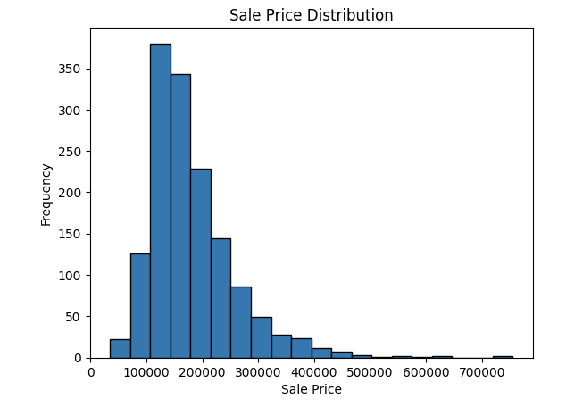
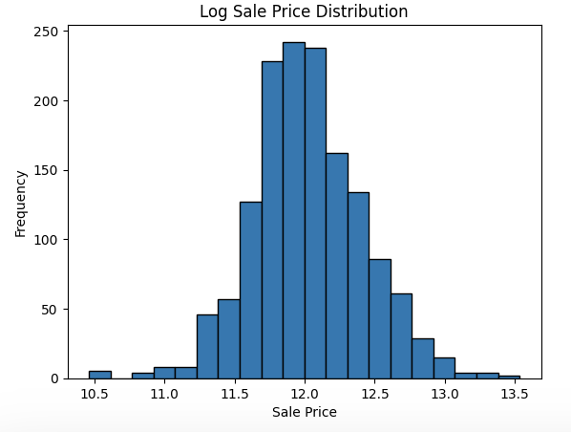
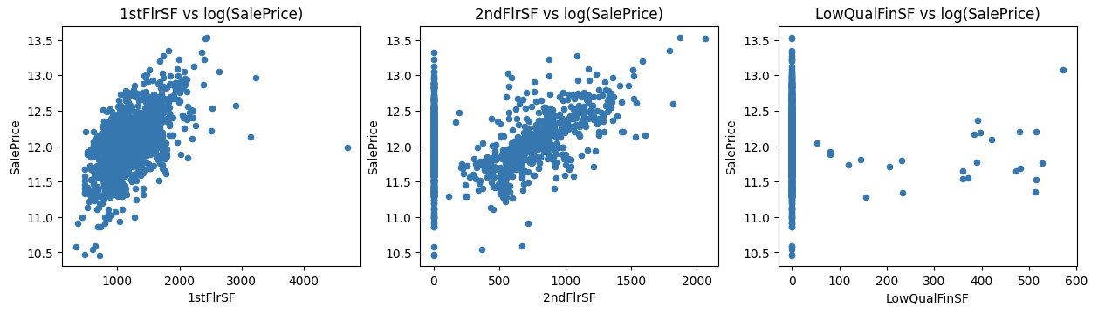
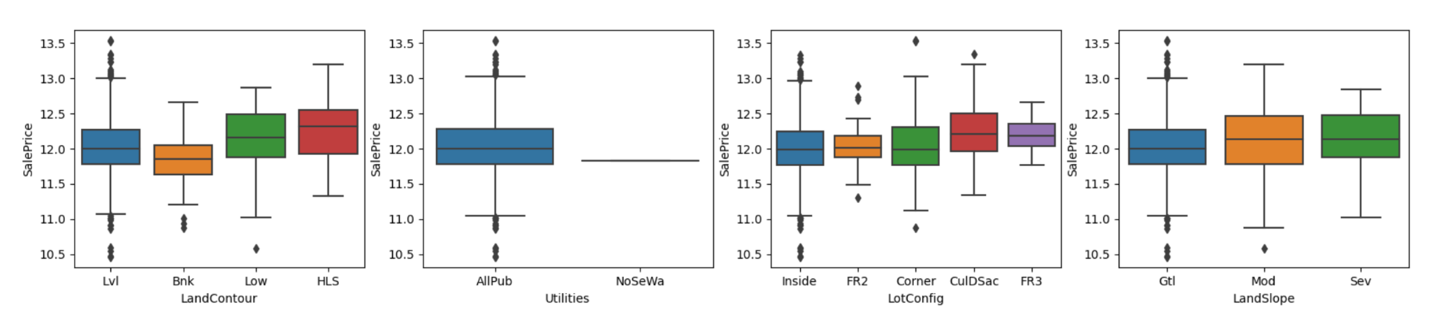
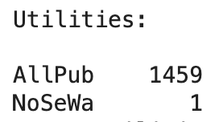
Initial Data Exploration
Plotted distribution of target variable (sale price). Used log of target variable to make plots more interpretable.
Examined feature vs target relationship with scatter plots and boxplots.
Histograms were mostly ineffective for numerical features due to the high volume of 0s.
Dropped columns with no correlation or very little information (For example, 99.9% of Utilities data falls under one category)

Slide 3
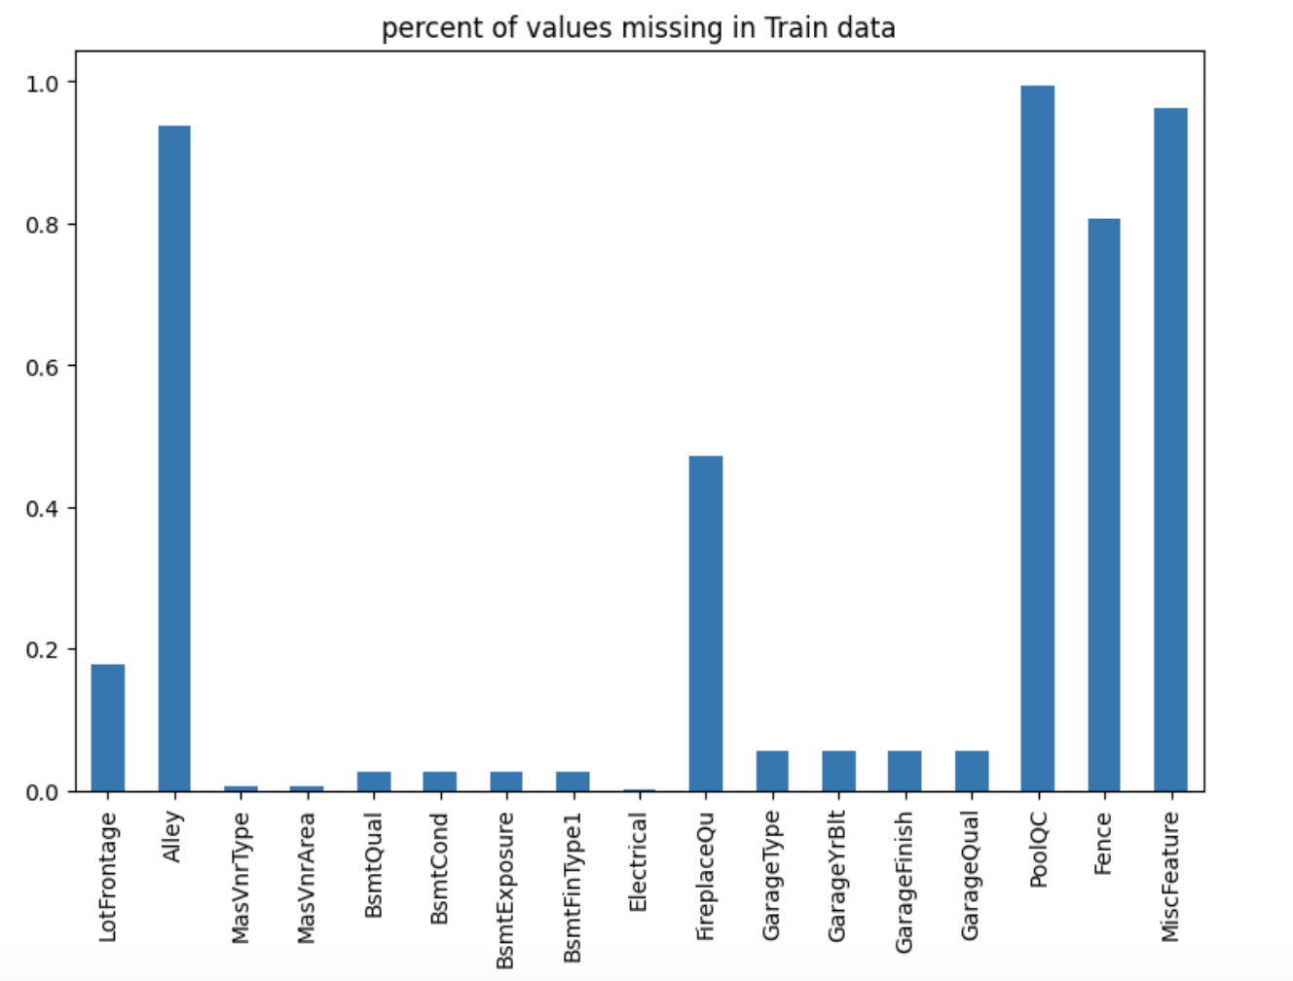
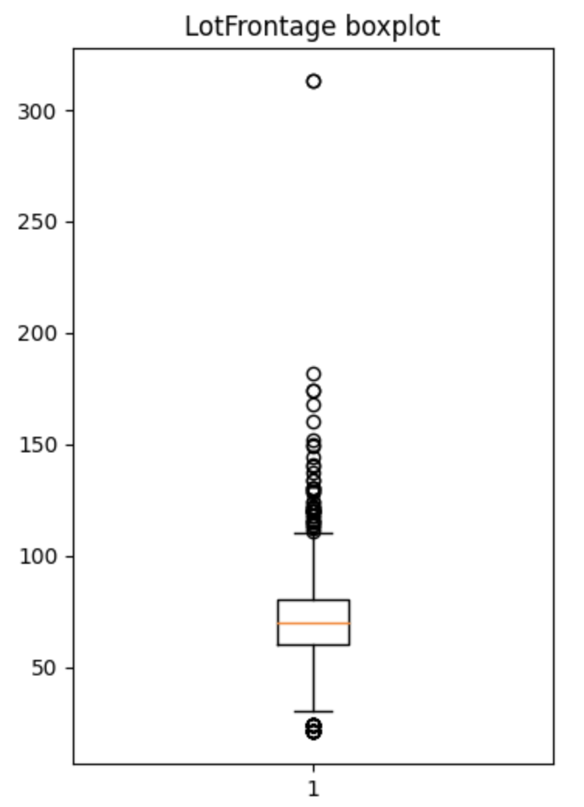
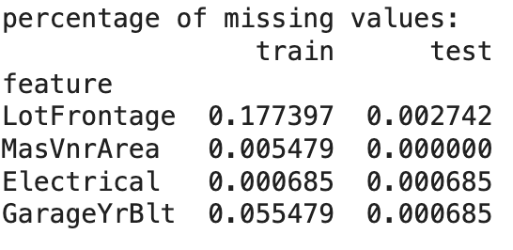
Missing Value Imputation
For most categorical features, creating a “Missing” label, indicating that property is missing the feature, makes sense because those values are missing not at random (MNAR).
Features with a few missing values
We simply dropped the rows.
Features with a lot of missing values
Features such as “LotFrontage”.
Used median imputation after examining its distribution.
Mean is heavily influenced by outliers.

Slide 4
Cleaning and Feature Engineering
Categorical Variable Encoding
Applied target encoding for high cardinality columns, such as “Neighborhood” and “Exterior1st”.
Applied ordinal encoding for various categorical columns, such as "LotShape," "ExterQual," and "BsmtQual." For missing values marked as "NA," we encoded them with the value -1.
Applied one-hot encoding for non-ordinal columns.
Applied label encoding to a specified list of ordinal columns, including "OverallQual" and "OverallCond."
Data Splitting
Divided the dataset into features (stored in the 'features' variable) and the target variable (in 'target') by dropping the "SalePrice" column.

Slide 5
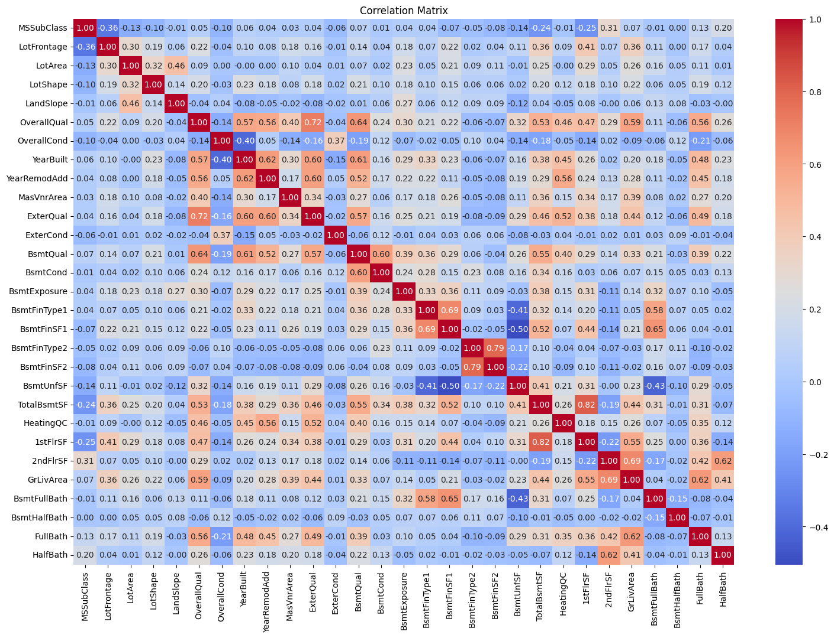
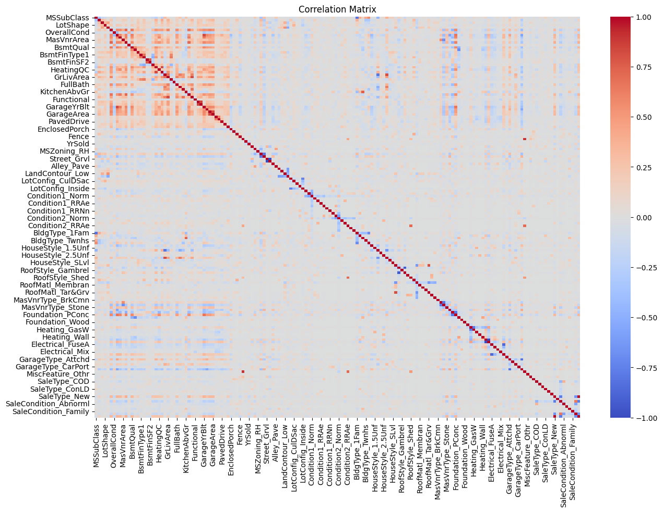
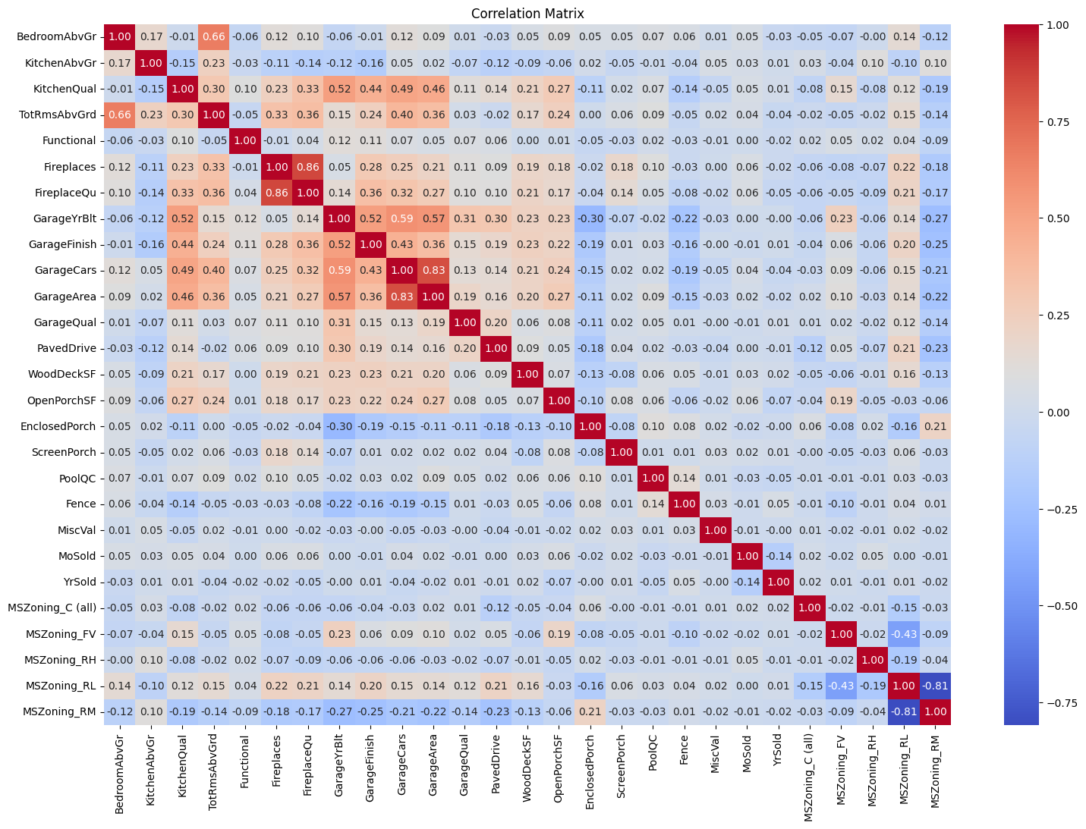
Partial correlation matrix #1
Full correlation matrix
Correlation Matrices
Generated two partial correlation heatmaps for visualization purposes. The first heatmap highlights features associated with property characteristics, while the second focuses on features linked to the property's condition and location.
Constructed a comprehensive correlation heatmap to visualize inter-feature relationships across the entire dataset.
Identified highly correlated features based on a predefined threshold of 0.85.
Partial correlation matrix #2

Slide 6
Cleaning and Sampling
Data Splitting for Model Training
Split the data into training, validation, and test sets, following a 60/20/20 distribution.
Feature Scaling
Applied standard scaling using the 'StandardScaler' to ensure that all features have a mean of 0 and a standard deviation of 1.
Bias Term Inclusion
Added a column of ones to the feature matrices to account for the bias term in linear regression models.
X_train, X_temp, y_train, y_temp = train_test_split(features, y, test_size=0.4, random_state=42) # 60/20/20
X_valid, X_test, y_valid, y_test = train_test_split(X_temp, y_temp, test_size=0.5, random_state=42)

Slide 7
Model Implementation
In order to accurately forecast the final selling price of each house, we decided to implement the following 6 ML models, and each model has its own pros and cons.
01
Linear Regression Model
Simple baseline model
Quick to train and predict
Can overfit with many features
Assumes linear relationships
02
Ridge Regression (L2 Regularization)
Reduces overfitting through L2 regularization
Handles multicollinearity well
Biased estimates with high regularization
Hyperparameter tuning needed
03
Lasso Regression (L1 Regularization)
Reduces overfitting through L2 regularization
Performs feature selection
Can underperform with complex relationships
May exclude useful features with high levels of regularization
04
Elastic Net Regression
Balances between Ridge and Lasso
Robust to various data scenarios
Computationally more intensive
Can be overkill for simple problems
05
XGBoost
High predictive power (often performs well in various Kaggle Competitions)
Supports GPU training, sparse data & missing values
Complex, many hyperparameters
Does not support categorical variables natively
06
CatBoost
Optimized for categorical features
Supports GPU training, sparse data & missing values
Still requires parameter tuning
May be excessive for simple datasets

Slide 8
Model Performance and Comparison
After implementing all 6 models, we used Root Mean Squared Error (RMSE) and R-Squared to evaluate the regression models. - RMSE measures the average magnitude of the errors between the predicted and actual values without considering their direction. However, RMSE alone does not provide any insights into the proportion of variance explained by the model, which is where R-squared comes in. R-squared represents the proportion of variance in the dependent variable that is predictable from the independent variables. It gives a sense of the quality of the model in terms of its explained variance.
- Using both RMSE and R-squared can provide a more comprehensive understanding of the model performances. RMSE can supplement the limitations of R² by giving us the average error in the units of the measured variable, and R² can show us the proportion of the outcome's variance that is explained by the model.
Model Performances | Root Mean Squared Error | R-Squared
Linear Regression | 3370845801568978.0 | 1.6732242479511812e+21
Ridge Regression | 53029.161 | 0.586
Lasso Regression | 53276.28 | 0.582
Elastic Net Regression | 47666.179 | 0.665
XGBoost (with Hyperparameter tuning) | 29828.033 | 0.869
CatBoost (with Hyperparameter tuning) | 28609.647 | 0.879
As shown on the table, CatBoost has the best performance. The boosting algorithms (XGBoost and CatBoost) are outperforming the linear models by a considerable margin on this dataset. The poor performance of the Linear models could be multicollinearity or non-linear relationships that it cannot capture. Ridge and Lasso provide improvements through regularization, but the boosting models, which are more complex and can model non-linear relationships, offer the best performance in this case.

Slide 9
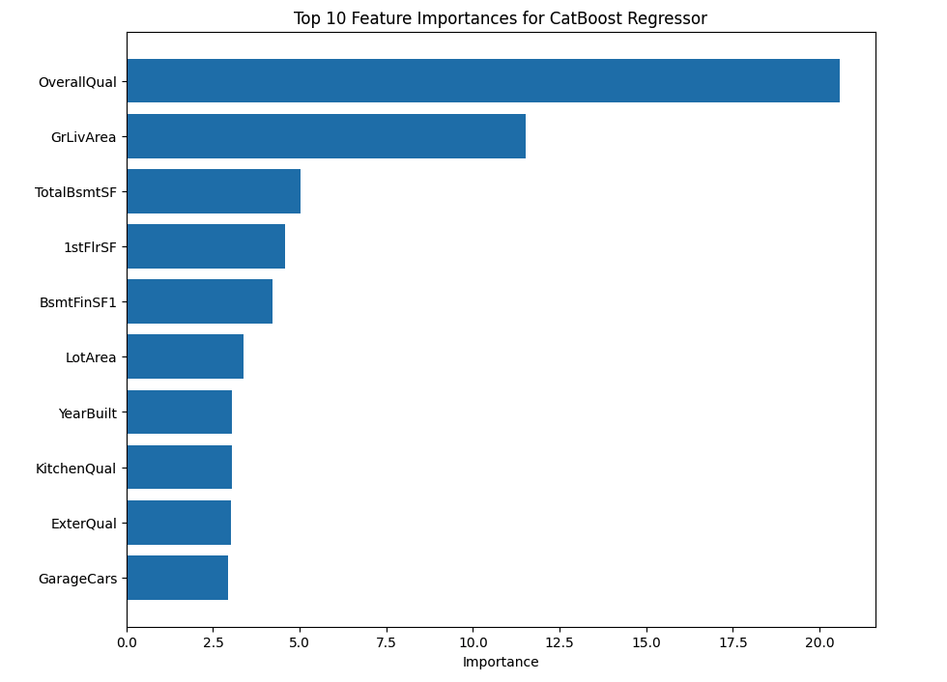
Feature Importance and Conclusion
Since CatBoost has the best performance, we decided to apply CatBoost to draw further insights from the dataset.
Based on the feature importance output from the CatBoost model, we can draw several insights:
Quality Over Quantity: While the size of the living areas is important, the overall quality of construction and finishes seems to have a more significant effect on sale prices.
Functional Spaces: Functional spaces like basements and garages are valued, indicating that buyers are looking for practical and usable space.
Modern and Updated: Newer homes and those with modern amenities like updated kitchens tend to fetch higher prices, which could be due to less immediate maintenance required or a preference for contemporary designs.
Investment Areas: For those looking to sell or improve their property value, focusing on improving overall quality, expanding or finishing living areas, and updating kitchens could potentially offer the best return on investment.
These findings are crucial for sellers, buyers, and real estate professionals as they provide a data-driven foundation for understanding what features are likely to drive home prices in this particular market or dataset.

