Slide 1
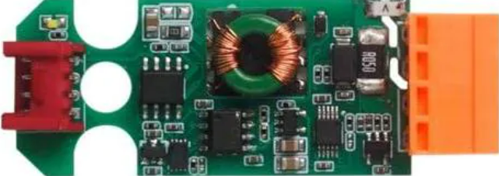
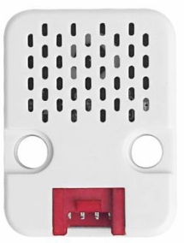


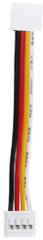
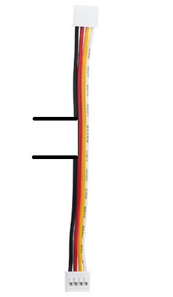


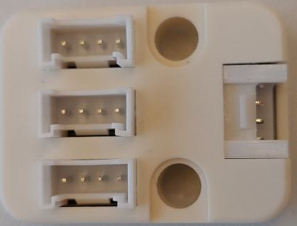

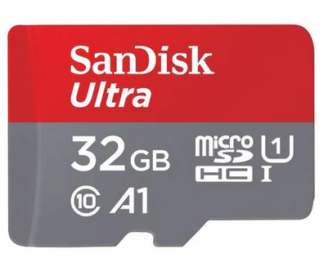
Hardware Setup
Meteo
Sht30/qmp6988
Temperature
Humidity
Pressure
Current Sensor
ADS1115
Modem SIMCOM7080G
U128
Port C (UART/Blue)
Port A (I2C/Red)
M5 Core
I2C Hub
SD-Card
USB C Power / Terminal

Slide 2

Seession Managment
Source:
- ELEX
SAPC
MME
????
eNodeB
Attach
UE
Informs MME
Informs MME
S-GW
Low Complexety Attach
DL Data Buffer Expiration Time
Downlinkbuffer (Userplane)

Slide 3
CAT-M Testcase eDRX/PSM Buffer
MME
Pages Mobile Device
Pageing
DL Data Buffer Expiration Time
UE
Informs MME
S-GW
eNodeB
Download
Incoming Data
Download (S1U-Interface)
Store Data
Downlinkbuffer

Slide 4
CAT-M Testcase eDRX/PSM Buffer
MME
Pages Mobile Device
And send direct Data
Inform MME and send Download
(S1 Interface)
UE
S-GW
eNodeB
Download
Incoming Data

Slide 5
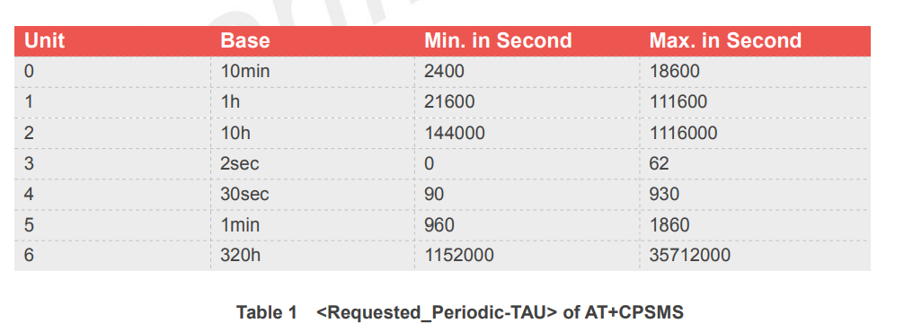
PSM: Tracking Area Update T3412
01000111
Unit = 0b010 = 2
Value = 0b00111 = 7
TAU = 7 *10h = 70h

Slide 6
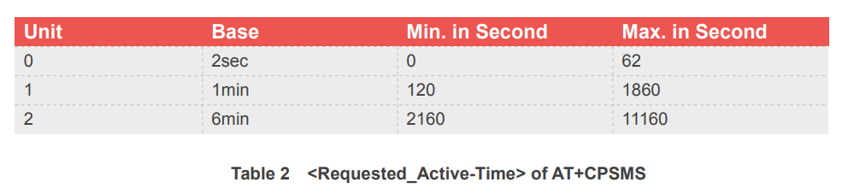
PSM: Activetime T3324
01000111
Unit = 0b01 = 1
Value = 0b00111 = 7
Activetime = 7 *1 min = 7 min

Slide 7
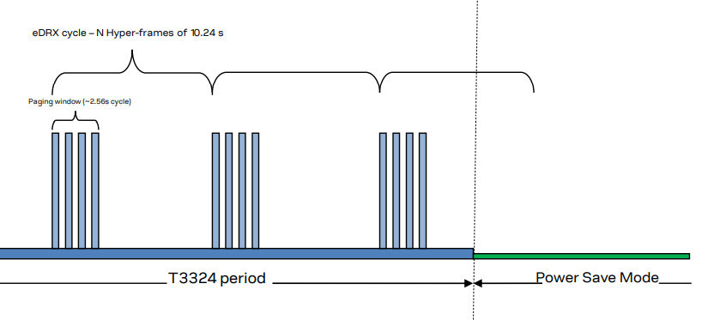
eDRX
Hyperframe
eDRX Value
0010 -> 2x10.24s (2x4x2.56s) -> 20.48s
0010 -> 2x2.56s-> 5.02
Pageing Window

Slide 8
Messen
Senden

Slide 9
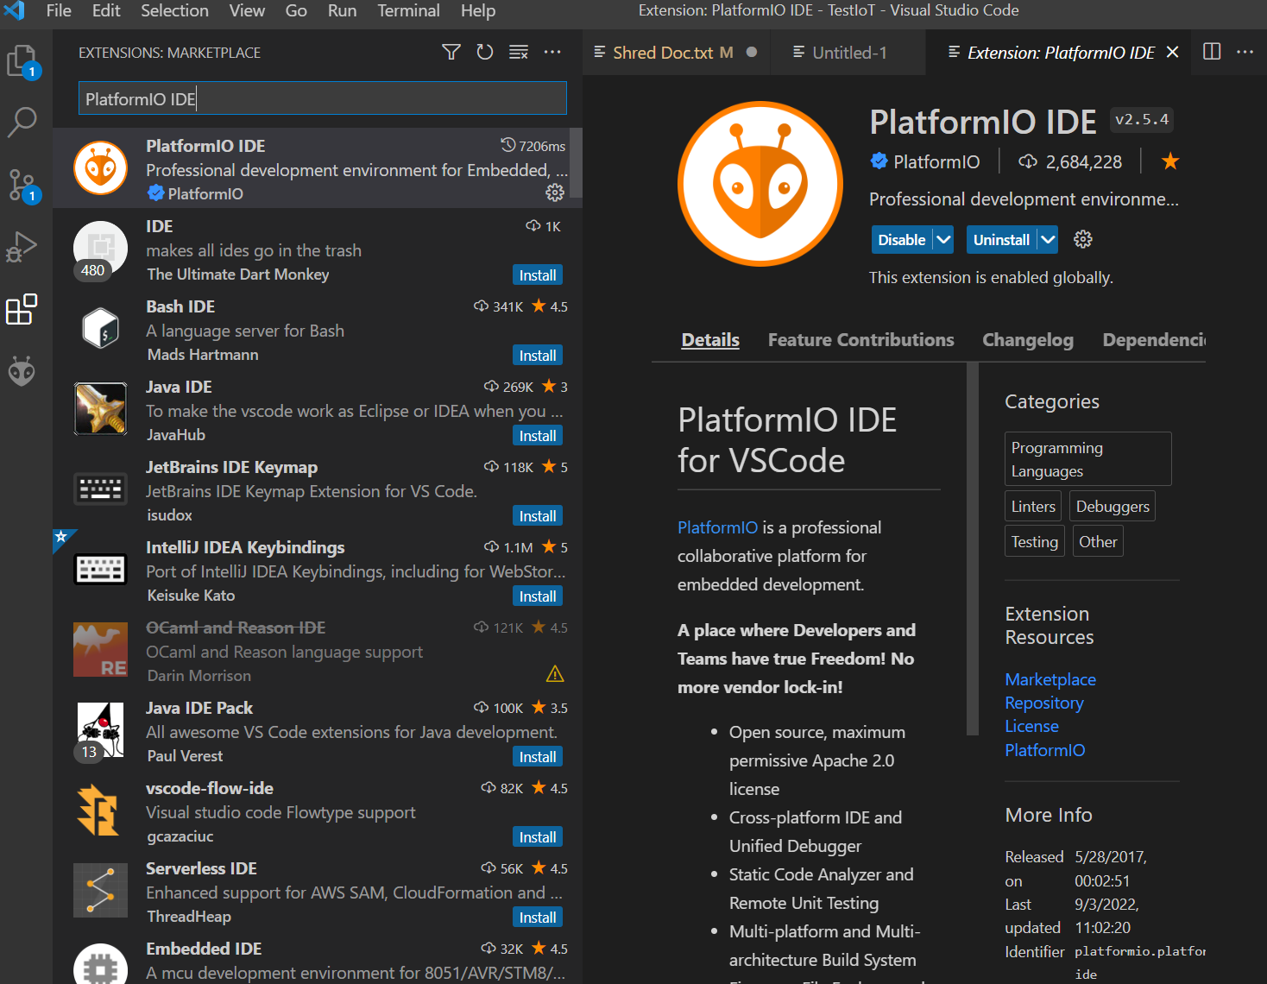
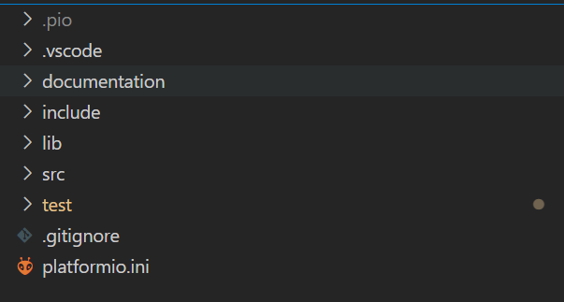
2.) Search for "PlatformIO
3.) Install Extension
1.) Click on Extensions

Slide 10


mail_bad.j2
Thingsboard.yml
Device Connectivity Event
Roule Run
Roulenode
(inactivity_mailnode.json)
Mailing_list.ini

Slide 11
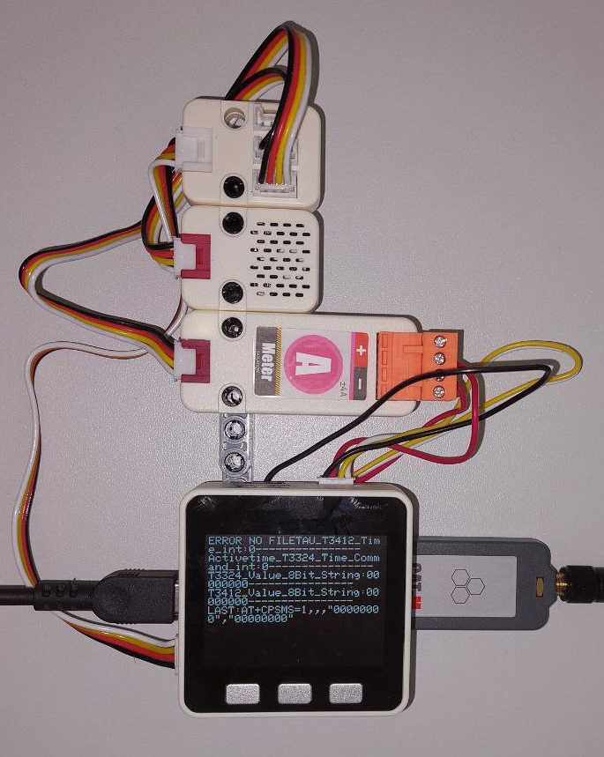


Insert SD-Card Power-Up
Parameter and 1 Value recieved
1.)
5.)
Error or Parameter Load
2.)
Waiting for PSM
Modem Connect and send Parameter and 1 Value
6.)
3.)
Rest the Timers if IP-Adress is same
8.)
Wakeup and send Values
7.)
Timeout
Wrong IP Adress

