Slide 1
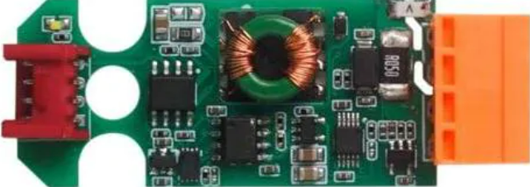
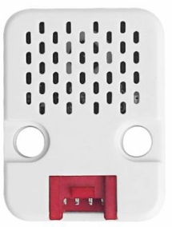


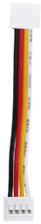
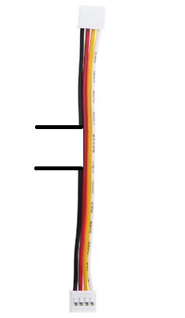

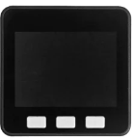
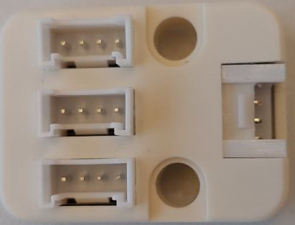

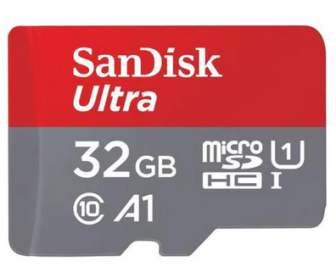
Hardware Setup
Meteo
Sht30/qmp6988
Temperature
Humidity
Pressure
Current Sensor
ADS1115
Modem SIMCOM7080G
U128
Port C (UART/Blue)
Port A (I2C/Red)
M5 Core
I2C Hub
SD-Card
USB C Power / Terminal

Slide 2

Seession Managment
Source:
- ELEX
SAPC
MME
????
eNodeB
Attach
UE
Informs MME
Informs MME
S-GW
Low Complexety Attach
DL Data Buffer Expiration Time
Downlinkbuffer (Userplane)

Slide 3
CAT-M Testcase eDRX/PSM Buffer
Target:
-
SAPC
MME
UE
DL Data Buffer Expiration Time
eNodeB
Informs MME
S-GW
Incoming Data
Store Data
Downlinkbuffer

Slide 4
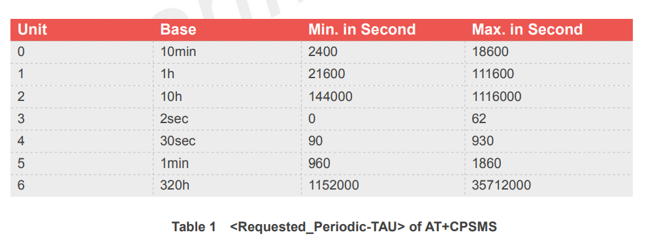
PSM: Tracking Area Update T3412
01000111
Unit = 0b010 = 2
Value = 0b00111 = 7
TAU = 7 *10h = 70h

Slide 5
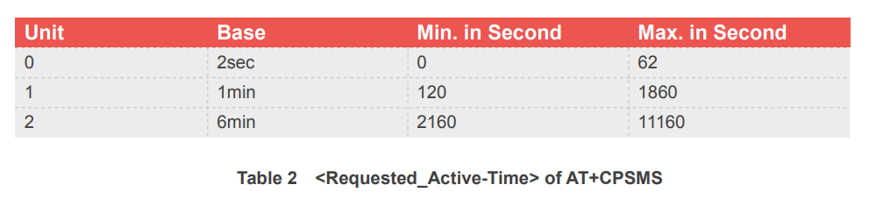
PSM: Activetime T3324
01000111
Unit = 0b01 = 2
Value = 0b00111 = 7
Activetime = 7 *2sec = 14 sec

Slide 6
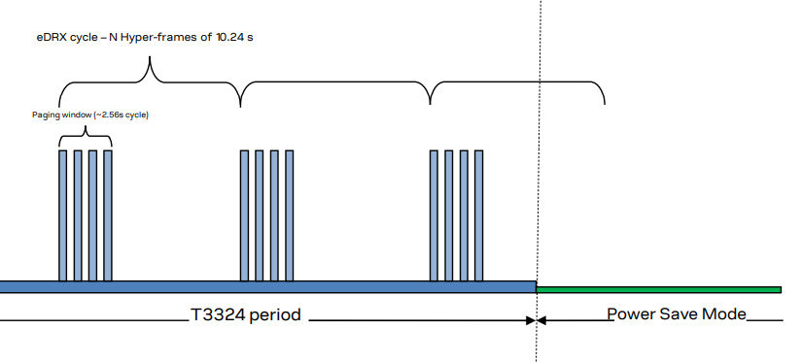
eDRX
Hyperframe
eDRX Value
0010 -> 2x10.24s (2x4x2.56s) -> 20.48s
0010 -> 2x2.56s-> 5.02
Pageing Window

Slide 7
Messen
Senden

Slide 8
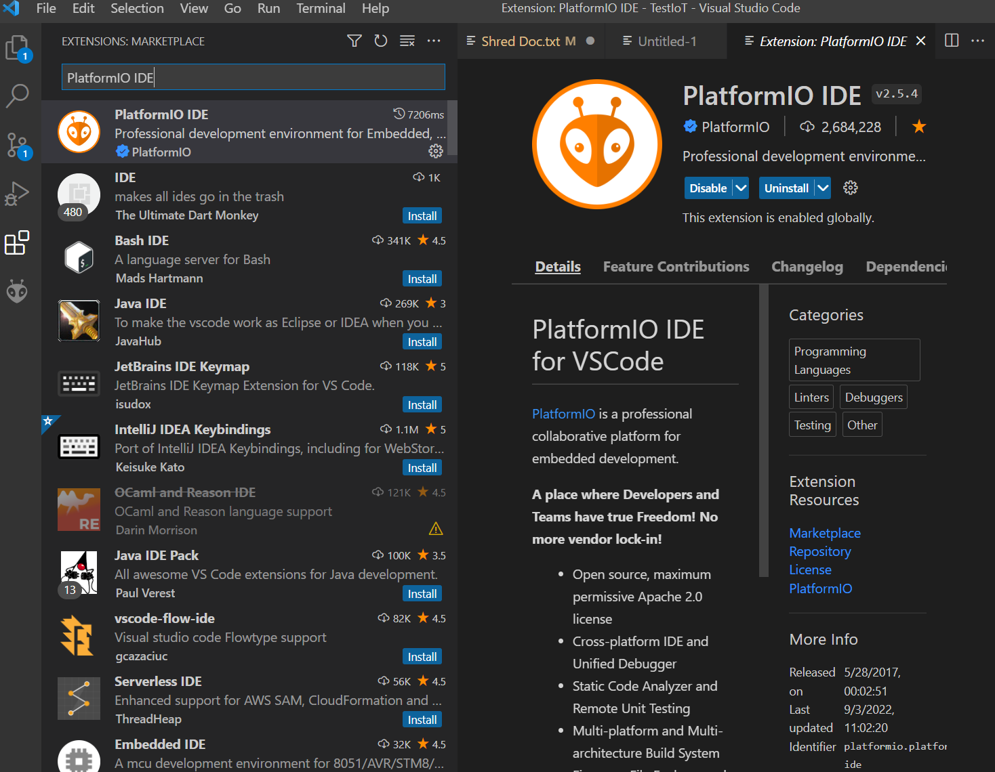
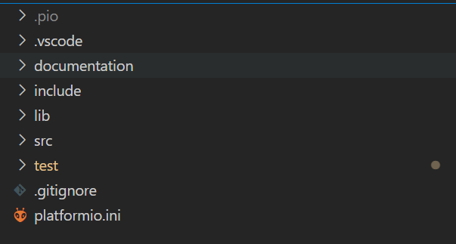
2.) Search for "PlatformIO
3.) Install Extension
1.) Click on Extensions

Slide 9


Thingsboard.yml
Device Connectivity Event
Rouler
Roulenode
(inactivity_mailnode.json)
Mailing_list.ini

