Slide 1
MUSIC STREAMING
PROJECT C
<p> Group 6</p>
<p> Mentor: Trần Văn Thọ </p>

Slide 2
TABLE OF CONTENTS.
01
02
03
04
05
06
Introducing group
Introducing app
Technology used
Thank you
Front end
Back end

Slide 3
INTRODUCING GROUP
01
<p> Introducing members of group </p>

Slide 4
MEMBERS
1. Hoàng Văn Lập (Leader)
4. Võ Nguyễn Minh Nhật
2. Nguyễn Lê Nguyên
5. Nguyễn Thanh Trí
3. Phan Đức Nghĩa

Slide 5
INTRODUCING APP
02
<p> Introducing name’s app, logo, and a few main functions </p>

Slide 6

MYSTIC MELODY
A few main functions:
Register/Login
Searching song
Add/Remove songs from a playlist
Play music
Create playlist
Add/Delete the playlist
...

Slide 7
Technology USED
03
<p> Talk about program language, GUI, and database </p>

Slide 8
TECHNOLOGY USED
GUI
Database
Program language
GTK3
C
SQLite3

Slide 9
FRONT END
04
<p> Talk about front end </p>

Slide 10
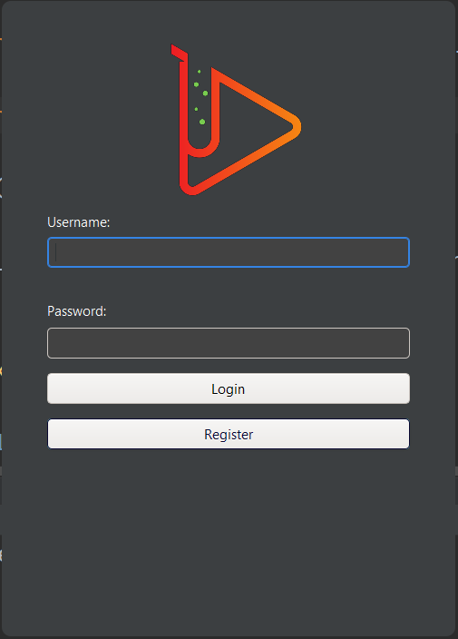
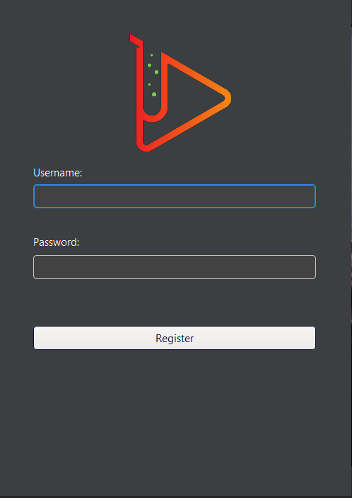
LOGIN
REGISTER

Slide 11
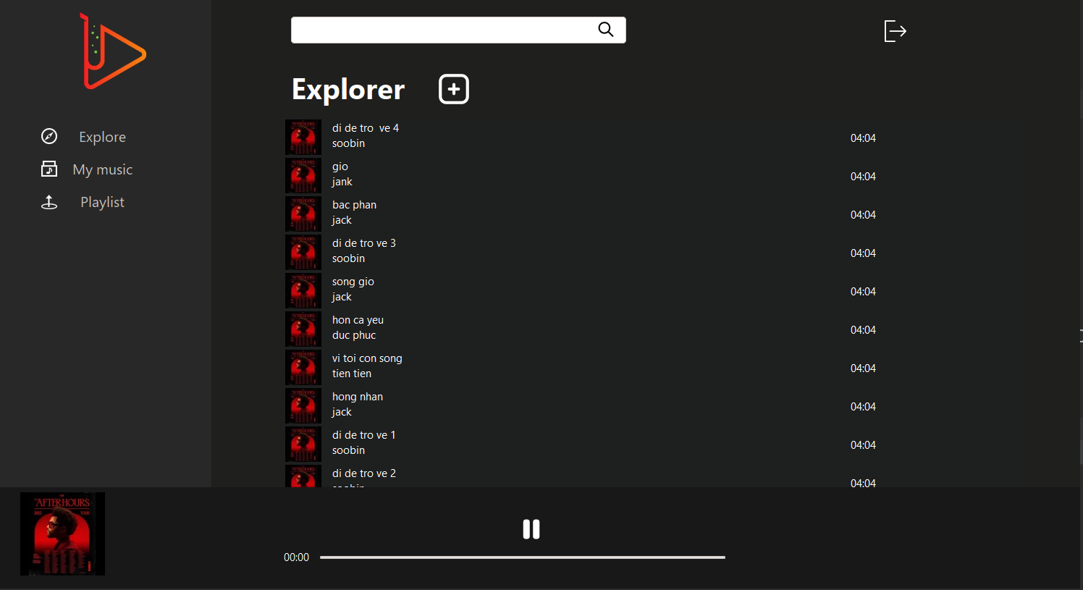
Logout
Reset
Searching song
Play music

Slide 12
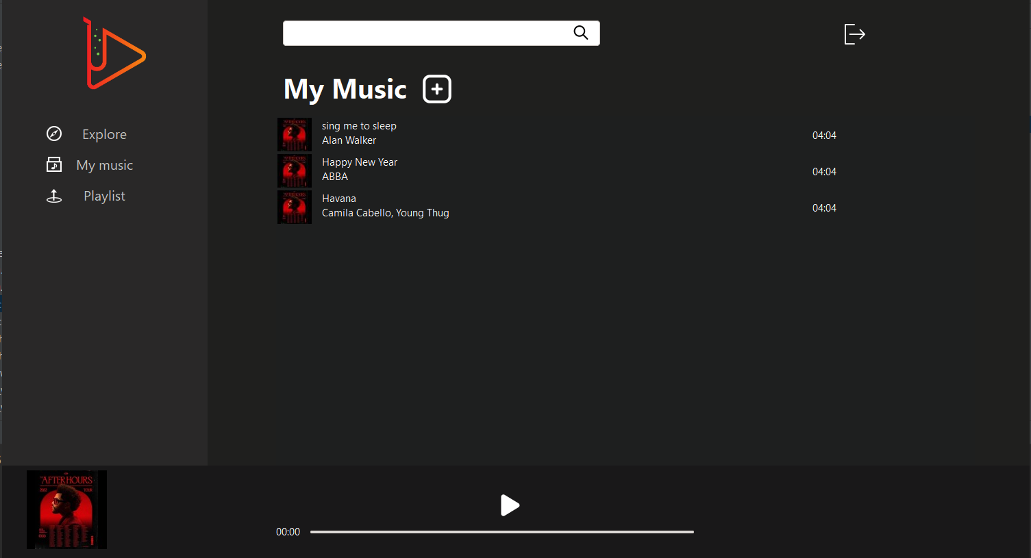
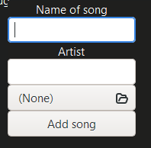

Slide 13
BACK END
05
<p> Talk about back end </p>

Slide 14
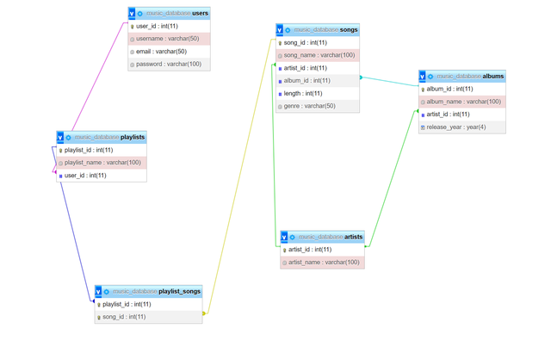

Slide 15
THANK YOU!

