Slide 1
A Comparison of Convolutional Neural Networks for Automated Malaria Detection in Cell Images
DSC 540
Chris Schaffer
03/18/19

Slide 2
A Machine Learning Approach
What are we trying to do?
What is the data?
How are we going to approach the problem?
Has it been done before?
What kind of model is suited for it?
What are the parameters?
How do we choose them?
How well does it work? Is it practical?
Notes:
Goal: apply ML approach to solve data-driven problem
Must ask some prelim questions
What is the objective?
What is the data?
Research- has it been done before?
Best suited model?
Is solution practical?

Slide 3
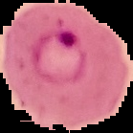
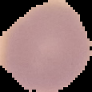
What are we trying to do?
Create a model that can successfully discriminate between healthy cells and those infected with malaria
Acc to CDC, 216 million malaria cases reported worldwide (2016)
Diagnoses could benefit from automated techniques
Regression: (0… 1)
Odds of being infected?
Classification: [0, 1]
Infected or healthy?
Notes:
Objectives
Create model that discriminates between healthy cells and those infected with malaria
Over 200 million cases reported worldwide ea. Year
Process could definitely benefit from automation
Binary Classification
Classifiers produce a binary output (either infected or healthy)
Can also use regression to get probability of being infected

Slide 4
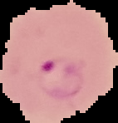
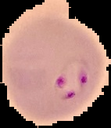
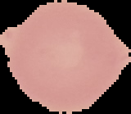
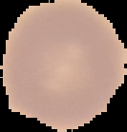
The Data: Malaria Cell Stain Images
Sourced for free from Kaggle*
*originally from: https://ceb.nlm.nih.gov/repositories/malaria-datasets/
27,558 Stained Cell Images
Half infected / half healthy
Variable height and width
https://www.kaggle.com/iarunava/
cell-images-for-detecting-malaria
Infected
Healthy
Notes:
Create a model that can discriminate betwe

Slide 5
The Model: Convolutional Neural Network
Specialize in image recognition / classification
Images pass through a set of filters to expose features
Images are downsampled repeatedly to condense data
Meant to automate the feature selection process
Notes:
Prev research shows convolutional neural networks can be applied to medical image classification and regression
Images are filtered and downsampled repeatedly
This helps CNNs automate the feature selection process

Slide 6
The Process: Building an Image Classifier
Raw Images
Model Evaluation (10x)
Image Stack
0
Training Data (23,545)
Model
Trained Model
Results
Test Data (2,617)
1
Validation Data (1,377)
Notes:
Before development, good idea to plan our approach
Leveraging random CNN initializations by finding average scores (acc, AUC, loss, etc)
Images are shuffled and split into training, test, and validation datasets

Slide 7
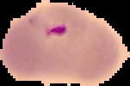
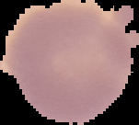
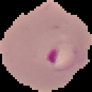
Data Preprocessing
Selecting image size
Information Preservation
Data Reduction
Images reshaped to 64 x 64 pixels
19 too small
Notes:
Preprocessing is often necessary step before model development
Images must be reshaped to correct input size (64 x 64 pixels)
Choice of input size is tradeoff between information loss and computational requirements

Slide 8
Model Architectures
SMALL | MEDIUM | LARGE
 | Conv2D(16) MaxPool | Conv2D(64) MaxPool
Conv2D(6) MaxPool | Conv2D(48) MaxPool | Conv2D(128) Conv2D(128) MaxPool
Conv2D(12) MaxPool | Conv2D(16) MaxPool | Conv2D(64) Conv2D(64) Conv2D(64) MaxPool
Dense(2352) | Dense(576) | Dense(4,096)
Dense(64) | Dense(64) | Dense(64)
Dense(1) | Dense(1) | Dense(1)
5,685,806 | 383,746 | 2,996,545
Small number of layers and filters Large neural network input layer | Additional convolution and pooling layer More filters Decreased neural network input layer | Increased number of filters Stacked filter layers Increased neural network input layer
Different architectures were implemented
Small model
Very few filters
Large NN
Medium model
Additional filter layer
More filters/layer
Large model
Filters are stacked
Even more filters
Notes:
3 different architectures were built for comparison
Small model has two filter/pooling layers (‘blocks’)
Medium and large have 3 blocks and increasing number of filters
Large model stacks filters

Slide 9
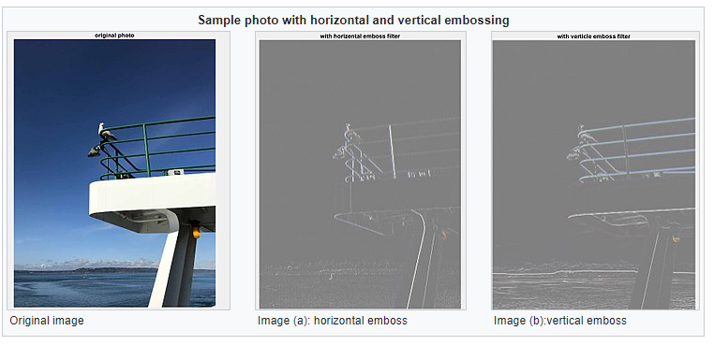
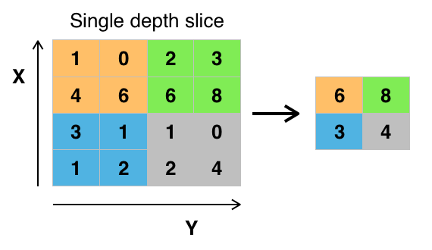
Convolutions
Transforms each pixel based on neighboring pixels
Filter values are updated and learned during training
Pooling
Reduces image size
Assigns a single value to a patch of pixels
https://en.wikipedia.org
https://en.wikipedia.org
Notes:
Quick discussion on convolutions and pooling – image processing techniques
Convolutions are image transformations with the use of filters
Emboss, blur, etc
Aid in feature extraction and discovery
Pooling downsamples patches of pixels
Many methods, max pooling is common

Slide 10
Filters & Feature Extraction
Input Image
Filters
Maxpool
Filters
Maxpool
Filters
Flatten
Neural Network
Notes:
Example CNN filter layer (medium model shown)
Network changes/updates filters, learns what is most useful
Transformed image is flattened to be received by NN

Slide 11
Classifier Network
Input
Hidden 1
Input layer
Flattened, processed image
Output layer
Softmax activation
How likely is cell Healthy or Infected?
Loss Type
Binary Cross-entropy
Hidden 2
…
…
…
Output
Healthy Imgs
Infected Imgs
64
[Varies]
[Varies]
Note: Biases not shown
Notes:
Representation of classification neural network
Input size and first hidden layer vary between models
For classification, softmax as activation, binary cross-entropy as loss
Model makes binary choice- is cell healthy or infected?

Slide 12
Regressor Network
Input
Hidden 1
Input layer
Flattened, processed image
Output layer
Sigmoid activation
Probability of being infected
Loss Type
MSE
Hidden 2
…
…
…
Output
σ
Infected? (0… 1)
64
[Varies]
[Varies]
Note: Biases not shown
Notes:
Representation of regression neural network
Mostly identical architectural choices
For regression, sigmoid as activation, MSE as loss
Model outputs the odds of image being infected

Slide 13
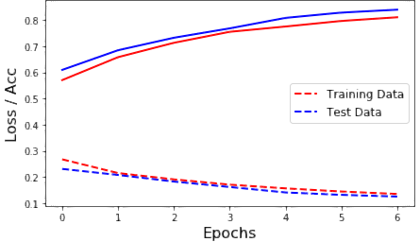
Learning Parameters
Several optimizers exist
Adam, Adagrad, Adadelta, Adamax, Nadam, SGD, RMSProp
Adagrad and RMSProp both worked well
Used Adagrad – adaptive learning helps prevent overfitting
Learning Rate is tunable parameter
Several activation functions exist
Sigmoid for Regression
Softmax for Classification
Number of epochs? Depends.
Notes:
What model learns and how quickly it does it is affected by
Optimization algorithms
Learning rate
Final activation and loss type
Development can be monitored to observe if model is being overfit
No. epochs also can be chosen to fine tune final result

Slide 14
Average Model Results
Classification
Precision: TP / (TP + FP)
Recall: TP / (TP + FN)
Regression
AUC
10 models evaluate same validation data (withheld from training)
Classifiers
Model Size | Accuracy | Precision | Recall | Loss
Small | 0.8481 ± 0.08 | 0.8152 ± 0.13 | 0.8584 ± 0.08 | 0.3485 ± 0.13
Medium | 0.9184 ± 0.04 | 0.8819 ± 0.03 | 0.9475 ± 0.04 | 0.2413 ± 0.09
Large | 0.9451 ± 0.01 | 0.9190 ± 0.01 | 0.9657 ± 0.01 | 0.1752 ± 0.02
Regressors
Model Size | Accuracy | AUC | Loss
Small | 0.8083 ± 0.09 | 0.8862 ± 0.08 | 0.1333 ± 0.05
Medium | 0.9314 ± 0.01 | 0.9623 ± 0.01 | 0.0587 ± 0.01
Large | 0.9519 ± 0.01 | 0.9826 ± 0.00 | 0.0406 ± 0.01
Notes:
Each model initialized with random weights and filters
To compare architectures, generate 10 models each, average results
Classification and regression models can be compared via accuracy

Slide 15
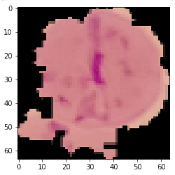
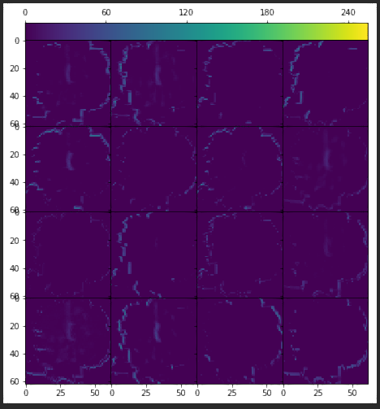
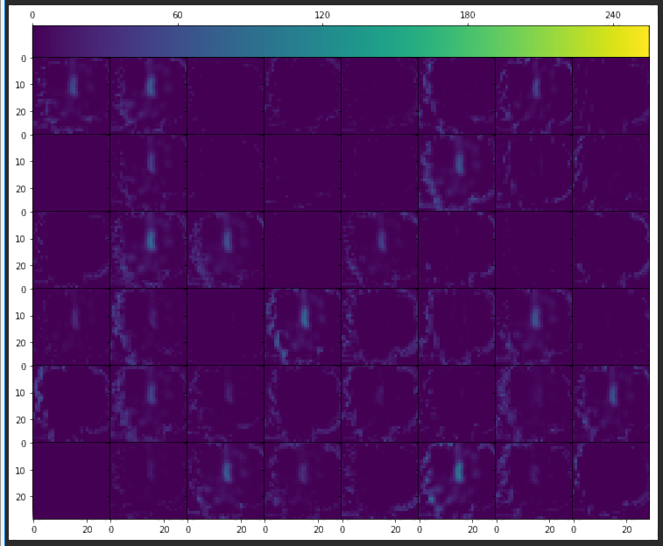
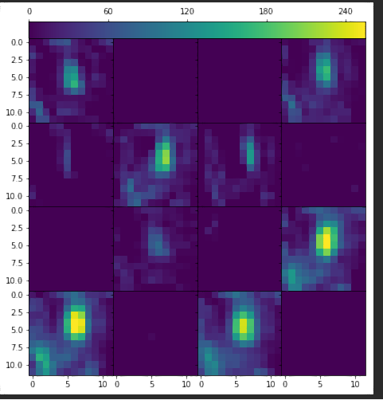
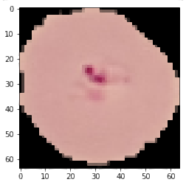
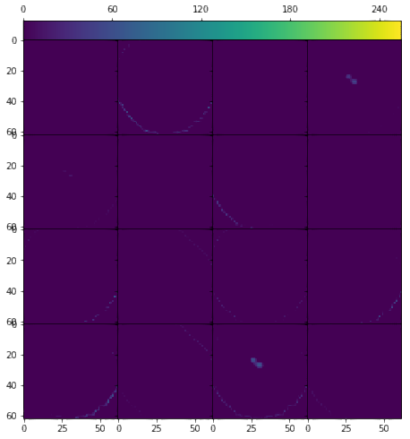
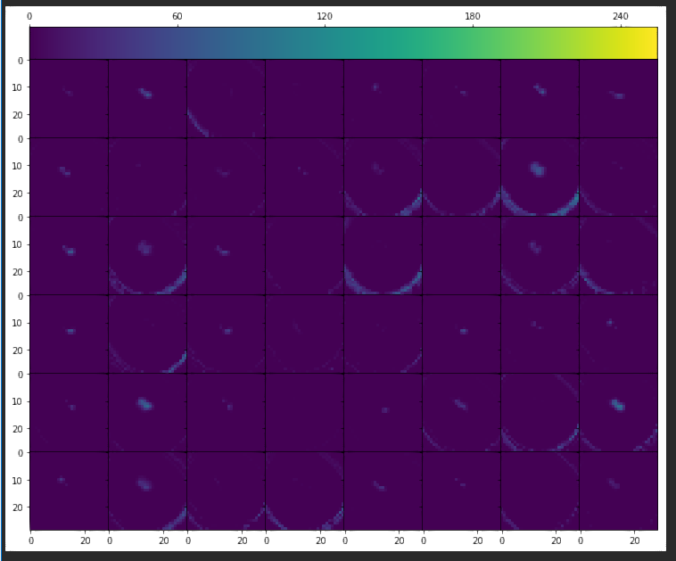
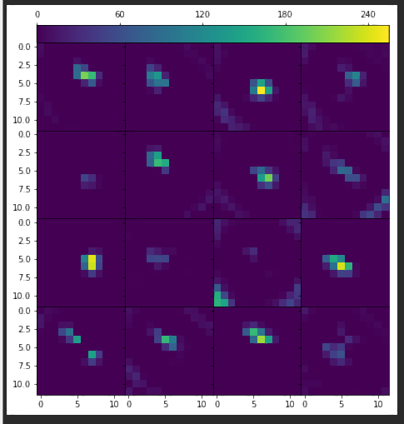
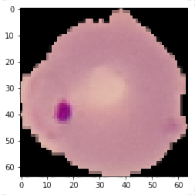
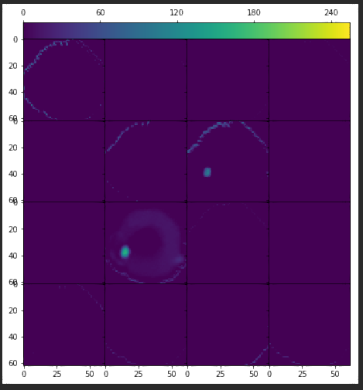
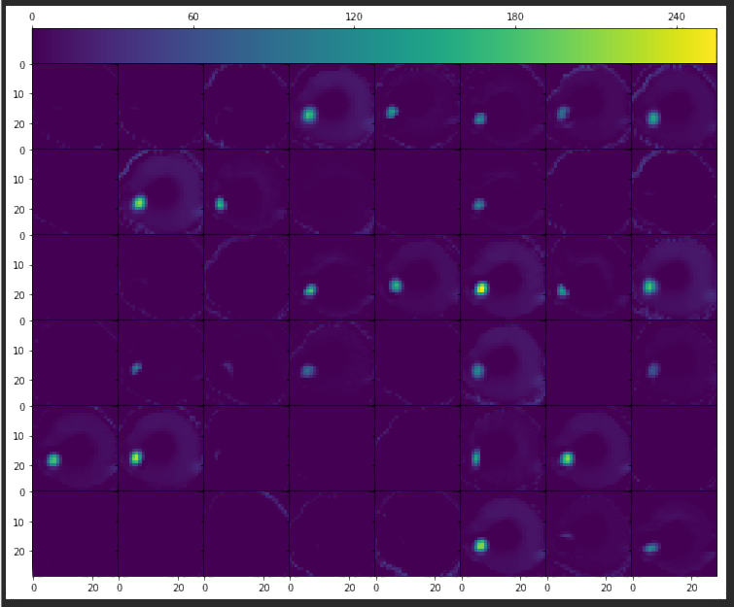
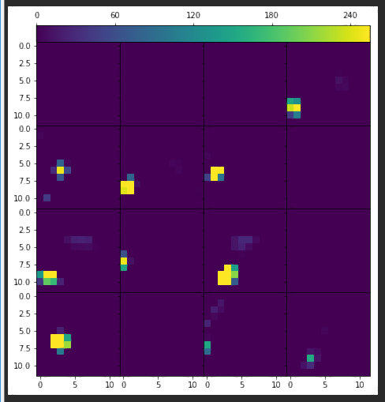
What it ‘sees’…
Conv Layer 1
Conv Layer 2
Conv Layer 3
Examples from Medium Classification CNN
First
Shape detection
Second
Feature/Texture detection
Finally
Feature enhancement
Notes:
In lieu of traditional feature selection, filters can be interpreted as having purpose
First layer enhances edges of cells
Second layer highlights features and textures
Third layer emphasizes features

Slide 16
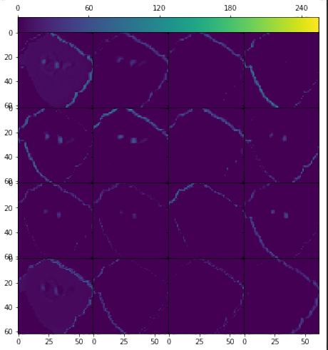
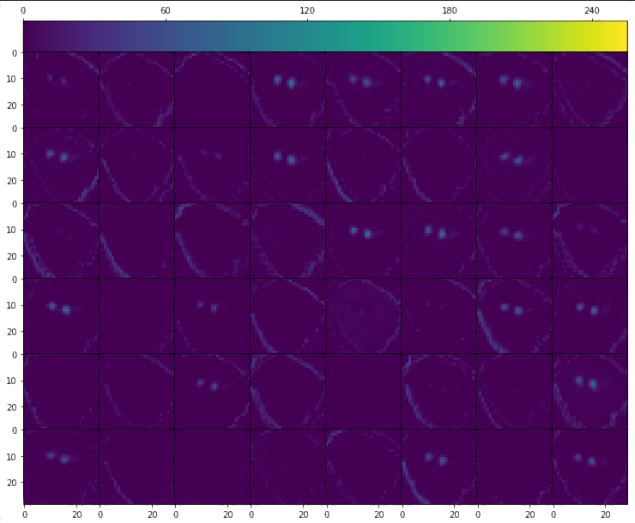
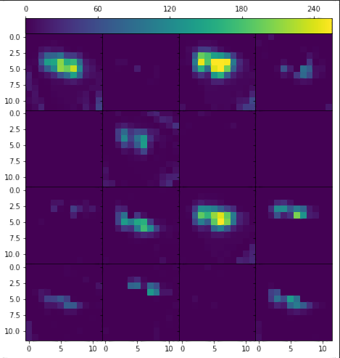
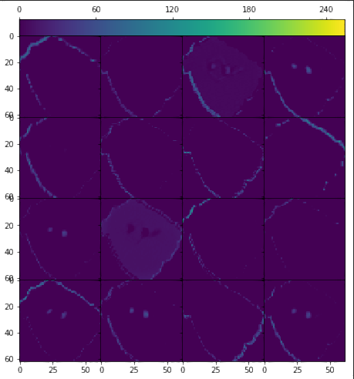
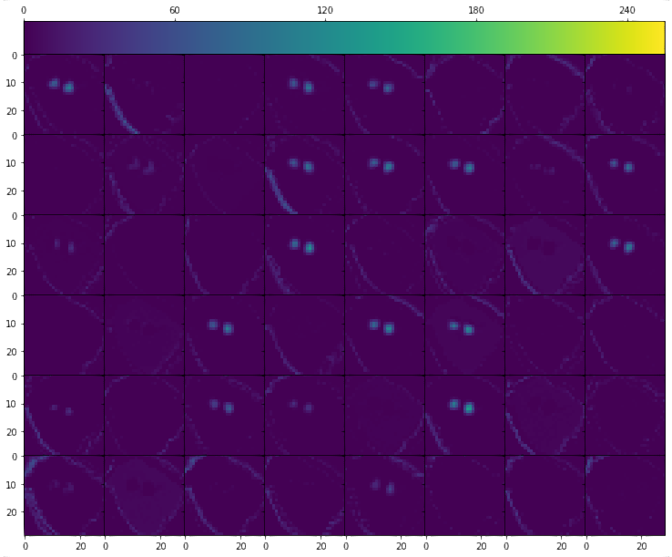
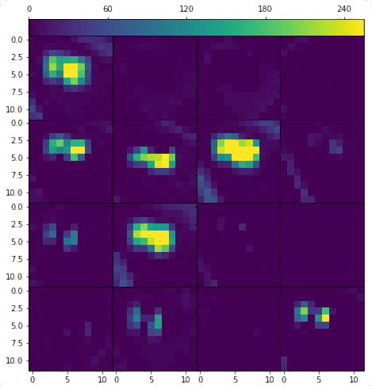
What it ‘sees’…
Edges
Features / Textures
Enhancement
Conv Layer 1
Conv Layer 2
Conv Layer 3
Same Learning Rates (0.0045)
Same Optimizers (Adagrad)
Different starting weights and filters
Different problem types
Different loss types
Medium Classifier
Medium Regressor
Notes:
Interestingly, models seem to mostly agree on filter process
Despite different starting weights and loss types
Illustrates unsupervised feature selection in CNNs

Slide 17
Drawbacks of CNNs…
Computationally expensive to develop and use
Best-suited for GPU processing
Large Input Data
Image dimensions and colors contain a lot of data
Model training is not trivial
Dozens of parameters to choose
Neural Network
Choosing an architecture
Interpreting results
Notes:
CNNs do have several drawbacks
Very expensive computationally
Large amount of training data
Model param selection not always trivial
Black box aspect of neural networks

Slide 18
Early Conclusions
Regression and classification have comparable accuracies
Larger models perform better on average
CNNs are huge black boxes
Hundreds of filters
Dozens of parameters
Require further analysis
Given right hardware, CNNs could be practical for automating malaria detection in cell stain images
Notes:
There is still a lot of work to do
Early results show that model performance seems to increase with model complexity
Hardware limitations can hinder exploration and development
Not readily interpretable
Still a promising solution for cell stain image classification

Slide 19
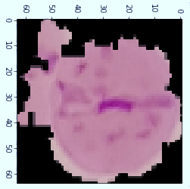
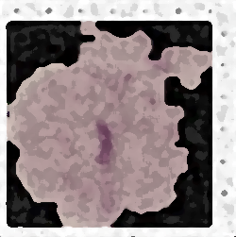
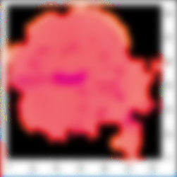
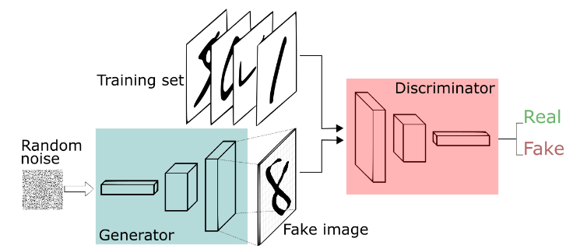
Future Work
Animate the Learning Process
Generate Synthetic Data
Investigate other Architectures
Identify Useful Filters and Combinations
https://skymind.ai/wiki/generative-adversarial-network-gan
Notes:
As stated, much work left to be done
Future work could include
Generating synthetic data
Implement other types of CNNs
Identify useful filters/combos
Animate learning process

Slide 20



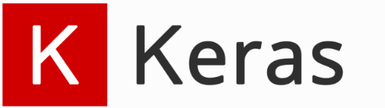

Development Tools
Notes:
Wanted to acknowledge tools used
Spyder – Python IDE (good for large scale dev)
Kaggle – Free online source of datasets
Keras – Python module for building CNNs
Tensorflow backend for using GPU

