Slide 1
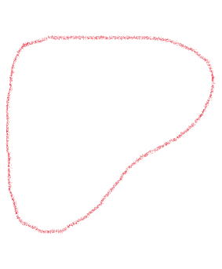
Approximation Solution
G
G’
Our approximation works by first finding the complement of the input graph first.
Then, we find the independent set of the complement.
This works for a lot of graphs.
A
B
A
B
C
D
C
D
Independent Set of size 3
Clique of size 3

Slide 2
Approximation Solution fault
7
0 1 2
1 0 2
2 0 1 3
3 2 4 5 6
4 3 6 5
5 6 4 3
6 3 4 5
Max clique size returned: 3
7
0 2 1 3
1 0 2 3
2 0 1 3
3 0 1 2 4
4 3 5 6
5 4 6
6 4 5
Max clique size returned: 4
It doesn’t work when there are 2 cliques within the solution and the smaller clique is obtained first.
This is the same graph, labeled differently

Slide 3
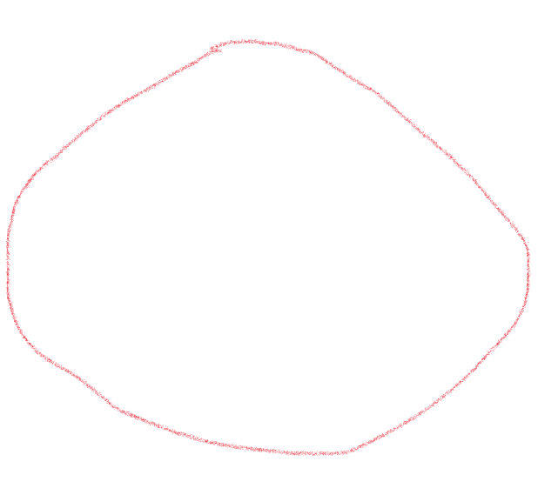
Approximation Solution fault (cont.)
0
2
4
1
3
6
5

Slide 4
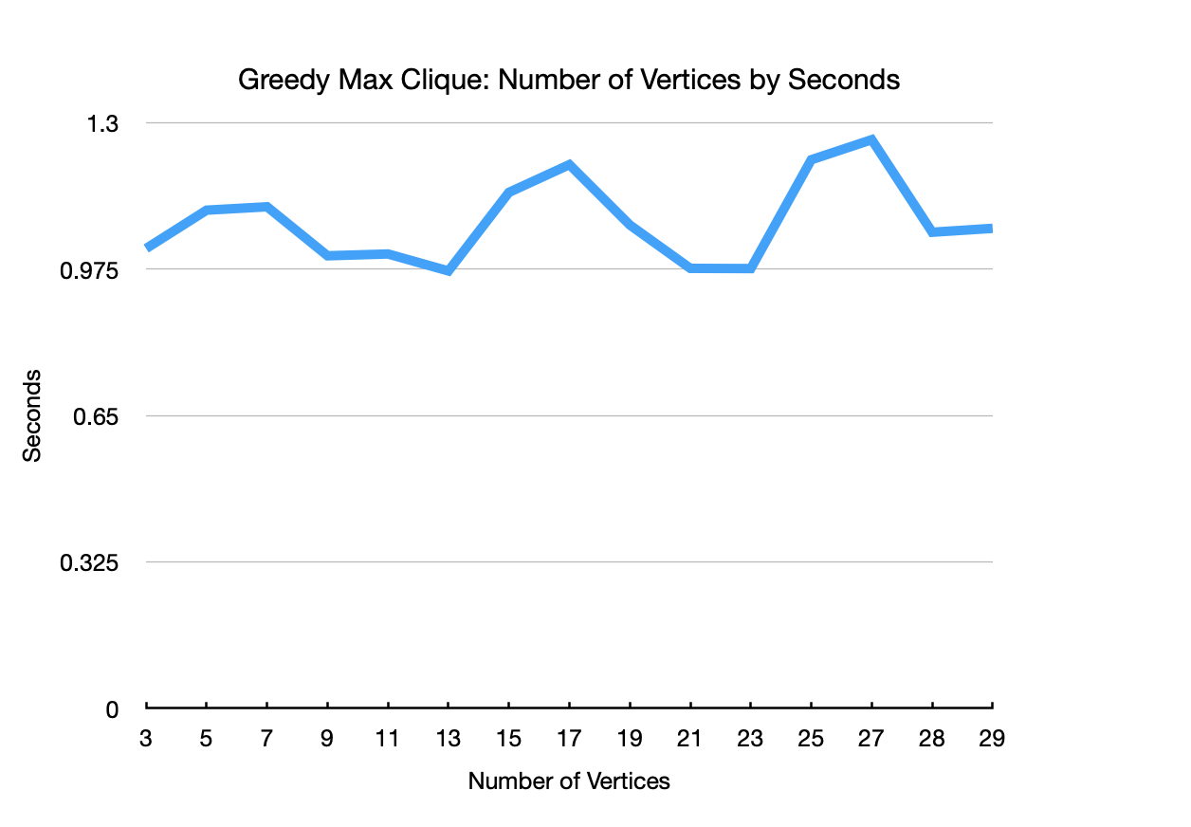

Slide 5
