Slide 1
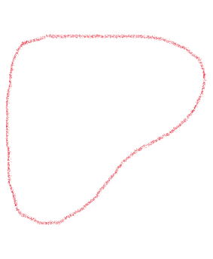
Approximation Solution
G
G’
There is no good approximation solution for this problem.
Our approximation works by first finding the complement of the input graph first.
Then, we find the independent set of the complement.
This works for a couple of graphs.
A
B
A
B
C
D
C
D
Independent Set of size 3
Clique of size 3

Slide 2
Approximation Solution
G
G’
There is no good approximation solution for this problem.
Our approximation works by first finding the complement of the input graph first.
Then, we find the independent set of the complement.
This works for a couple of graphs.
A
B
A
B
C
D
C
D
Independent Set of size 3
Clique of size 3

Slide 3
Approximation Solution fault
7
0 1 2
1 0 2
2 0 1 3
3 2 4 5 6
4 3 6 5
5 6 4 3
6 3 4 5
Max clique size returned: 3
7
0 2 1 3
1 0 2 3
2 0 1 3
3 0 1 2 4
4 3 5 6
5 4 6
6 4 5
Max clique size returned: 4
This solution falls apart quickly.
It doesn’t work when there are 2 or more independent sets within complement graph.
Most of the time, it doesn’t work.
This is the same graph, labeled differently

Slide 4
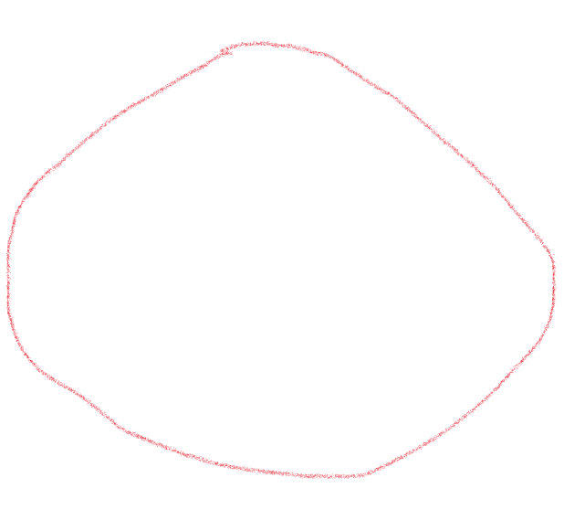
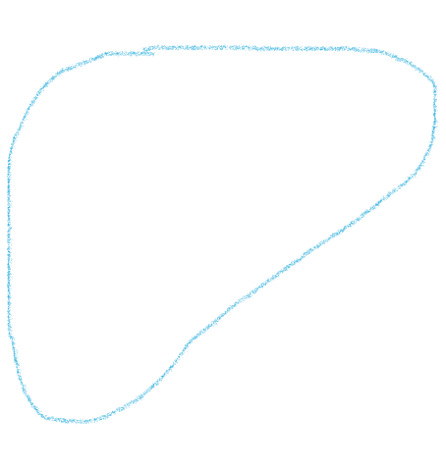
Approximation Solution fault (cont.)
Starting node
0
2
4
Actual max clique
1
3
6
Second graph starts here
Returned max clique
5

Slide 5
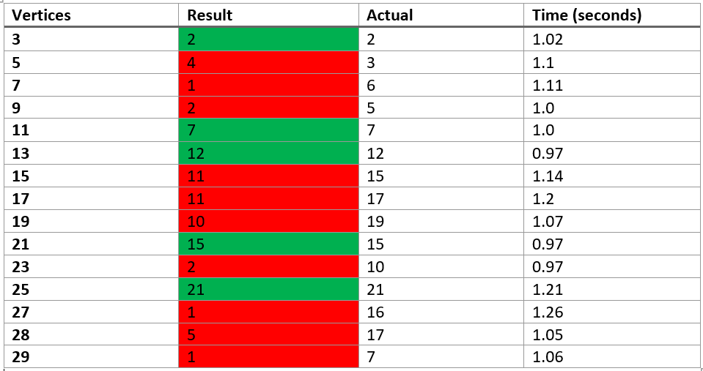
Analysis
As you can see, it’s only correct 1/3 of the time, hitting the mark on 5 out of 15 tests.
For larger and more complex graphs, the algorithm is more likely to fail.
However, it runs very quickly, consistently.

Slide 6
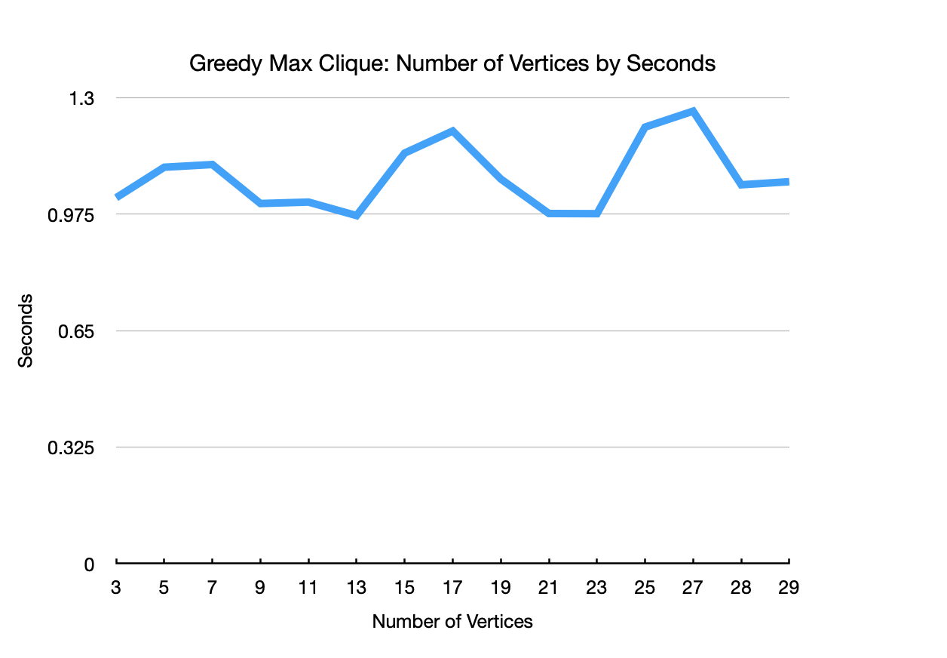
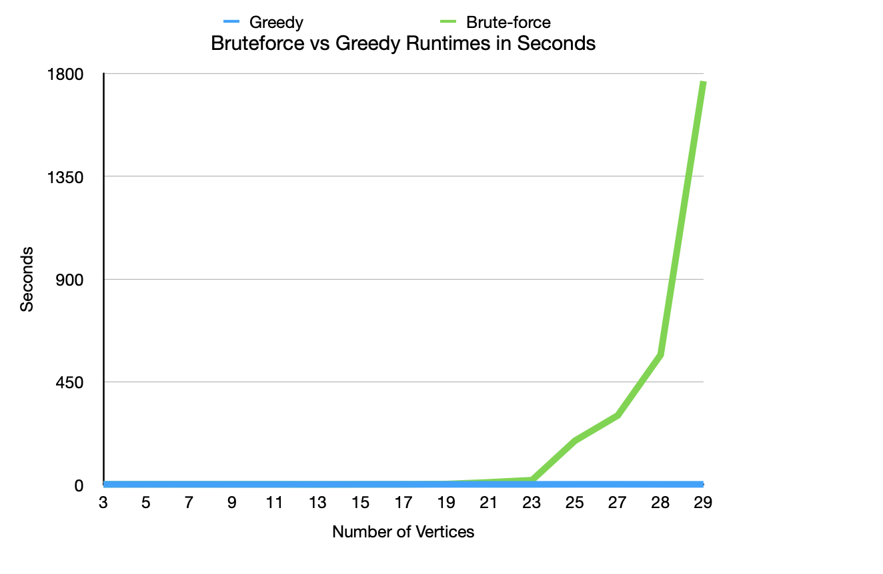
Analysis

Slide 7
Bounds
While the approximation is quicker, it’s not necessarily quick.
If n = number of nodes in the graph, and e(n) = number of edges at a node n, the bounds for our approximation are.
Upper Bound: O(n e(n))

