Slide 1
S3: Max Clique
Sam, Ben, Chris, Gavin

Slide 2
What is Max Clique?
Clique of size 3
A
The decision problem:
Given an undirected, unweighted graph G, and an integer k, is there a clique of size k within G?
The optimization problem:
What is the maximum clique within a given undirected and unweighted graph G?
B
C
E
D
Clique of size 2

Slide 3
Sample Input
10
0 3 4 6 7 8 1 6
1 5
2 3
3 0 4 6 7 8 8
4 0 3 6 7 8
5
6 0 3 4 7 8
7 0 3 4 6 8
8 0 3 4 6 7
9
The input is formatted in the same way as lab 9: acyclic detection:
The first line is an integer n representing the number of vertices in the graph.
The next n lines begin with an integer representing the source vertex, followed by up to n – 1 integers (which range from 0 to n) representing destination nodes for the graph’s edges.
Sample input containing a clique of size 6.

Slide 4
Reduction – Independent Set to Max Clique
To reduce Independent Set to the clique decision problem given a graph G = (V, E), the first step is to construct a complementary graph G’ such that:
V’ = V
E’ = all edges not present in G.
If there is a clique of size k within G, it means that all vertices in the clique are connected to each other. Since E’ contains all edges not in G, the vertices of the clique form an independent set in G’ of size k.
Since G’ can be constructed in polynomial time…
Independent Set ≤_{P} Max Clique

Slide 5
G
Reduction – Independent Set to Max Clique
G’
A
B
A
B
≤_{P}
C
D
C
D
Independent Set of size 3
Clique of size 3

Slide 6
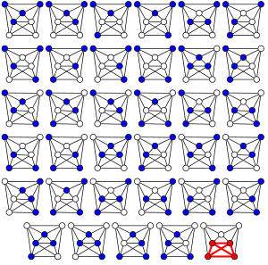
Exact Solution in Pseudocode
Given graph G and int n representing the number of vertices:
for i in range(2, n):
create combinations of v ⋲ V of sizes 2…i
for each generated combination:
if combination is a clique:
clique_size = len(clique)
max_clique = max(clique_size, max_clique)
return max_clique
All possible combinations of four vertices in a given graph.

Slide 7
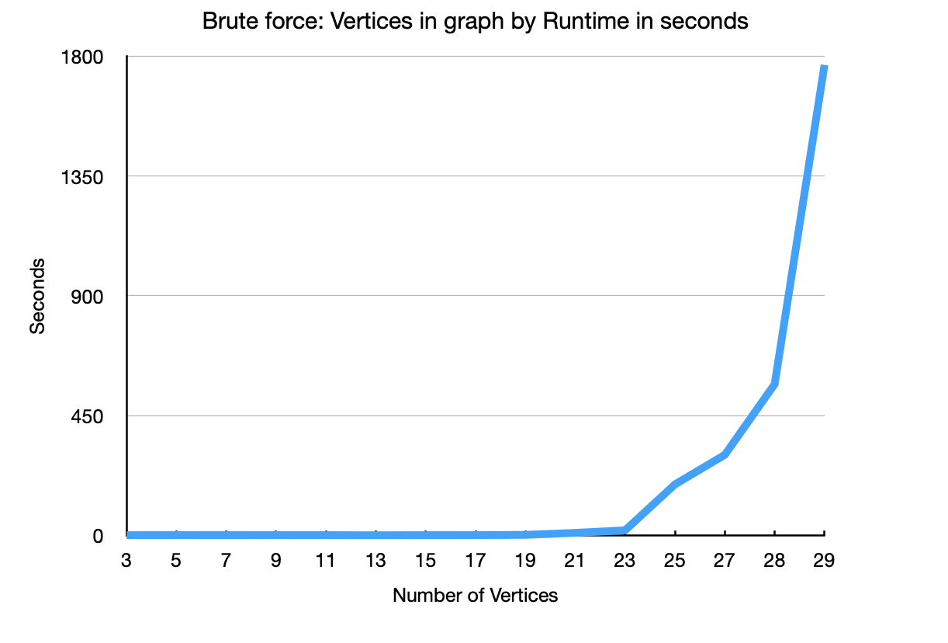
There is No Worst-Case.
The exact solution must check every possible combination of vertices giving it a runtime of Θ(n!).

Slide 8
Test Case Generation
Test cases were generated by a python script that takes in:
int n representing number of vertices.
int c representing the size of the clique.
The clique is generated first, then random edges are added to the graph such that the degree of any added edge is less than the size of the max clique.
The output is formatted as an adjacency list and is paired with an expected max clique size.
9
0 2 8 1
1 6 1 2
2 1 2
3
4 5 6 7 8
5 4 6 7 8
6 4 5 7 8
7 4 5 6 8
8 4 5 6 7
Max clique size: 5
Example test case.

Slide 9
Approximation slide…

