Slide 1
TEMPLE DARSHAN, SIMPLIFIED
DarshanEase
A MERN-Stack Temple Darshan Ticket Booking System
MongoDB · Express.js · React.js · Node.js
TEAM MEMBERS
Satya sri - 23MH1A05O2
Manasa - 23MH1A05N9
Hemasri - 23MH1A05P5
Chaitanya - 23MH1A05Q7
CSE Department
Aditya College of Engineering and Technology

Slide 2
ABOUT THE PROJECT
Introduction
1
Project
MongoDB
M
DarshanEase is a full-stack MERN web application that lets devotees browse temples, view darshan slots, and book tickets online — replacing offline queues with a secure digital platform.
Express.js
E
2
Domain
Full-Stack Web Development, built on the MERN stack (MongoDB, Express.js, React.js, Node.js) with RESTful APIs.
React.js
R
3
Architecture
Modular design with secure JWT authentication, bcrypt password encryption, and role-based access for Users, Organizers, and Admins.
Node.js
N
DarshanEase | MERN Stack Temple Darshan Booking System
02

Slide 3
MOTIVATION
Why This Project
!
✓
★
Real Problem
Clear Objective
Skill Building
Devotees routinely face long offline queues and scattered, unreliable information when planning temple visits.
Build a secure, user-friendly platform that lets devotees plan visits in advance and book darshan slots online.
Gain hands-on, end-to-end experience with the MERN stack — REST APIs, JWT auth, and role-based systems.
DarshanEase | MERN Stack Temple Darshan Booking System
03

Slide 4
PROBLEM STATEMENT
Offline booking doesn't scale
No centralized source of truth for darshan slots and timings
×
Devotees stand in long physical queues to book tickets
×
Manual, paper-based booking is slow and error-prone
×
Temple organizers have no digital way to manage bookings
×
DarshanEase | MERN Stack Temple Darshan Booking System
04

Slide 5
OUR APPROACH
The Solution — DarshanEase
✓
Slot Booking
⌗
QR Entry Pass
Reserve Seeghra, Sarva, or Divya darshan slots in advance across every listed temple.
Every booking instantly generates a scan-and-enter QR pass — no printed ticket required.
≡
Organizer Console
⛨
Role-Based Access
Temple organizers manage listings, darshan types, and incoming bookings from one dashboard.
Separate, secure experiences for Devotees, Organizers, and Admins via JWT authentication.
DarshanEase | MERN Stack Temple Darshan Booking System
05

Slide 6
HOW IT'S BUILT
Methodology & Tech Stack
Frontend
Backend
Database & Auth
• React.js
• Node.js
• MongoDB
• JavaScript / HTML5 / CSS3
• Express.js
• JWT Authentication
• Bootstrap / Material UI
• REST API architecture
• bcrypt.js password hashing
Version Control: Git & GitHub | API Testing: Postman | Dev Environment: Visual Studio Code
DarshanEase | MERN Stack Temple Darshan Booking System
06

Slide 7
PROJECT IMPLEMENTATION
Key Modules
User Authentication
Temple Management
1
2
Darshan Slot Management
Ticket Booking System
3
4
Booking Management
Donation Module
5
6
Admin Dashboard
Organizer Dashboard
7
8
DarshanEase | MERN Stack Temple Darshan Booking System
07

Slide 8
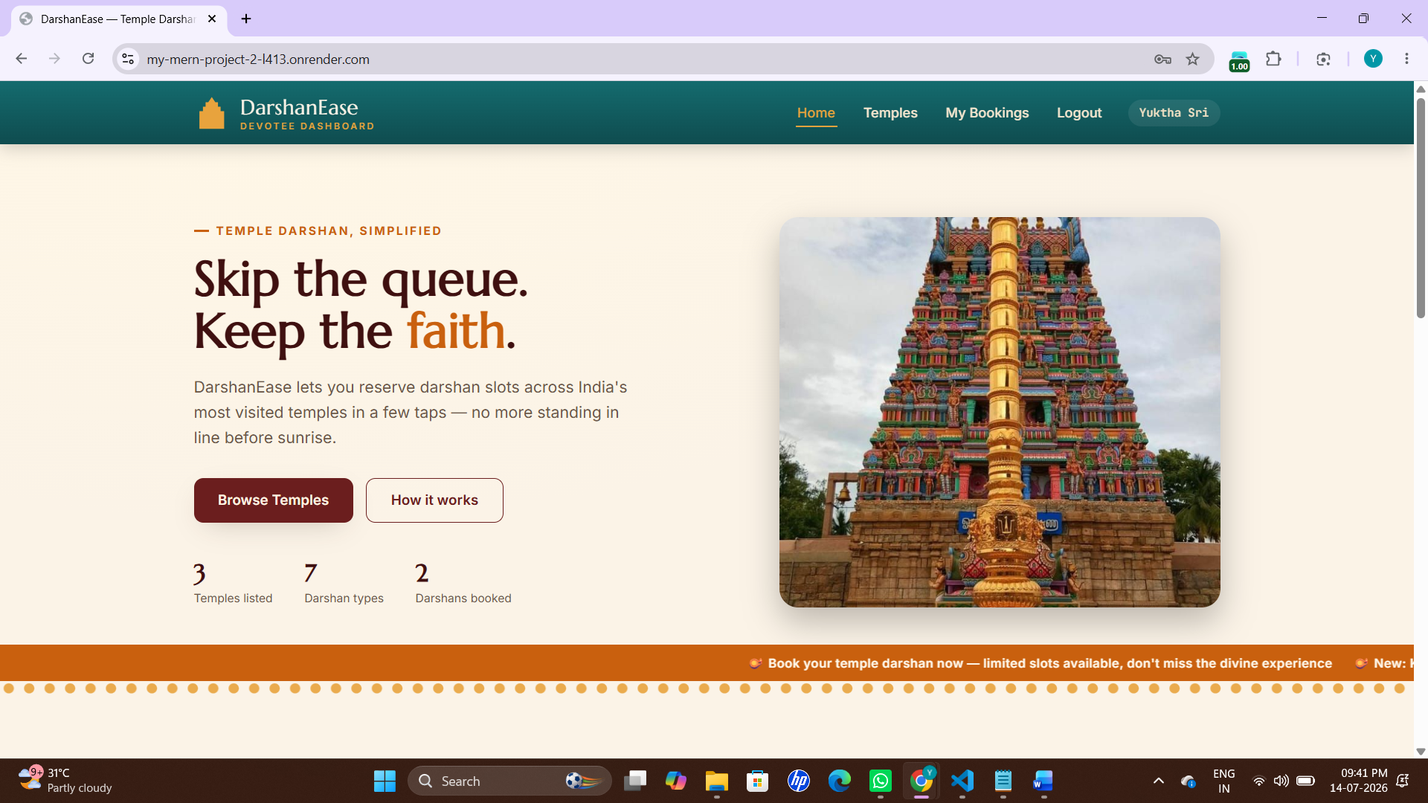
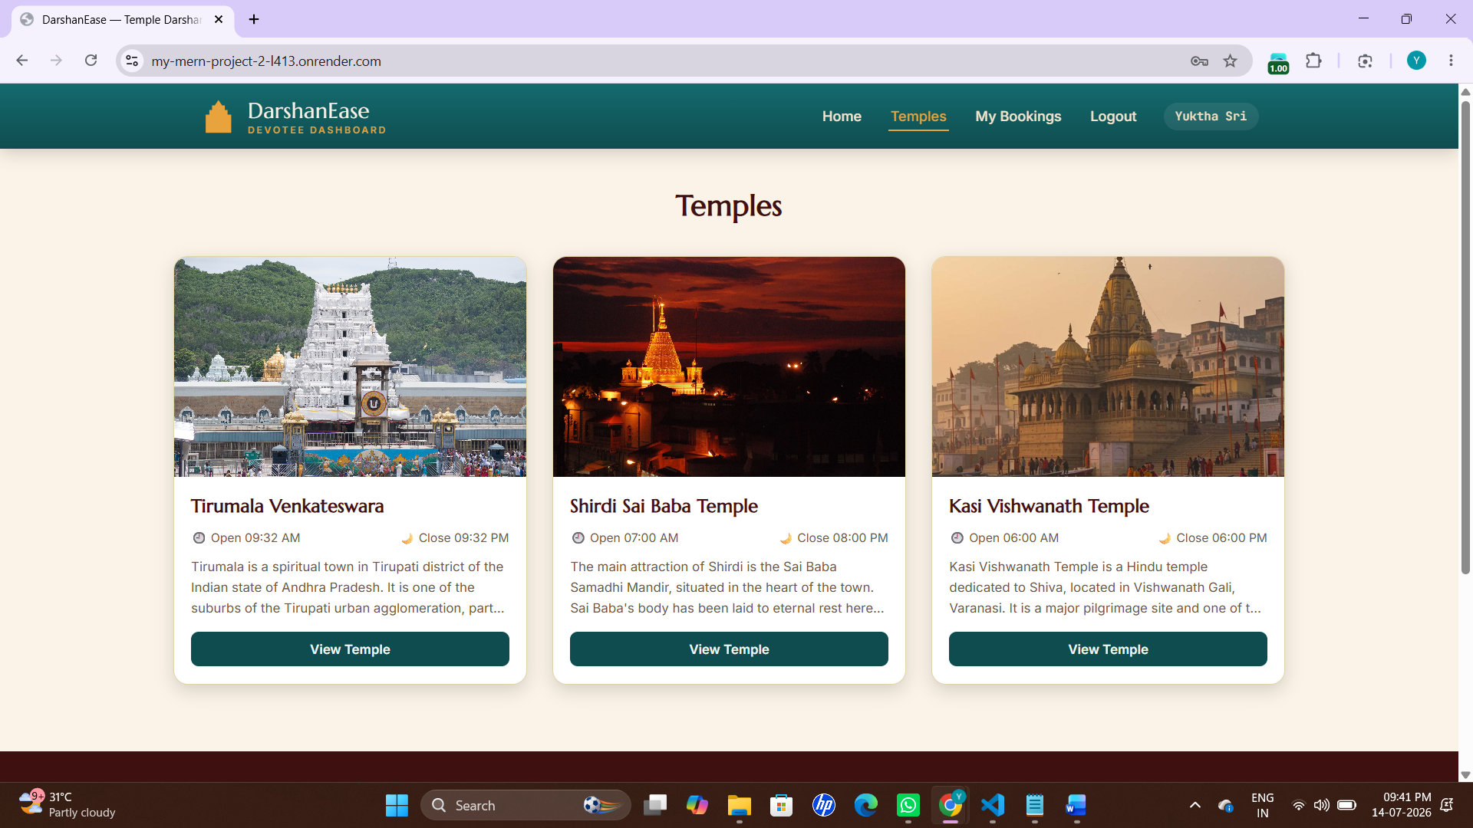
APP WALKTHROUGH
Home & Temple Directory
Devotee Home
Temple Directory
A welcoming landing page with quick stats and a call-to-action to browse temples.
Browse all listed temples with timings and a short description before booking.
DarshanEase | MERN Stack Temple Darshan Booking System
08

Slide 9
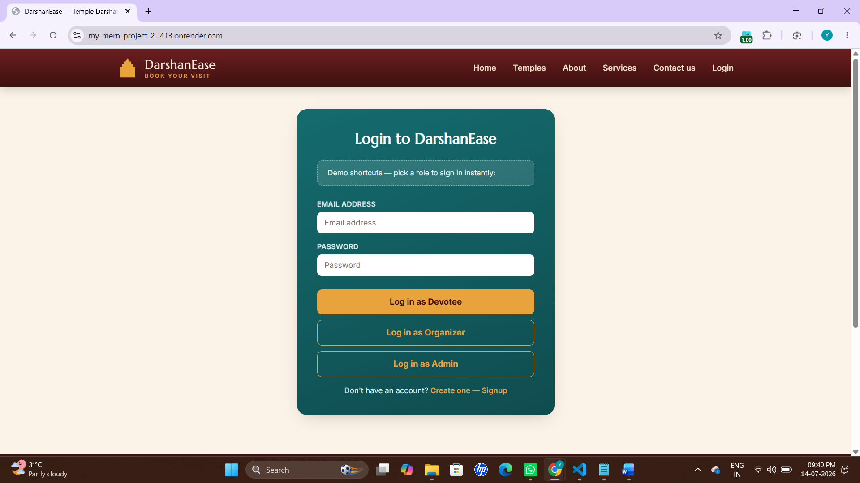
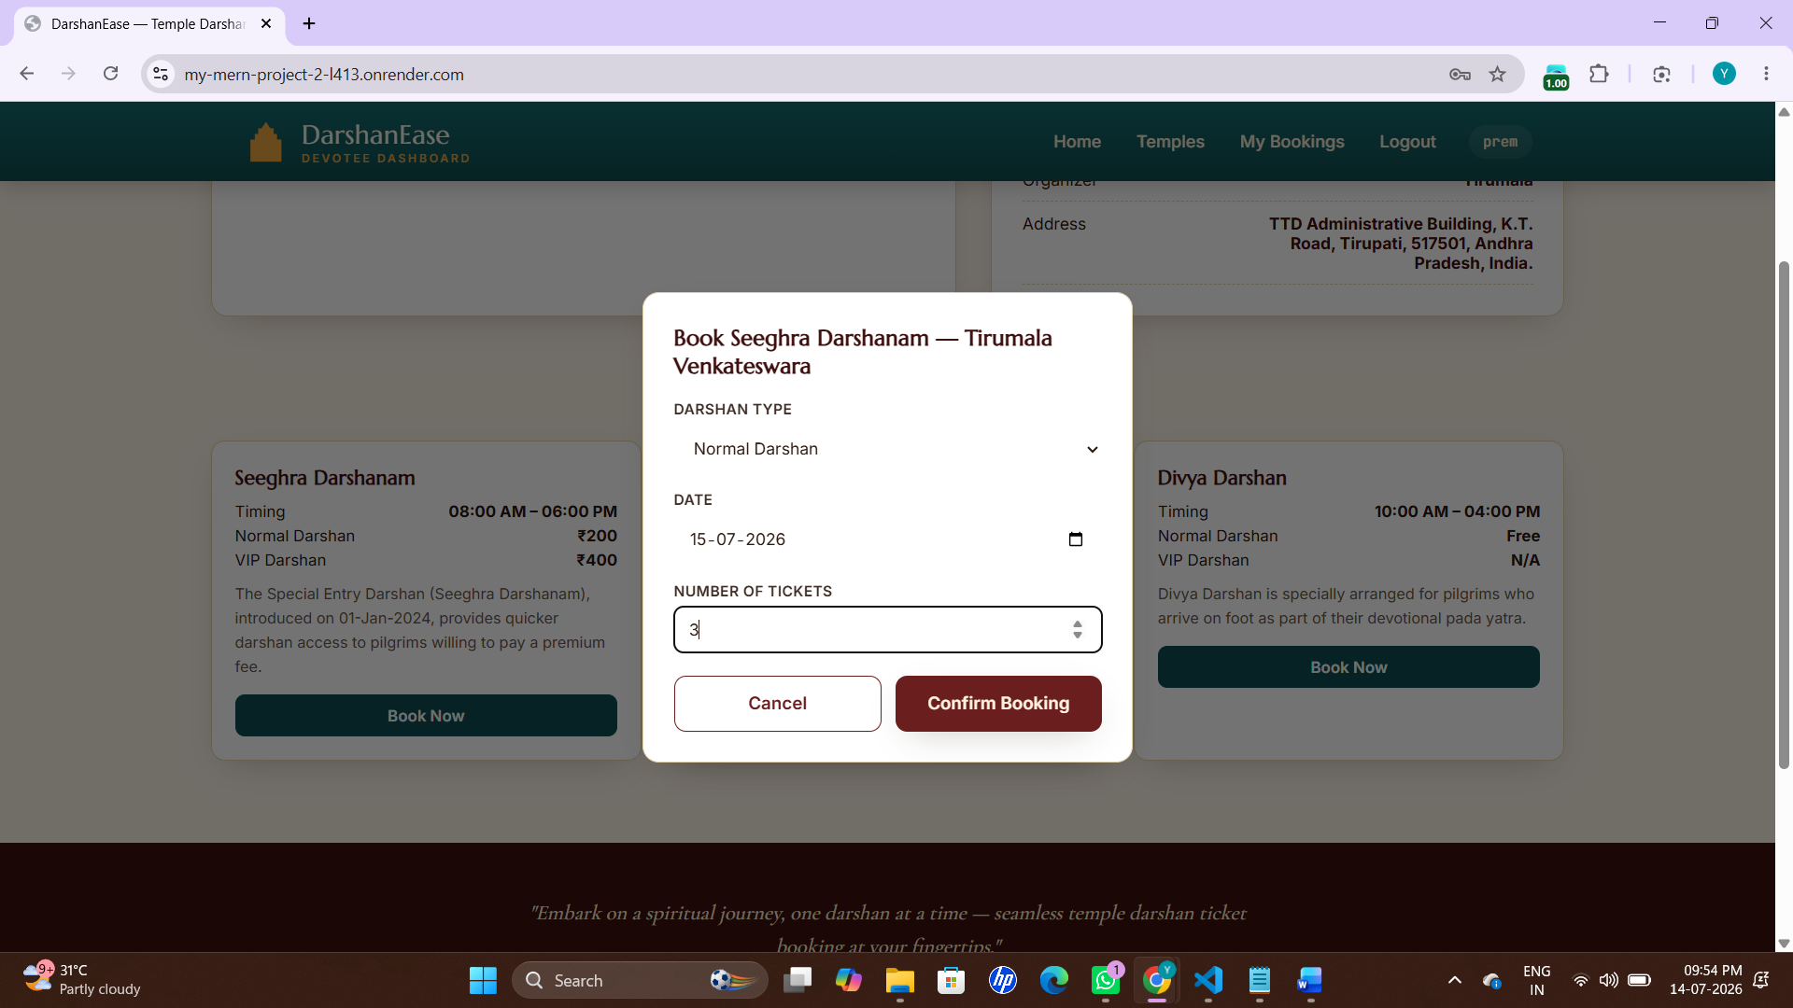
APP WALKTHROUGH
Login & Slot Booking
Role-Based Login
Book a Darshan Slot
One login screen, three roles — Devotee, Organizer, and Admin — each routed to its own dashboard.
Pick a darshan type, date, and ticket count, then confirm the booking in a few taps.
DarshanEase | MERN Stack Temple Darshan Booking System
09

Slide 10
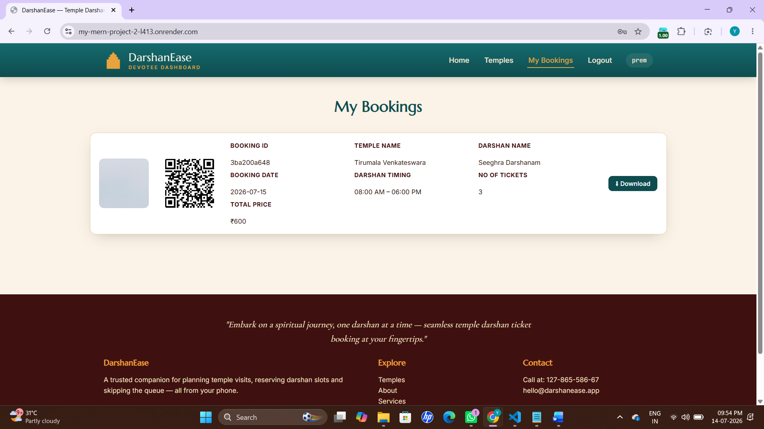
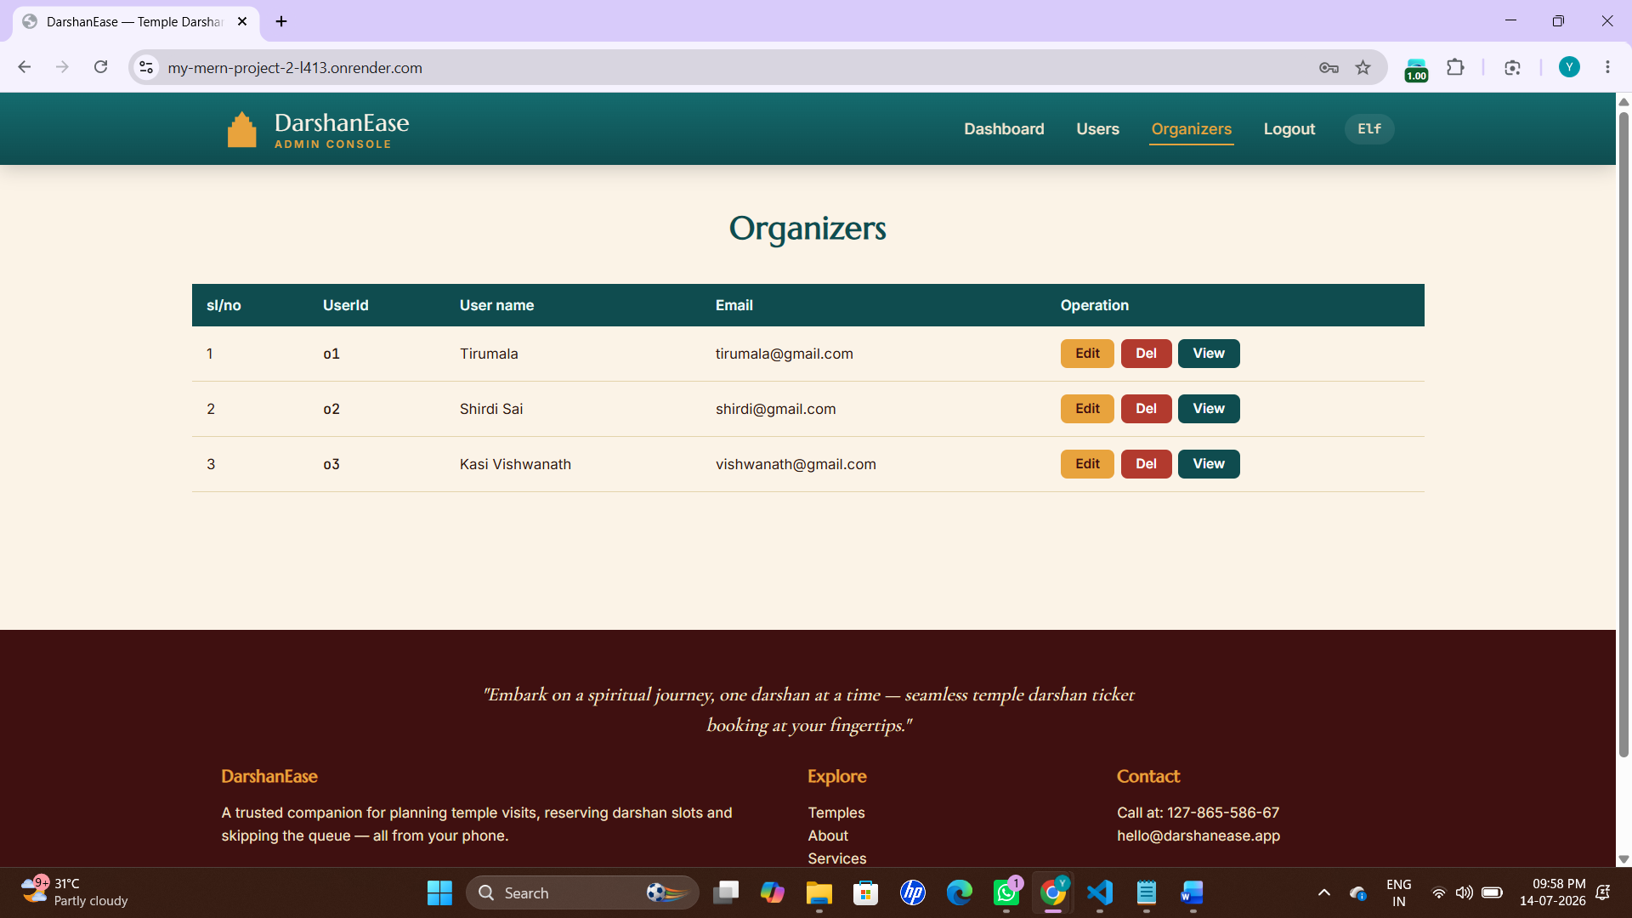
APP WALKTHROUGH
My Bookings & Admin Console
My Bookings
Admin Console
Every booking generates a scan-and-enter QR pass with temple, timing, and price details.
Admins manage organizer accounts across every temple from a single table view.
DarshanEase | MERN Stack Temple Darshan Booking System
10

Slide 11
OUTCOME
Results & Analysis
Output Obtained
A fully developed MERN-stack web application — DarshanEase — with working authentication, booking, and admin modules.
✓
Serves as a prototype for a real temple communication and booking platform, improving accessibility for devotees.
✓
Digital slot booking reduces physical queues and helps temple staff plan crowd flow in advance.
✓
The Organizer Console cuts manual coordination between temple staff and administrators.
✓
Role-based architecture (User / Organizer / Admin) demonstrates a production-style access model.
DarshanEase | MERN Stack Temple Darshan Booking System
11

Slide 12
SUMMARY
Conclusion
1
Successfully designed and developed DarshanEase, a practical full-stack solution for temple darshan booking.
Not just a class
project —
2
Implemented secure JWT authentication, bcrypt password encryption, and role-based authorization.
a solid foundation ready to expand with real payments, notifications, and more temples.
3
Built a complete REST API with Express.js and Node.js backed by a MongoDB database.
4
The project showcases proficiency in the MERN stack — a modern, in-demand full-stack framework.
DarshanEase | MERN Stack Temple Darshan Booking System
12

Slide 13
Thank You
Any Questions?
Satya sri, Manasa, Hemasri, Chaitanya | CSE, Aditya College of Engineering and Technology

