Slide 1
Credit Card Fraud Detection

Slide 2
Introduction
The dataset has been collected and analysed during a research collaboration of Worldline and the Machine Learning Group (http://mlg.ulb.ac.be) of ULB (Université Libre de Bruxelles) on big data mining and fraud detection.
The datasets contains transactions made by credit cards in September 2013 by european cardholders.
This dataset presents transactions that occurred in two days, where we have 492 frauds out of 284,807 transactions.
The dataset is highly imbalanced, the positive class (frauds) account for 0.172% of all transactions.
It contains only numerical input variables which are the result of a PCA transformation.
Features V1, V2, ... V28 are the principal components obtained with PCA .
'Time' and ‘Amount' are the only features that were not transformed.

Slide 3
Standardization
Feature standardization makes the values of each feature in the data have zero-mean (when subtracting the mean in the numerator) and unit-variance.
Since the features V1-V28 are standardized, I applied StandardScaler normalization on my amount feature.
Converted the time into 24 hour format as the time was in seconds in the actual data set.

Slide 4
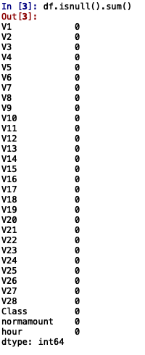
Missing Data

Slide 5
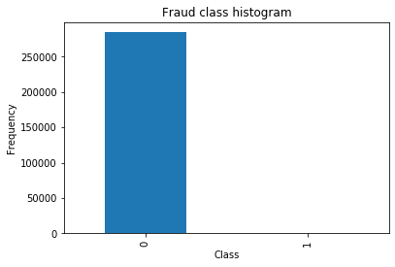
Class Distribution
Fraud : 492 (0.17%)
Non-fraud : 284315 (99.83 %)

Slide 6
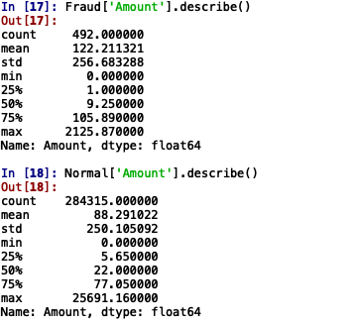
Amount distribution by Class
Max Amount in Fraud class was $2125 and the mean was $122
Max Amount in Non Fraud class was $25691 and the mean was $88

Slide 7
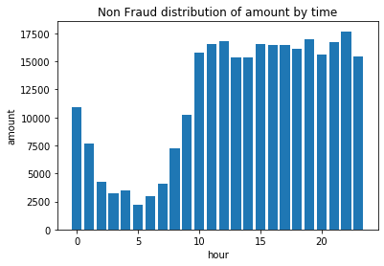
Distribution of Amount by time for the Non Fraud class
Non fraud transactions mostly happened from 10AM to 11PM

Slide 8
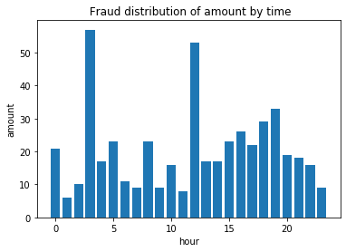
Distribution of Amount by time for the Fraud class
Fraudulent transactions mostly happened around 12PM and 3PM.

Slide 9
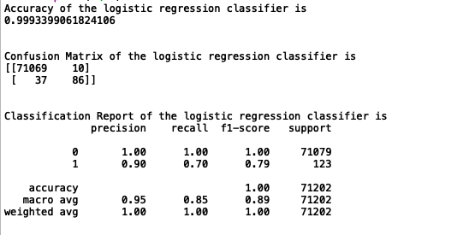
Logistic Regression on the data set using train_test_split

Slide 10
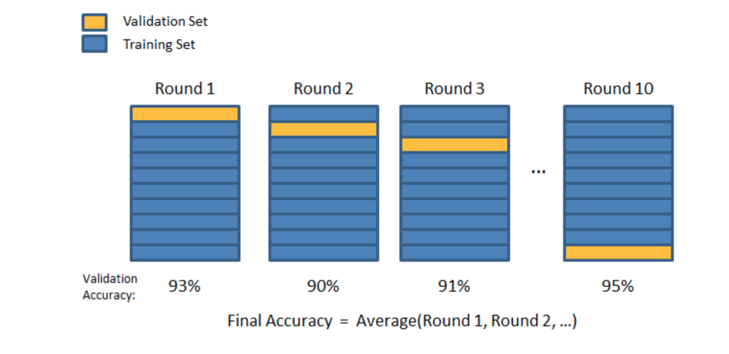
Cross Validation
Initially I trained Logistic Regression classifier using train_test_split, but after knowing that there is a possibility of overfitting. I want to make use of cross_validation.

Slide 11
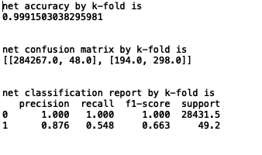
LR with K-Fold

Slide 12
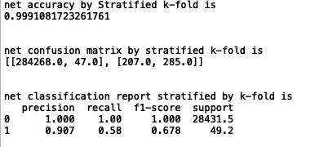
LR with Stratified K-fold

Slide 13
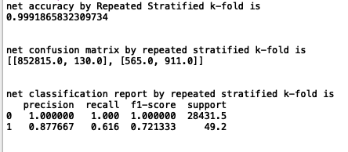
LR with Repeated Stratified K-fold

Slide 14
Sampling
A widely adopted technique for dealing with highly unbalanced datasets
It consists of removing samples from the majority class (under-sampling) and / or adding more examples from the minority class (over-sampling).
Sampling Variants:
1.Oversampling
2.Undersampling
3.Combination of Oversampling and under sampling

Slide 15
Oversampling
RandomOverSampling:- Oversampling by duplicating some of the original samples of the minority class,
SMOTE :-
Generate new samples in by interpolation.
ADASYN:-
Generate new samples in by interpolation.
The basic implementation of SMOTE will not make any distinction between easy and hard samples to be classified using the nearest neighbors rule. Therefore, the decision function found during training will be different among the algorithms.

Slide 16
UnderSampling
Cluster Centroids:-
Method that under samples the majority class by replacing a cluster of majority samples by the cluster centroid of a KMeans algorithm.
Random Under sampling:- RandomUnderSampler is a fast and easy way to balance the data by randomly selecting a subset of data for the targeted classes .
Near Miss:- NearMiss adds some heuristic rules to select samples.

Slide 17
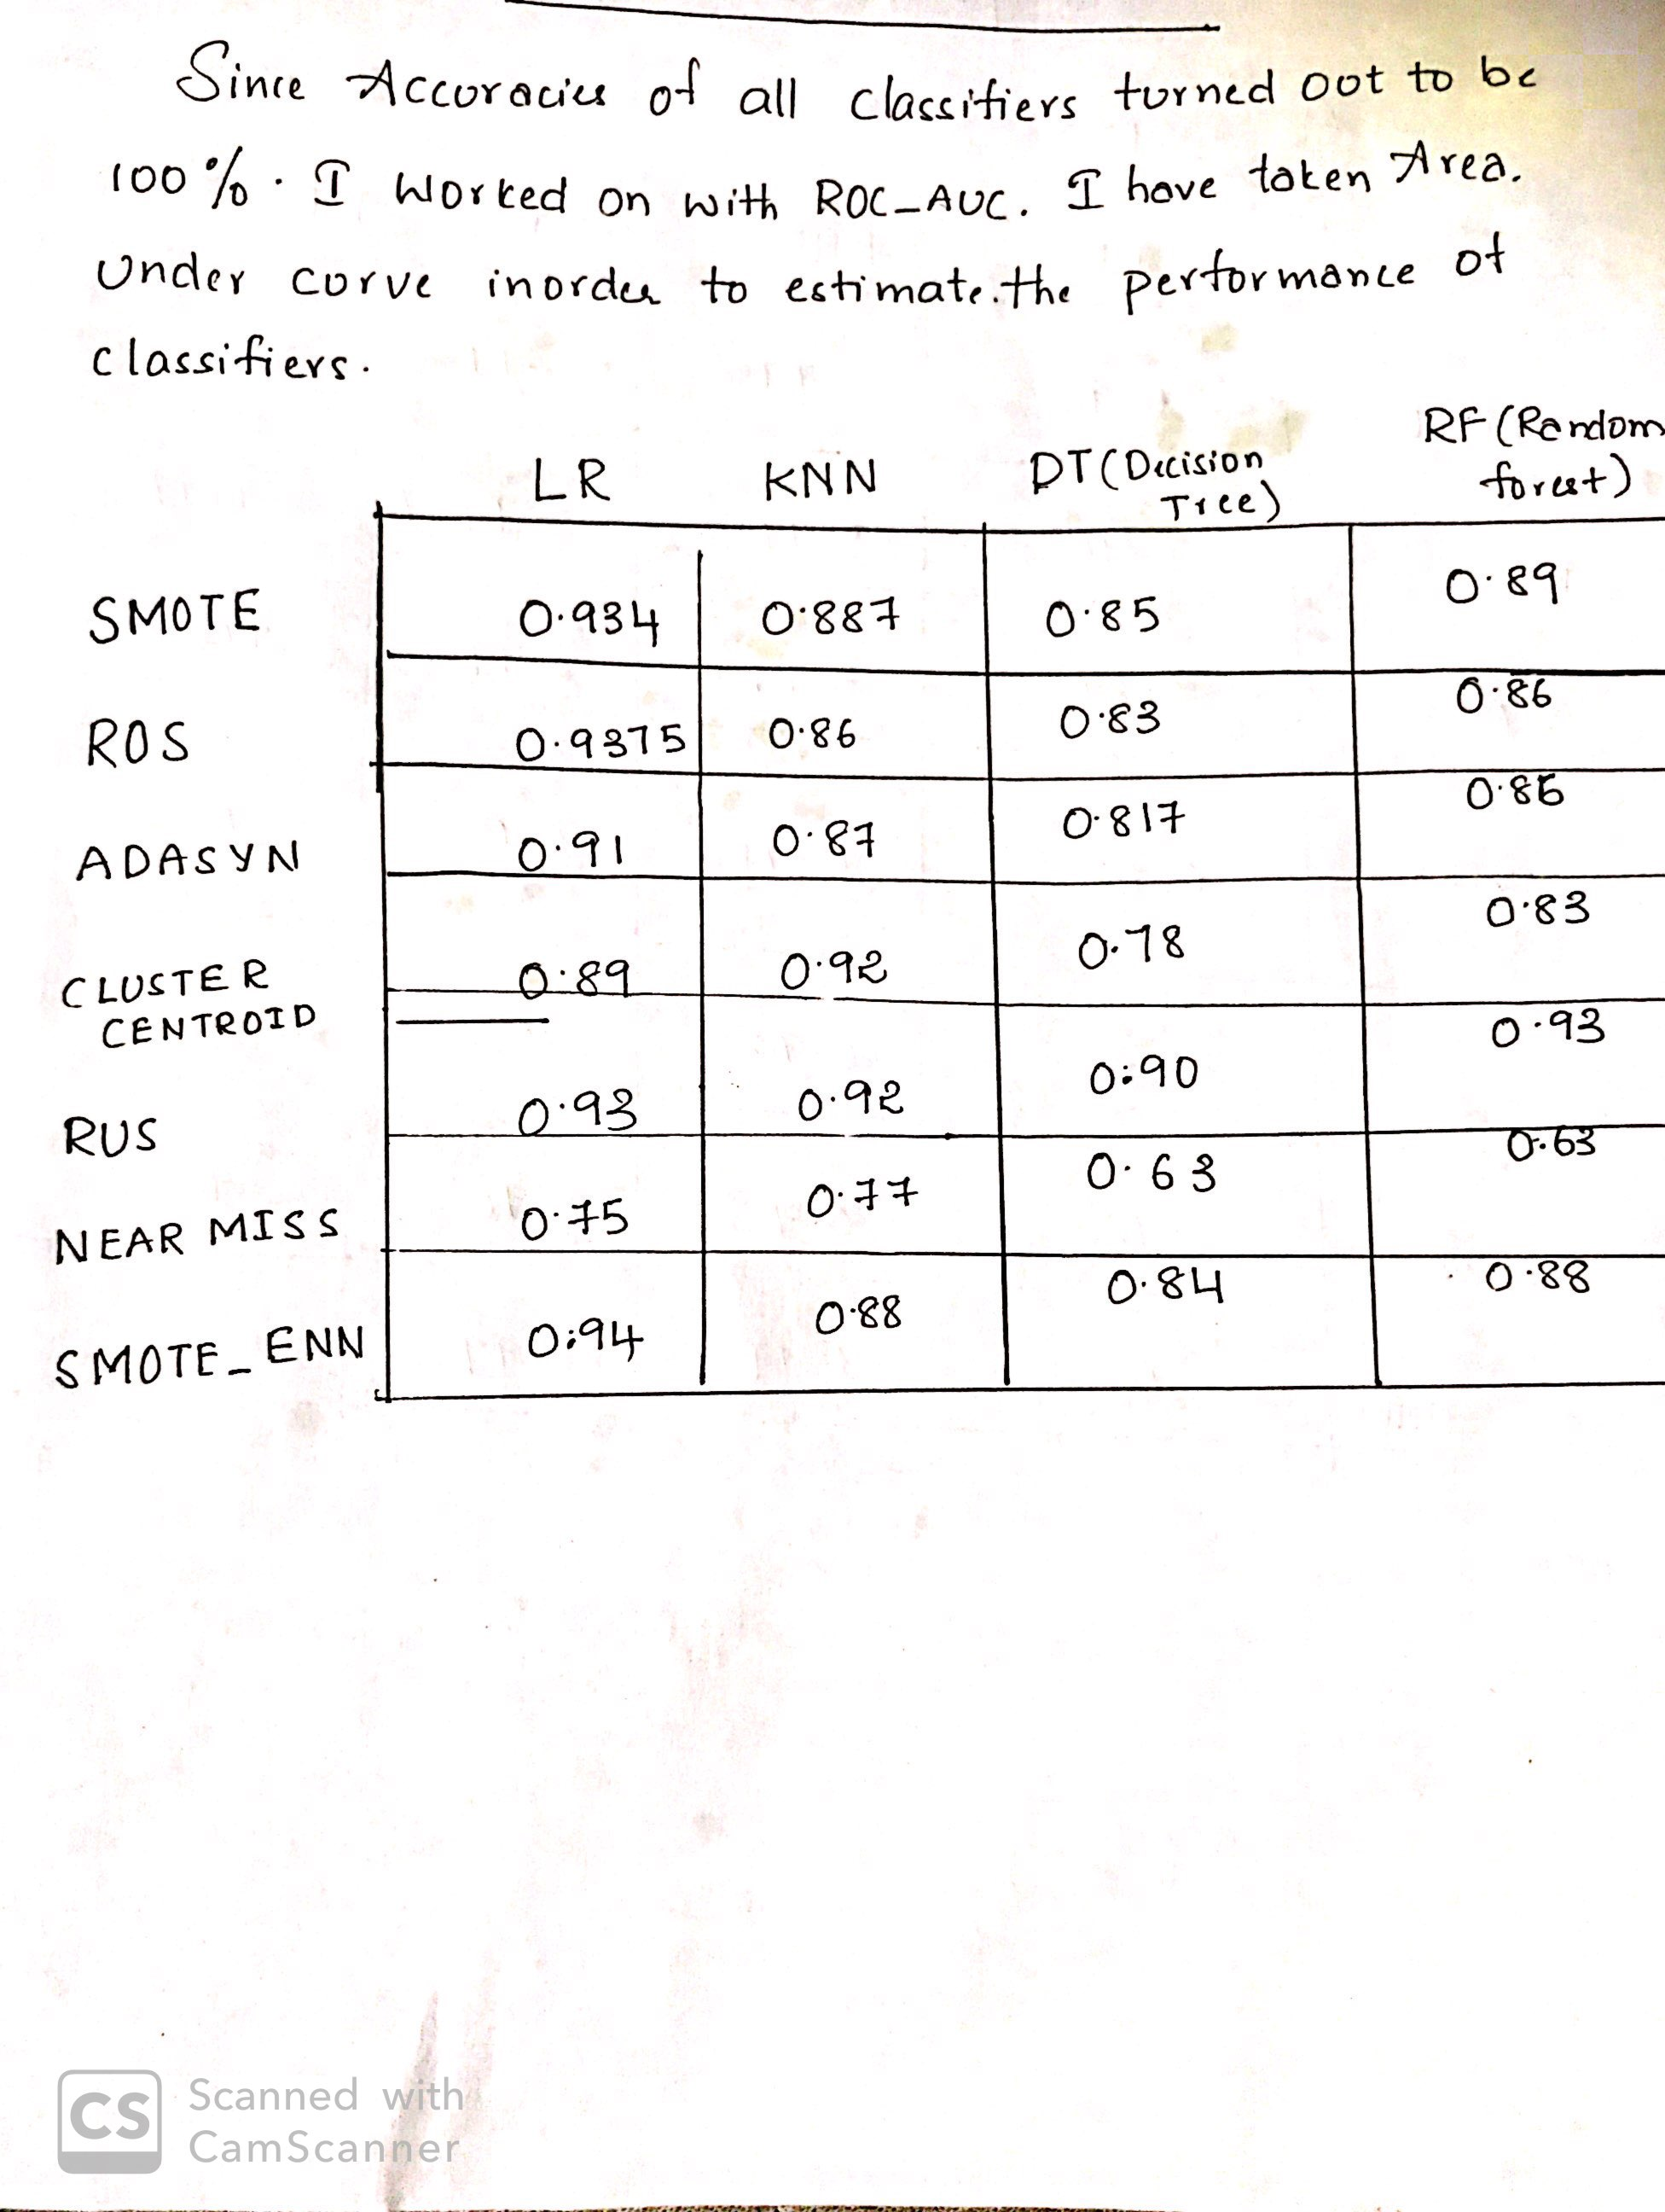
Sampling after splitting

Slide 18
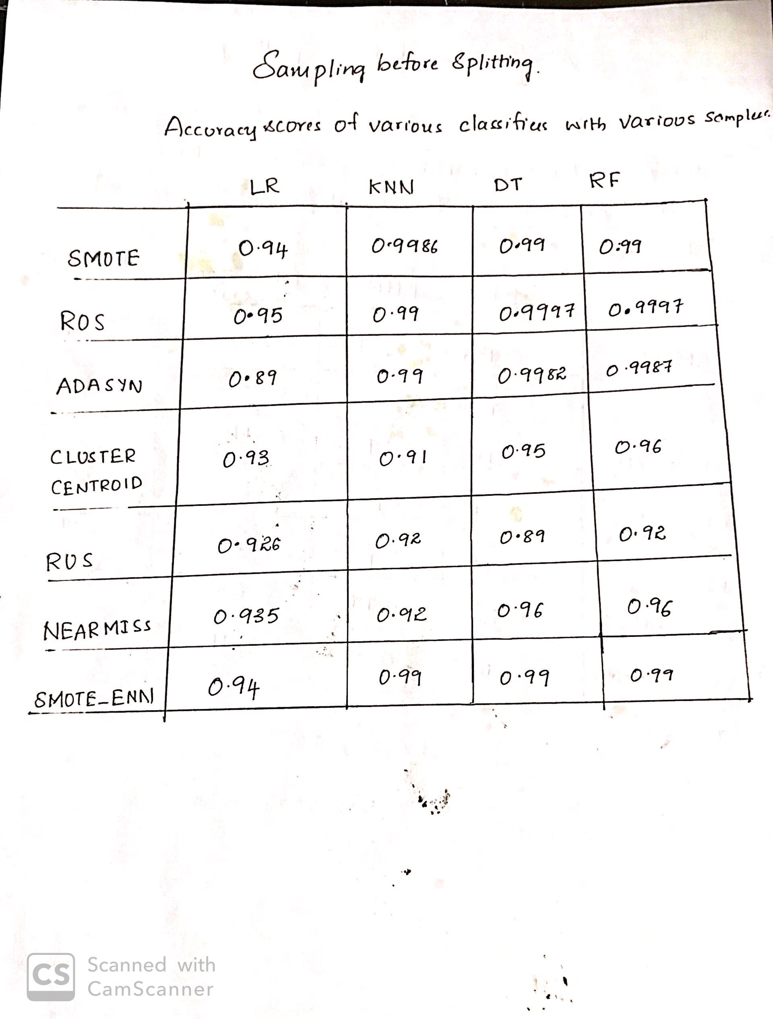
Sampling before splitting

Slide 19
Conclusion for Sampling
Random forest performed good with all samplers .
Sampling should be done after splitting
In case of over sampling, some samples might be common in between the train and test data sets which could lead to higher accuracy.

Slide 20
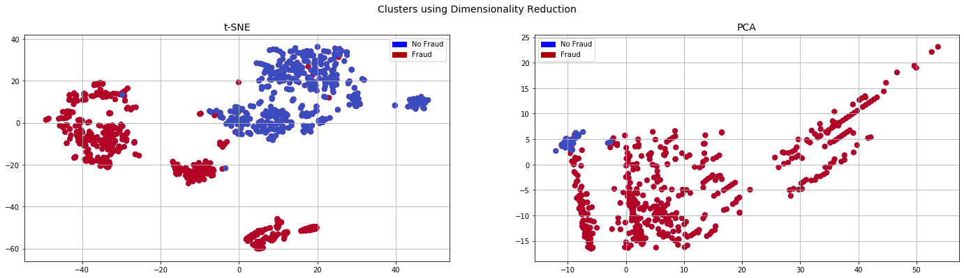
Dimensionality Reduction
Applied t-SNE and PCA on under sampled data to reduce time

Slide 21
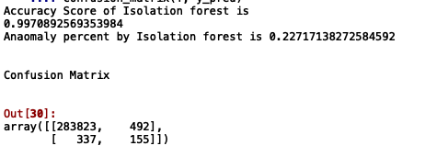
Anamoly detection
Isolation Forest
Isolation forest predicted some of the non_fraud samples as the fraud_samples.
Performance of isolation forest was not great.

Slide 22
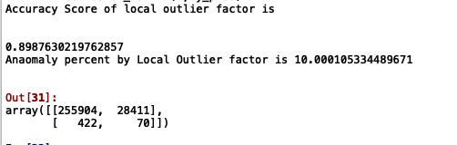
Local Outlier factor algorithm
Isolation forest worked better compared to that of local outlier
It was wrongly classifying both the classes

Slide 23
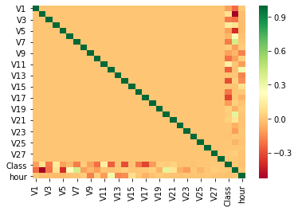
Dataset Correlation matrix
V17, V14, V12 and V10 are negatively correlated.
V2, V4, V11, and V19 are positively correlated

Slide 24
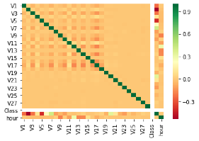
Non fraud Correlation matrix
In the Non_fraud dataset, i didn’t find any features that are correlated greater than 0.5

Slide 25
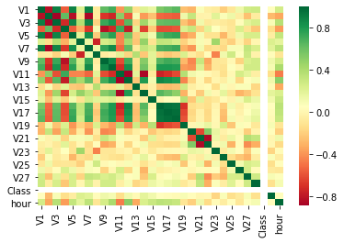
Fraud dataset Correlation matrix
Features V1, V3, V5, V7, V9,V10,V16,V17,V18 are highly correlated Features
V20,V21 are highly correlated

Slide 26



Any Questions?

