Slide 1

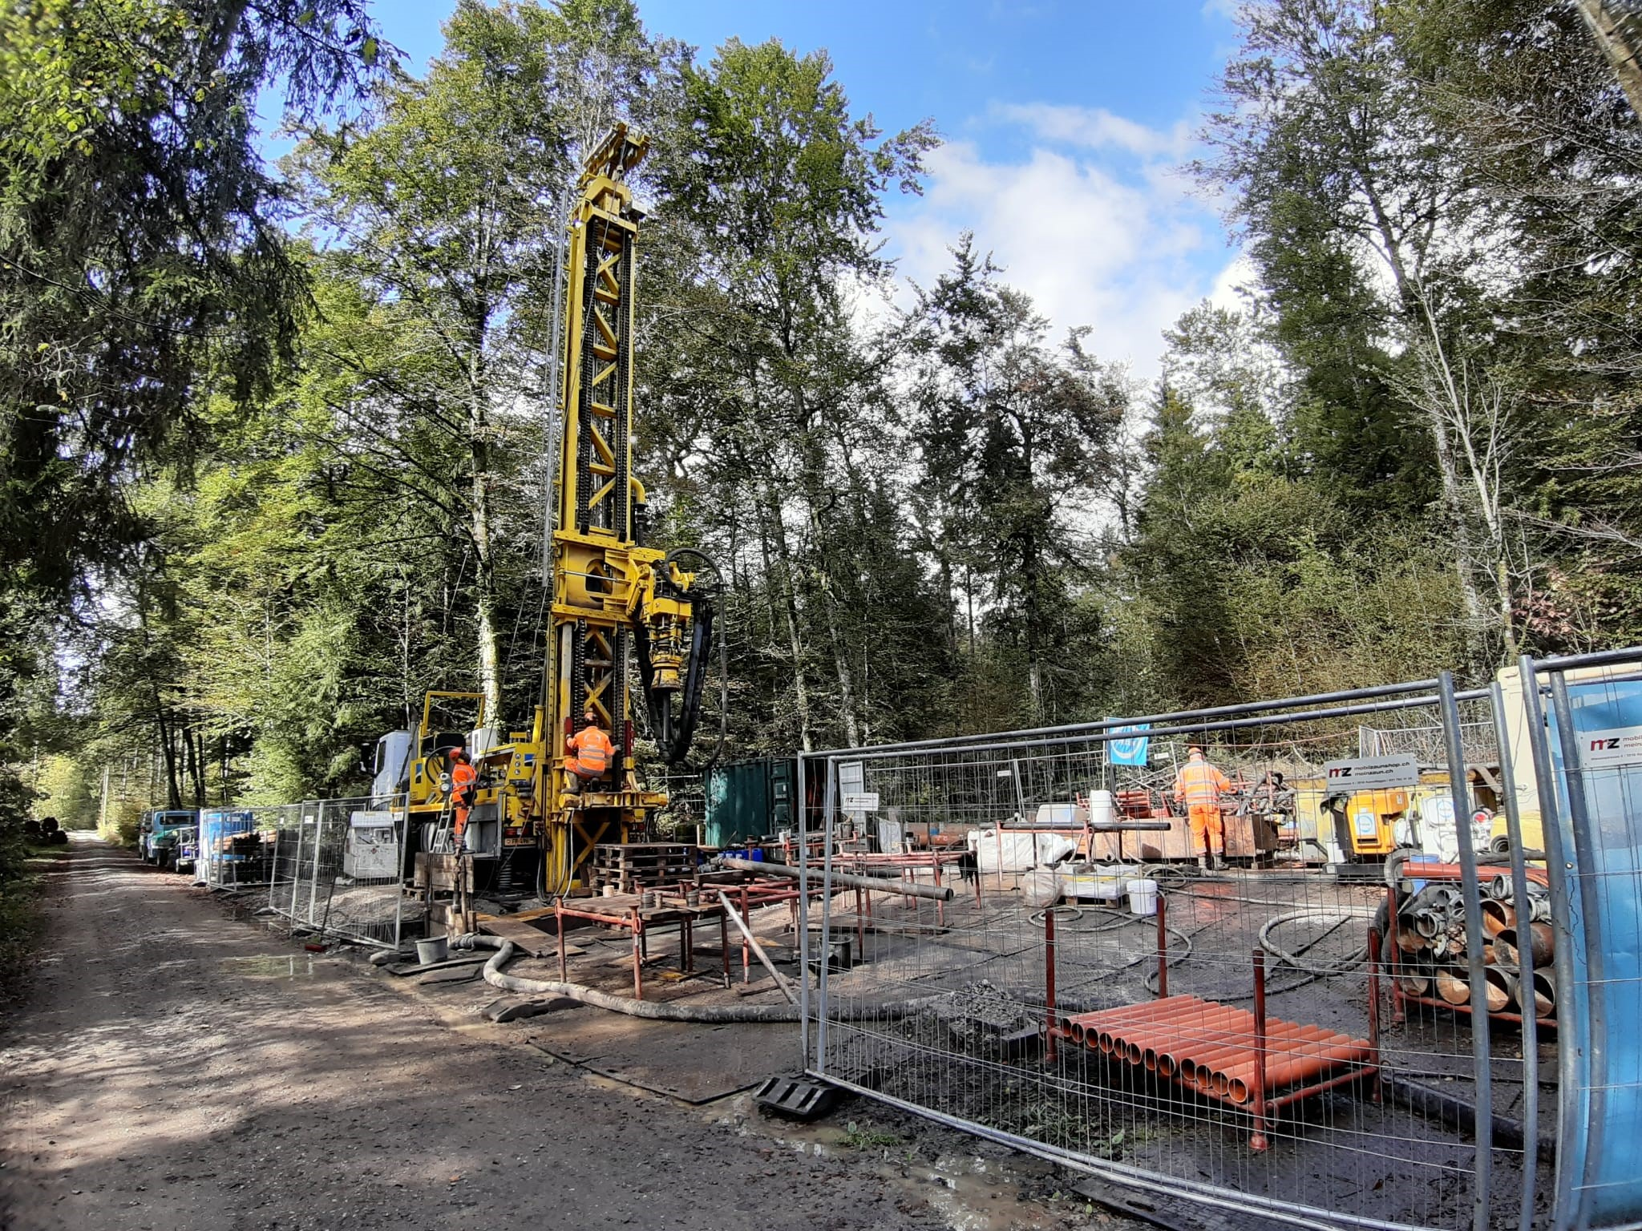


Presentation CAS-ADP
Module 2
9.10.03.2023
Sebastian Schaller and Avizek Regmi

Slide 2
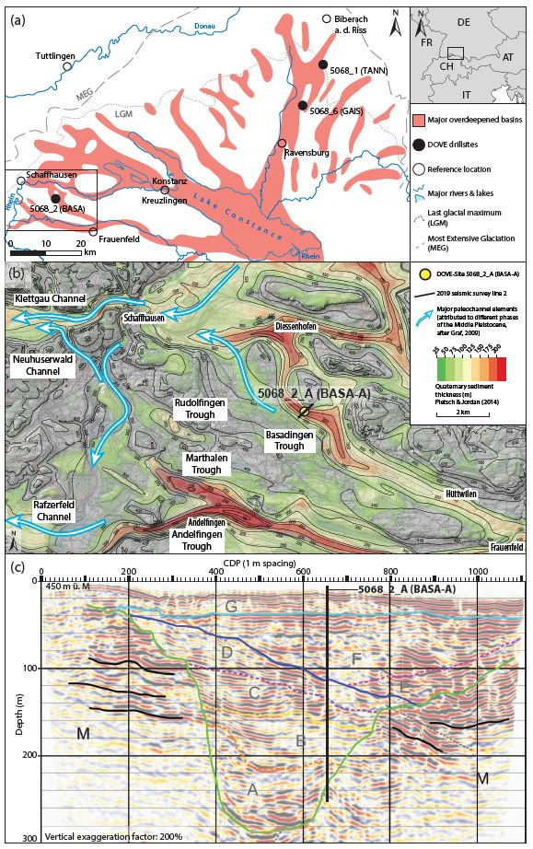
Introduction and background
Glacial exents of the Rhine Glacier
Seismic lein
Local overdeepenings
Drill core

Slide 3
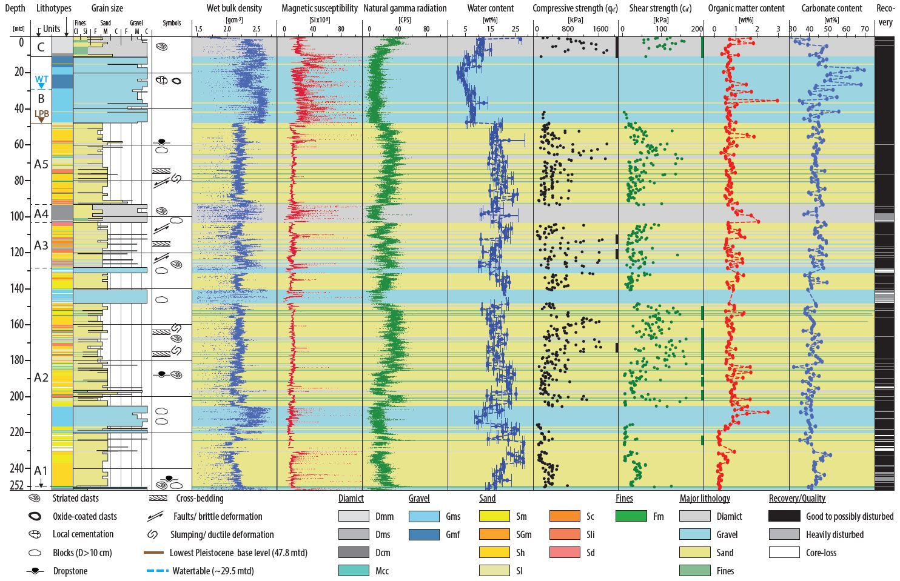
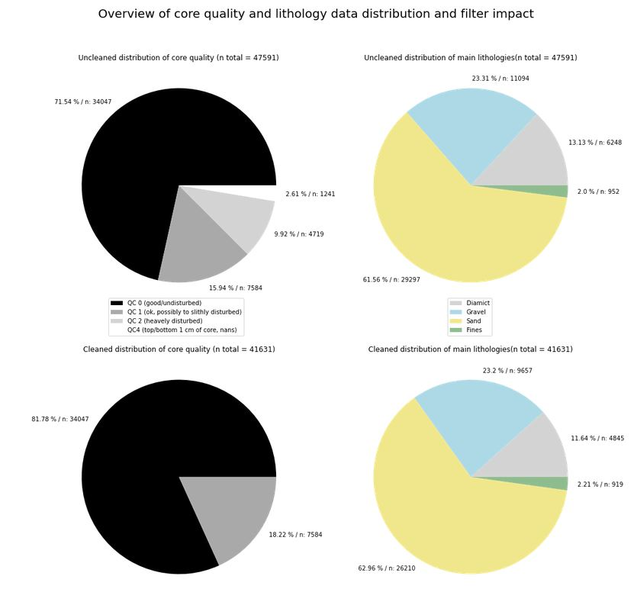
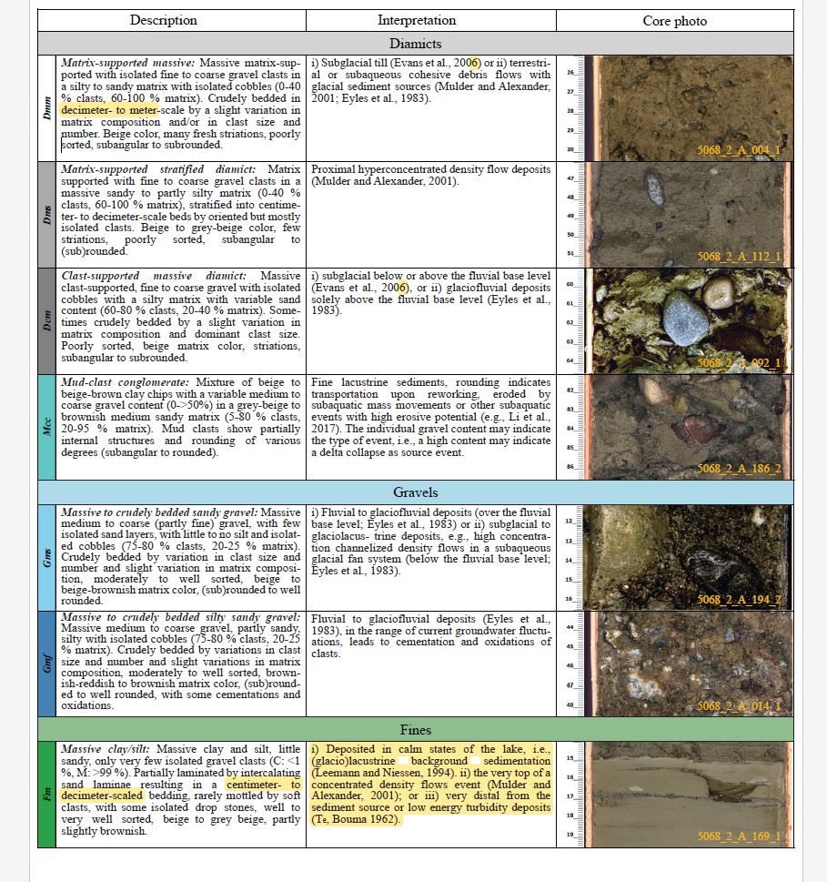
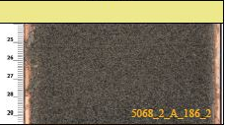
Dataset
Unfiltred
Gravel
Class 1 (undist.)
Diamict
Sand
Fines
Class 3
(heavy dist.)
Class 2
(pos. dist.)
Filtred
Gravel
Class 1 (undist.)
Diamict
Diamict
Gravel
Class 2
(pos. dist.)
Fines
Sand
Sand
Fines

Slide 4
Questions and 0-Hypotheses
H₁ -> Log data is not normally distributed
H₀¹ -> Log data is normally distributed
H₂ -> Visual-based classification of the sub-datasets is supported by the data and shows clear differences between the sub-datasets
H₀²->Distribution of the sub-datasets (based on visible core descriptions) shows no clear difference between the sub-datasets, and the clustering is random.
Further questions:
- Impact of different logs on clustering
- More suitable logs for trying
- ….

Slide 5
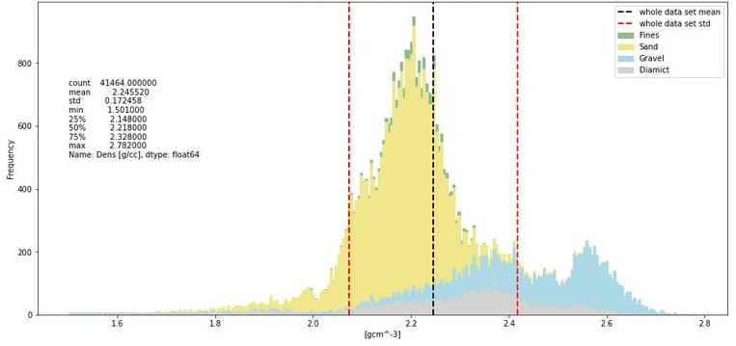
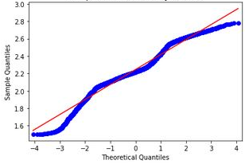
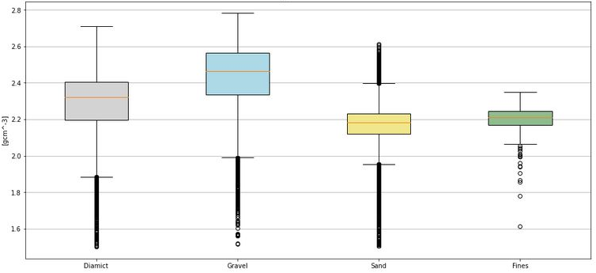
Density Log
 | All data | Diamict | Gravel | Sand | Fines
counts | 41464 | 4782 | 9633 | 26130 | 919
mean | 2.25 | 2.28 | 2.43 | 2.17 | 2.20
std | 0.17 | 0.20 | 0.17 | 0.10 | 0.07
min | 1.50 | 1.50 | 1.52 | 1.51 | 1.61
25% | 2.15 | 2.20 | 2.34 | 2.12 | 2.17
50% | 2.22 | 2.32 | 2.46 | 2.18 | 2.21
75% | 2.33 | 2.40 | 2.56 | 2.23 | 2.24
max | 2.78 | 2.71 | 2.78 | 2.61 | 2.35

Slide 6
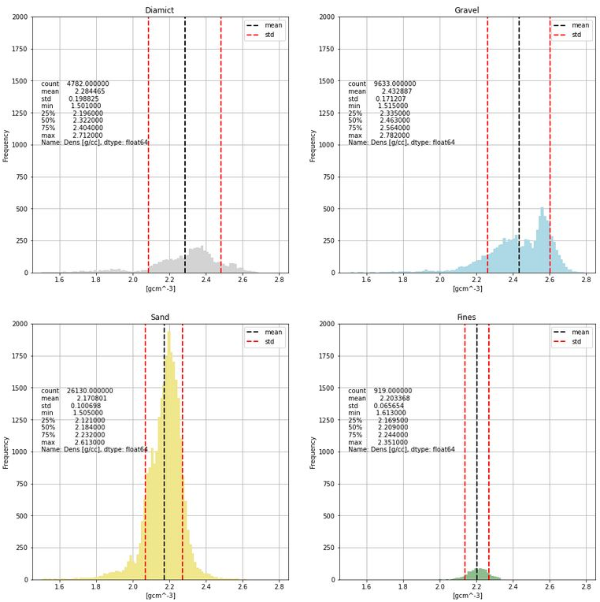
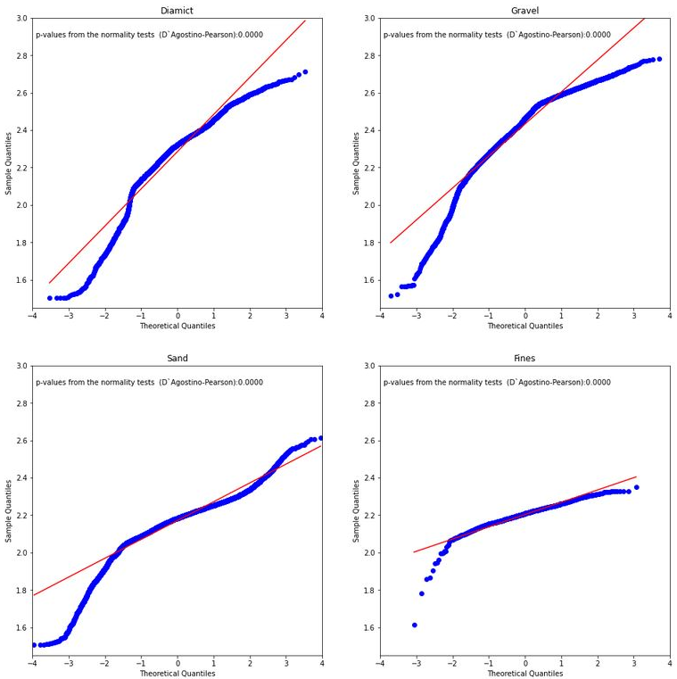
Density Log

Slide 7
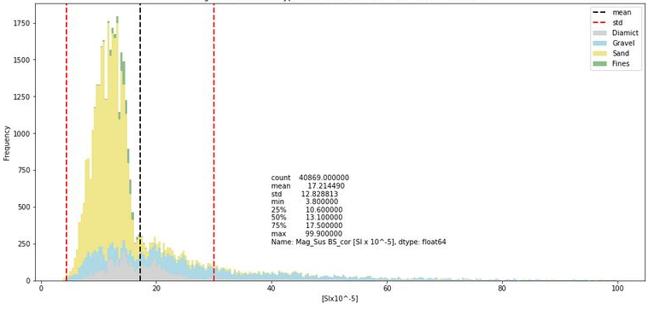
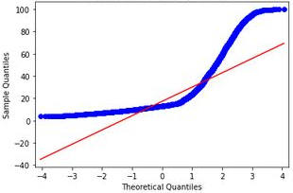
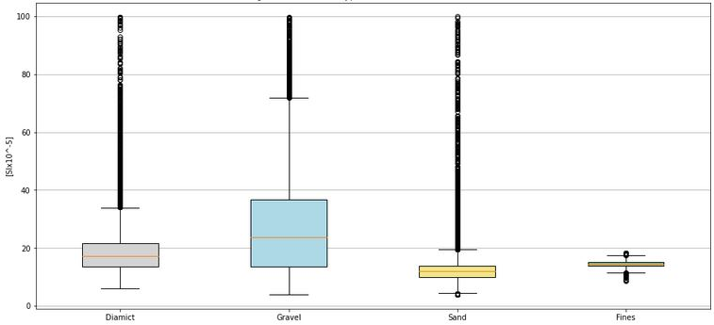
Magnetic Suseptibilety Log
 | All data | Diamict | Gravel | Sand | Fines
counts | 40869 | 4705 | 9384 | 25861 | 919
mean | 17.21 | 20.86 | 27.77 | 12.82 | 14.30
std | 12.83 | 13.63 | 18.10 | 6.70 | 1.41
min | 3.80 | 6.00 | 4.00 | 3.80 | 8.60
25% | 10.60 | 13.40 | 13.40 | 10.00 | 13.70
50% | 13.10 | 17.20 | 23.60 | 11.90 | 14.30
75% | 17.50 | 21.60 | 36.83 | 13.80 | 15.20
max | 99.90 | 99.80 | 99.80 | 99.90 | 18.10

Slide 8
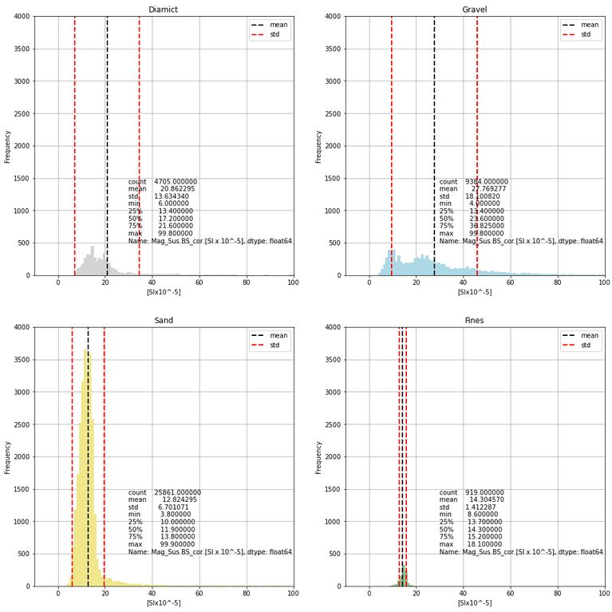
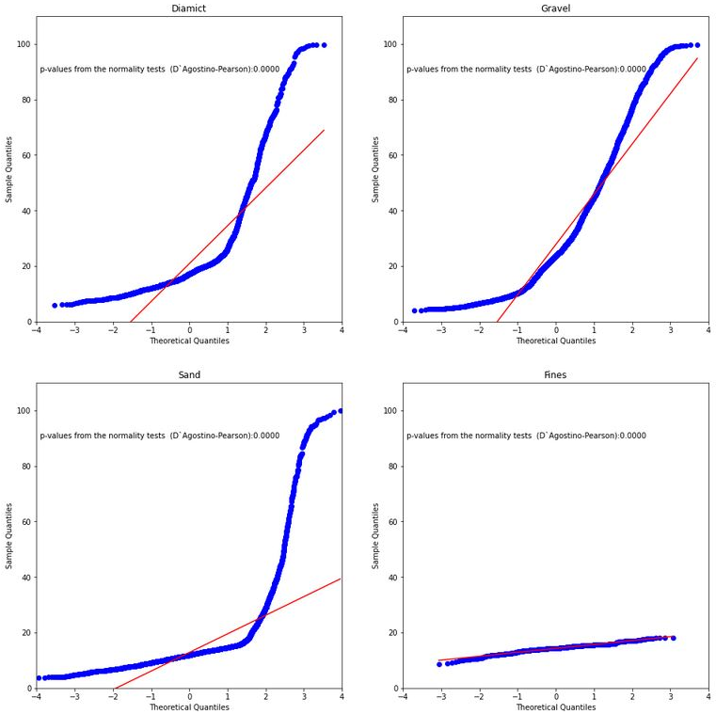
Magnetic Suseptibilety Log

Slide 9
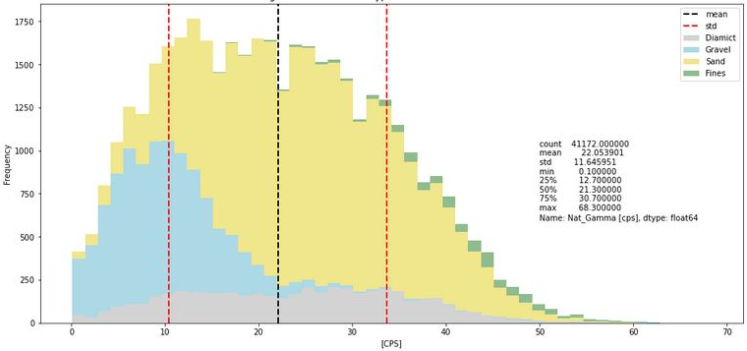
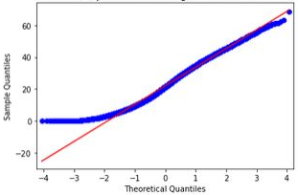
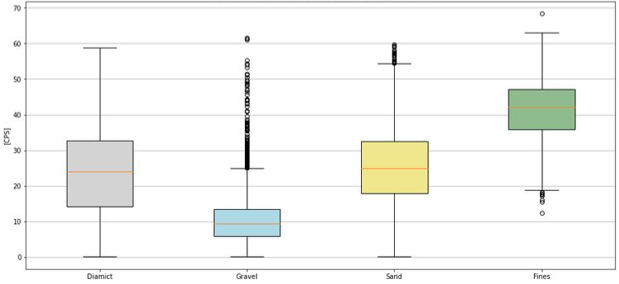
Natural Gamma Log
 | All data | Diamict | Gravel | Sand | Fines
counts | 41172 | 4790 | 9285 | 26178 | 919
mean | 22.05 | 23.68 | 10.16 | 25.30 | 41.18
std | 11.65 | 11.44 | 6.16 | 9.96 | 8.61
min | 0.10 | 0.10 | 0.10 | 0.10 | 12.30
25% | 12.70 | 14.30 | 5.90 | 17.90 | 35.80
50% | 21.30 | 24.10 | 9.50 | 24.90 | 42.10
75% | 30.70 | 32.70 | 13.50 | 32.50 | 47.10
max | 68.30 | 58.70 | 61.50 | 59.70 | 68.30

Slide 10
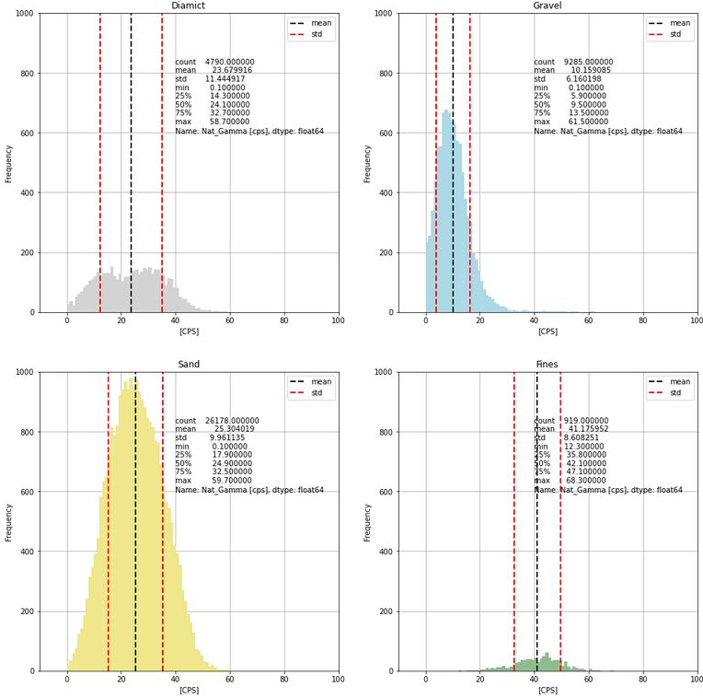
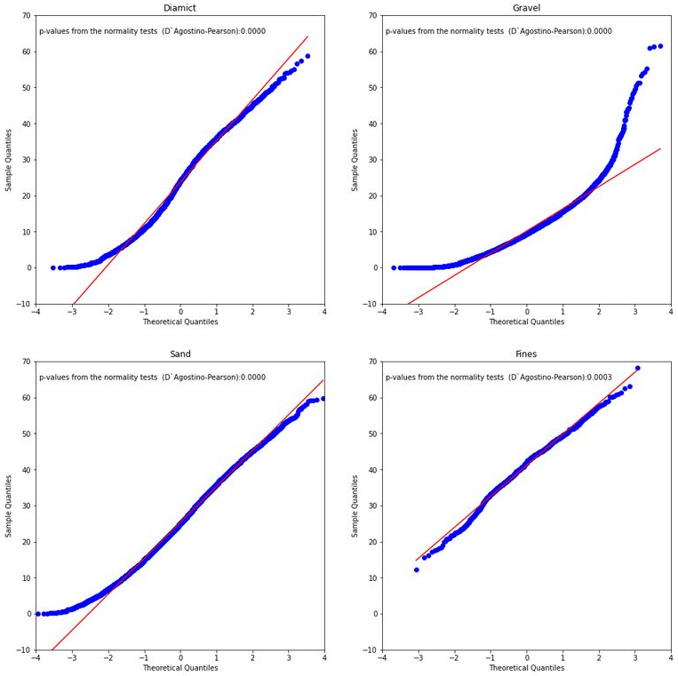
Natural Gamma Log

Slide 11
 | Density | Mag. Sus. | Nat. Gamma
 | D`Agostino-Pearson-Normality-Test
 | p-value | p-value | p-value
Whole dataset | 0.000 | 0.000 | 0.000
Diamict | 0.000 | 0.000 | 0.000
Gravel | 0.000 | 0.000 | 0.000
Sand | 0.000 | 0.000 | 0.000
Fines | 0.000 | 0.000 | 0.000
 | Kruskal-Wallis-Test
comparsion | p-value | p-value | p-value
all | 0.000 | 0.000 | 0.000
 | Pairwise Mann-Whitney-U-Test
comparsion | p-value | p-value | p-value
Diamict-Diamict | 1.000 | 1.000 | 1.000
Diamict-Gravel | 0.000 | 0.000 | 0.000
Diamict-Sand | 0.000 | 0.000 | 0.000
Diamict-Fines | 0.000 | 0.000 | 0.000
Gravel-Diamict | 0.000 | 0.000 | 0.000
Gravel-Gravel | 1.000 | 1.000 | 1.000
Gravel-Sand | 0.000 | 0.000 | 0.000
Gravel-Fines | 0.000 | 0.000 | 0.000
Sand-Diamict | 0.000 | 0.000 | 0.000
Sand-Gravel | 0.000 | 0.000 | 0.000
Sand-Sand | 1.000 | 1.000 | 1.000
Sand-Fines | 0.000 | 0.000 | 0.000
Fines-Diamict | 0.000 | 0.000 | 0.000
Fines-Gravel | 0.000 | 0.000 | 0.000
Fines-Sand | 0.000 | 0.000 | 0.000
Fines-Fines | 1.000 | 1.000 | 1.000
H₁
(Logs consist of not normally distributed data)
H₀¹
(Log data is normally distributed)
The first 0-hypothesis can be rejected with high certainty for all logs. The data sets and its sub-datasets are not normally distributed.
Visual-based classification of the sub-datasets is supported by the data and shows clear differences between the sub-datasets
H₂
H₀²
(Distribution of the sub-datasets (based on visible core descriptions) shows no clear difference between the sub-datasets, and the clustering is random.)
The first part of the second 0-hypothesis can be rejected with high certainty for all sub-datasets of all logs. The sub-datasets of each logs show a clear difference between each other. However, it does not say anything about the meaningfulness of the grouping.
To answer the second part of the hypothesis:
-Qualitative answer -> Scatterplots/data distributions
-Quantitative answer -> Cluster analyses/PCA

Slide 12
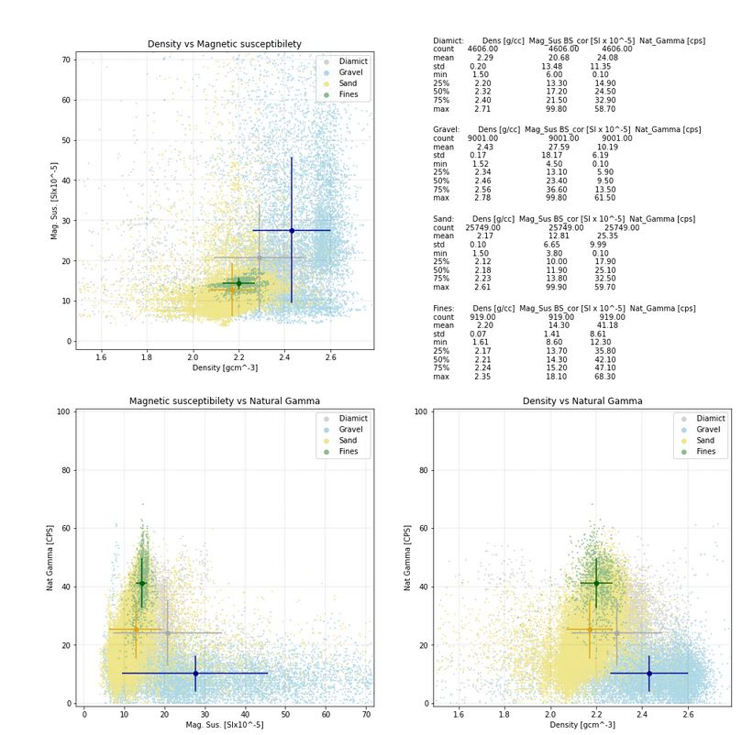
Scatter Plots Density/Magnetic Susceptibility/Natural Gamma

Slide 13
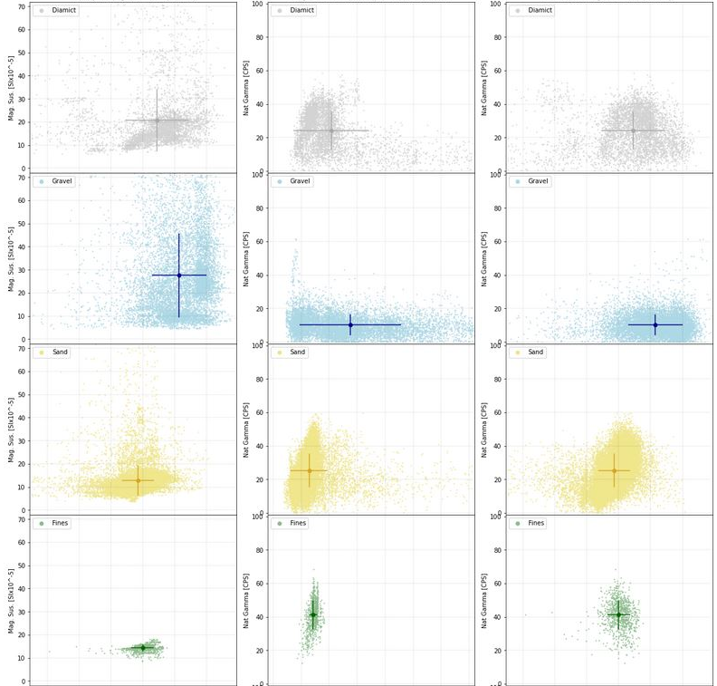
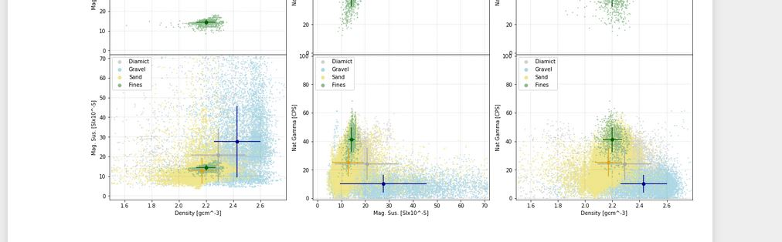
Scatter Plots Density/Magnetic Susceptibility/Natural Gamma
Dens./Mag.Sus
Mag.Sus/Nat.Gamma.
Dens./Nat.Gamma
Diamict | Density | Mag. Sus | Natgamma
counts | 4606
mean | 2.29 | 20.68 | 24.08
std | 0.20 | 13.48 | 11.35
min | 1.50 | 6.00 | 0.10
25% | 2.20 | 13.30 | 14.90
50% | 2.32 | 17.20 | 24.50
75% | 2.40 | 21.50 | 32.90
max | 2.71 | 99.80 | 58.70
Gravel | Density | Mag. Sus | Natgamma
counts | 9001
mean | 2.43 | 27.59 | 10.19
std | 0.17 | 18.17 | 6.19
min | 1.52 | 4.50 | 0.10
25% | 2.34 | 13.10 | 5.90
50% | 2.46 | 23.40 | 9.50
75% | 2.56 | 36.60 | 13.50
max | 2.78 | 99.80 | 61.50
Sand | Density | Mag. Sus | Natgamma
counts | 25749
mean | 2.17 | 12.81 | 25.35
std | 0.10 | 6.65 | 9.99
min | 1.50 | 3.80 | 0.10
25% | 2.12 | 10.00 | 17.90
50% | 2.18 | 11.90 | 25.10
75% | 2.23 | 13.80 | 32.50
max | 2.61 | 99.90 | 59.70
Fines | Density | Mag. Sus | Natgamma
counts | 919
mean | 2.20 | 14.30 | 41.18
std | 0.07 | 1.41 | 8.61
min | 1.61 | 8.60 | 12.30
25% | 2.17 | 13.70 | 35.80
50% | 2.21 | 14.30 | 42.10
75% | 2.24 | 15.20 | 47.10
max | 2.35 | 18.10 | 68.30

Slide 14
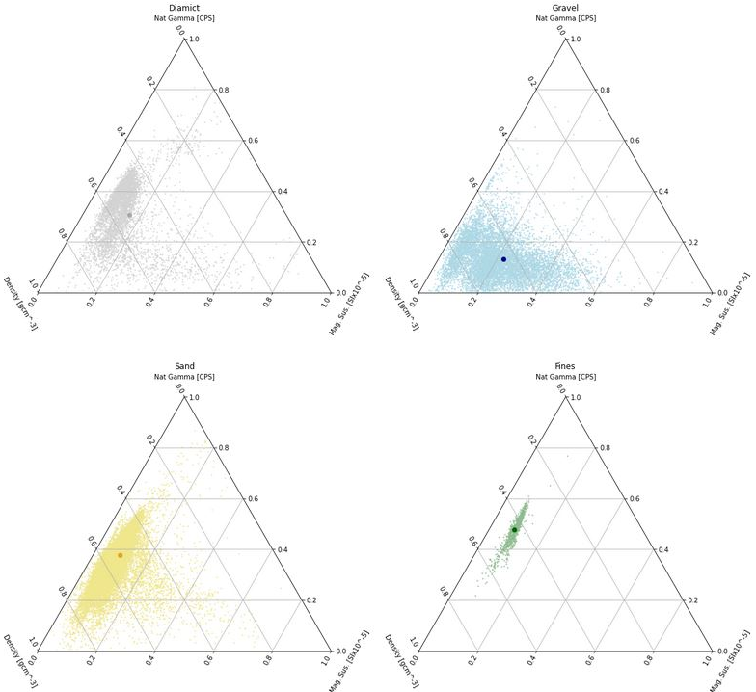
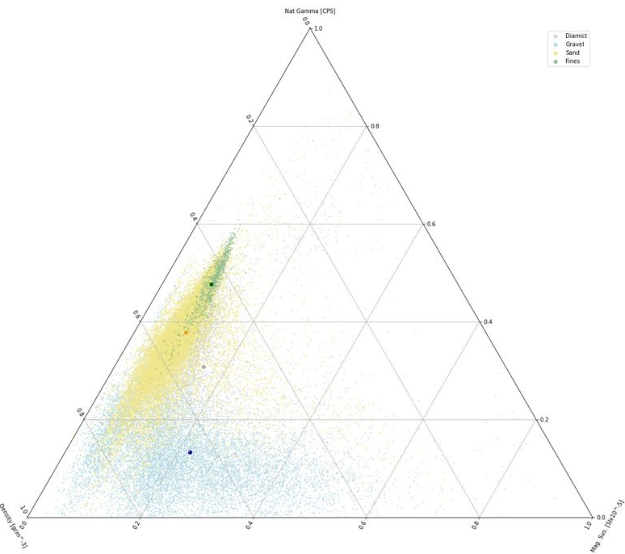
Ternary Scatter Plots Density/Magnetic Susceptibility/Natural Gamma
Density <->Natural Gamma, dominant logs?
Nat Gamma
Two clusters?
Impact of magnetic on gravel?
Density
Mag. Sus.

Slide 15
Conclusions
Logs consist clearly of not normally distributed data
Data supports the visual-based classification qualitatively ->
The scatter plots and the internal distributions (histograms) make sense in a geological/sedimentological way
Density and Natural gamma logs seem to be the dominant logs in the data set and are promising candidates for use
Magnetic susceptibility may be less useful in the current type of sediments due to several technical and geological reasons
Outlook
Searching for alternative logs/parameters
Quantitative analyses (Cluster analyses, Principal Component Analyses (PCA))
Test on further datasets

