Slide 1
The Evolution of software development
Sean Chambers

Slide 2

Welcome!
WELCOME!

Slide 3


Slide 4
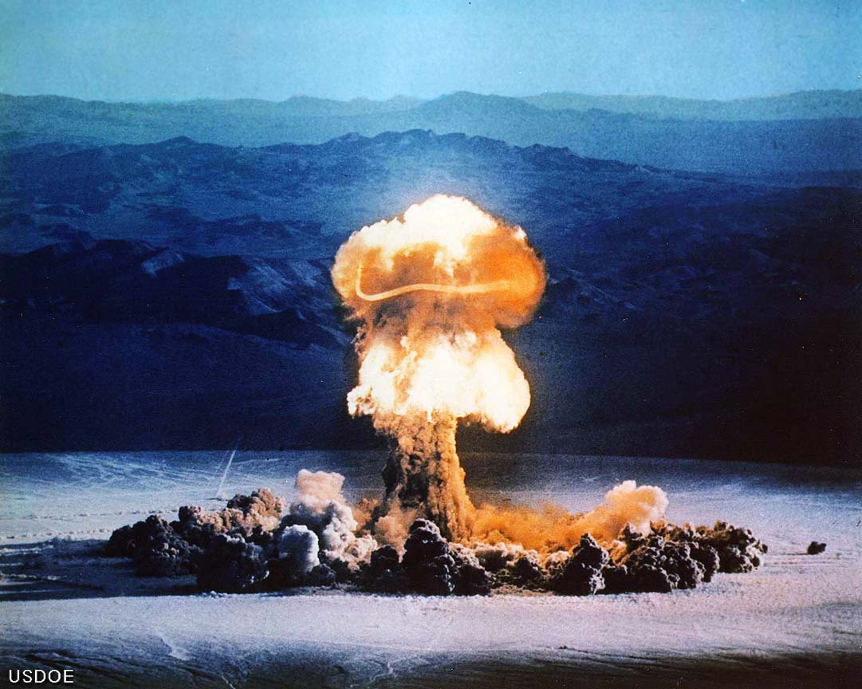

Slide 5
Behavior Driven Development
Ubiquitous
Language
Emergent Design
Refactoring
Business Value Drives
Domain Model

Slide 6

I need an order to go to a
screening queue if it fails address scrubbing
Ok, so we need to validate an order and place in what we’ll call the “staging area”

Slide 7
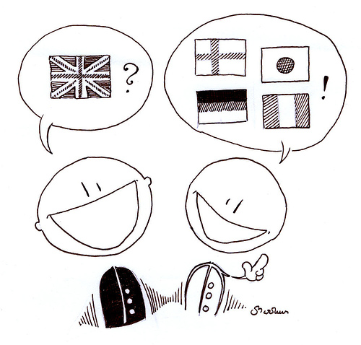
Notes:
Ubiquitous language

Slide 8


Slide 9


Slide 10
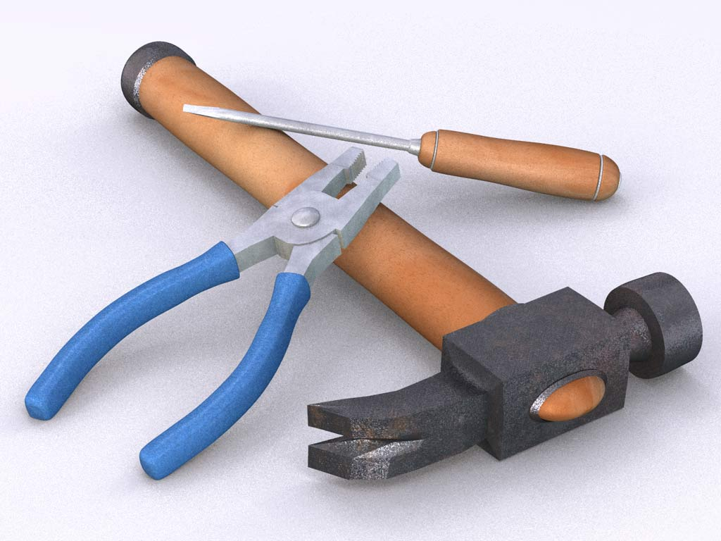

Slide 11
User Story
As a [role] I want to [do something] So that [business value]

Slide 12
Acceptance Criteria
Given [some context] When [something happens] Then [some outcome]

Slide 13
Scenario : Adding a Track
As a Code Camp Organizer I want to add a track So that attendees can learn specific topics
Given the track has not been added
When I type in a track name
And I click the Create button
Then I expect for a track to be added to the site
Given the track has already added
When I type in a track name
And I click the Create button
Then I expect to see a message stating that track already exists

Slide 14
Scenario : Submitting a Session
As a Presenter I want to submit a session So that I can teach people new things
Given I am logged into the site
When I click the Submit Presentation link
And I enter “Software Dev Evolution” in the title field
And I enter “some info” in the description field
And I click the Create button
Then I expect to see that presentation under my submitted
presentations
Given I have submitted a presentation named “Software Dev Evolution”
And I am logged into the site
When I click the submitted presentations link
Then I expect to see the presentation in the list

Slide 15
Scenario : Registering
As an Attendee I want to register for code camp So that I can learn new things
Given the
When I type in a track name
Then I expect
Given the
When I
Then I

Slide 16
Links/info
http://schambers.lostechies.com
Twitter: schambers
Sample url

