Slide 1
Refactoring to ioc
Sean Chambers

Slide 2

Welcome!
WELCOME!

Slide 3

Inversion of What?!?

Slide 4
User Controller
Authentication Service
User Controller
Authentication Service
depends on
Provided to

Slide 5
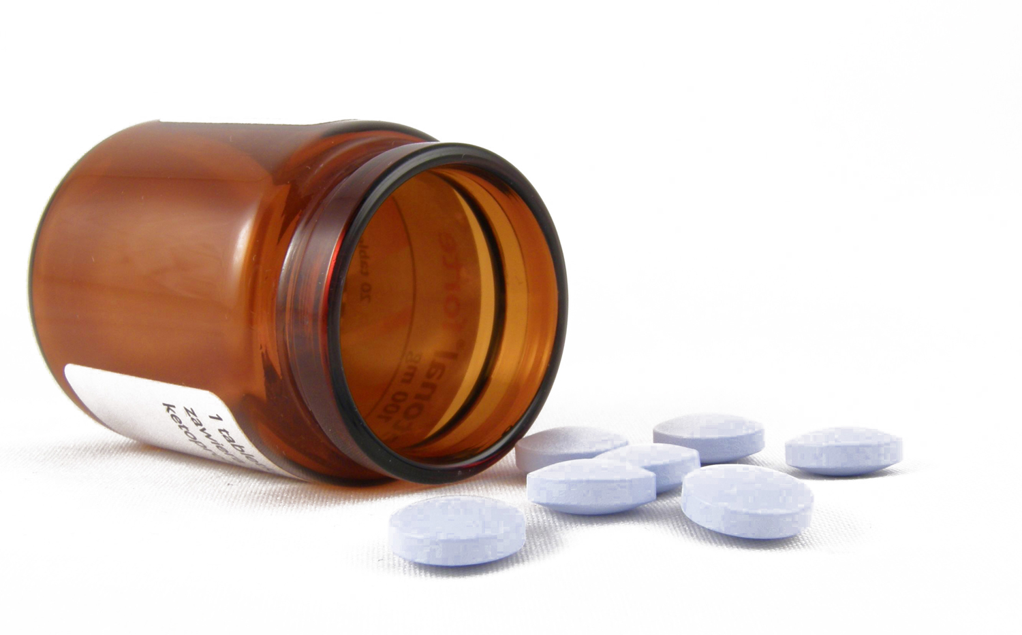
Inversion of Control
Service Locator
Dependency Injection

Slide 6

Let’s Go!

Slide 7

DANGER!!! DANGER!!!

Slide 8
Links/info
http://schambers.lostechies.com
Twitter: schambers
Sample url

