Slide 1
The Evolution of software development
Sean Chambers

Slide 2

Welcome!
WELCOME!

Slide 3
Agile
Common Language
Refactoring
Pairing
TDD/BDD

Slide 4
Behavior Driven Development
Ubiquitous
Language
Domain
Refactoring
Business Value Drives

Slide 5
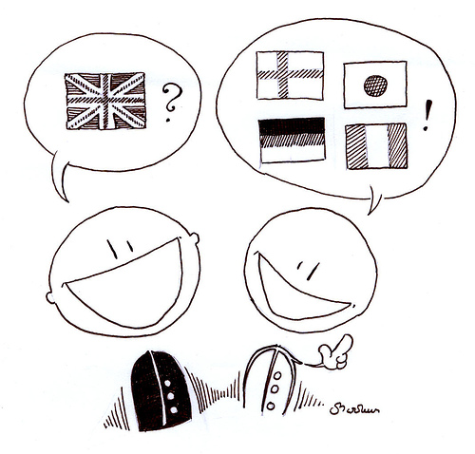
Notes:
Ubiquitous language

Slide 6


Slide 7
As a [role] I want to [do something] So that [business value]

Slide 8
Scenario : Adding cargo to an itinerary
As a Shipping Manager I want to add cargo to an itinerary So that the cargo can reach it’s destination
Given the itinerary is not full
And I have a cargo with the id of C12345
When I add the cargo to the itinerary
Then I expect to see the cargo id in the itinerary manifest

Slide 9
Links/info
http://schambers.lostechies.com
Twitter: schambers
Sample url

