Slide 1
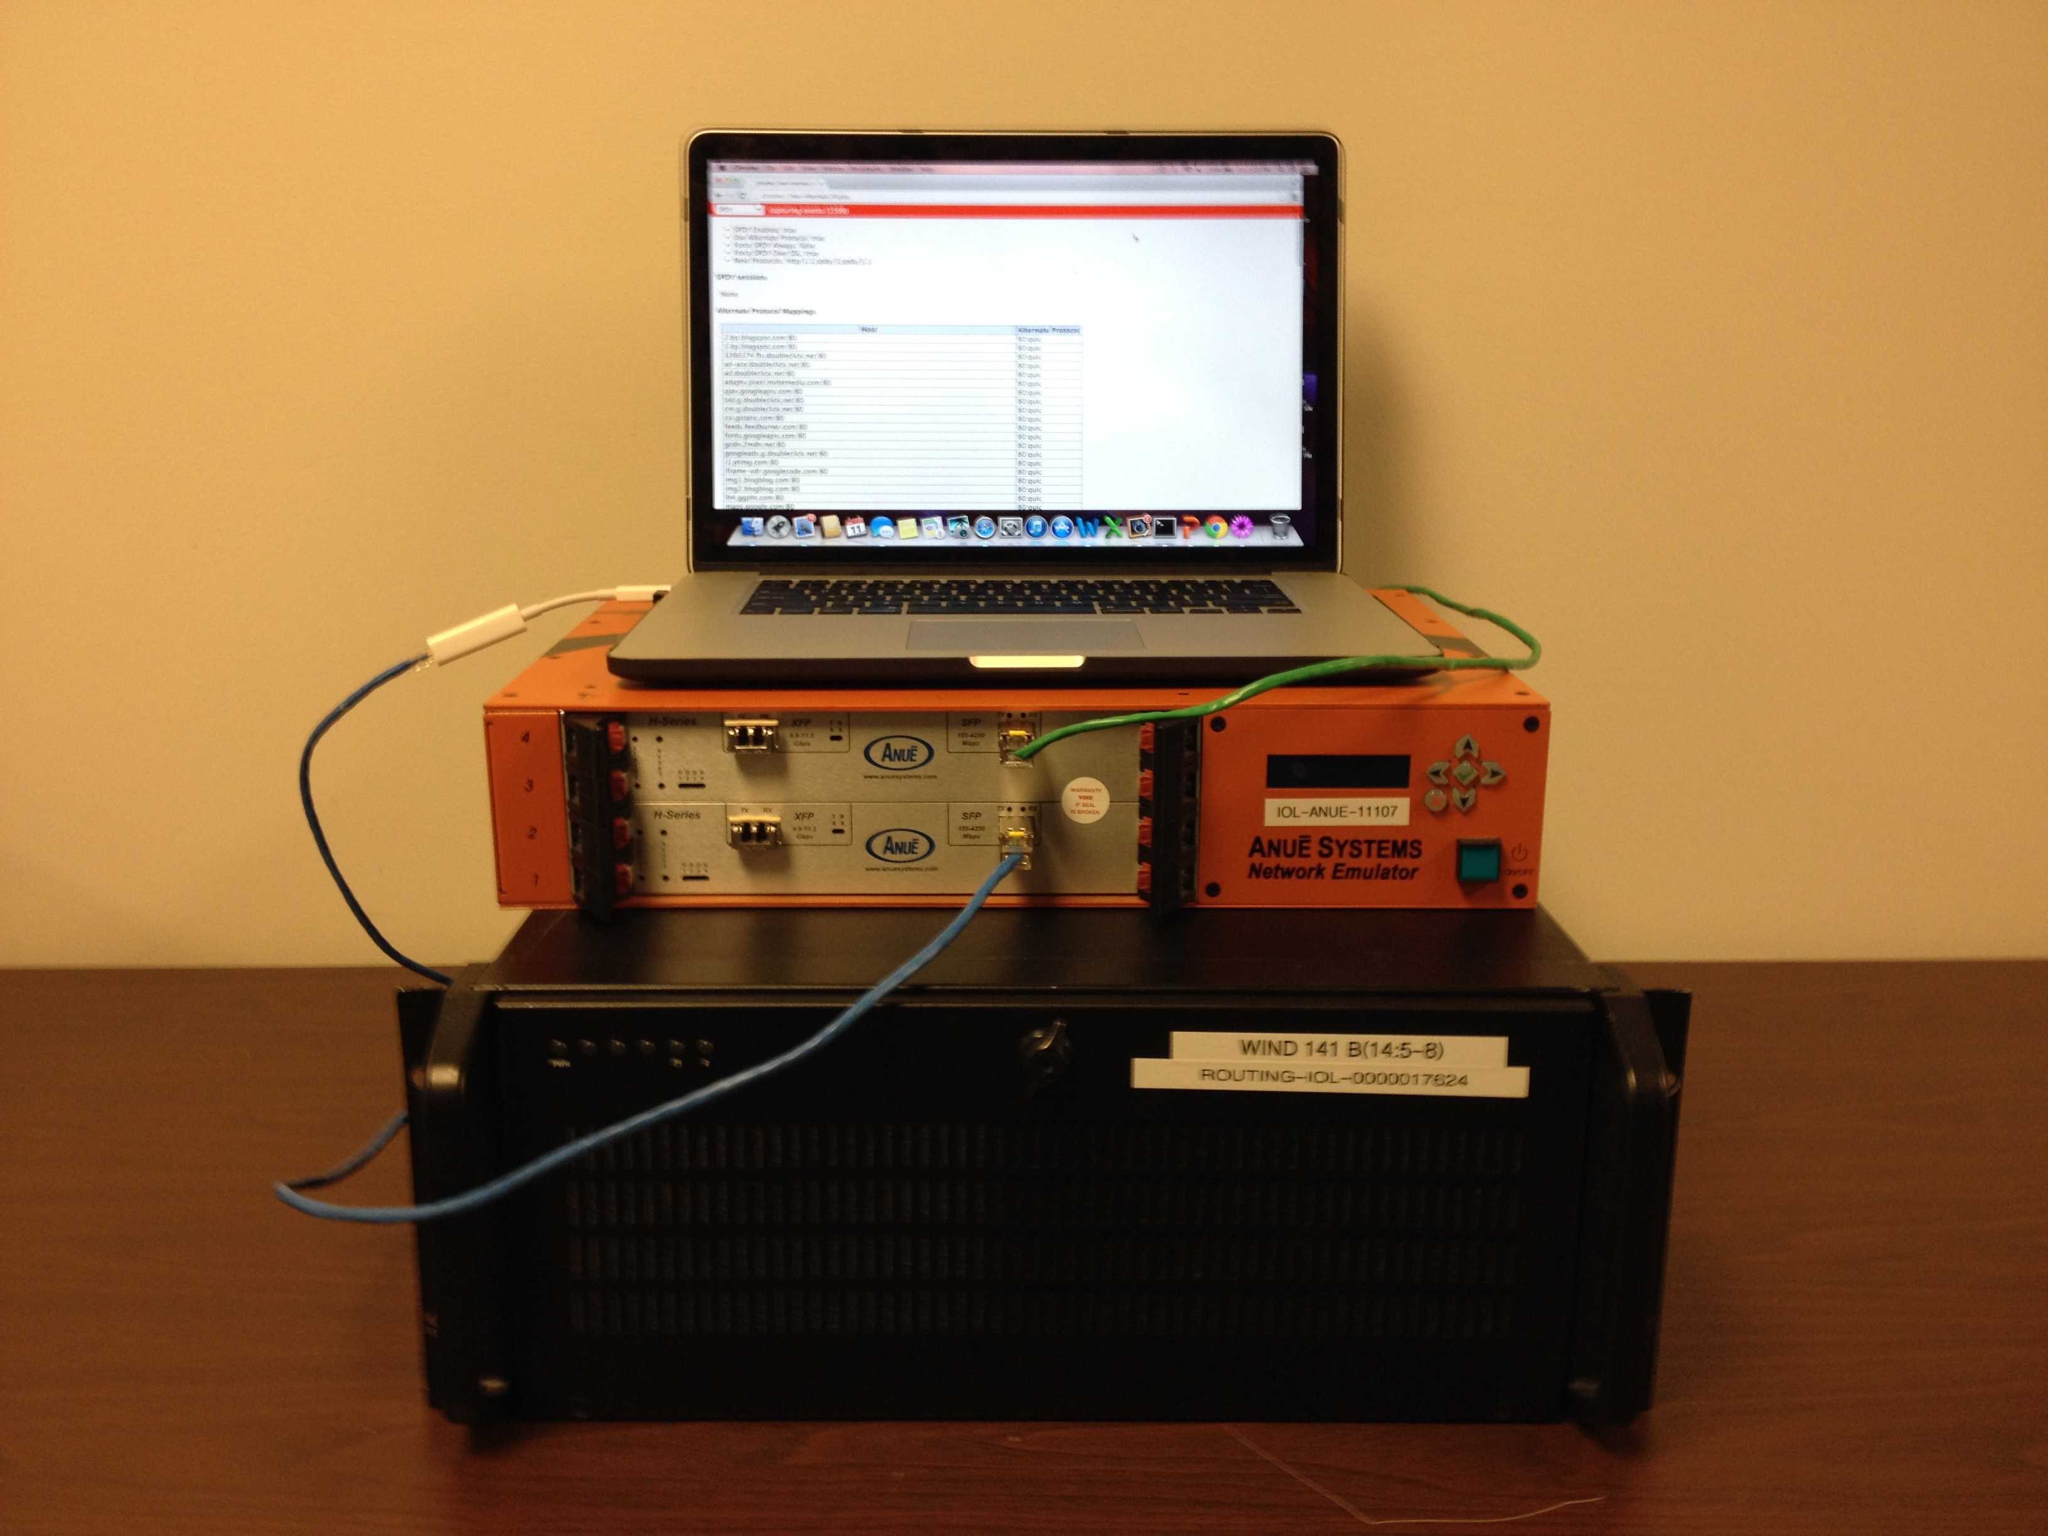
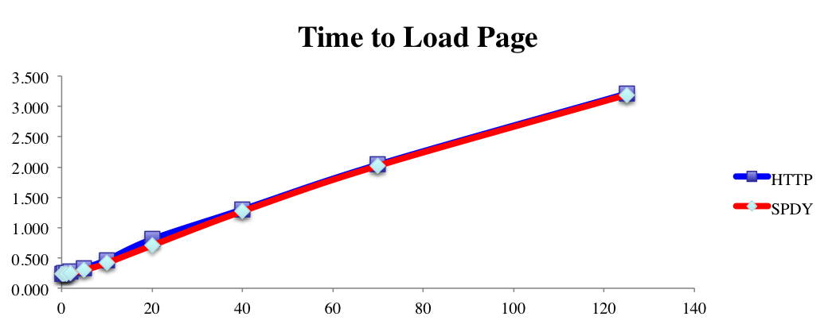
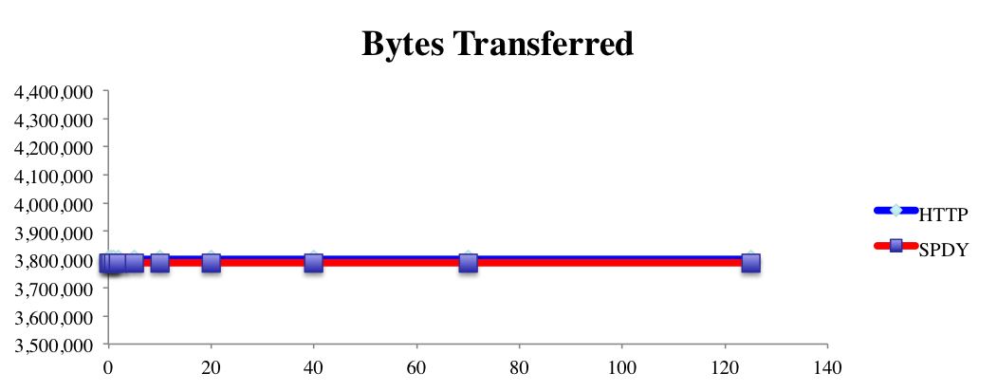
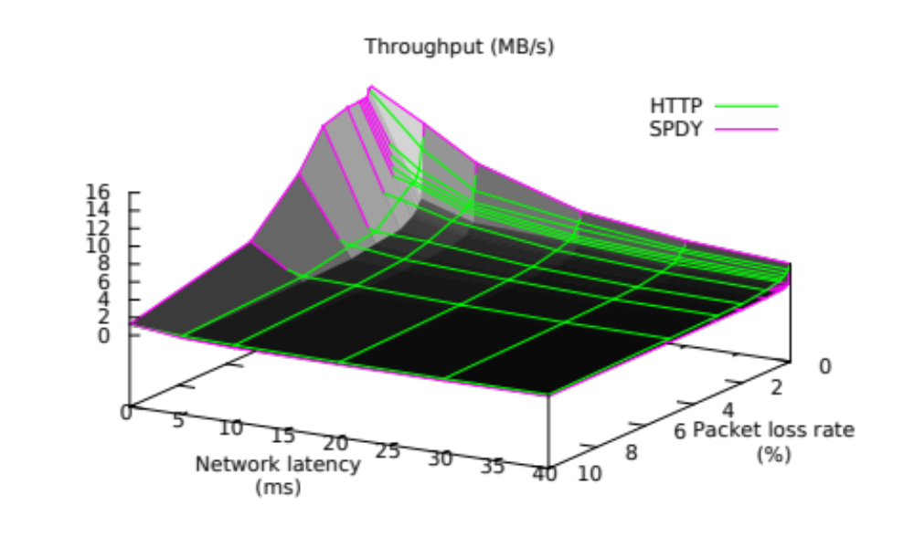
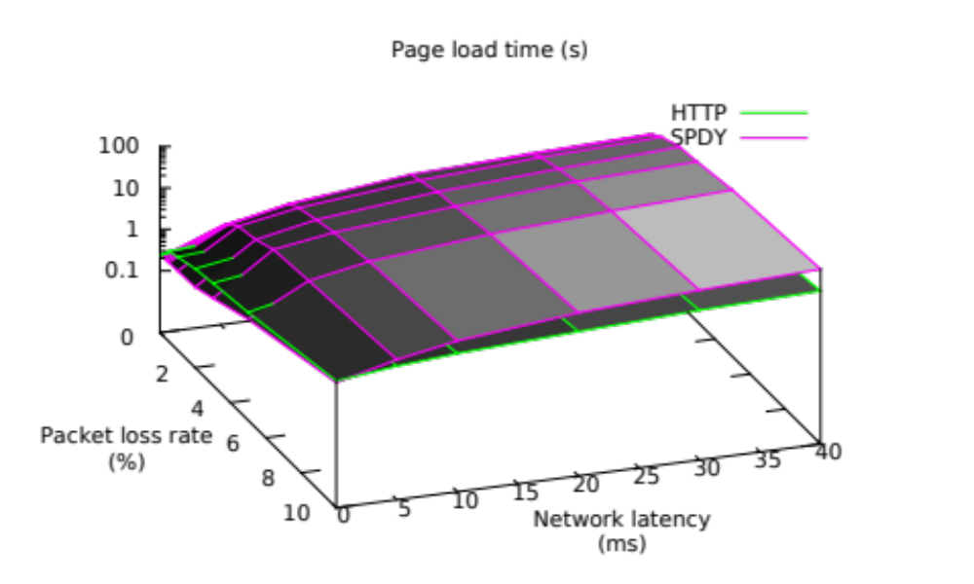
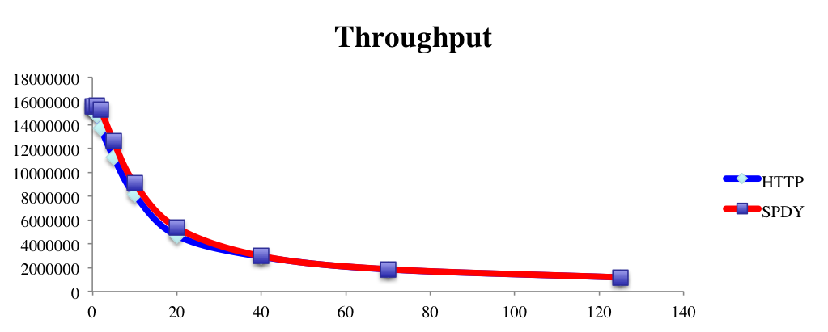
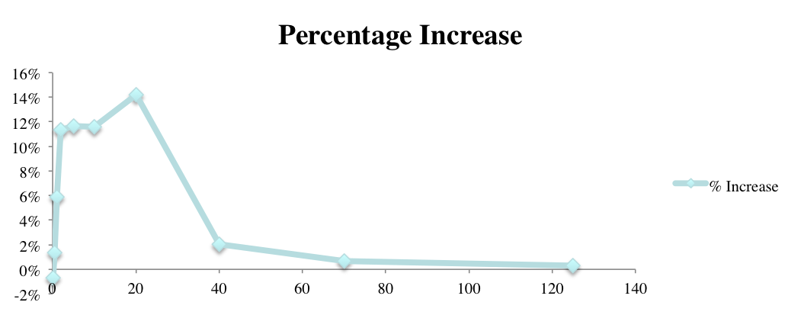

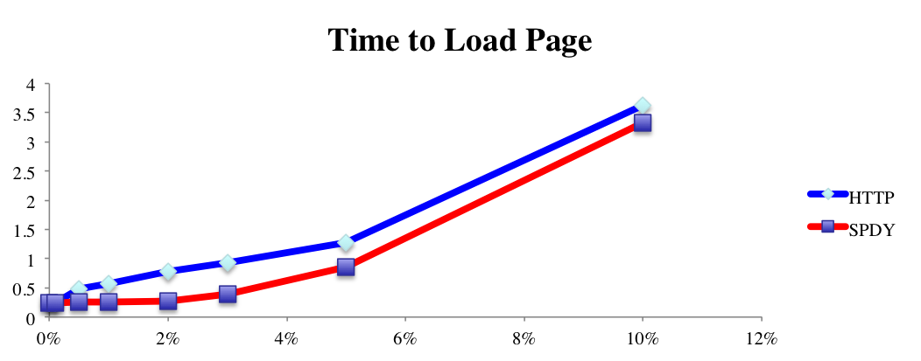
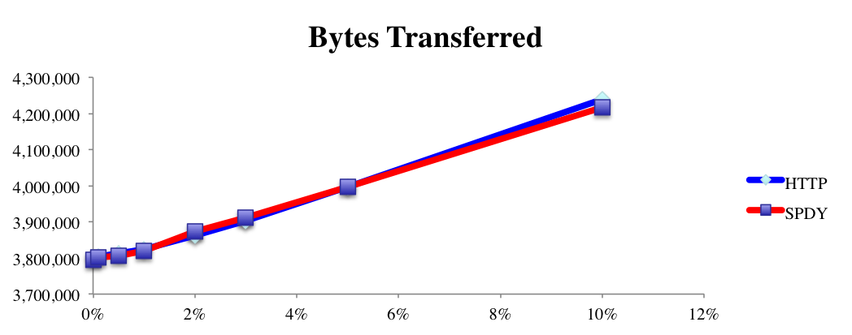
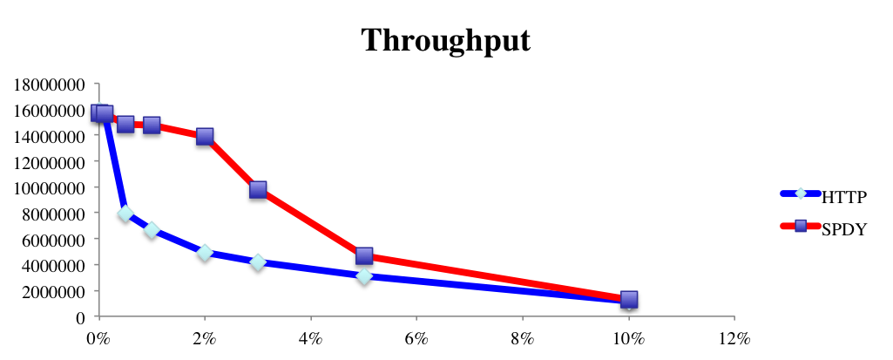
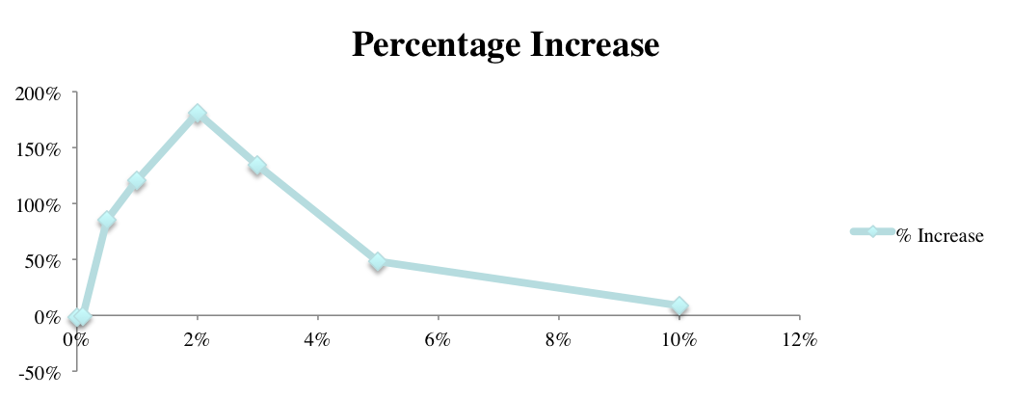


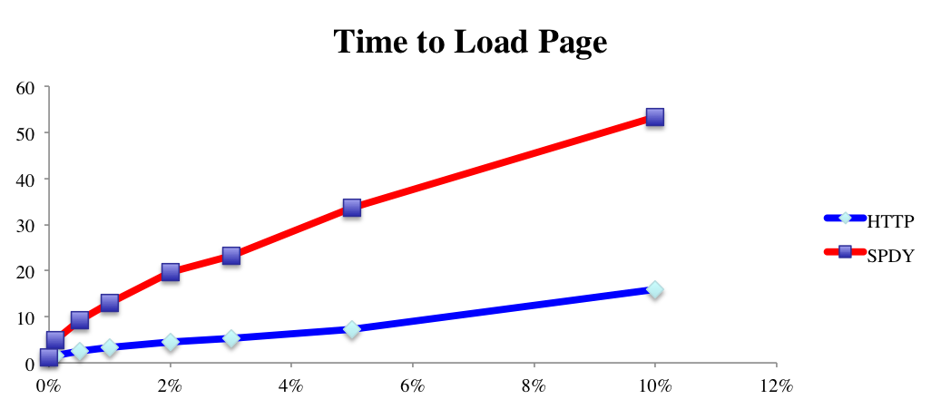
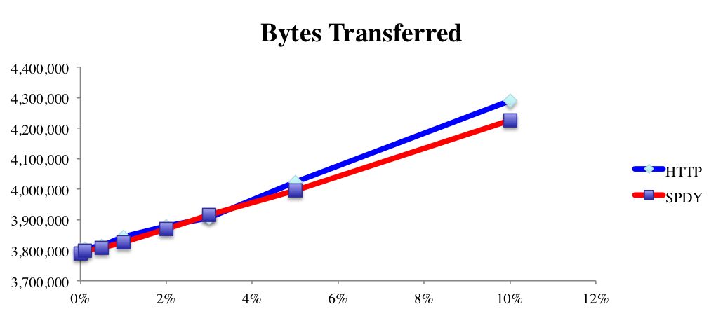



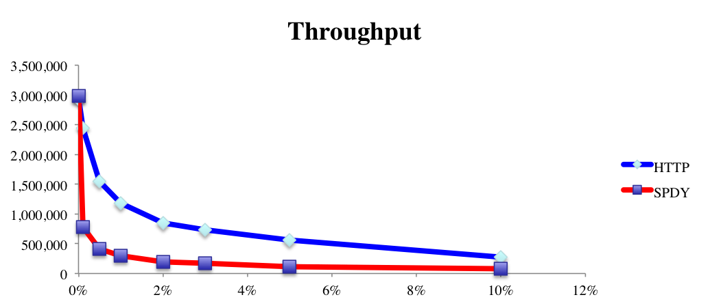
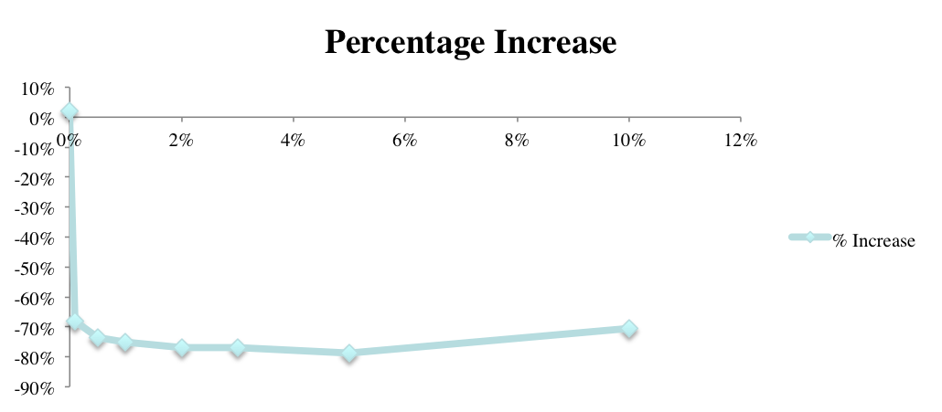

SPDY? Not So Fast!
Author: Stephen Chambers
Advisor: Radim Bartos
Department: Computer Science
Background
As the Internet evolves, the reduction of page load time has an increased importance.
The application layer should be changed to avoid altering existing implementations.
SPDY is a Google proprietary protocol that is deployed in the production environment already on websites such as Google, Facebook, and Twitter.
SPDY is the working base for HTTP/2.0.
Experimental Setup
Anue Network Emulator
Client
Google Chrome
v. 34.0.1847.116
Emulated Network
Server
Apache v. 2.2.22
mod_spdy v. 3.0
Client
Latency
Periodic Packet Loss
Network
Emulator
Why change?
.
Client requested a web page with 100 small image files totaling ~ 3.4MB.
PHP script used to generate distinct pages in order to avoid content caching.
Presented results are averages of 5 runs.
Server
HTTP | SPDY
HTTP uses multiple connections because it can only process requests in a FIFO queue. | Multiplexing over a single connection.
Only the client can initiate a request. | Server push/Server hint: Server can either suggest a resource to request or push the request to the client unsolicited.
Sends static header data throughout connection. | Removes static information, such as the User-Agent and Host headers.
Optional compression encodings for data. | Forces header compression.
High Latency, Zero Packet Loss
Throughput and Page Load Time
High Latency, Zero Packet Loss
Analysis
In a high latency network with zero packet loss, SPDY outperforms HTTP in terms of throughput as it takes advantage of SPDY’s multiplexing.
In a high packet loss network with near zero latency, SPDY outperforms HTTP. Very small latency masks packet loss problems, so SPDY can recover very quickly.
In a bad network with high packet loss and high latency, HTTP outperforms SPDY. HTTP can perform load balancing with its multiple connections.
HTTP vs SPDY
RTT
RTT
High Latency, High Packet Loss
Next Steps
Experiments are far from exhaustive. Different application types should be tested against; video files and dynamic content would take advantage of SPDY’s Server Push and Server Hint features.
RTT
RTT

