Slide 1
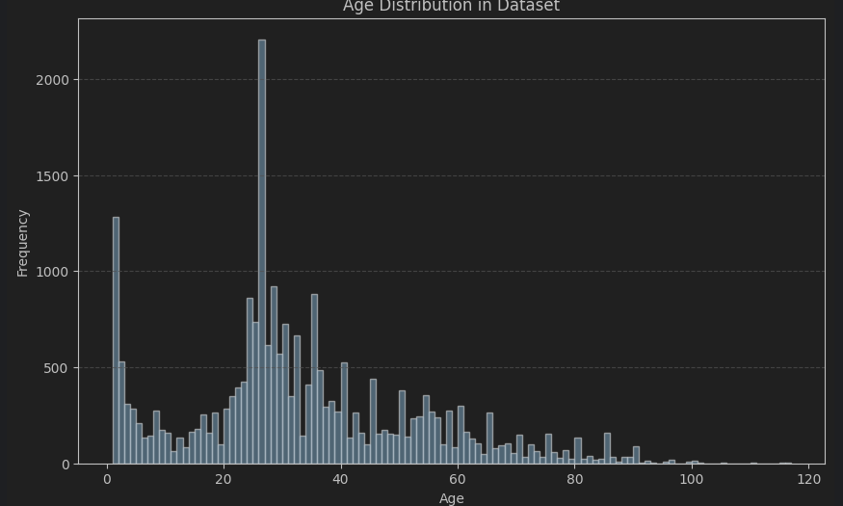

Slide 2
Unbalanced -> sampler -> weighted loss function

Slide 3
Missing Data -> class binding -> predict 1-5, 6-10…

Slide 4
Long trainig time
Cutting down Network Dims -> 2m param -> 600k
Using autocast which swichtes bewtenn 16 bit and 32 bit floats for optimization

Slide 5
Overfitting
Dropout
Batchnorm
Data Augmenation

Slide 6
Test Accuracy after Epoch 0: 49.92%
Test F1 Score after Epoch 0: 42.00%
Epoch: 70/1000, Age Accuracy: 48.43%
Test Accuracy after Epoch 70: 49.59%
Test F1 Score after Epoch 70: 42.01%

