Slide 1
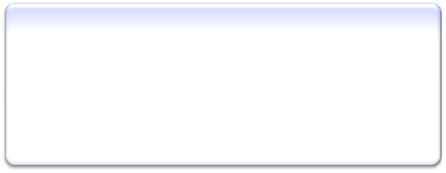
Test
Maintenance
Regression
Testing
Test
Planning
Test
Design
Test Data
Generation
Test
Automation
Test
Execution

Slide 2

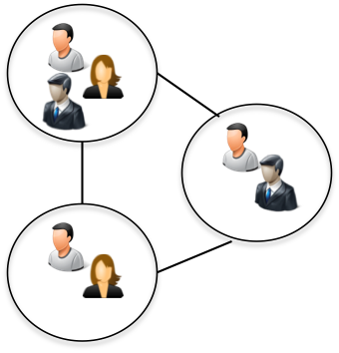



Distributed Development – Single product or client
Services – Multiple clients, distributed
Collocated single product development
Shared
Client B
Client A
Personal Knowledge Management
Intra Project Knowledge Management
Inter Project Knowledge Management

Slide 3


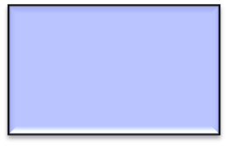


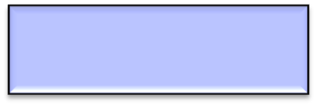
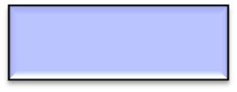



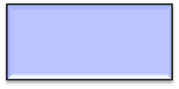
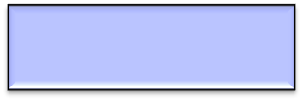



Other Documentation
Email Archives
Context
Manually authored content
Best practices, analysis reports, frequently asked questions ..
ALM Repositories
Query Generator
Manual Query
Expertise mining , recommendation
Quality Detection
Clustering, topic inference
Graph/semantic search
Cross account comparisons
Segment
Classification
Summarize
Question Answer Generation
Text based search
Sanitize
Entity Resolution
Detect Duplicates
Crawl
Parse
Annotate
Index
Search
Rank
Advanced analytics
Content Creation
Content Retrieval

Slide 4
Enter the book name as “MySQL” in the “Title” field, select “Category” as “All” from the drop-down list, and then click “Search” button
Select the book titled “mysql (other new riders)” from the list of search results displayed
Enter login “guest” and password “guest”, and click login
Enter the Quantity “1” and click on “Add to Shopping Cart” button
<enter, title, MySQL>
<select, category, all>
<click, search, >
<select, mysql (other new riders), >
<enter, login, guest >
<enter, password, guest >
<click, login, >
<enter, quantity, 1>
<click, add to shopping cart, >

