Slide 1
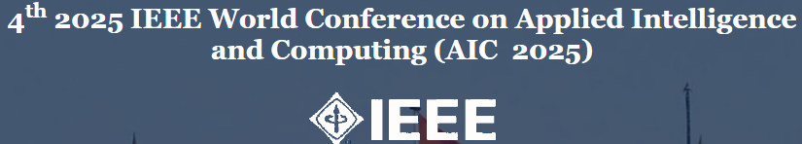

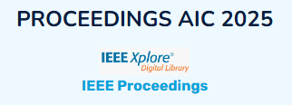
Architecting Next-Gen Financial Systems with AI and Cloud-Native Microservices
IEEE AIC 2025 – 4th IEEE World Conference on Applied Intelligence and Computing
July 26–27, 2025
Mr. Sasibhushan Rao Chanthati,
Senior Member IEEE – Baltimore Section.
AVP Sr. Software Engineer, T. Rowe Price, MD, USA

Slide 2
Problem Statement
Approval Bottlenecks Lengthy and inefficient approval cycles slow investment decisions, impacting time-to-market for financial products.
Data Silos Fragmented data spread across multiple legacy systems hinders real-time analysis and increases error risk.
Regulatory Overload Complex and evolving compliance mandates (GDPR, SOX, DORA) increase operational overhead and require constant auditing.

Slide 3
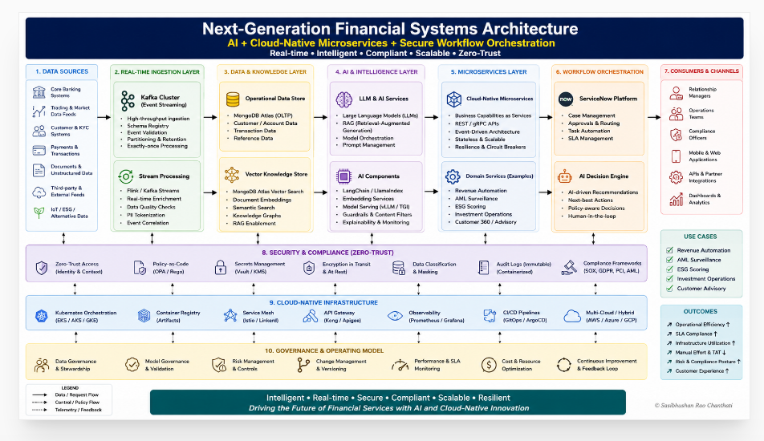

Slide 4
Innovation Overview
Comprehensive AI-powered financial modernization framework.
Integration of LLMs, Vector DB, Kafka, ServiceNow, and Zero Trust security.
Designed for scalability, compliance, and operational efficiency.

Slide 5
ServiceNow-Enabled AI Decision Workflows
Custom Glide APIs, business rules, and scoped applications.
Automated investment reviews, risk controls, and compliance checks.

Slide 6
LLM-Orchestrated Microservices
Integration of LangChain with cloud-native microservices.
Real-time asset valuation, AML detection, and ESG scoring.

Slide 7
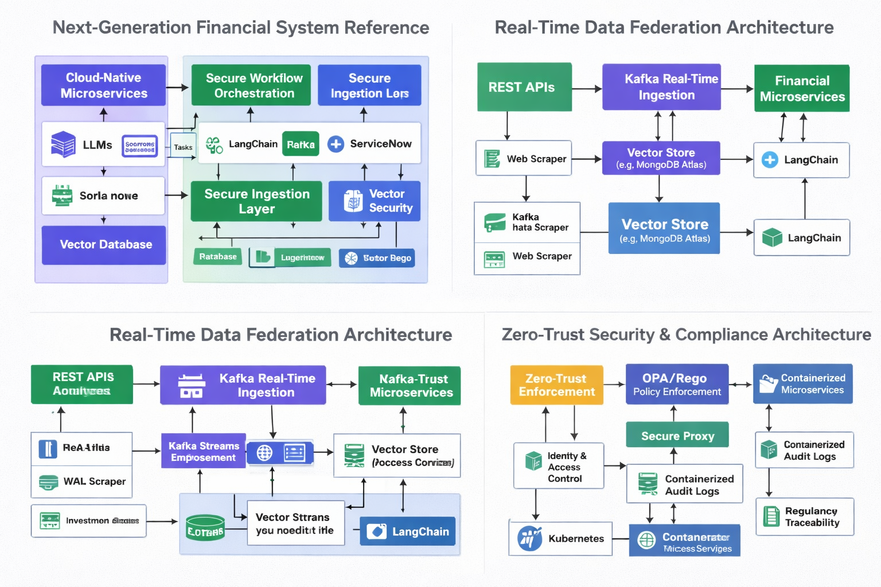

Slide 8
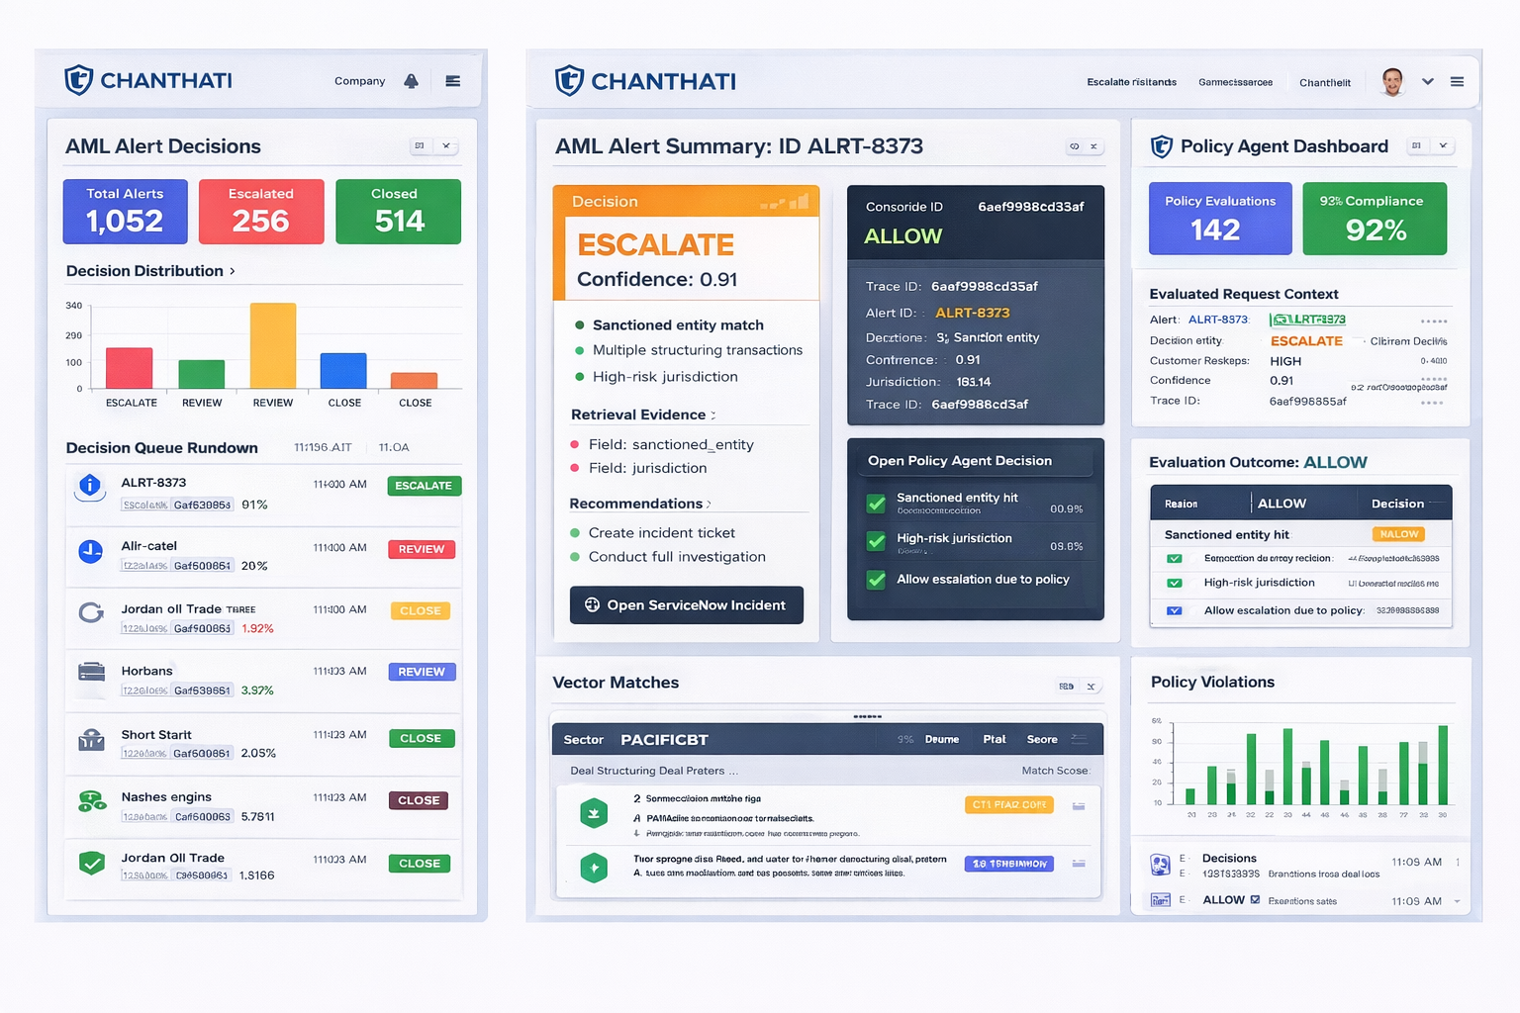

Slide 9
Vector Database Fusion
Semantic embeddings stored in vector search engines.
Enables dynamic, context-aware querying for financial analysis.

Slide 10
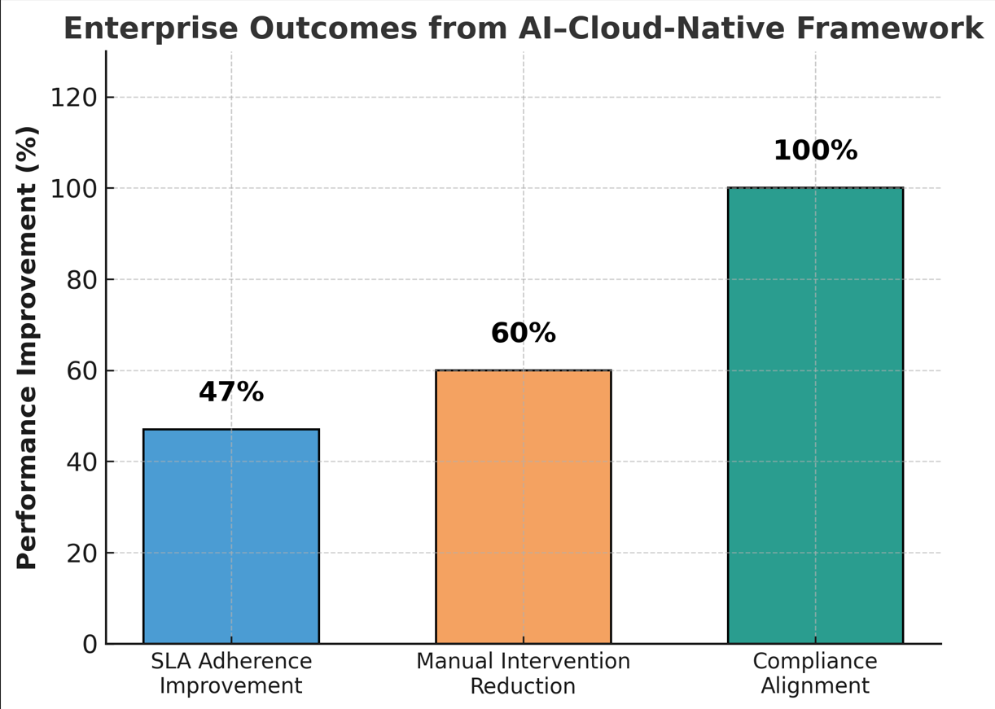

Slide 11
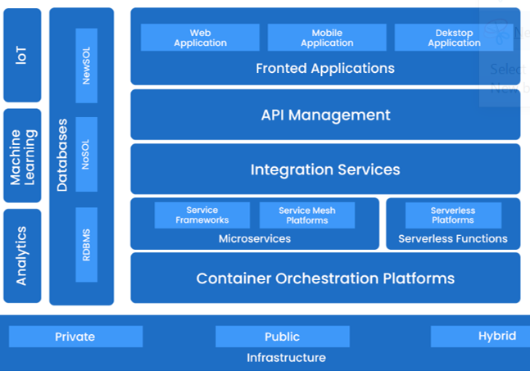

Slide 12
Use Case Solution Method
Overview | Setting up the architectural Process.
System Architecture | Adapt the Standard Cloud-Native layout to include your LLM, Kafka, ServiceNow, vector store, and OPA/Rego layers.
Workflow | Use the Intelligent Financial System flowchart style to show how data flows from input to decisioning modules and dashboards.
Detailed Stack | Use the Financial System Technology Stack to map services gateway, compliance modules, microservices, and data stores.

Slide 13
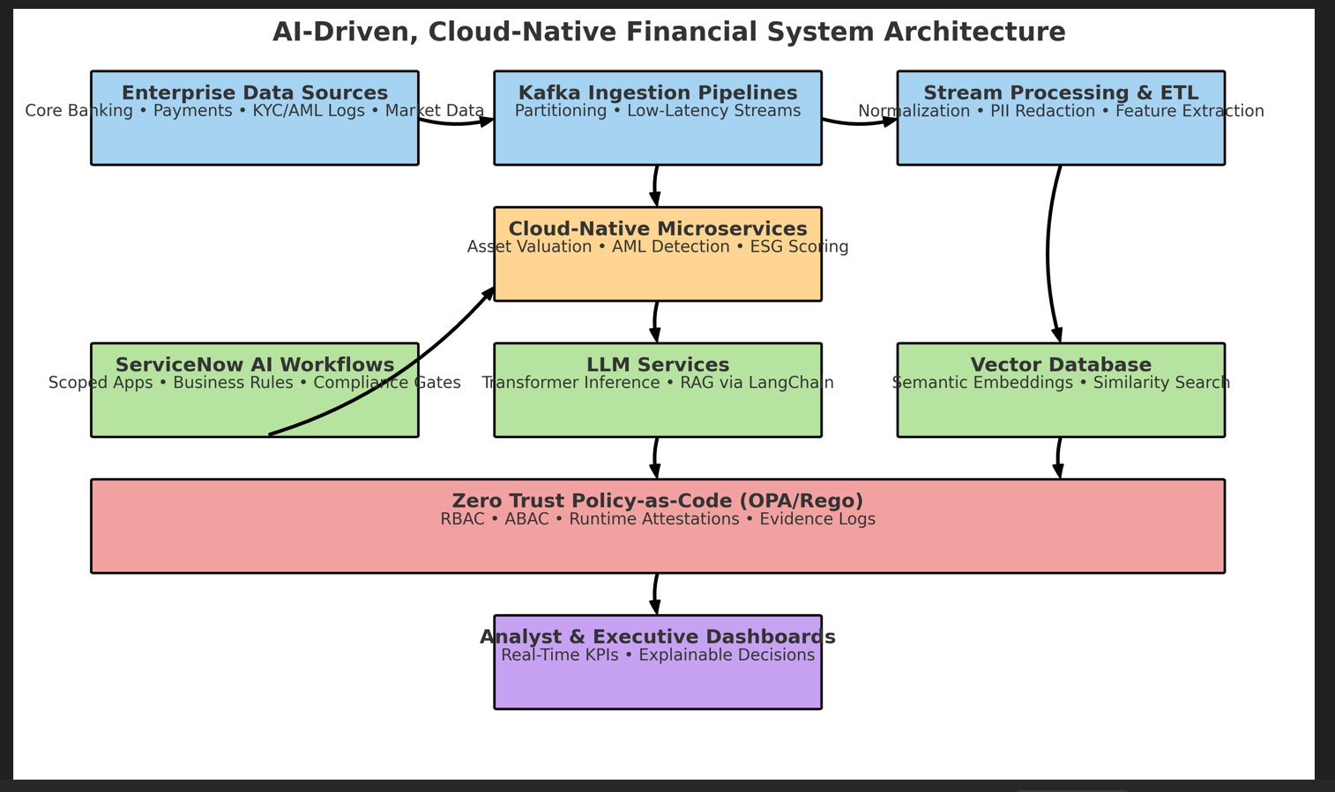

Slide 14
Real-Time Kafka Streams
Federated ingestion pipelines for multi-source transaction data.
Low-latency access enabling real-time analytics.

Slide 15
Zero Trust Enforcement via Policy-as-Code
Role-based access control and compliance modules in OPA/Rego.
Runtime validation logs for regulatory traceability.

Slide 16
Enterprise Outcomes & Metrics
47% improvement in SLA adherence for approval cycles.
60% reduction in manual intervention via AI workflows.
Full explainability of AI decisions for compliance audits.

Slide 17
Broader Impact
Benefits extend to global finance and other regulated sectors.
Combination of academic rigor and enterprise-scale validation.

Slide 18
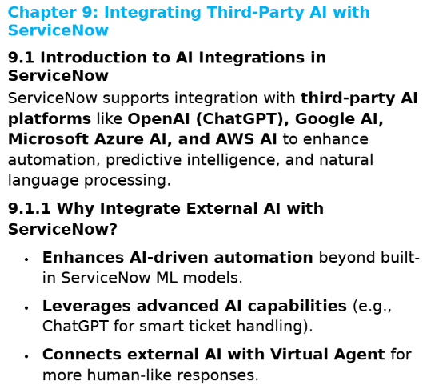
Use Case Reference: “Mastering AI & Machine Learning in ServiceNow: Intelligent Automation & Data-Driven Solutions: AI & Machine Learning in ServiceNow”
International ISBN: 979-8-89704-145-9 Amazon ISBN: 979-8309500550

Slide 19
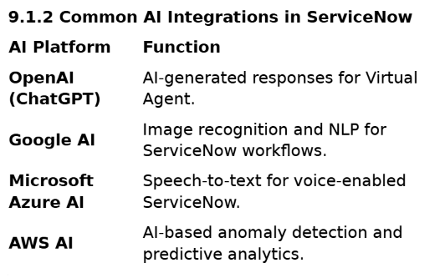
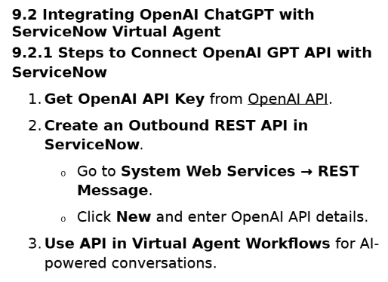
Use Case Reference: “Mastering AI & Machine Learning in ServiceNow: Intelligent Automation & Data-Driven Solutions: AI & Machine Learning in ServiceNow”
International ISBN: 979-8-89704-145-9 Amazon ISBN: 979-8309500550

Slide 20
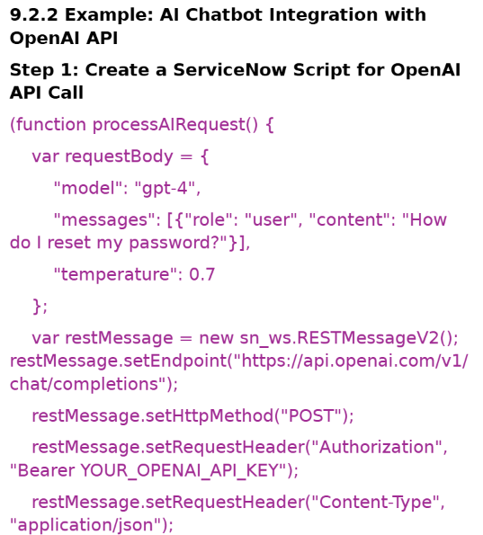
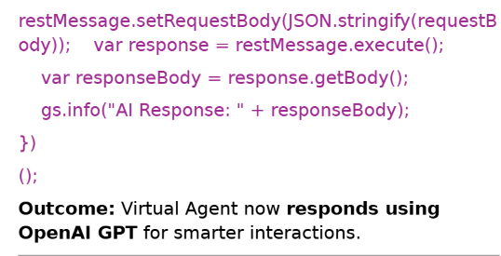
Use Case Reference: “Mastering AI & Machine Learning in ServiceNow: Intelligent Automation & Data-Driven Solutions: AI & Machine Learning in ServiceNow”
International ISBN: 979-8-89704-145-9 Amazon ISBN: 979-8309500550

Slide 21
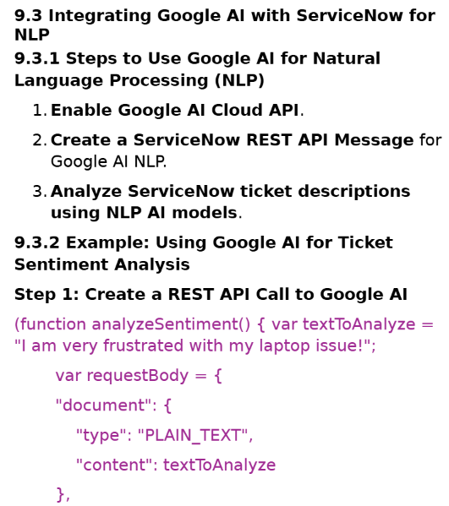
Use Case Reference: “Mastering AI & Machine Learning in ServiceNow: Intelligent Automation & Data-Driven Solutions: AI & Machine Learning in ServiceNow”
International ISBN: 979-8-89704-145-9 Amazon ISBN: 979-8309500550

Slide 22
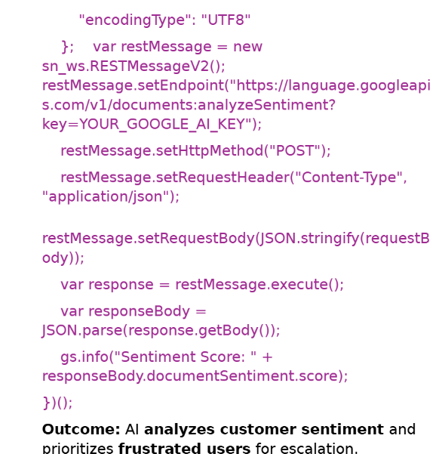
Use Case Reference: “Mastering AI & Machine Learning in ServiceNow: Intelligent Automation & Data-Driven Solutions: AI & Machine Learning in ServiceNow”
International ISBN: 979-8-89704-145-9 Amazon ISBN: 979-8309500550

Slide 23
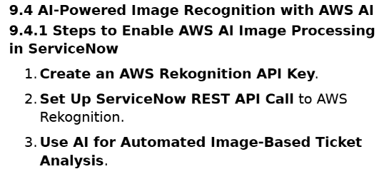
Use Case Reference: “Mastering AI & Machine Learning in ServiceNow: Intelligent Automation & Data-Driven Solutions: AI & Machine Learning in ServiceNow”
International ISBN: 979-8-89704-145-9 Amazon ISBN: 979-8309500550

Slide 24
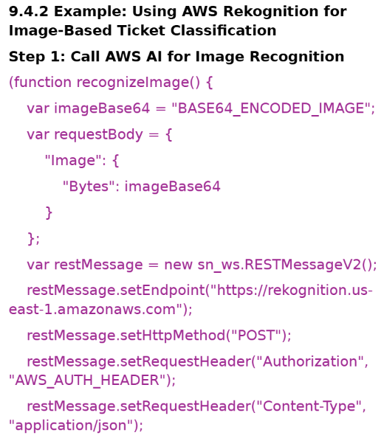
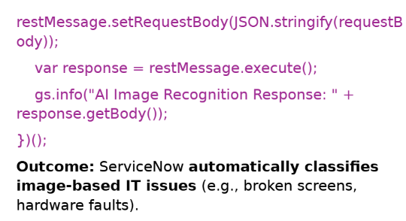
Use Case Reference: “Mastering AI & Machine Learning in ServiceNow: Intelligent Automation & Data-Driven Solutions: AI & Machine Learning in ServiceNow”
International ISBN: 979-8-89704-145-9 Amazon ISBN: 979-8309500550

Slide 25
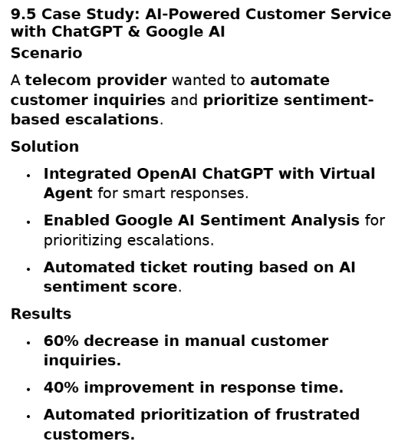
Use Case Reference: “Mastering AI & Machine Learning in ServiceNow: Intelligent Automation & Data-Driven Solutions: AI & Machine Learning in ServiceNow”
International ISBN: 979-8-89704-145-9 Amazon ISBN: 979-8309500550

Slide 26
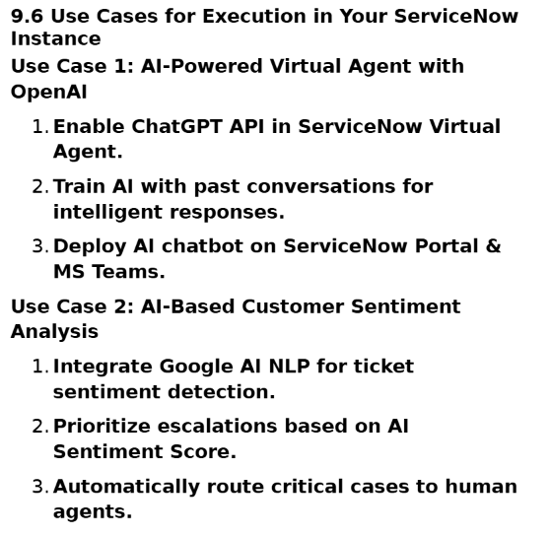
Use Case Reference: “Mastering AI & Machine Learning in ServiceNow: Intelligent Automation & Data-Driven Solutions: AI & Machine Learning in ServiceNow”
International ISBN: 979-8-89704-145-9 Amazon ISBN: 979-8309500550

Slide 27
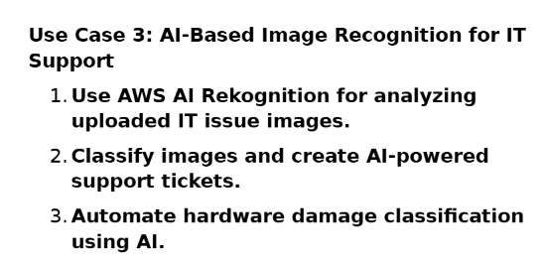
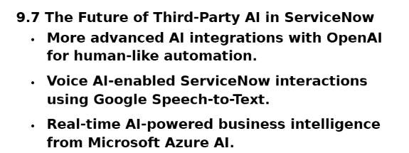
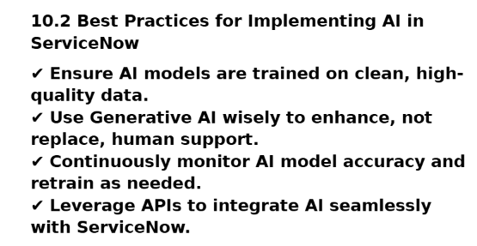
Use Case Reference: “Mastering AI & Machine Learning in ServiceNow: Intelligent Automation & Data-Driven Solutions: AI & Machine Learning in ServiceNow”
International ISBN: 979-8-89704-145-9 Amazon ISBN: 979-8309500550

Slide 28
Use Case Reference: “Mastering AI & Machine Learning in ServiceNow: Intelligent Automation & Data-Driven Solutions: AI & Machine Learning in ServiceNow” Author/Owner: Sasibhushan Rao Chanthati International ISBN: 979-8-89704-145-9 Amazon ISBN: 979-8309500550
Thank you
Contact: [sasichanthati@gmail.com]
https://www.linkedin.com/in/sasibhushanchanthati/

