Slide 1

Designing Trustworthy Artificial Intelligence: Privacy-Preserving Architectures for the Next Generation of Enterprise-Scale Intelligent Systems
Sasibhushan Rao Chanthati
Sr. Software Engineer, Distinguished Fellow, Soft Computing Research Society (SCRS) and Sr. IEEE Baltimore
DOI: 10.5281/zenodo.19766720

Slide 2
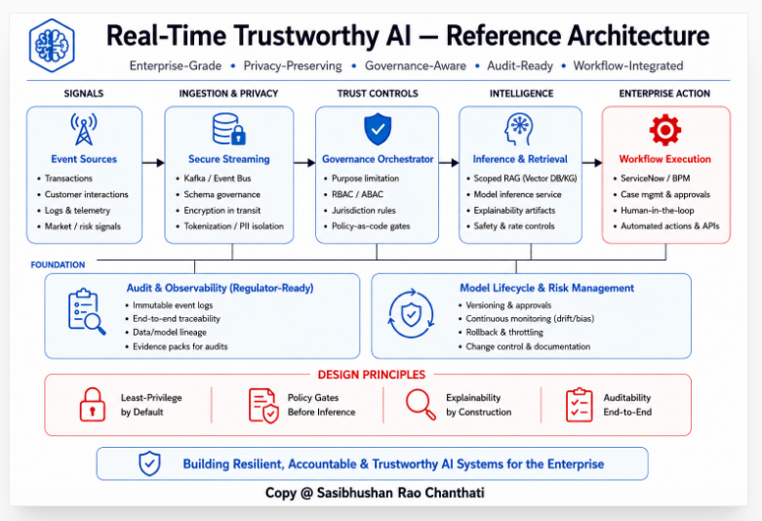

Slide 3
Real-Time Trustworthy Artificial Intelligence Reference Architecture
This architecture illustrates a trust-by-design artificial intelligence framework designed for enterprise-scale intelligent systems operating within governance-sensitive and regulated environments.
The architecture begins with operational and transactional data sources that are processed through secure ingestion and privacy-preserving controls, including encryption, tokenization, and data isolation mechanisms. Governance orchestration components enforce policy controls, access management requirements, and operational guardrails before information reaches the intelligence layer.
The intelligence layer incorporates controlled knowledge retrieval, Retrieval-Augmented Generation (RAG), explainability mechanisms, and safety controls to support accountable artificial intelligence operations. Enterprise workflow integration enables automated actions, business process management, and human-in-the-loop decision workflows.
The architecture is supported by foundational capabilities including audit and observability controls, model lifecycle management, version governance, continuous monitoring, traceability mechanisms, and risk management processes. These components collectively support resilient, accountable, and trustworthy artificial intelligence deployment within enterprise environments.

Slide 4
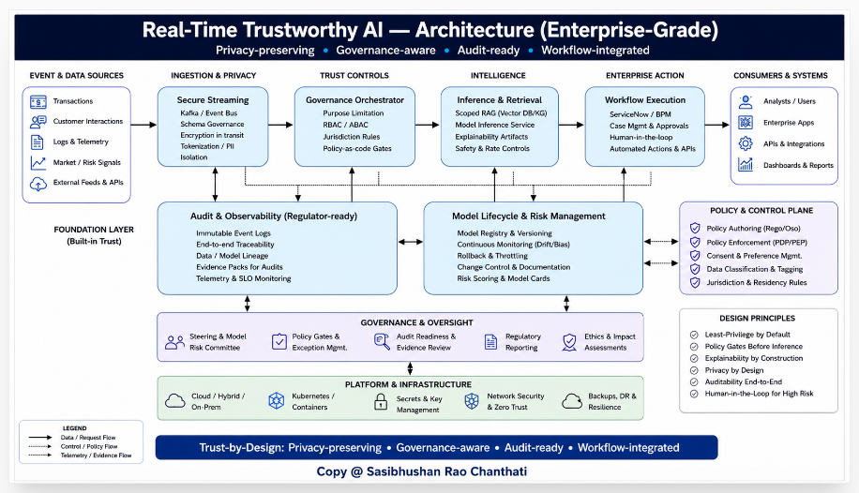

Slide 5
Real-Time Trustworthy AI Architecture
This diagram presents an enterprise-grade artificial intelligence architecture designed around privacy-preserving, governance-aware, audit-ready, and workflow-integrated system principles.
The architecture shows how event and data sources move through secure ingestion, privacy controls, governance orchestration, inference and retrieval, and enterprise workflow execution. It also includes consumers and systems such as analysts, enterprise applications, APIs, integrations, dashboards, and reports.
The foundation layer includes audit and observability, model lifecycle and risk management, governance and oversight, and platform infrastructure. These controls support traceability, policy enforcement, model monitoring, risk review, regulatory reporting, network security, zero trust, backup, disaster recovery, and resilience.
The design principles include least-privilege by default, policy gates before inference, explainability by construction, privacy by design, end-to-end auditability, and human-in-the-loop controls for high-risk artificial intelligence workflows.

Slide 6
Enterprise Trustworthy AI – Technical Architecture
Trust-by-Design
• Privacy-Preserving
• Governance-Aware
• Audit-Ready
• Resilient
• Accountable

Slide 7
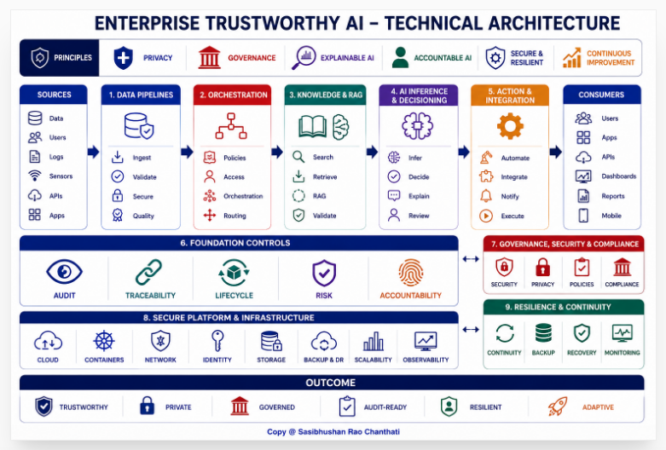

Slide 8
This architecture presents a trust-by-design artificial intelligence framework
integrating privacy-preserving data pipelines, governance-aware orchestration,
controlled knowledge retrieval, Retrieval-Augmented Generation (RAG),
intelligent decisioning, enterprise workflow execution,
and continuous operational oversight.
Key Components
• Privacy-Preserving Data Pipelines
• Governance-Aware Orchestration
• Controlled Knowledge Retrieval
• Retrieval-Augmented Generation (RAG)
• Intelligent Decisioning
• Enterprise Workflow Integration
• Audit and Accountability Controls

Slide 9
Technical Focus Areas
Trust-by-design artificial intelligence architecture and intelligent system design principles.
Privacy-preserving data pipelines, governance-aware orchestration frameworks, and policy-embedded decision infrastructures.
Controlled knowledge retrieval mechanisms and Retrieval-Augmented Generation (RAG) architectures.
Enterprise artificial intelligence architecture integrating governance, security, compliance, and operational oversight controls.
System-level design approaches for resilient, accountable, and trustworthy artificial intelligence environments.
Audit-ready model lifecycle management, traceability controls, and architectural accountability mechanisms.

Slide 10
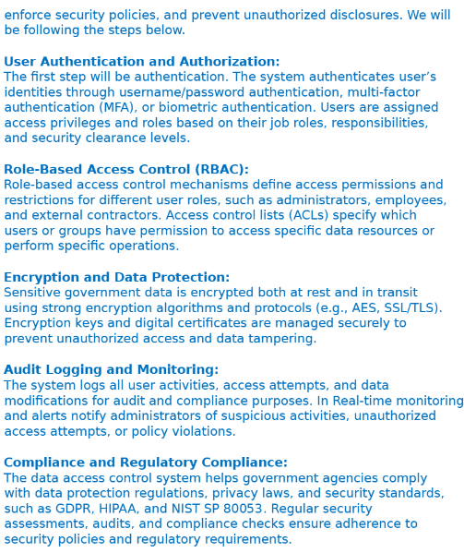
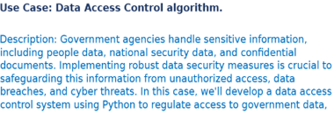

Slide 11
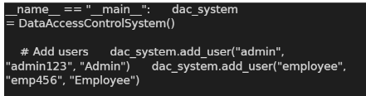
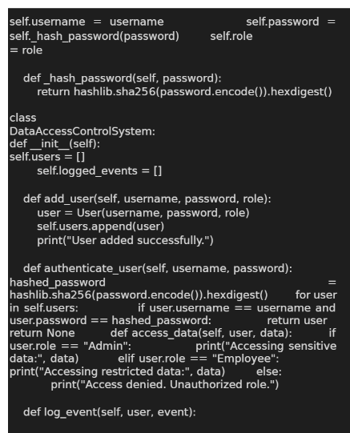
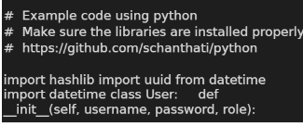
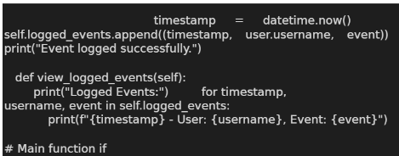
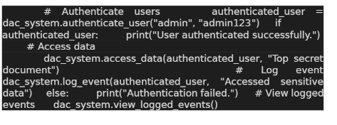

Slide 12
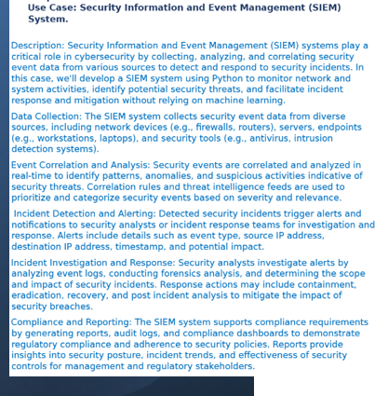
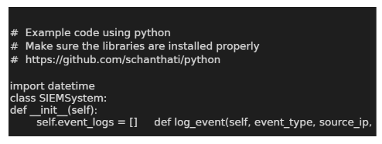
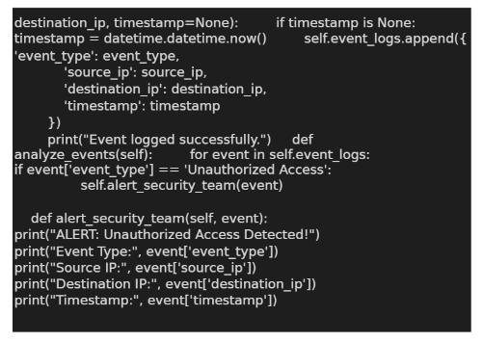
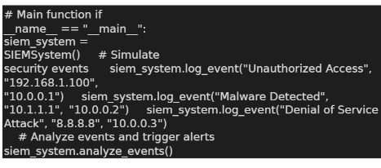

Slide 13
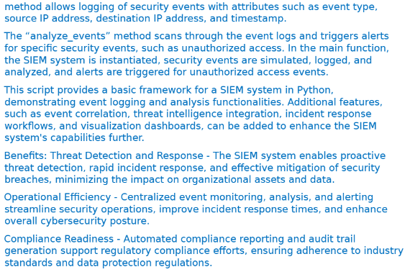
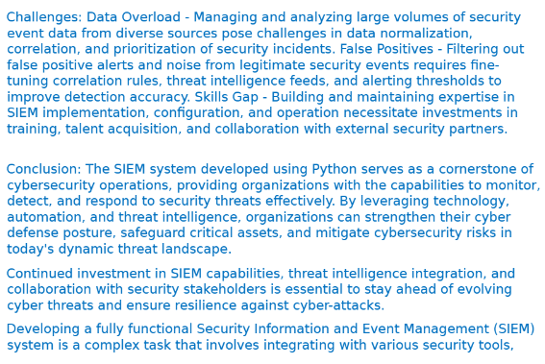

Slide 14
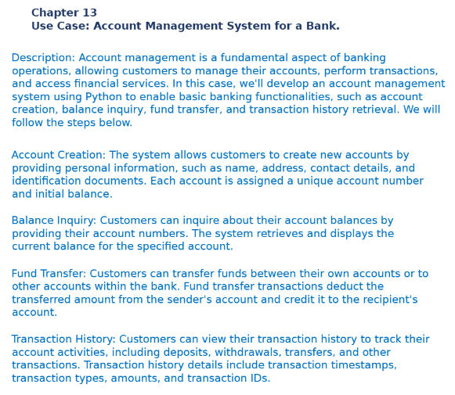
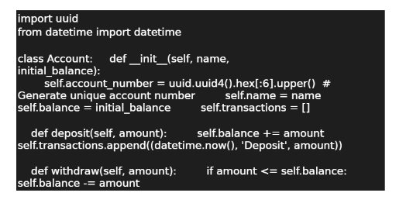

Slide 15
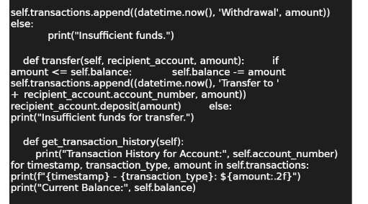



Slide 16
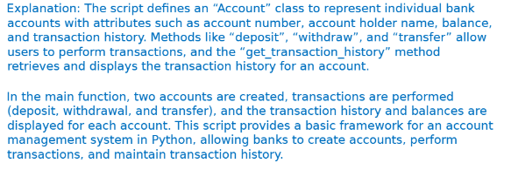
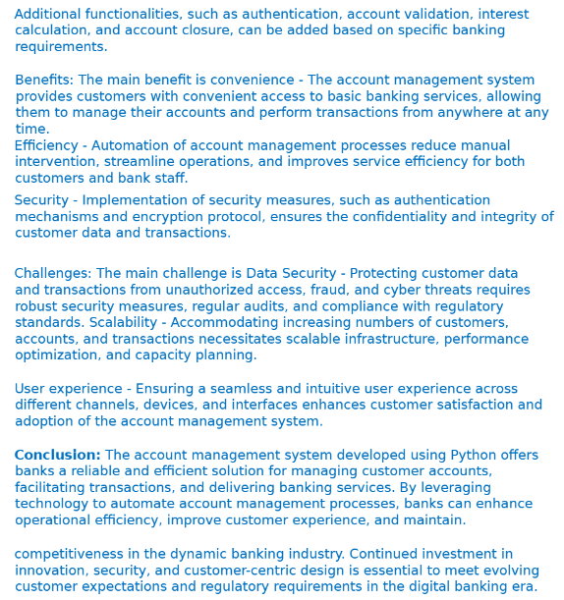

Slide 17
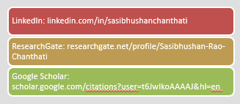
Thank you Sasibhushan Rao Chanthati sasichanthati@gmail.com
Reference - Solutions from Book: A comprehensive guide with solutions of use cases using python programming and leveraging large language model LLM: Use Cases Solutions Using Python and LLM
Author: Sasibhushan Rao Chanthati International ISBN: 979-8-89298-451-5 Amazon ISBN: 979-8307073353

