Slide 1
🛡 ThreatLens AI
AI-powered threat intelligence platform
Enriches CVEs with CISA KEV + NVD data, runs a five-agent LangGraph pipeline, and produces executive-ready security advisories — via a FastAPI backend and a Streamlit dashboard.
ThreatLens AI · AI-powered threat intelligence · Data sourced from CISA KEV + NVD

Slide 2
How It Works
An API-first, agent-driven architecture.
👤 User
Streamlit
Dashboard
FastAPI
Backend
LangGraph
Orchestrator
5 Agents
→
→
→
→
The five specialized agents:
🔍 Threat Intelligence
Merges CISA KEV + NVD, generates a structured CVE report
LLM
🏭 Industry Intelligence
Executive security briefing tailored to an industry
LLM
📦 Exposure
Attack-surface profile derived from a CycloneDX SBOM
Deterministic
⚖️ Risk
Scores threat + industry + exposure into one risk rating
Deterministic
📝 Advisor
Synthesizes everything into a Markdown security advisory
LLM
ThreatLens AI · AI-powered threat intelligence · Data sourced from CISA KEV + NVD

Slide 3
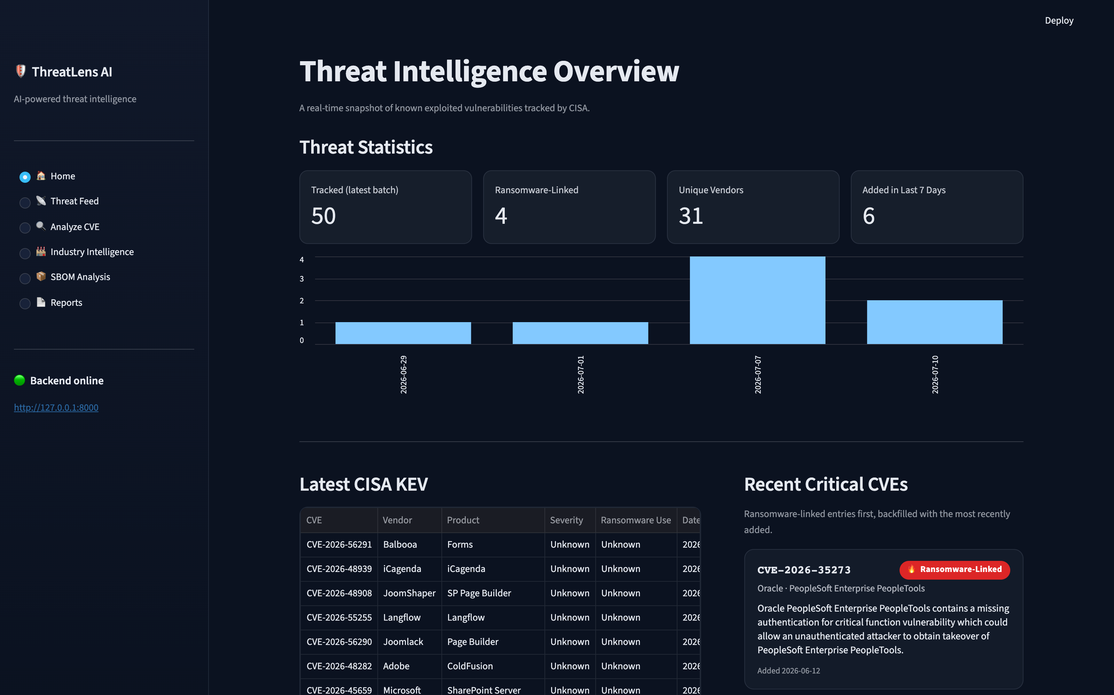
No agent · live feed
Home — Threat Overview
A real-time snapshot of CISA's Known Exploited Vulnerabilities.
• Key stats: tracked entries, ransomware-linked, unique vendors, added in the last 7 days.
• A 14-day trend chart of newly added entries.
• Latest KEV table beside the most recent critical CVEs — ransomware-linked surfaced first.
Reads the CISA KEV feed directly — no agent required.
ThreatLens AI · AI-powered threat intelligence · Data sourced from CISA KEV + NVD

Slide 4
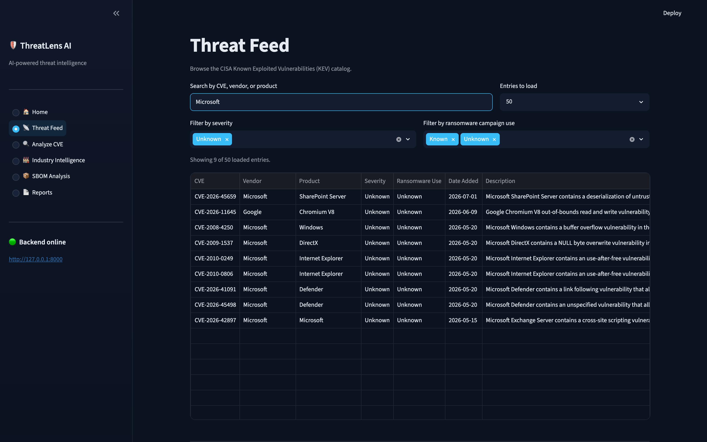
No agent · live feed
Threat Feed
Browse the full CISA KEV catalog.
• Search by CVE, vendor, or product.
• Filter by severity and ransomware-campaign use.
• Load 20–200 entries on demand.
The analyst's starting point for triage. Filtering happens client-side.
ThreatLens AI · AI-powered threat intelligence · Data sourced from CISA KEV + NVD

Slide 5
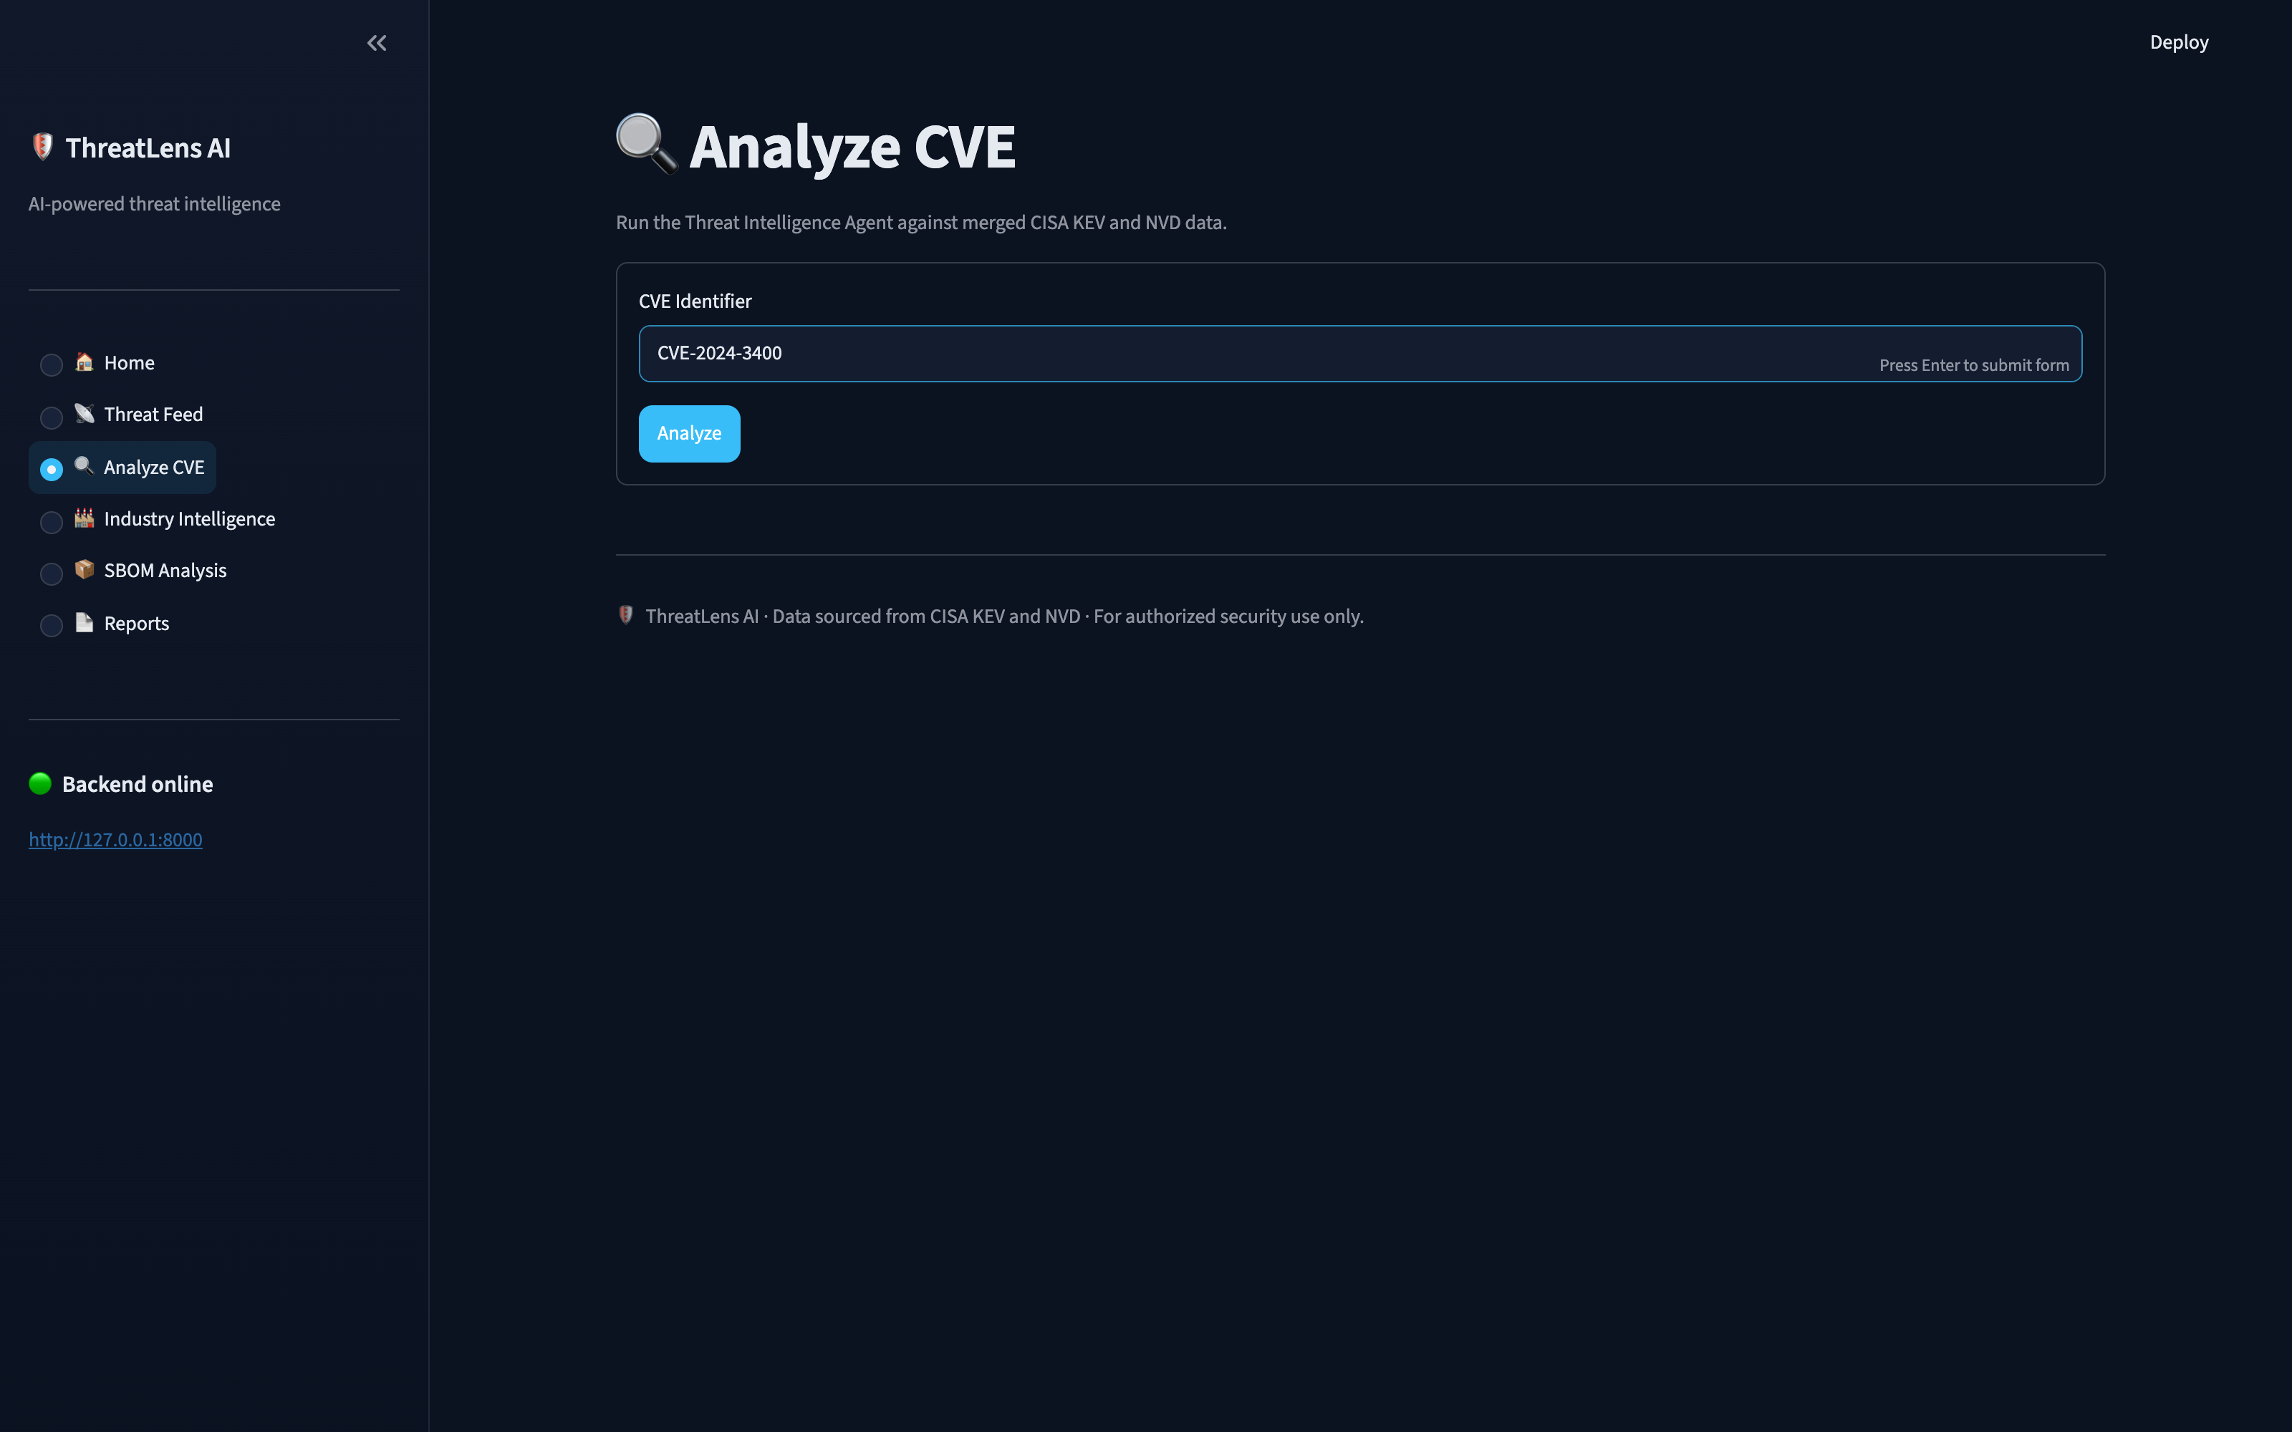
🔍 Threat Intelligence Agent
Analyze CVE — Run
Single-CVE deep dive.
Enter any CVE and the Threat Intelligence Agent:
• Queries the CISA KEV catalog,
• Enriches it with NVD vulnerability data,
• Calls the LLM to generate a structured report.
Progress is shown live at every step.
ThreatLens AI · AI-powered threat intelligence · Data sourced from CISA KEV + NVD

Slide 6
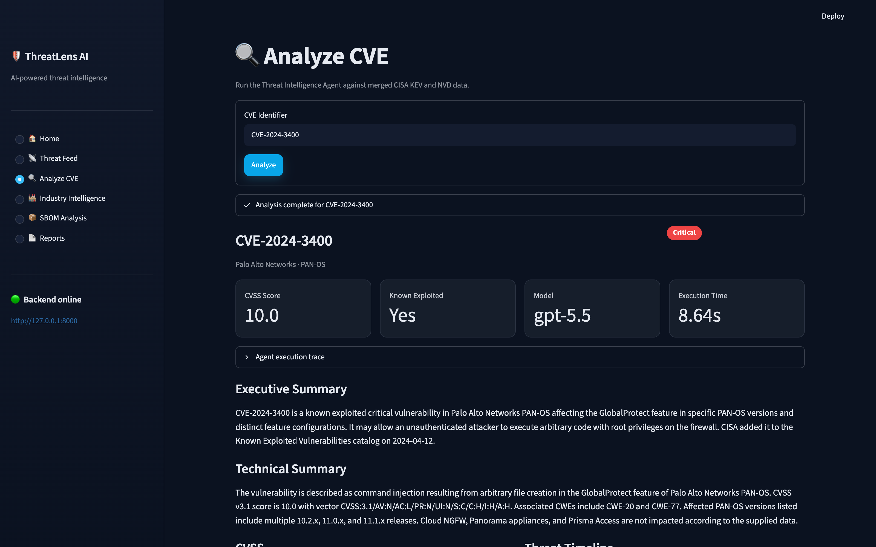
🔍 Threat Intelligence Agent
Analyze CVE — Result
From raw feeds to an executive-ready brief.
• Metrics: CVSS score, exploitation status, model, execution time.
• A severity badge and vendor / product header.
• AI-written executive & technical summaries, CVSS breakdown, and a threat timeline.
Example: CVE-2024-3400 — CVSS 10.0, Critical, known exploited.
ThreatLens AI · AI-powered threat intelligence · Data sourced from CISA KEV + NVD

Slide 7
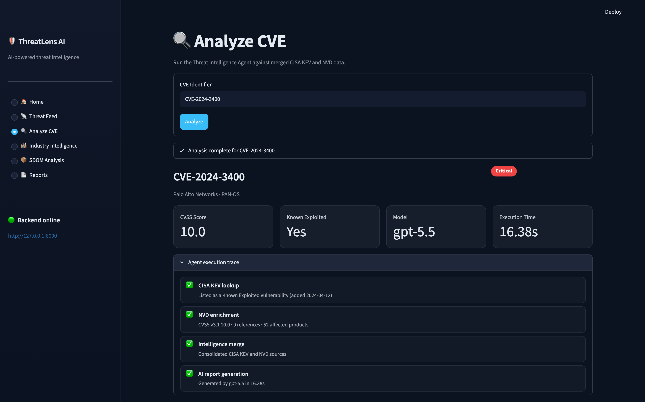
🔍 Threat Intelligence Agent
Explainable & Auditable
No black box.
Every report includes a verified, step-by-step trace of what the agent did:
• ✅ CISA KEV lookup
• ✅ NVD enrichment (CVSS, references, affected products)
• ✅ Intelligence merge
• ✅ AI report generation
The raw merged CISA KEV + NVD payload is one click away.
ThreatLens AI · AI-powered threat intelligence · Data sourced from CISA KEV + NVD

Slide 8
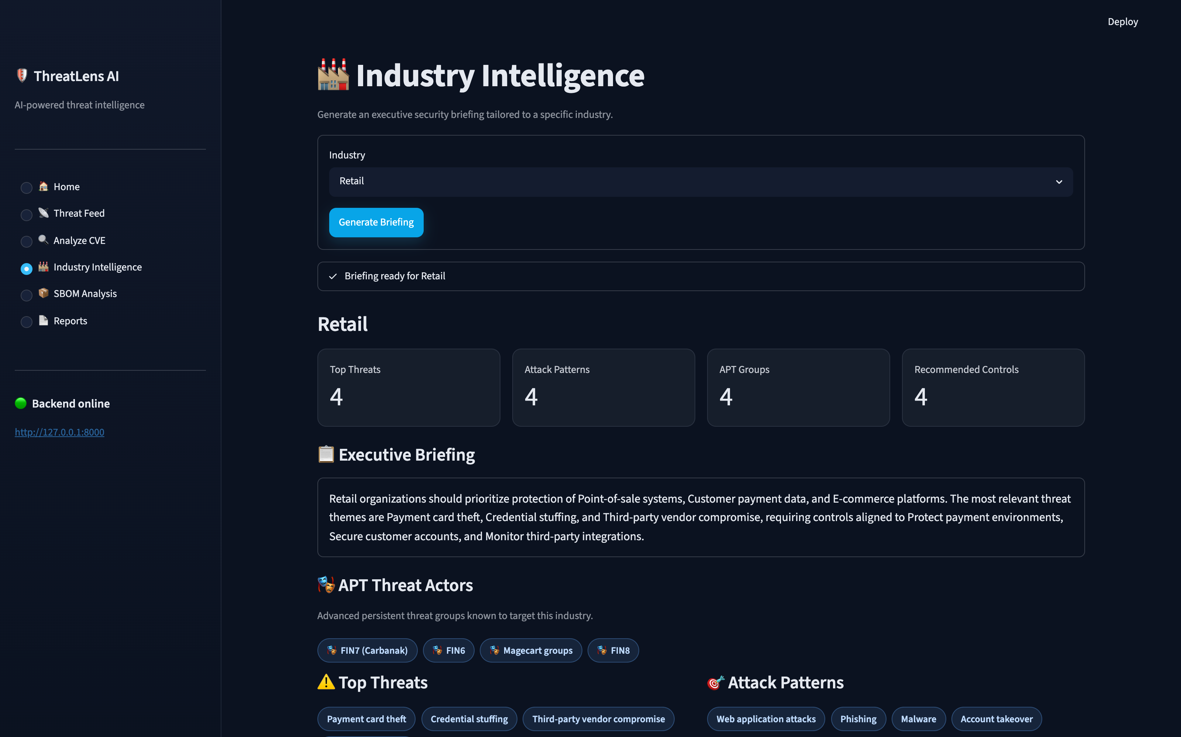
🏭 Industry Intelligence Agent
Industry Intelligence
Industry-tailored security briefings.
Pick an industry and the agent compiles an executive briefing:
• Top threats and common attack patterns,
• APT groups known to target that sector (e.g. FIN7, Magecart),
• Recommended controls and business priorities.
ThreatLens AI · AI-powered threat intelligence · Data sourced from CISA KEV + NVD

Slide 9
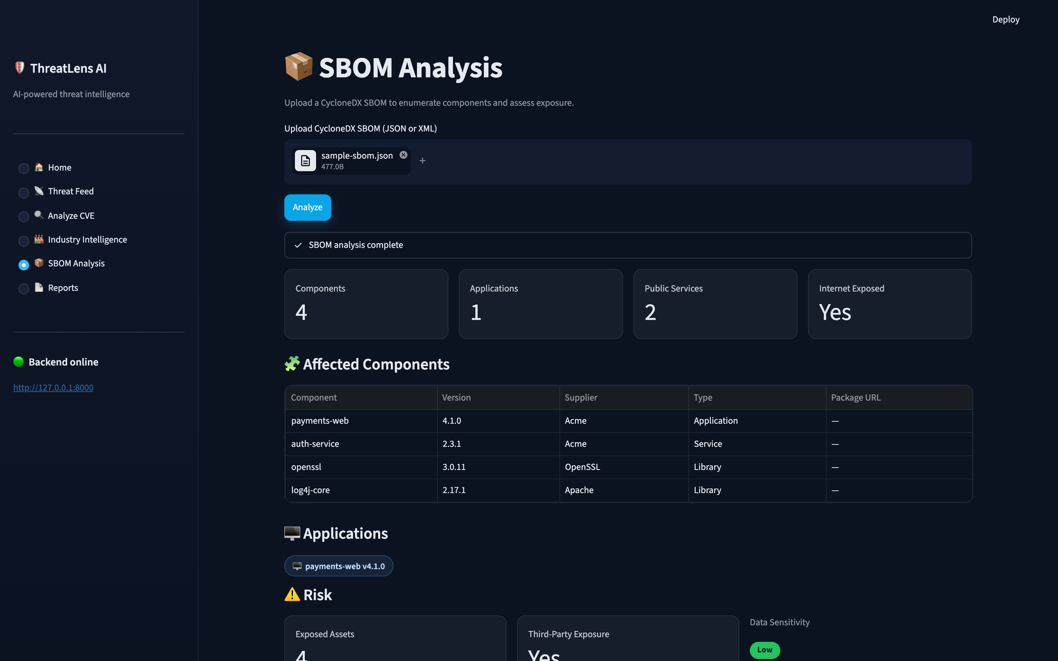
📦 Exposure Agent
SBOM Analysis
Know your attack surface.
Upload a CycloneDX SBOM and the Exposure Agent:
• Enumerates components and applications,
• Derives an exposure profile — public services, internet exposure, third-party risk, data sensitivity,
• Returns concrete recommendations.
Fully deterministic — no LLM involved.
ThreatLens AI · AI-powered threat intelligence · Data sourced from CISA KEV + NVD

Slide 10
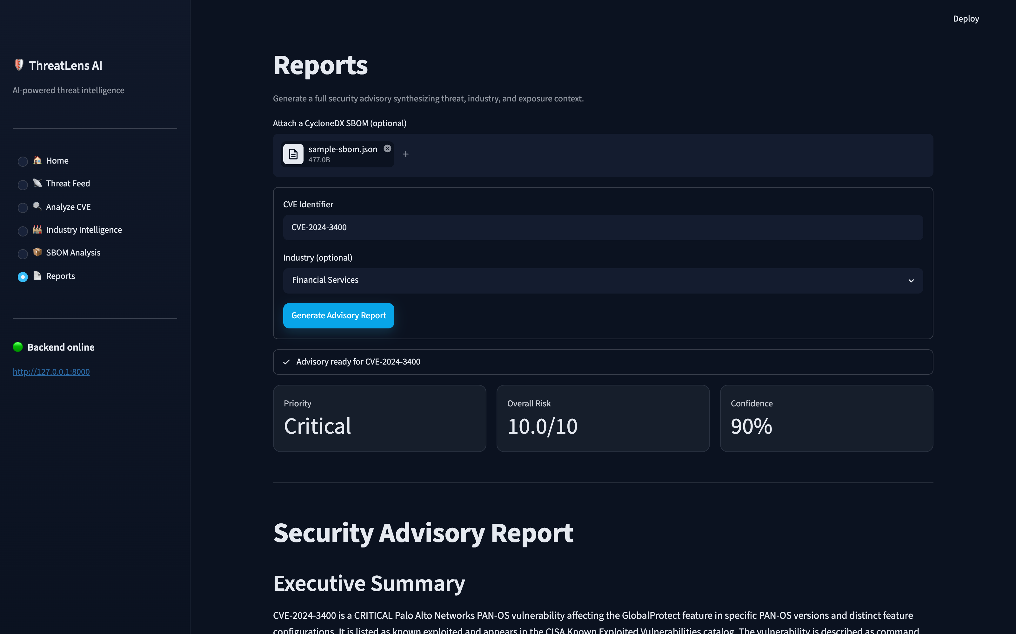
⚙️ Orchestrator · ⚖️ Risk · 📝 Advisor
Reports — Full Advisory
One click, full advisory.
Runs the entire LangGraph pipeline:
🔍 Threat → 🏭 Industry → 📦 Exposure → ⚖️ Risk → 📝 Advisor.
• Risk Agent scores threat + industry + exposure (Priority, Overall Risk, Confidence).
• Advisor Agent writes the final downloadable Markdown advisory.
Exposure runs only when an SBOM is attached (conditional routing).
ThreatLens AI · AI-powered threat intelligence · Data sourced from CISA KEV + NVD

Slide 11
🛡 ThreatLens AI
From public feeds to executive-ready advisories — with explainable, auditable agents. Built for authorized security research, CTF, and defensive use.
ThreatLens AI · AI-powered threat intelligence · Data sourced from CISA KEV + NVD

