Slide 1
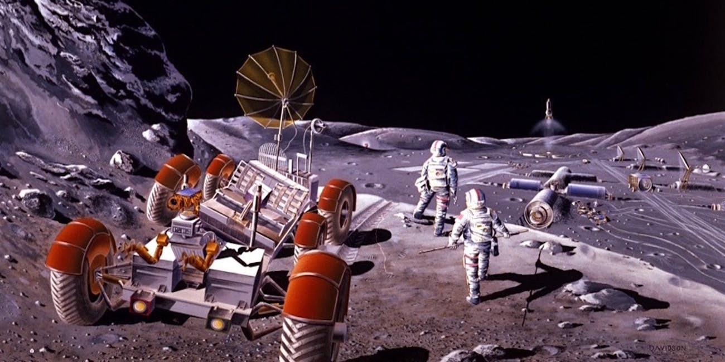

Water in the South Pole…
….of the MOON!
Galgos PUC-Rio
Georges, Guilherme, Leonardo, Luiz, Matheus

Slide 2
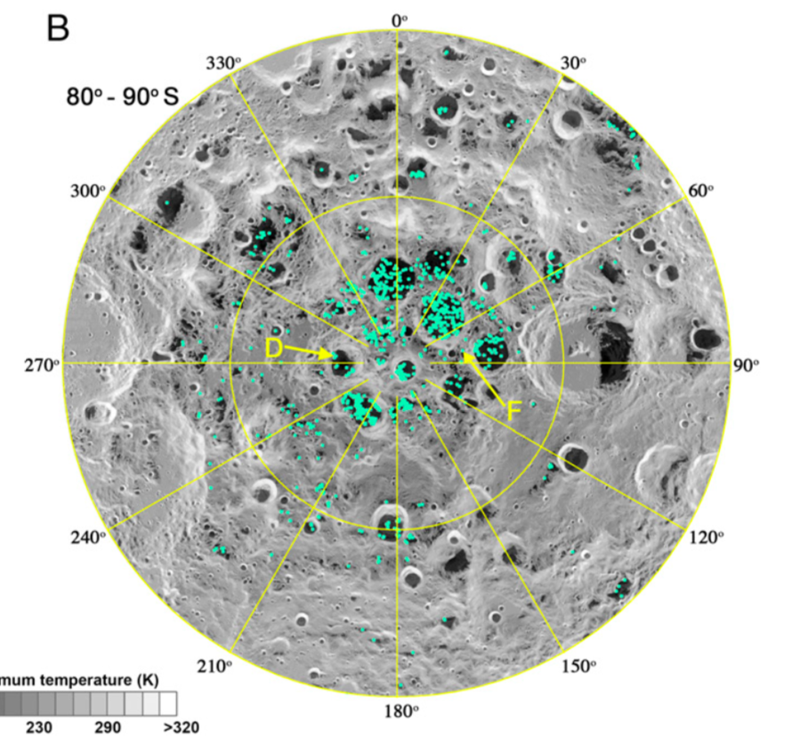
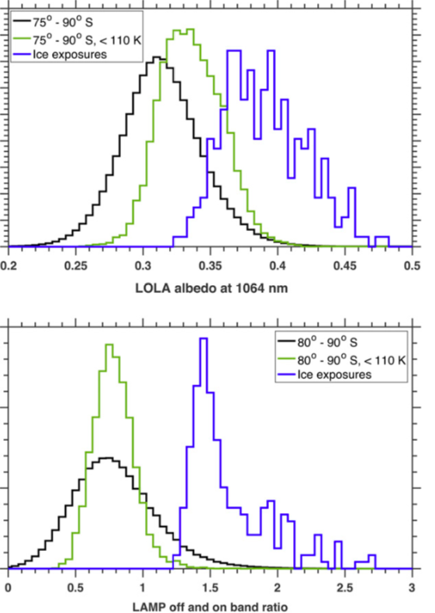

Slide 3
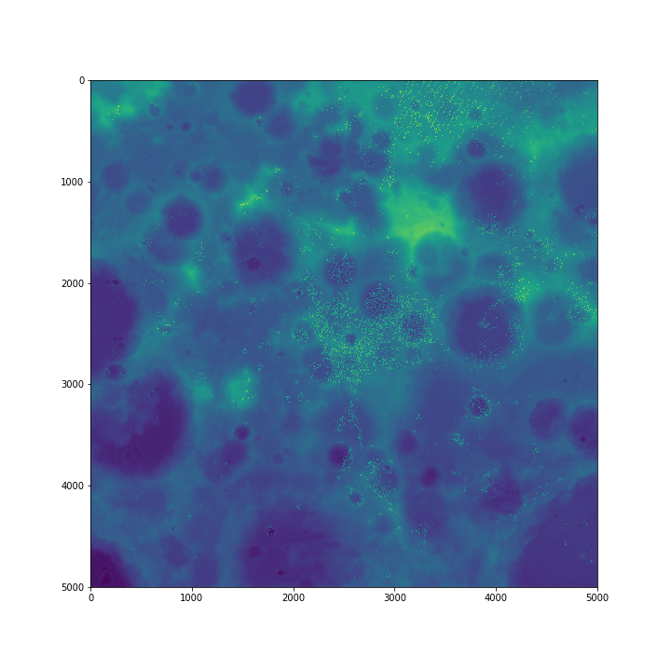

Slide 4

x

Slide 5
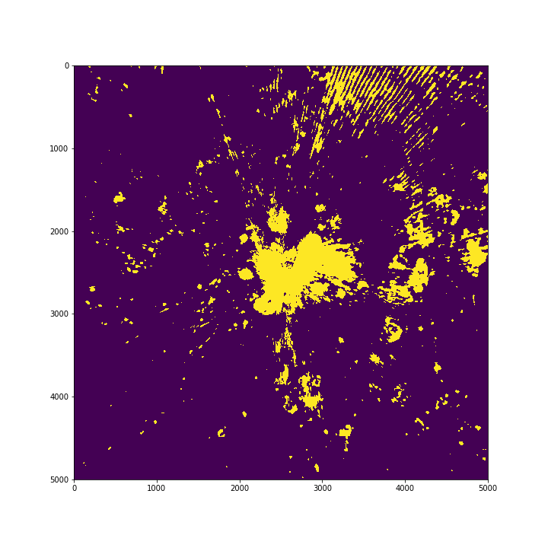

Slide 6
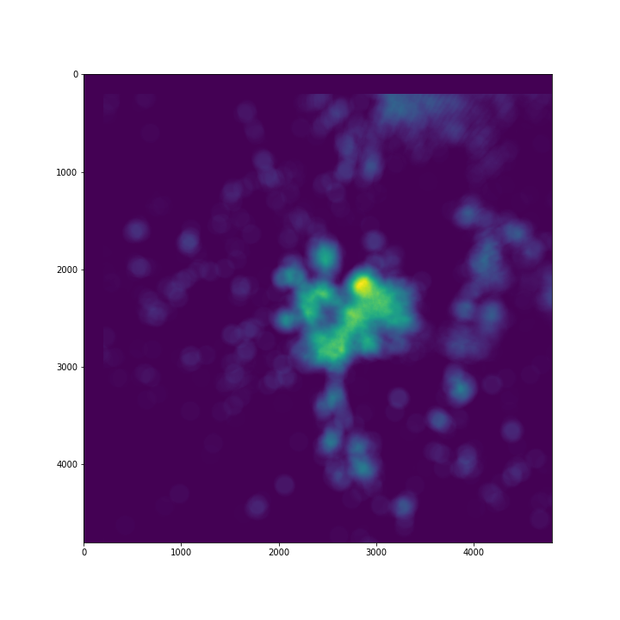

Slide 7
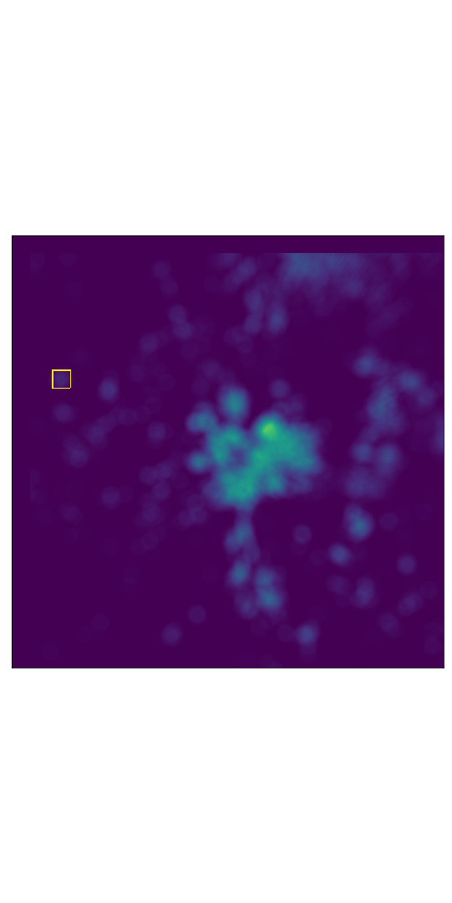

Slide 8
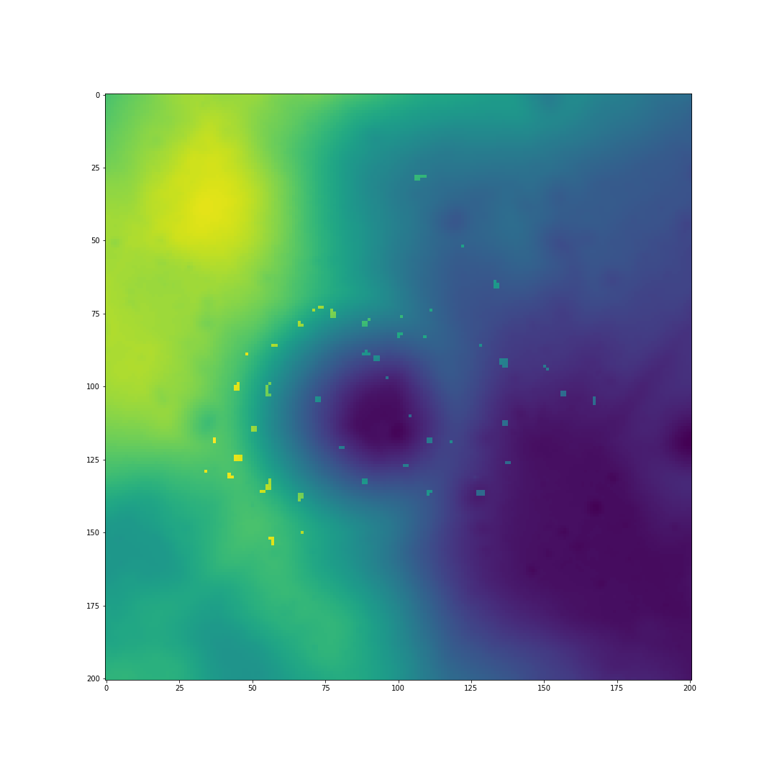

Slide 9


Slide 10
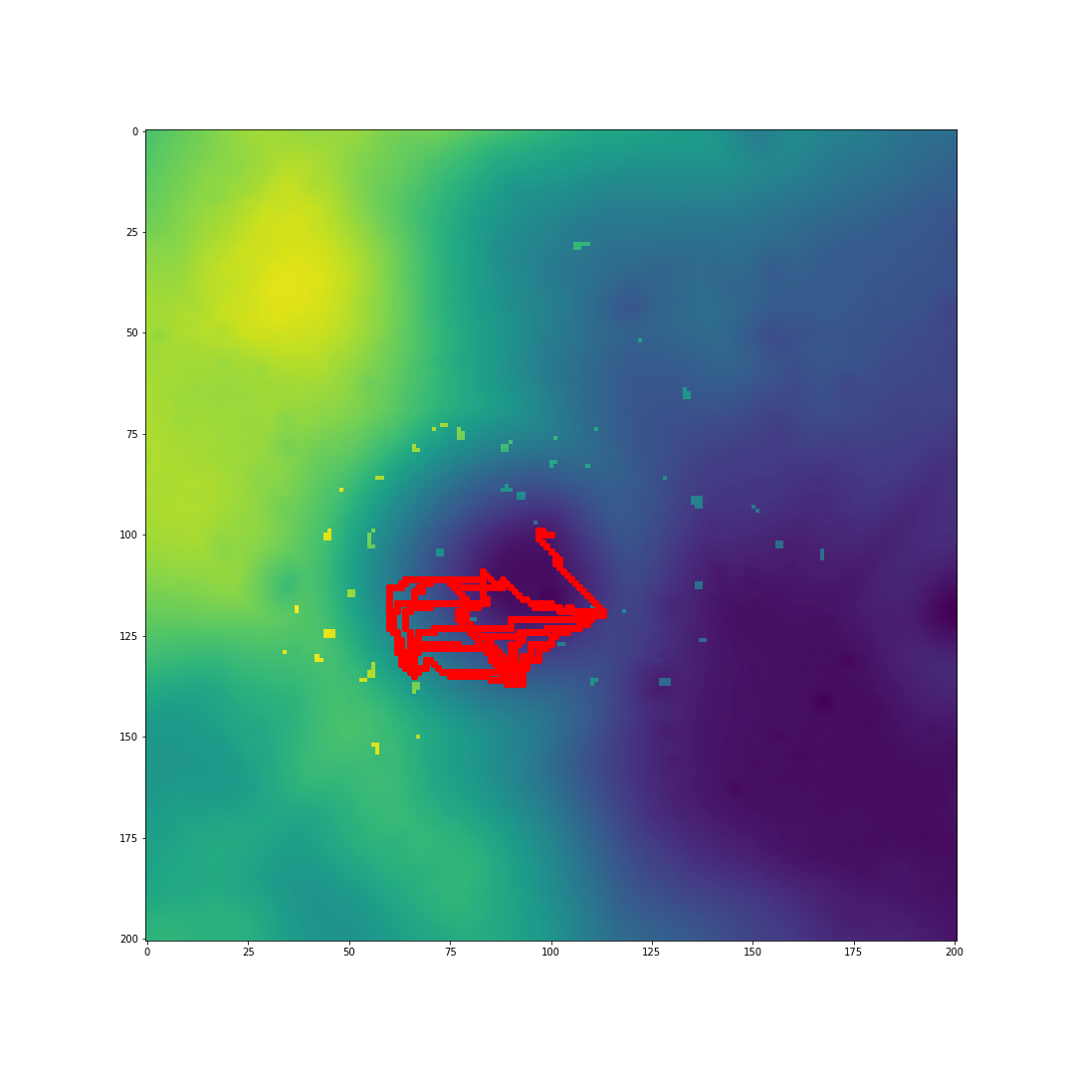
CHARGE 1

Slide 11
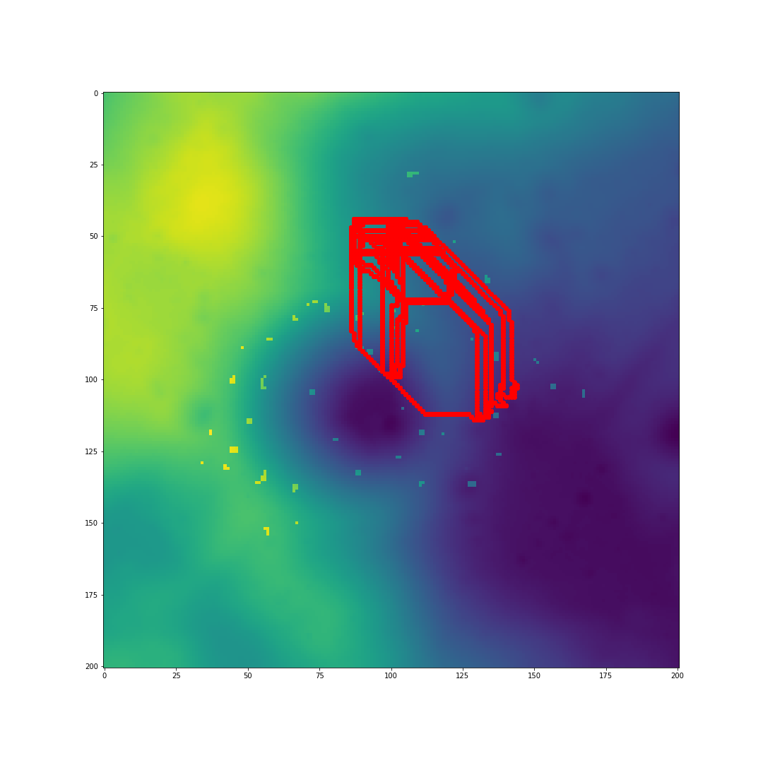
CHARGE 2

Slide 12

CHARGE 3

Slide 13
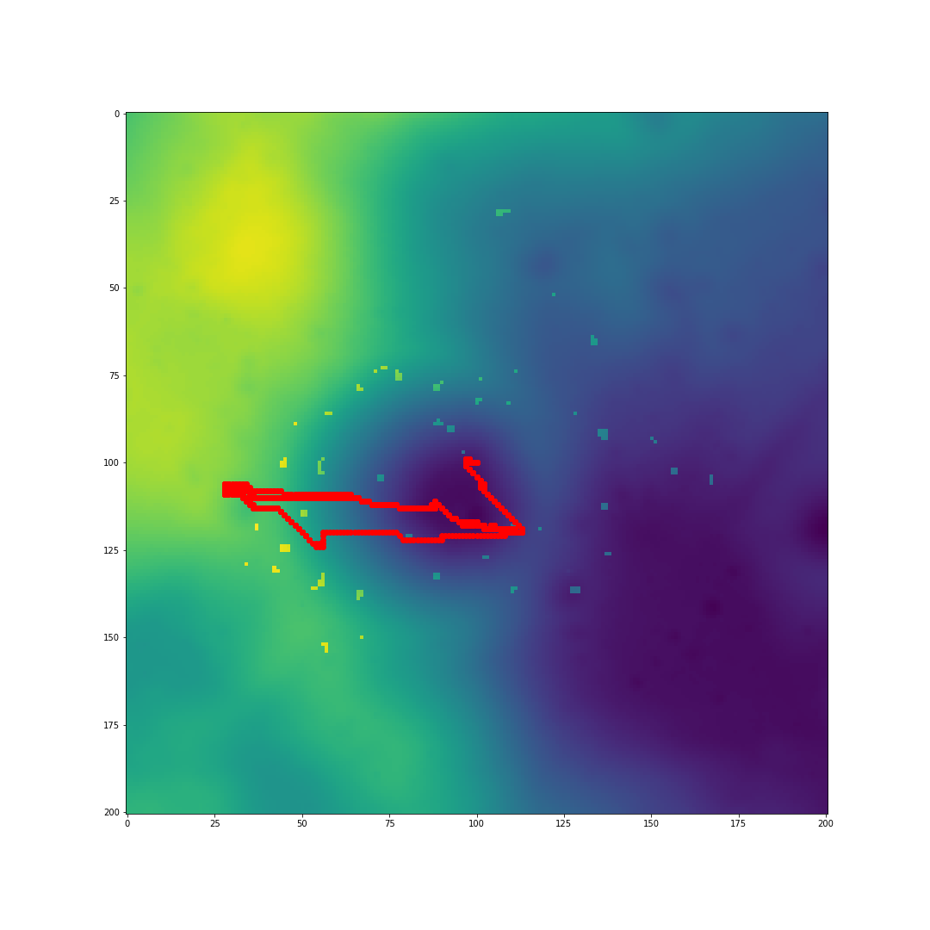
CHARGE 4

Slide 14
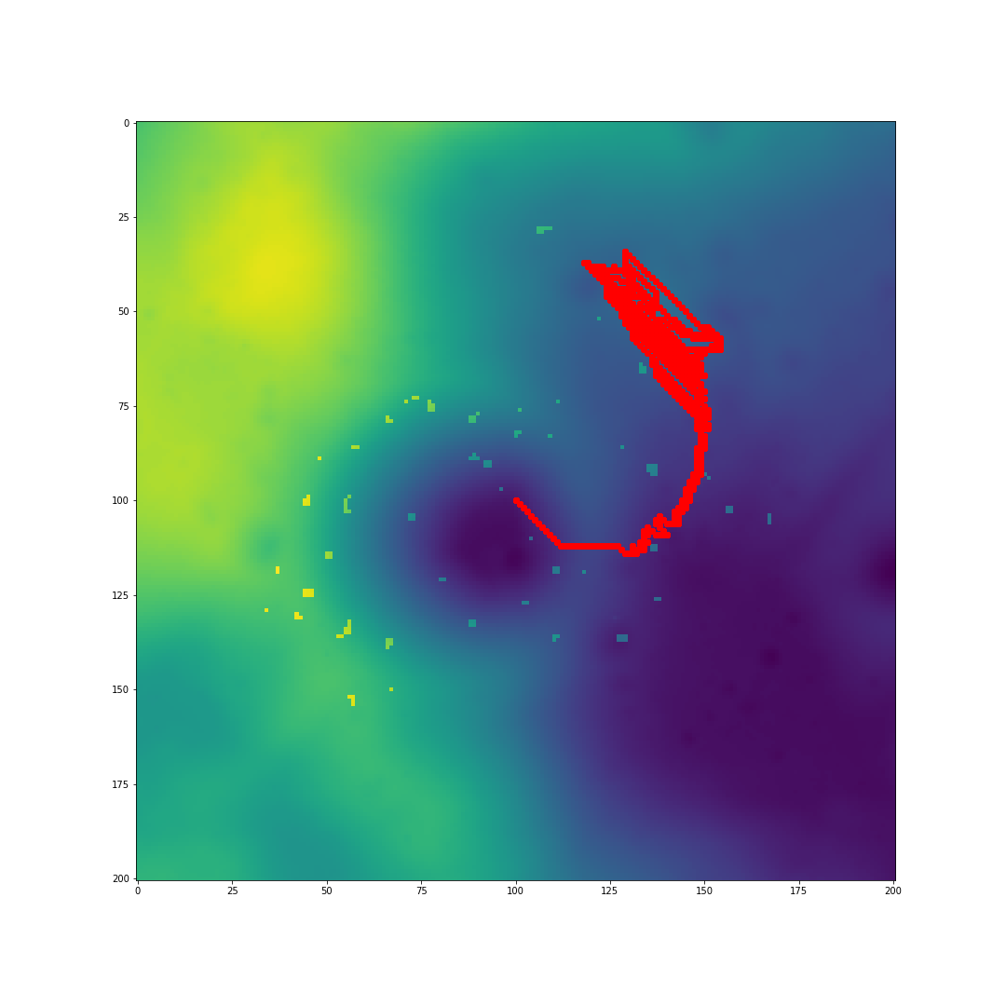
CHARGE 5

Slide 15
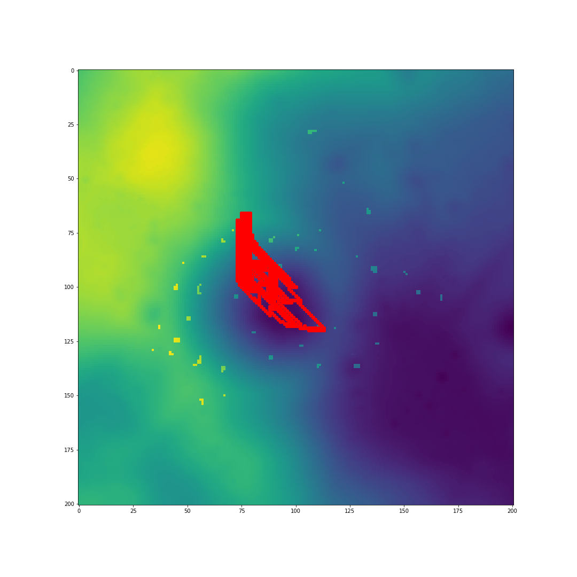
CHARGE 6

