Slide 1


Networked Programs
Chapter 12
Python for Everybody
www.py4e.com
Notes:
Note from Chuck. If you are using these materials, you can remove the UM logo and replace it with your own, but please retain the CC-BY logo on the first page as well as the acknowledgement page(s) at the end.

Slide 2

TCP Connections / Sockets
“In computer networking, an Internet socket or network socket is an endpoint of a bidirectional inter-process communication flow across an Internet Protocol-based computer network, such as the Internet.”
Process
Process
Internet
http://en.wikipedia.org/wiki/Internet_socket

Slide 3
Sockets in Python
Python has built-in support for TCP Sockets
import socket
mysock = socket.socket(socket.AF_INET, socket.SOCK_STREAM)
mysock.connect( ('data.pr4e.org', 80) )
Host
Port
http://docs.python.org/library/socket.html

Slide 4
Application Protocols

Slide 5
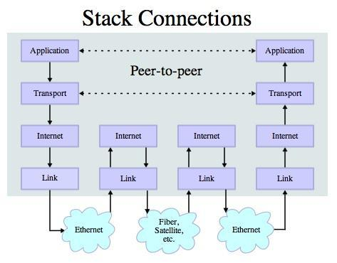
Application Protocol
Since TCP (and Python) gives us a reliable socket, what do we want to do with the socket? What problem do we want to solve?
Application Protocols
- Mail
- World Wide Web
Source: http://en.wikipedia.org/wiki/Internet_Protocol_Suite

Slide 6
HTTP - Hypertext Transfer Protocol
The dominant Application Layer Protocol on the Internet
Invented for the Web - to Retrieve HTML, Images, Documents, etc.
Extended to be data in addition to documents - RSS, Web Services, etc. Basic Concept - Make a Connection - Request a document - Retrieve the Document - Close the Connection
http://en.wikipedia.org/wiki/Http

Slide 7
HTTP
The HyperText Transfer Protocol is the set of rules to allow browsers to retrieve web documents from servers over the Internet

Slide 8
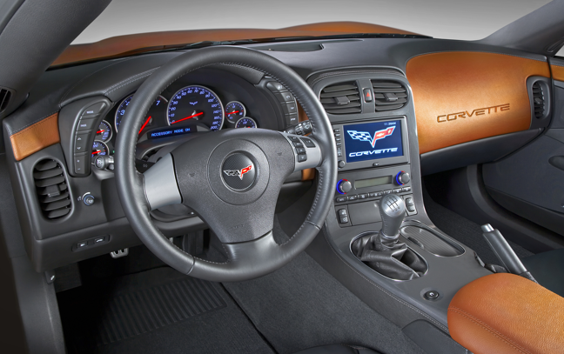
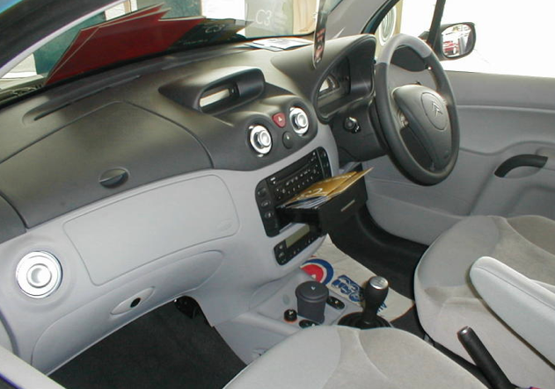
What is a Protocol?
A set of rules that all parties follow so we can predict each other’s behavior
And not bump into each other
On two-way roads in USA, drive on the right-hand side of the road
On two-way roads in the UK, drive on the left-hand side of the road

Slide 9
http://www.dr-chuck.com/page1.htm
protocol
host
document

Slide 10
Source code

Slide 11
Viewing the Source Code
Chrome:
using Right-Click, Inspect Element
Firefox:
Press the Alt key to bring up the browser's menu bar.
Select Tools, Web Developer, and then Page Source.
Safari:
Select the Develop menu.

Slide 12
Getting Data From The Server
Each time the user clicks on an anchor tag with an href= value to switch to a new page, the browser makes a connection to the web server and issues a “GET” request - to GET the content of the page at the specified URL
The server returns the HTML document to the browser, which formats and displays the document to the user

Slide 13

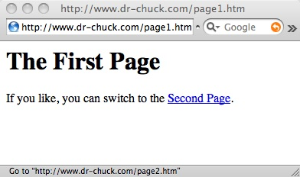
Web Server
80
Browser

Slide 14
Web Server
80
Browser
Click

Slide 15
Request
Web Server
80
GET http://www.dr-chuck.com/page2.htm
Browser
Click

Slide 16
Request
Web Server
80
GET http://www.dr-chuck.com/page2.htm
Browser
Click

Slide 17
Request
Web Server
Response
80
<h1>The Second Page</h1><p>If you like, you can switch back to the <a href="page1.htm">First Page</a>.</p>
GET http://www.dr-chuck.com/page2.htm
Browser
Click

Slide 18
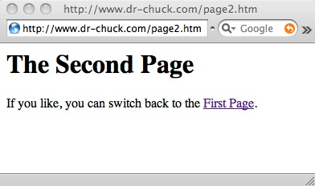
Request
Web Server
Response
80
<h1>The Second Page</h1><p>If you like, you can switch back to the <a href="page1.htm">First Page</a>.</p>
GET http://www.dr-chuck.com/page2.htm
Browser
Click
Parse/
Render

Slide 19
Let’s Write a Web Browser!

Slide 20
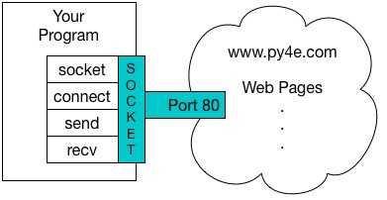
An HTTP Request in Python
import socket
mysock = socket.socket(socket.AF_INET, socket.SOCK_STREAM)
mysock.connect(('data.pr4e.org', 80))
cmd = 'GET http://data.pr4e.org/romeo.txt HTTP/1.0\n\n'.encode()
mysock.send(cmd)
while True:
data = mysock.recv(512)
if (len(data) < 1):
break
print(data.decode())
mysock.close()

Slide 21
HTTP/1.1 200 OK
Date: Sun, 14 Mar 2010 23:52:41 GMT
Server: Apache
Last-Modified: Tue, 29 Dec 2009 01:31:22 GMT
ETag: "143c1b33-a7-4b395bea"
Accept-Ranges: bytes
Content-Length: 167
Connection: close
Content-Type: text/plain
But soft what light through yonder window breaks
It is the east and Juliet is the sun
Arise fair sun and kill the envious moon
Who is already sick and pale with grief
HTTP Header
while True:
data = mysock.recv(512)
if ( len(data) < 1 ) :
break
print(data.decode())
HTTP Body

Slide 22
Making HTTP Easier With urllib

Slide 23
Using urllib in Python
Since HTTP is so common, we have a library that does all the socket work for us and makes web pages look like a file
import urllib.request, urllib.parse, urllib.error
fhand = urllib.request.urlopen('http://data.pr4e.org/romeo.txt')
for line in fhand:
print(line.decode().strip())
urllib1.py

Slide 24
import urllib.request, urllib.parse, urllib.error
fhand = urllib.request.urlopen('http://data.pr4e.org/romeo.txt')
for line in fhand:
print(line.decode().strip())
But soft what light through yonder window breaks
It is the east and Juliet is the sun
Arise fair sun and kill the envious moon
Who is already sick and pale with grief
urllib1.py

Slide 25
Like a File...
import urllib.request, urllib.parse, urllib.error
fhand = urllib.request.urlopen('http://data.pr4e.org/romeo.txt')
counts = dict()
for line in fhand:
words = line.decode().split()
for word in words:
counts[word] = counts.get(word, 0) + 1
print(counts)
urlwords.py

Slide 26
Reading Web Pages
import urllib.request, urllib.parse, urllib.error
fhand = urllib.request.urlopen('http://www.dr-chuck.com/page1.htm')
for line in fhand:
print(line.decode().strip())
<h1>The First Page</h1>
<p>If you like, you can switch to the <a href="http://www.dr-chuck.com/page2.htm">Second Page</a>.
</p>
urllib2.py

Slide 27
Following Links
import urllib.request, urllib.parse, urllib.error
fhand = urllib.request.urlopen('http://www.dr-chuck.com/page1.htm')
for line in fhand:
print(line.decode().strip())
<h1>The First Page</h1>
<p>If you like, you can switch to the <a href="http://www.dr-chuck.com/page2.htm">Second Page</a>.
</p>
urllib2.py

Slide 28
Parsing HTML (a.k.a. Web Scraping)

Slide 29
What is Web Scraping?
When a program or script pretends to be a browser and retrieves web pages, looks at those web pages, extracts information, and then looks at more web pages
Search engines scrape web pages - we call this “spidering the web” or “web crawling”
http://en.wikipedia.org/wiki/Web_scraping
http://en.wikipedia.org/wiki/Web_crawler

Slide 30
Why Scrape?
Pull data - particularly social data - who links to who?
Get your own data back out of some system that has no “export capability”
Monitor a site for new information
Spider the web to make a database for a search engine

Slide 31
Scraping Web Pages
There is some controversy about web page scraping and some sites are a bit snippy about it.
Republishing copyrighted information is not allowed
Violating terms of service is not allowed

Slide 32
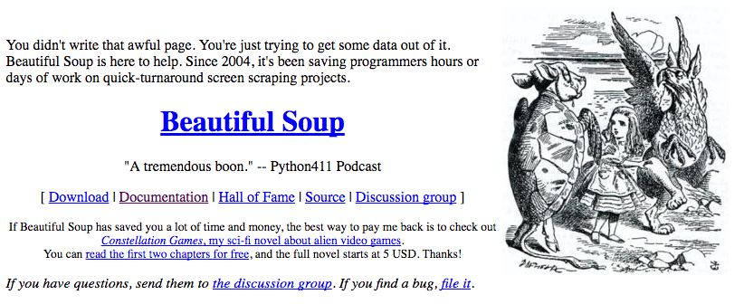
The Easy Way - Beautiful Soup
You could do string searches the hard way
Or use the free software library called BeautifulSoup from www.crummy.com
https://www.crummy.com/software/BeautifulSoup/

Slide 33
BeautifulSoup Installation
# To run this, you can install BeautifulSoup
# https://pypi.python.org/pypi/beautifulsoup4
# Or download the file
# http://www.py4e.com/code3/bs4.zip
# and unzip it in the same directory as this file
import urllib.request, urllib.parse, urllib.error
from bs4 import BeautifulSoup
...
urllinks.py

Slide 34
import urllib.request, urllib.parse, urllib.error
from bs4 import BeautifulSoup
url = input('Enter - ')
html = urllib.request.urlopen(url).read()
soup = BeautifulSoup(html, 'html.parser')
# Retrieve all of the anchor tags
tags = soup('a')
for tag in tags:
print(tag.get('href', None))
python urllinks.py
Enter - http://www.dr-chuck.com/page1.htm
http://www.dr-chuck.com/page2.htm

Slide 36
More HTML
HTML is a mark-up language where you encase pieces of content in tags
<h1>..</h1>
<p> .. </p>
<span> .. </span>
<div>
<a href = “destination” >Clickable Text</a>
<img src = “filename” >

Slide 37
Tags vs attributes
<img src = “filename” >
Which is the tag and which is the attribute?
It is common to add classes as attributes
<span class= “field-content” >
<div class= “field-content views” >

Slide 38
CSS
A way to style the different HTML elements:
h1{
color:blue;
}
p{
font-family: Cursive;
}
.field-content{
font-family: Roman;
}
.views{
text-align: center;
}

Slide 39
In class-exercise
Go to: https://www.michigandaily.com/section/government/legalize-it-push-towards-legal-recreational-marijuana-michigan
Using Developer Tools:
Change pie chart to a picture of you
Change the contents of the text
Change the color of the text

Slide 40
Acknowledgements / Contributions
Thes slide are Copyright 2010- Charles R. Severance (www.dr-chuck.com) of the University of Michigan School of Information and open.umich.edu and made available under a Creative Commons Attribution 4.0 License. Please maintain this last slide in all copies of the document to comply with the attribution requirements of the license. If you make a change, feel free to add your name and organization to the list of contributors on this page as you republish the materials.
Initial Development: Charles Severance, University of Michigan School of Information
… Insert new Contributors here
...

