Slide 1
Reddit Language Modeling
By Matthew Scharf & Alex Seidel

Slide 2
Goals
We analyze 5 subreddit categories:
Writing&stories
TV_show
Autos
Hardware&tools
Electronics
First, we aim to:
Build generative models for each category
Build a classifier to label text with a category
Finally, we aim to:
Build a classifier to identify generated text

Slide 3
Social Impact
Generation
Personalized automated service
More effective language response for different dialects
Identification
Discerning generated text to combat internet bots
Important implications for election fairness

Slide 4
Non-Neural: N-gram Trees

Slide 5
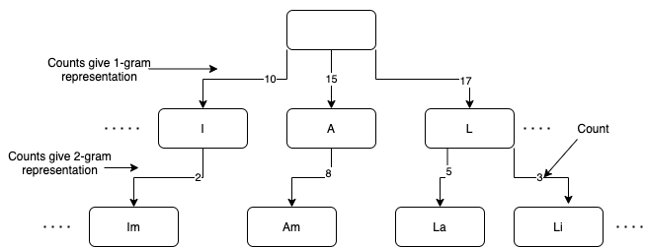
Building Order 10 Character Level n-gram Trees
For each subreddit category, we build a tree where each level n<=k is an n-gram model where k=order of the tree

Slide 6
Tree Smoothing
For each tree we use an absolute discounting technique to smooth over the n-grams of each length (i.e. levels of tree)
We start with n-gram where n=k and use a discounting factor of .9 as we move down the levels.
This gives us a smoothed probability distribution over character transitions given a history of k-1 characters

Slide 7
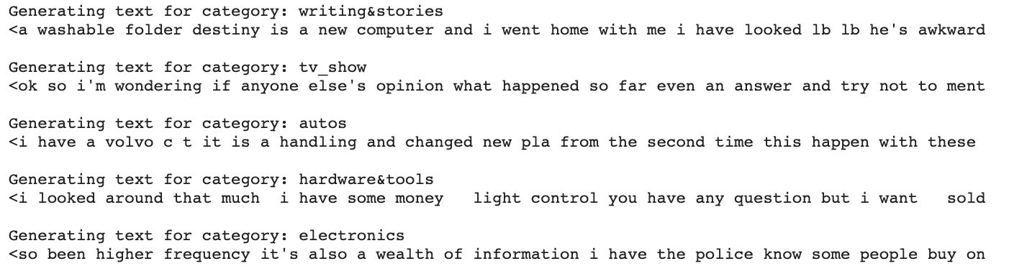
Generation
We can generate text by sampling from the smoothed distribution character by character

Slide 8
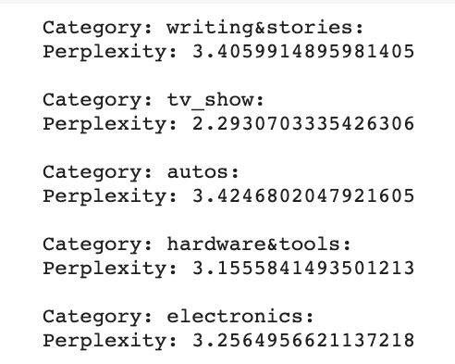
Classification
Given a text, for each of the five models we can calculate surprisal and assign the text to the lowest

Slide 9
Neural Baseline:
Generation: GPT2
Classification: BERT

Slide 10
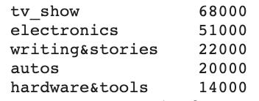
Generation
Fine-tuning pre-trained model for each subreddit category
Used GPT2 base model: distilgpt2 from huggingface 🤗
Posts per category:
Trained for 3 epochs each

Slide 11
Examples
Writing&stories: What I think ive read so far is a fantastic description of the project i'm really looking forward to doing lb lb i'm looking for a writer to fill the role of the girl lb lb lb if you have any other ideas in mind please drop
Tv_show: What I think ive heard has been a relatively new phenomenon i've been following for awhile and i feel like the rise in frequency of stories on the web and in my experience a lot of people want to share in the world lb lb for example the

Slide 12
Examples cont.
Autos: What I think ive been driving a lot ever since the 's was an excellent toyota for years and a few times i had a hard time getting past the clutches and it seemed obvious that the gs needed for larger vehicles like the i
Hardware&tools: What I think ive just made a mistake i'm planning on replacing the scooter i've owned since i was a kid but im looking for something that's both fun and fun and i need to carry a scooter i've never had a sc
Electronics: What I think ive tried and tried the zx gopro and the xy and ive tried them as a side note all my favorite features were the motion detection for the xy and the motion detection for the xy and xy

Slide 13
Classification
Fine-tuning pre-trained BERT base model:
distilBERT from huggingface 🤗
Classifies posts into one of the 5 subreddit categories
Used 70k posts as data points:
Sampled 14k from each of the 5 categories
Used 80/20 train-test split
Ran for one epoch

Slide 14
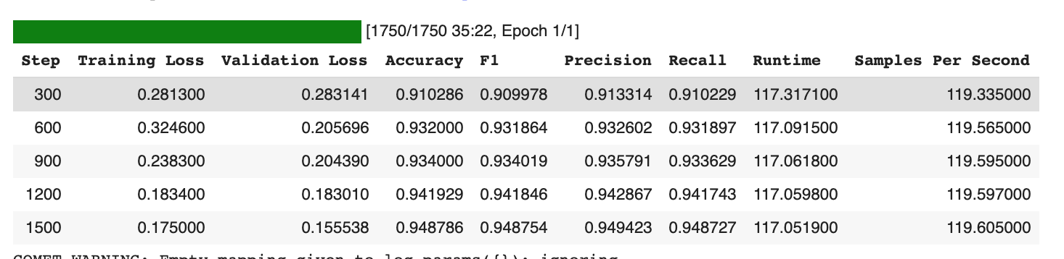
Training

Slide 15
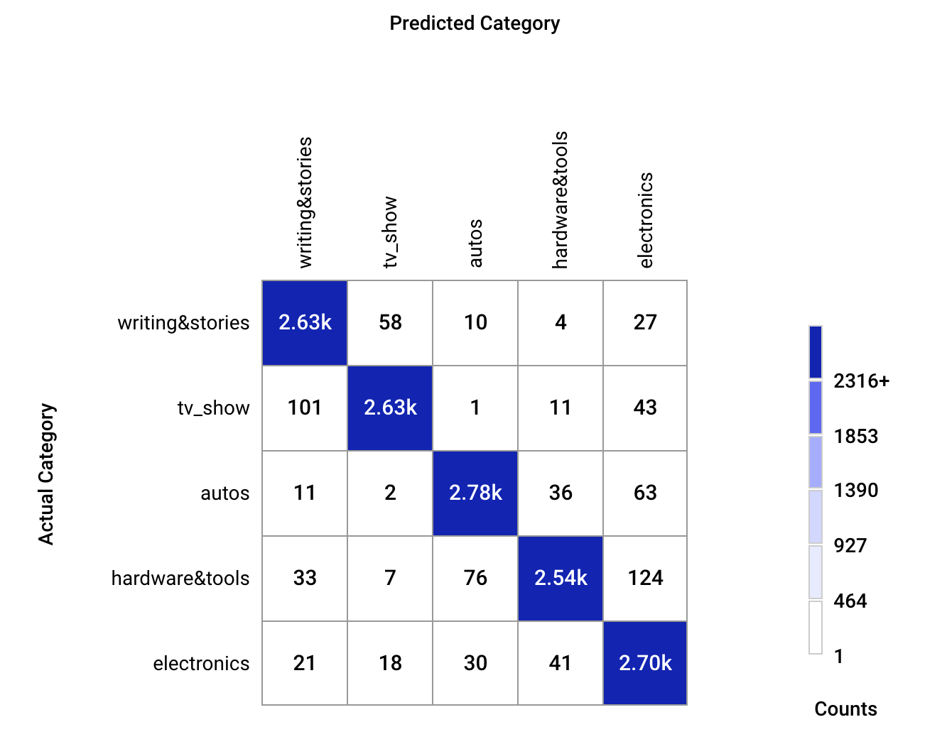
Test Set Confusion Matrix
Predicted
Actual

Slide 16
Advanced Neural:
BERT classifier for real/generated data

Slide 17
Classification
Fine-tuning pre-trained BERT base model again
Classify posts as generated or real
Generate 1000 posts from each of the 5 GPT2 generative models fine-tuned on the 5 subreddit categories
Sample 1000 posts from each of the 5 categories
Fine tune a binary discriminator to identify fake posts:
Total 5000 total real/5000 total generated
Used 80/20 train-test split again
Training for 3 epochs

Slide 18
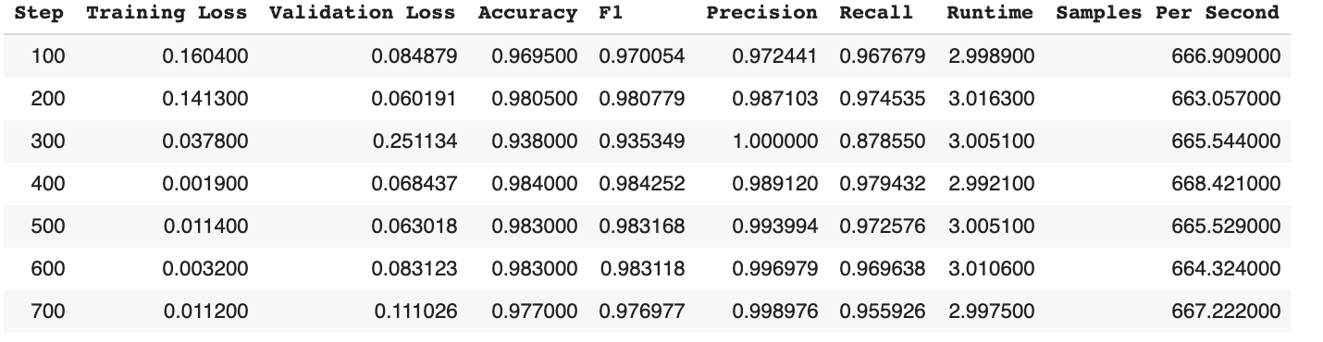
Results

Slide 19
Conclusion
Successfully:
Trained generative models for each subreddit
Built subreddit classifier
Built fake text identifier
Pretrained Neural models are:
better at generation & classification
much faster to train and use after training
Order K n-gram tree
Built discriminator using 5 different models to minimize overfitting, but all generators use GPT2 and kaggle data
This might limit generalization for fake text identifier
However GPT series are currently SOTA

