Slide 1
SMART THERMOSTAT SYSTEM
Siri Uday Shastry and Sravani Chatrathi

Slide 2
Motivation
The main idea is to have remotely managed temperature in the house.

Slide 3
A brief description
The thermostat detects and displays the house temperature
Regulates the house temperature according to the user requirement
Set temperature - LCD display / Mobile app

Slide 4
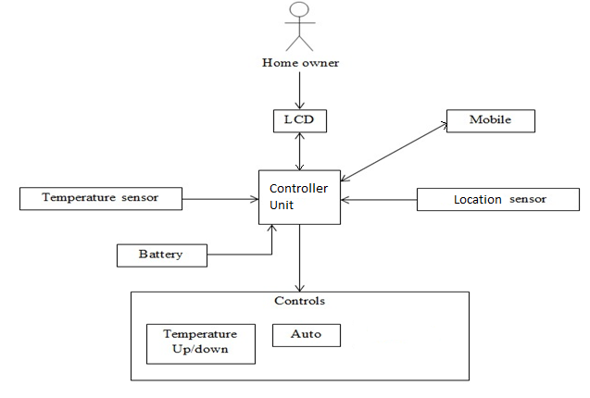
System Architecture

Slide 5
Quality Attributes
Accuracy
Safety
Usability
Reliability

Slide 6
Prioritized Scenarios
User sets the temperature
Thermostat Shuts down automatically on detection of any spark or internal failure.
The temperature can be set differently at different locations in the house.
Auto mode-The app is used to set default temperatures.
The Emergency Heat switch can be turned ON or OFF manually, it is set ON during a failure.
The user cannot interact via mobile with the thermostat when the battery level is low.
Notes:
Auto mode - The app is used to set default temperatures at particular times during day or night.

Slide 7
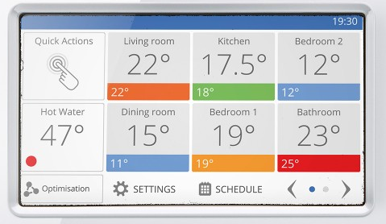

Slide 8
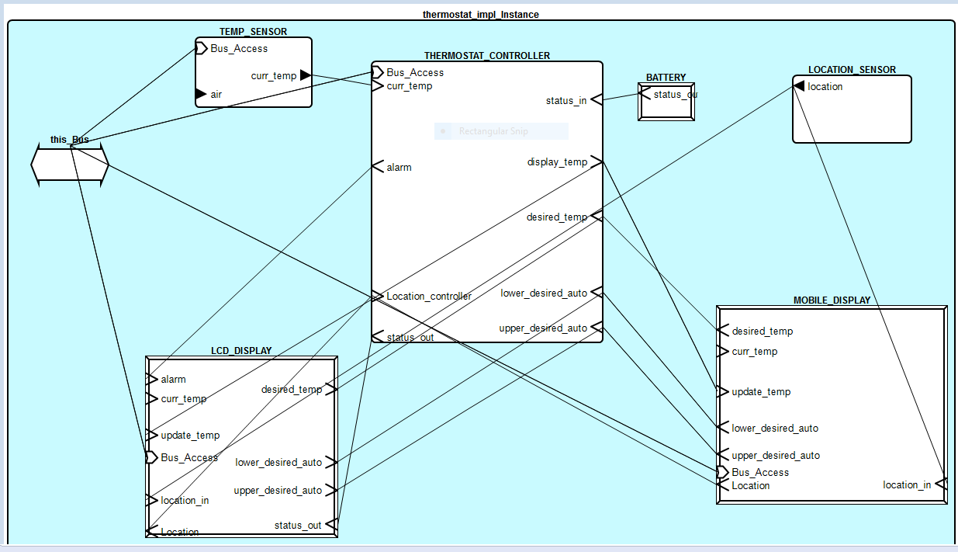
Block Diagram

Slide 9
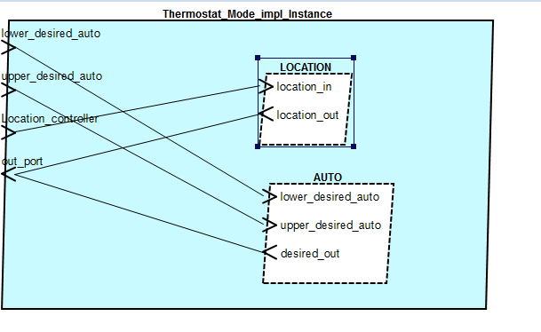

Slide 10
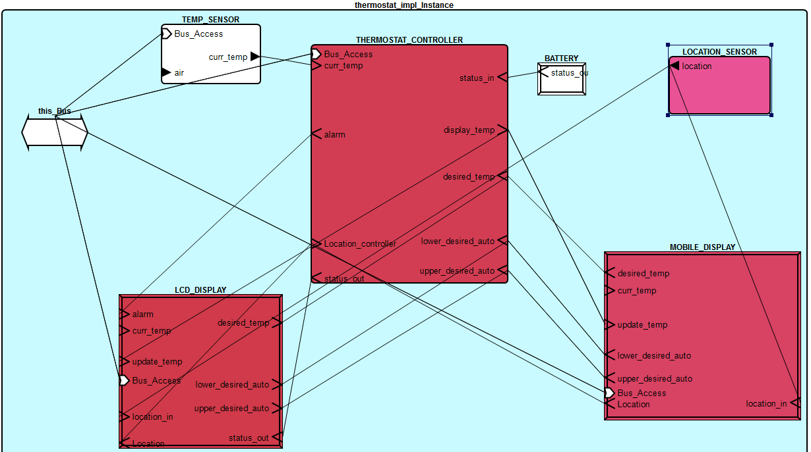
Error Flows

Slide 11
Thank you :)

