Slide 1
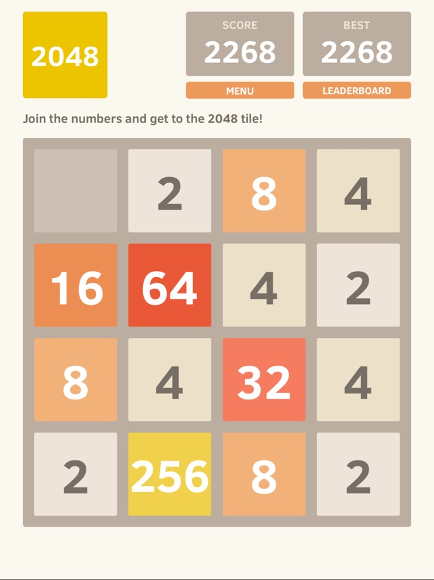
What is the optimal strategy to win the game 2048?

Slide 2
Solution: AI
A bot that will search the 2048 state space to find the next “best” move based on a certain board evaluation criterion
left
right
up
down

Slide 3
Heuristics
Choose the move that:
Gets the most points
Leaves the most open spaces
Lines up the most merges for the next move
Keeps the biggest number in the corner
Has the best chances of success (based on Monte Carlo Simulation)

Slide 4
Result
An evaluation of each method used:
Highest tile reached
Average tile reached
% games that reached 2048
High score
Average score
A decision about which method appears to be the optimal strategy based on these stats

