Slide 1
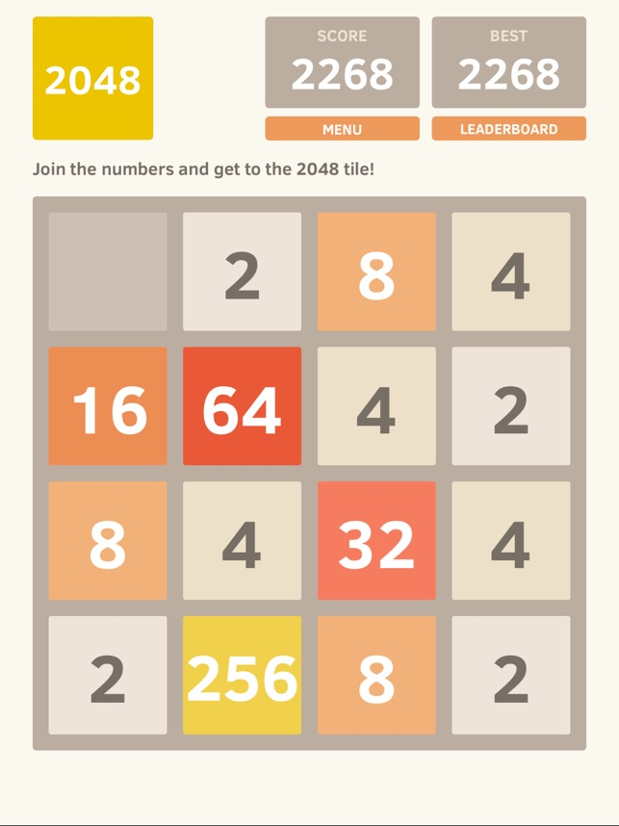
What is the optimal strategy to win the game 2048?

Slide 2
What am I doing?
A bot that will play 2048 using several different strategies for determining the next “best” move
left
right
up
down

Slide 3
What have I done so far?
Written the game from scratch
Developed a basic GUI
Written the bot to play according to the following strategies:
Random move
High scores
Most merges
Keep largest tile in corner
looking only one move ahead

Slide 4
What issues have I encountered?
Next step: modify bot to look n moves ahead when choosing the next “best” move
How should I handle the random aspect of placing a new tile when looking ahead n moves?
Ignore it
Monte Carlo Simulation
L
R
left
U
D
right
L
R
. . .
U
up
D
. . .
down

