Slide 1


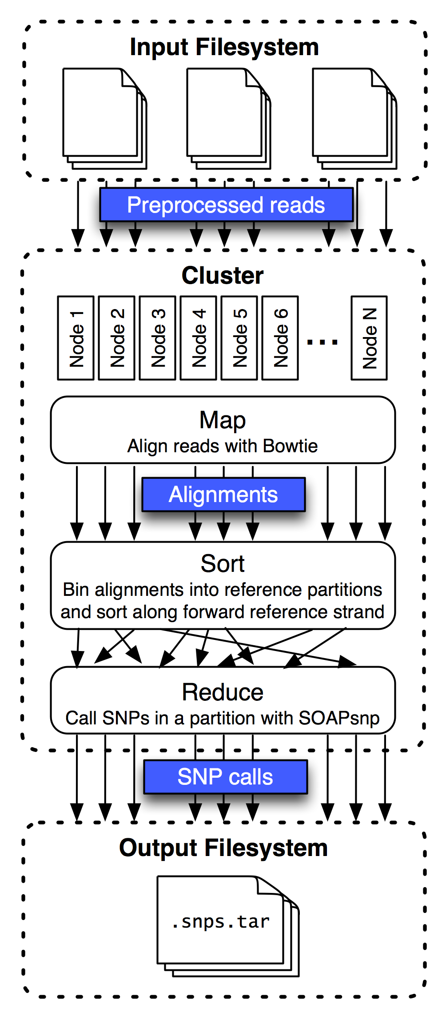
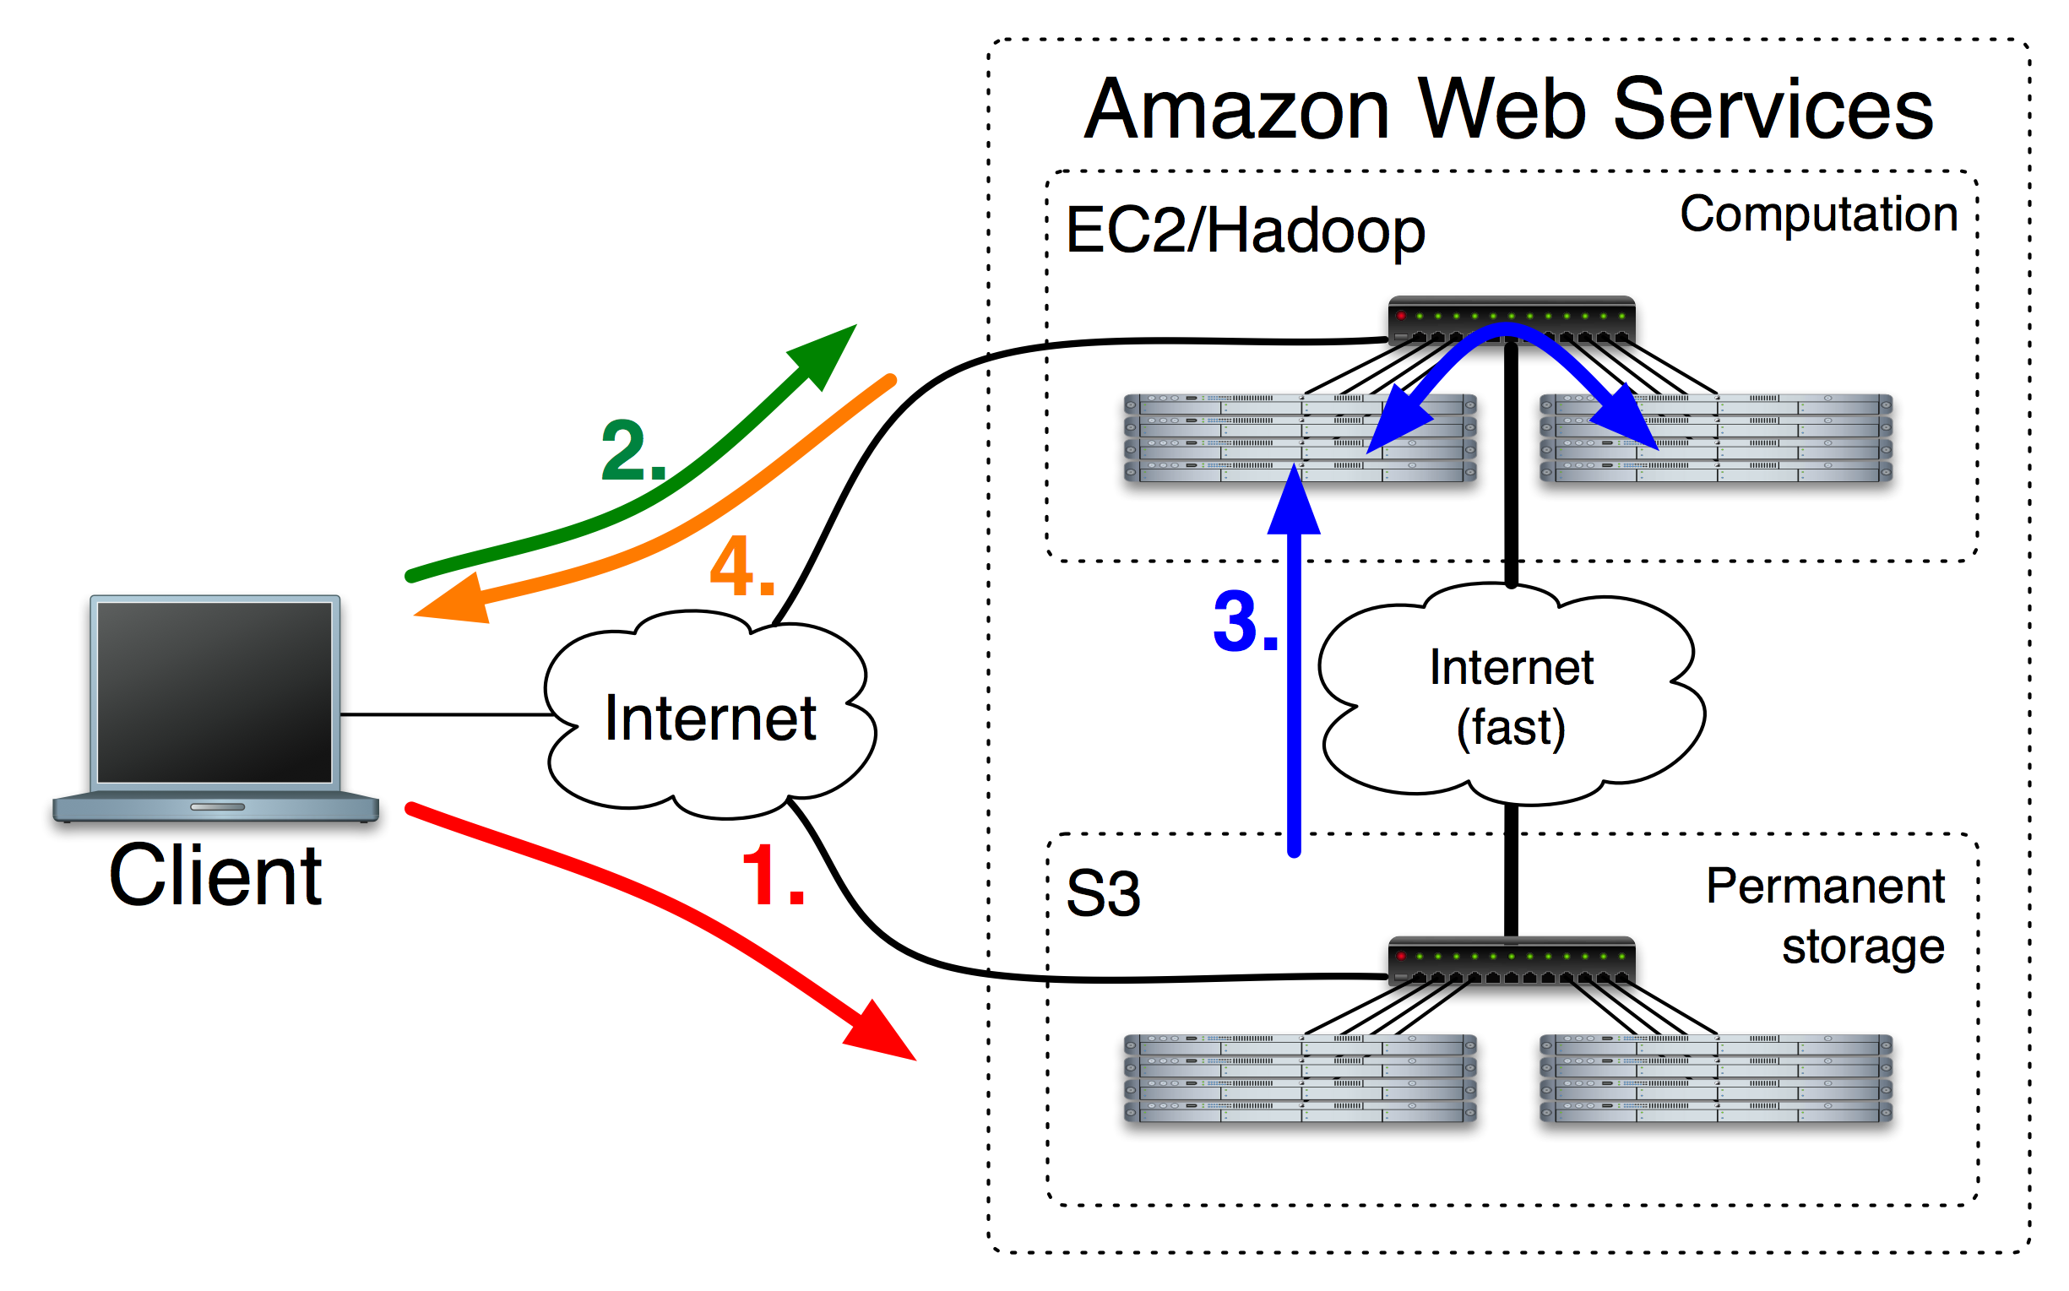

Human SNPs from short reads in hours using cloud computing
Ben Langmead^{1, 2}, Michael C. Schatz², Jimmy Lin³, Mihai Pop², Steven L. Salzberg²
¹ Department of Biostatistics, Johns Hopkins Bloomberg School of Public Health, Baltimore, Maryland, USA
² Center for Bioinformatics and Computational Biology, University of Maryland, College Park, MD, USA
³ The iSchool, College of Information Studies, University of Maryland, College Park MD, USA
http://bowtie‐bio.sf.net/crossbow
Department of Biostatistics
Abstract
Crossbow Flow
Whole-Human Resequencing with Crossbow
As growth in short read sequencing throughput vastly outpaces improvements in microprocessor speed, there is a critical need to accelerate common tasks, such as short read alignment and SNP calling, via large-scale parallelization.
Crossbow is a software tool that combines the speed of the short read aligner Bowtie¹ and the accuracy of the SOAPsnp² consensus and SNP caller within a cloud computing environment. Crossbow aligns reads and makes highly accurate SNP calls from a dataset comprising 38-fold coverage of the human genome in under 1 day on a local 40 core cluster, and under 3 hours using a 320‐core cluster rented from Amazon’s Elastic Compute Cloud³ (EC2) service. Crossbow’s ability to run on EC2 means that users need not own or operate an expensive computer cluster in order to run Crossbow. Crossbow is available at http://bowtie‐bio.sf.net/crossbow under the Artistic license.
Crossbow was used to align and call SNPs from the set of 2.7 billion reads sequenced from a Han Chinese male by Wang et al⁶. Previous work demonstrated SNPs called from this dataset by SOAPsnp are highly concordant with genotypes determined via an Illumina 1M BeadChip assay of the same individual². Reads were downloaded from a mirror of the YanHuang site (http://yh.genomics.org.cn). The reads cover the assembled human genome sequence to 38‐fold coverage. They consist of 2.02 billion unpaired reads with sizes ranging from 25 to 44 bps, and 658 million paired‐end reads. The most common unpaired read lengths are 35 and 40 bps, comprising 73.0% and 17.4% of unpaired reads respectively. Cost timing, and accuracy results are summarized below. SNPs produced by Crossbow exhibit similar agreement with the BeadChip calls as did the SOAPsnp study.
The user first uploads reads to a filesystem visible to the Hadoop cluster. If the Hadoop cluster is in EC2, the filesystem might be an S3 bucket. If the Hadoop cluster is local, the filesystem might be an NFS share.
A cluster may consist of any number of nodes. Hadoop handles the details of routing data, distributing and invoking programs, providing fault tolerance, etc.
 | 1 Master 10 Workers | 1 Master 20 Workers | 1 Master 40 Workers
Worker CPU cores | 80 | 160 | 320
Wall clock time | 6h:30m | 4h:33m | 2h:53m
Cost | $61.60 | $84.00 | $98.40
Crossbow Design
Crossbow builds upon a parallel software framework called Hadoop⁴. Hadoop is an open source implementation of the MapReduce programming model that was first described by scientists at Google⁵. Hadoop has become a popular tool for computation over very large datasets, used at companies including Google, Yahoo, IBM, and Amazon. Hadoop requires that programs be expressed as a series of Map and Reduce steps operating on tuples of data. Though not all programs are easily expressed this way, Hadoop programs gain many benefits. In general, Hadoop programs need not deal with particulars of how work and data are distributed across a cluster or how to recover from failures. Hadoop handles this.
Map step is short read alignment. Many instances of Bowtie run in parallel across the cluster. Input tuples are reads and output tuples are alignments.
Sort step bins alignments according to primary key (genome partition) and sorts according to a secondary key (offset into partition). This is handled efficiently by Hadoop.
The insight behind Crossbow is that alignment and SNP calling can be framed as a series of Map, Sort and Reduce steps. The Map step is short read alignment, the Sort step bins and sorts alignments according to the genomic position aligned to, and the Reduce step calls SNPs for a given partition.
Simulated | True # sites | Crossbow sensitivity | Crossbow precision
Human Chr. 22, simulated SNPs | 46,586 | 99.01% | 99.14%
Human Chr. X, simulated SNPs | 102,219 | 98.97% | 99.64%
Real | # sites | Autosomal agreement | Chr. X agreement
Whole human, versus Illumina 1M BeadChip | 1.04M | 99.5% | 99.6%
Crossbow is a new software tool for efficient and accurate whole genome genotyping. Crossbow aligns and calls SNPs from 38‐fold coverage of short reads from a human in less than 3 hours on a 320‐core cluster rented from Amazon’s EC2 service. Crossbow condenses over 1,000 hours of resequencing computation into a few hours without requiring the user to own or operate a computer cluster. Running on standard software (Hadoop) and hardware (EC2 instances) makes it easier for other researchers to reproduce our results or other results obtained with Crossbow. Crossbow is freely available from http://bowtie‐bio.sf.net/crossbow
Reduce step calls SNPs for each reference partition. Many instances of SOAPsnp run in parallel across the cluster. Input tuples are sorted alignments for a partition and output tuples are SNP calls.
References
Steps involved in running Crossbow using Amazon’s EC2 and S3 services
Langmead B, Trapnell C, Pop M, Salzberg SL. Ultrafast and memory-efficient alignment of short DNA sequences to the human genome. Genome Biol 10 (3): R25.
Li, R., Y. Li, et al. (2009). SNP detection for massively parallel whole‐genome resequencing. Genome Res 19 (6): 1124‐32.
http://aws.amazon.com/
http://hadoop.apache.org
Dean, J. and Ghemawat, S. 2008. MapReduce: simplified data processing on large clusters. Communications of the ACM 51, 1 (Jan. 2008), 107-113.
Wang, J., W. Wang, et al. (2008). The diploid genome sequence of an Asian individual. Nature 456 (7218): 60‐5.
Results are stored in cluster’s filesystem, then automatically archived and downloaded to the client machine. SNP calls are provided in SOAPsnp’s format.
Simulated reads are paired-end reads with simulated SNPs, including known HapMap SNPs, which SOAPsnp handles specially, and novel SNPs. “Real” reads are the reads from the Wang et al study. Agreement is calculated as correct calls at genotyped sites divided by number of genotyped sites.

