Slide 1
Cyberpunk Bartender
Developer –
Sonal Chavan

Slide 2
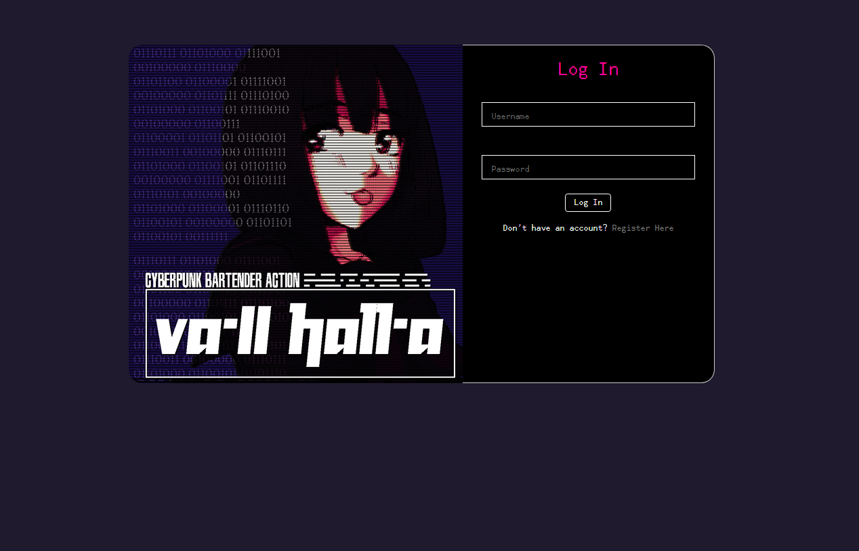
Log In

Slide 3
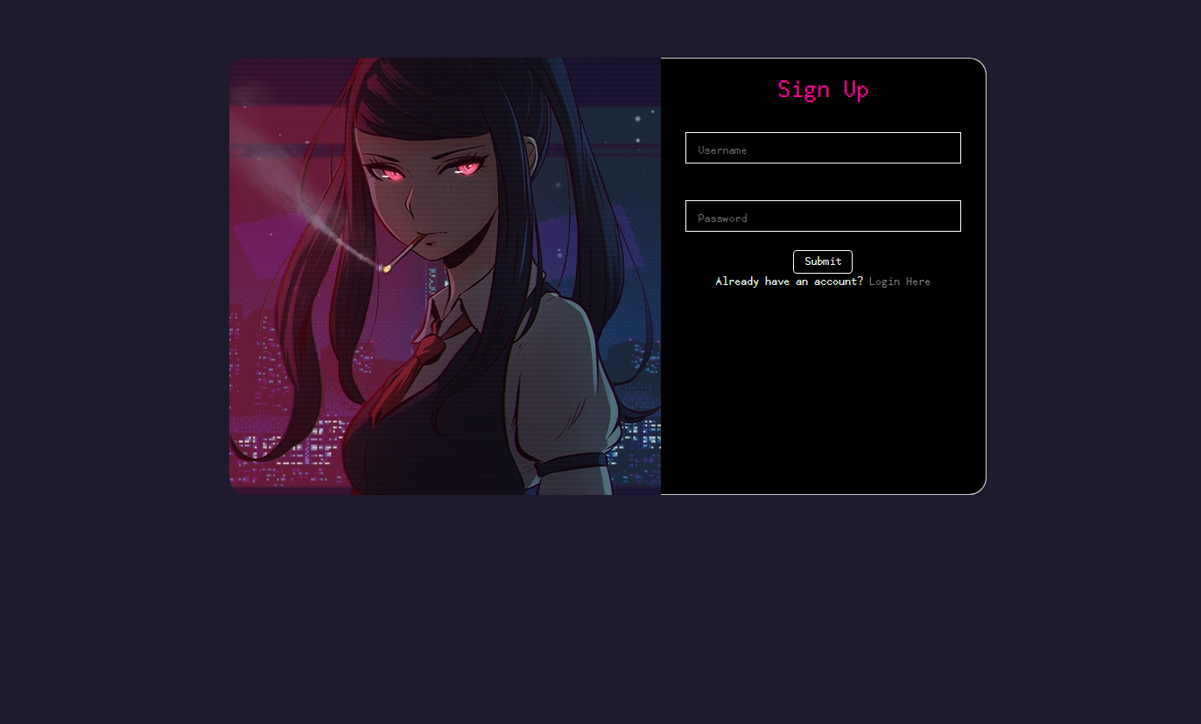
Sign Up

Slide 4
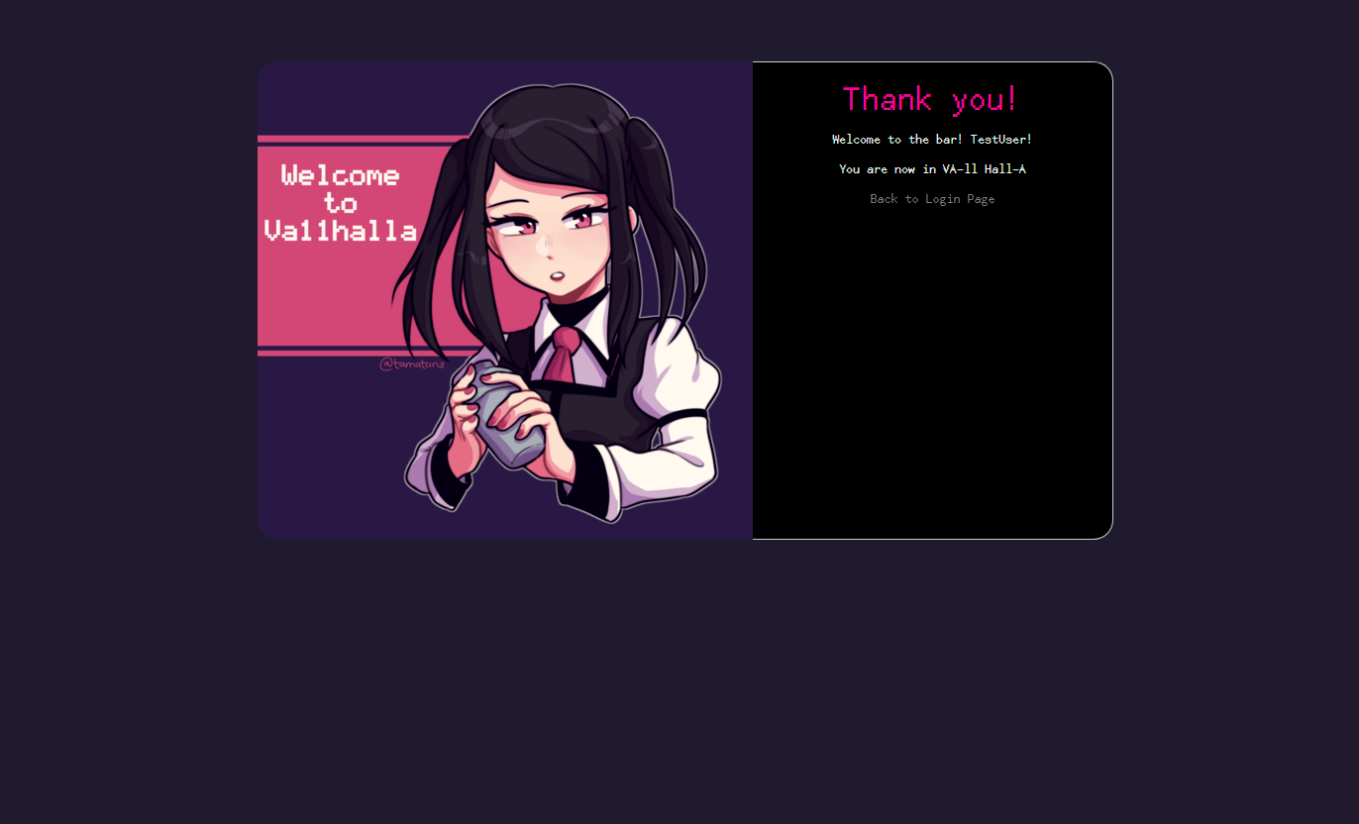
Sign Up Confirmation

Slide 5
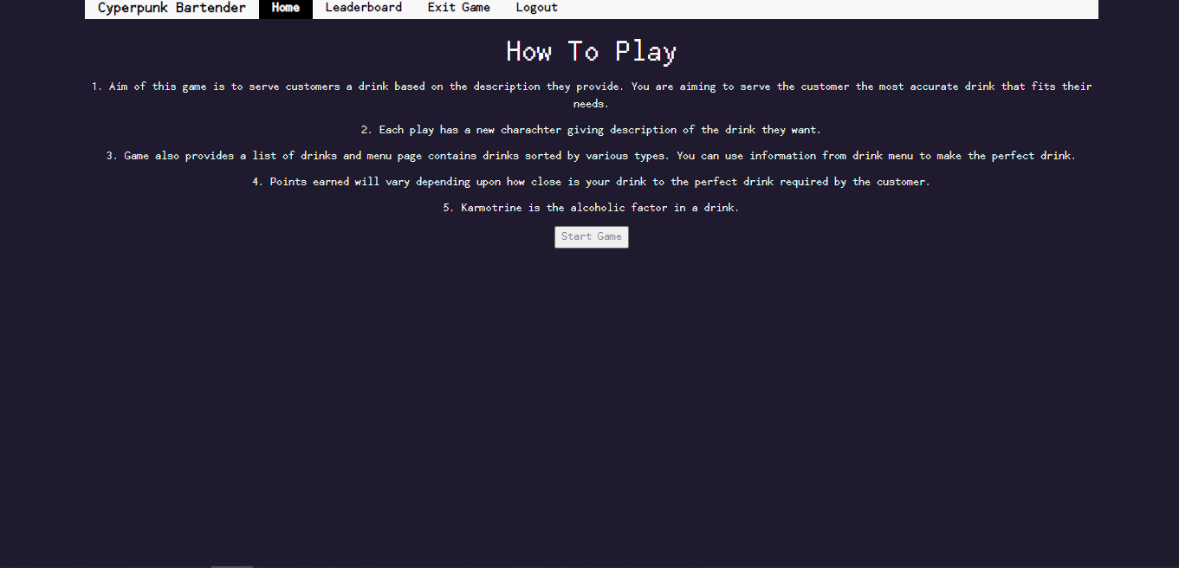
Instruction Page

Slide 6
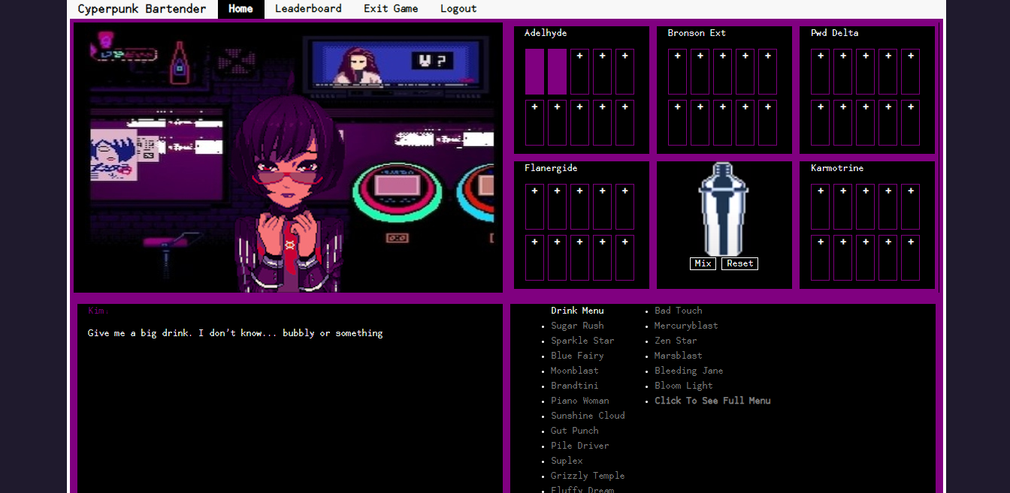
Main Page

Slide 7

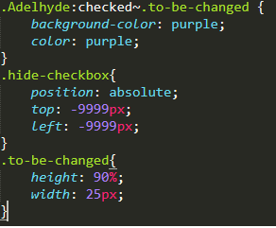
Hidden Checkbox

Slide 8
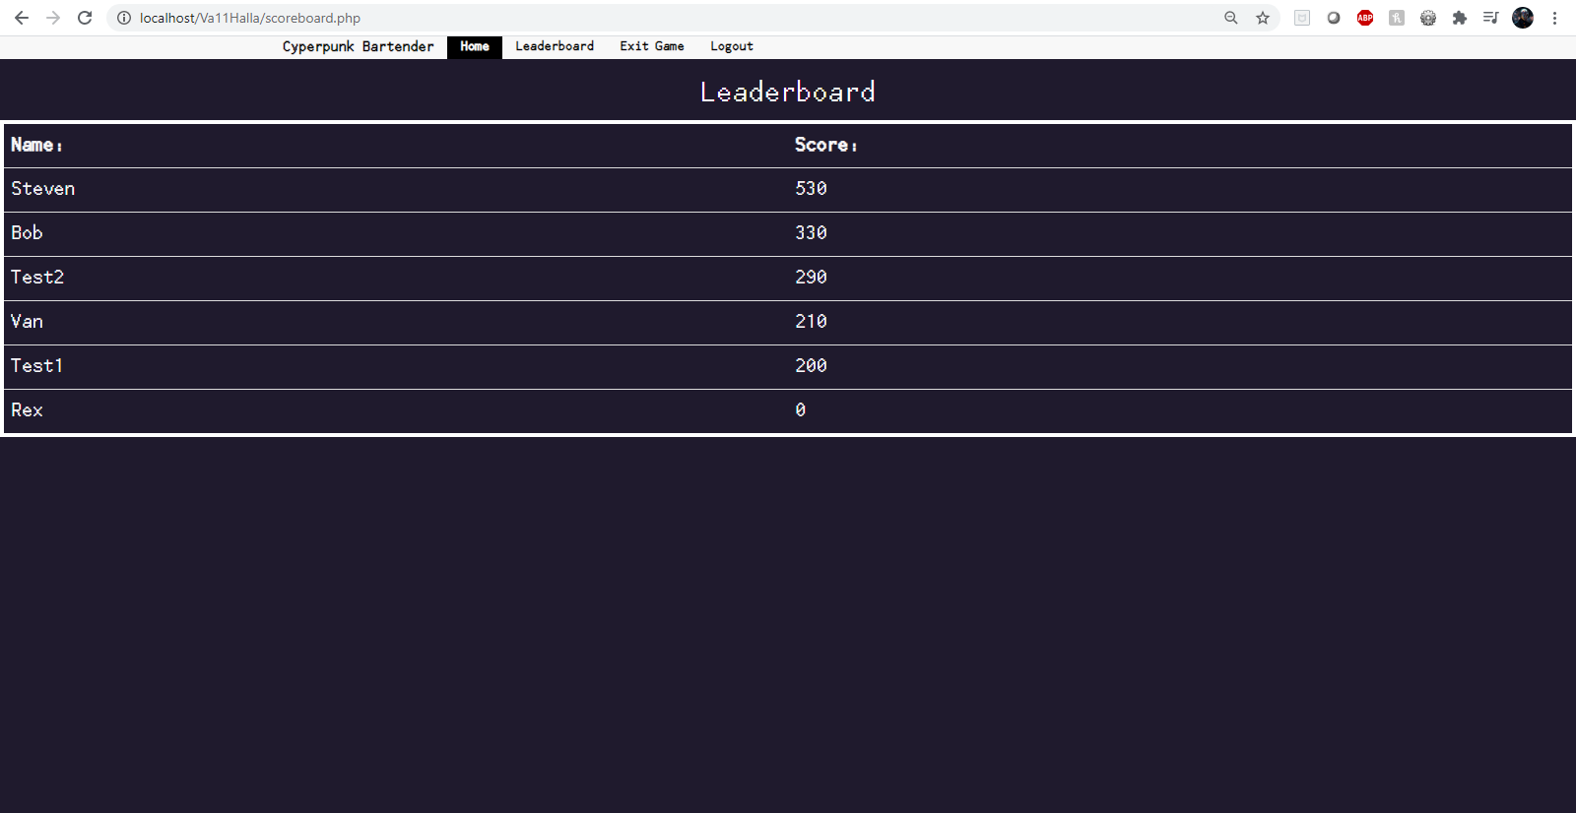
Scoreboard.php
Notes:
When the user clicks on Leaderboard in the nav bar, this page is opened. It shows the scores of all the players saved to scores.txt

Slide 9
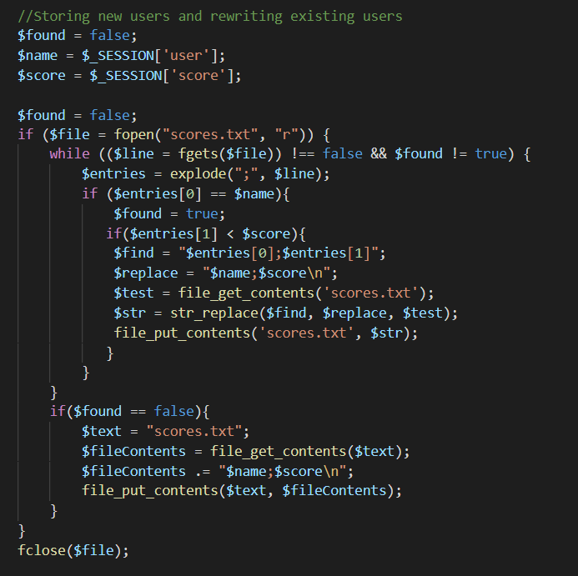
Adding/Replacing scores
Notes:
When scoreboard.php is opened, the current user’s score is saved depending on if they are new or returning. If they are returning, the score is also checked to see if their current score is higher than their previous.

Slide 10
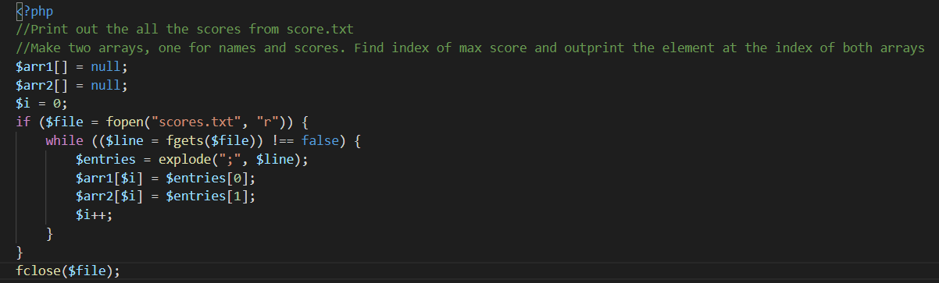
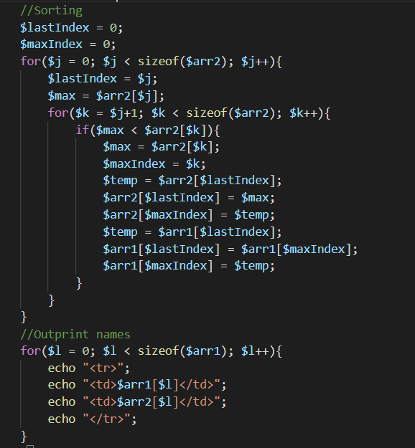
Sorting and printing scores
Notes:
The scores are printed from greatest to least by a simple sorting algorithm that swaps the max score to the front of an array. Once sorted all the values are echoed as table data.

Slide 11
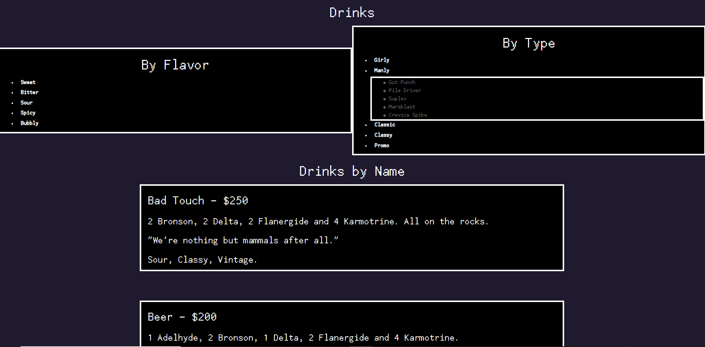
Menu.html
Notes:
Contains a menu list for the player so they know how to create the drinks. Clicking on the text under flavor and type will open a sublist where you can quickly navigate to the drink via id

Slide 12
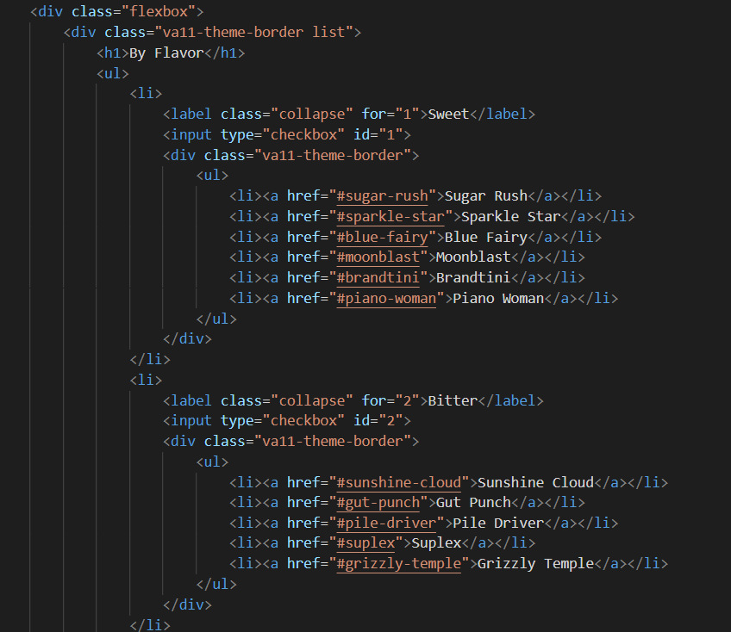
Hidden Checkbox
Notes:
The text under flavor and type acts as a hidden checkbox that opens up the sublist when clicked

Slide 13
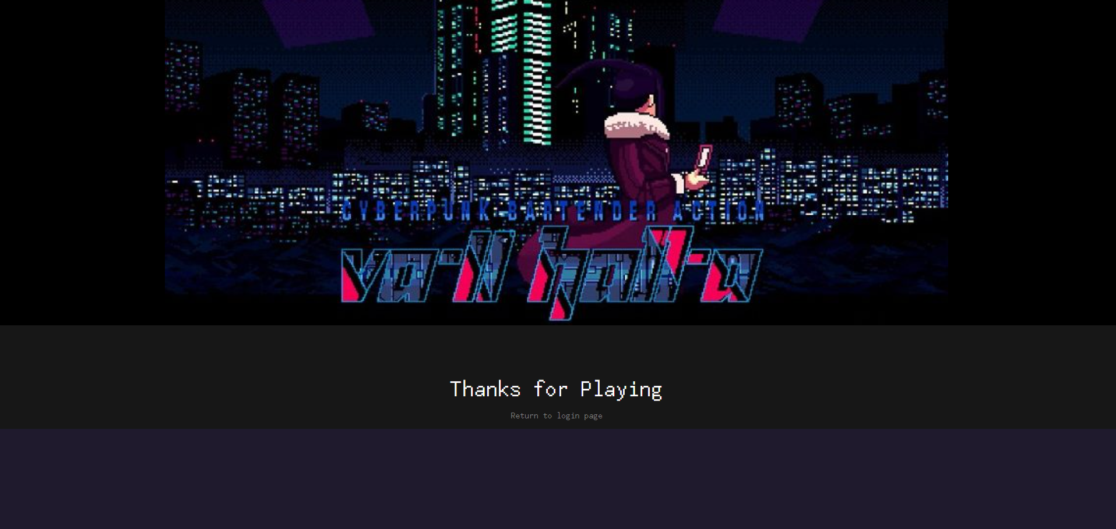

Logout.php
Notes:
When pressing the logout button the nav bar, it redirects to this page. The page clears the info from the session and deletes the cookie

Slide 14
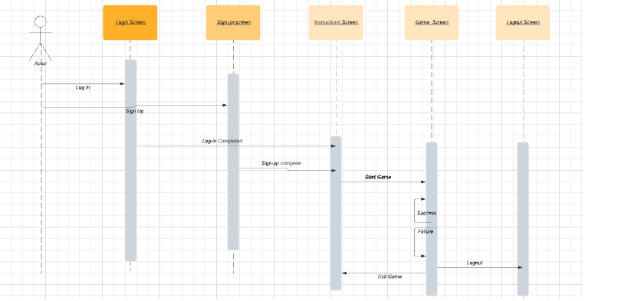
Sequence Diagram

Slide 15
Thank you

