Slide 1
Maneuver Detection – Loft Dynamics Simulator
Florian Eugster, Marcel Schubert, Nicola Dall’Acqua
StatML – 02.12.2024

Slide 2
Content
Description of approach
Pre-processing
Algorithms
Settings
Achieved results
Maneuver-Recall
Other results

Slide 3
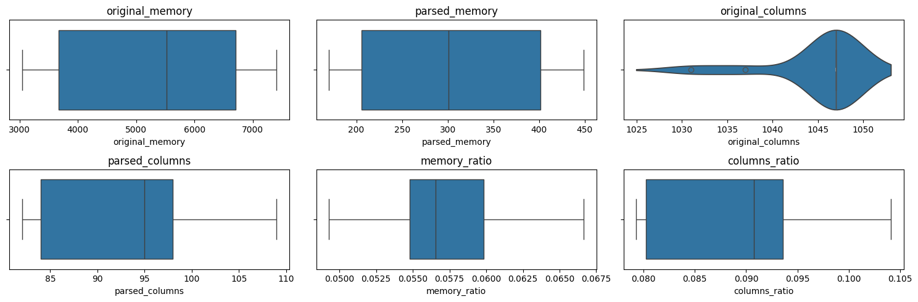
Pre-Processing
Convert datatypes
Removed unchanging columns
Forward Fill NaN values
Add dependent variable
Figure: Preprocessing Stats

Slide 4
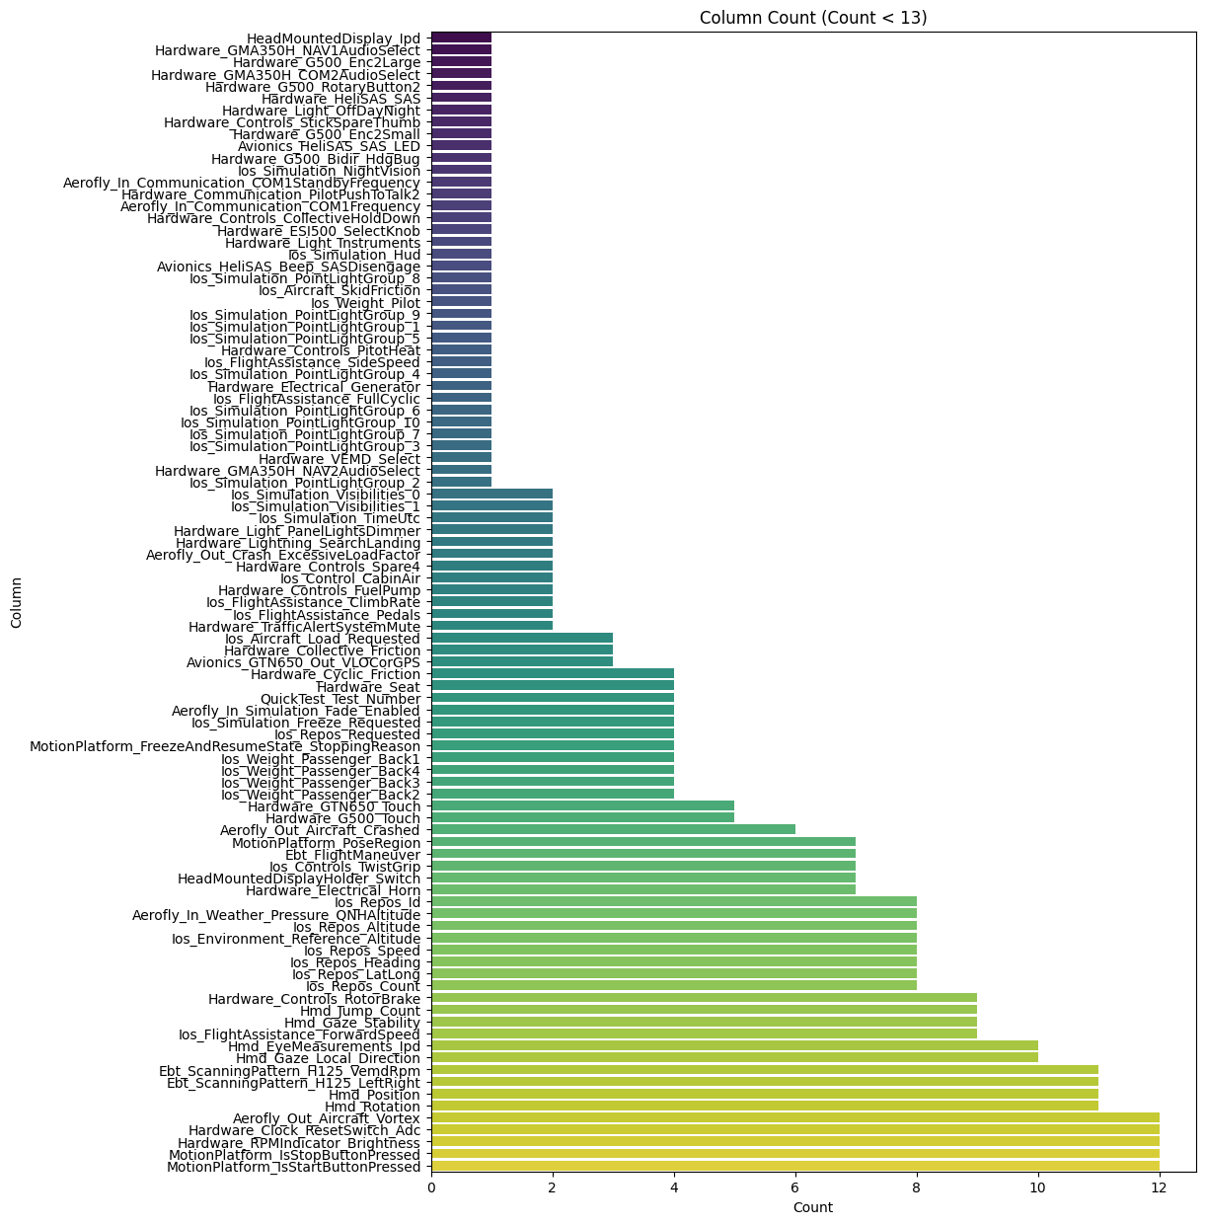
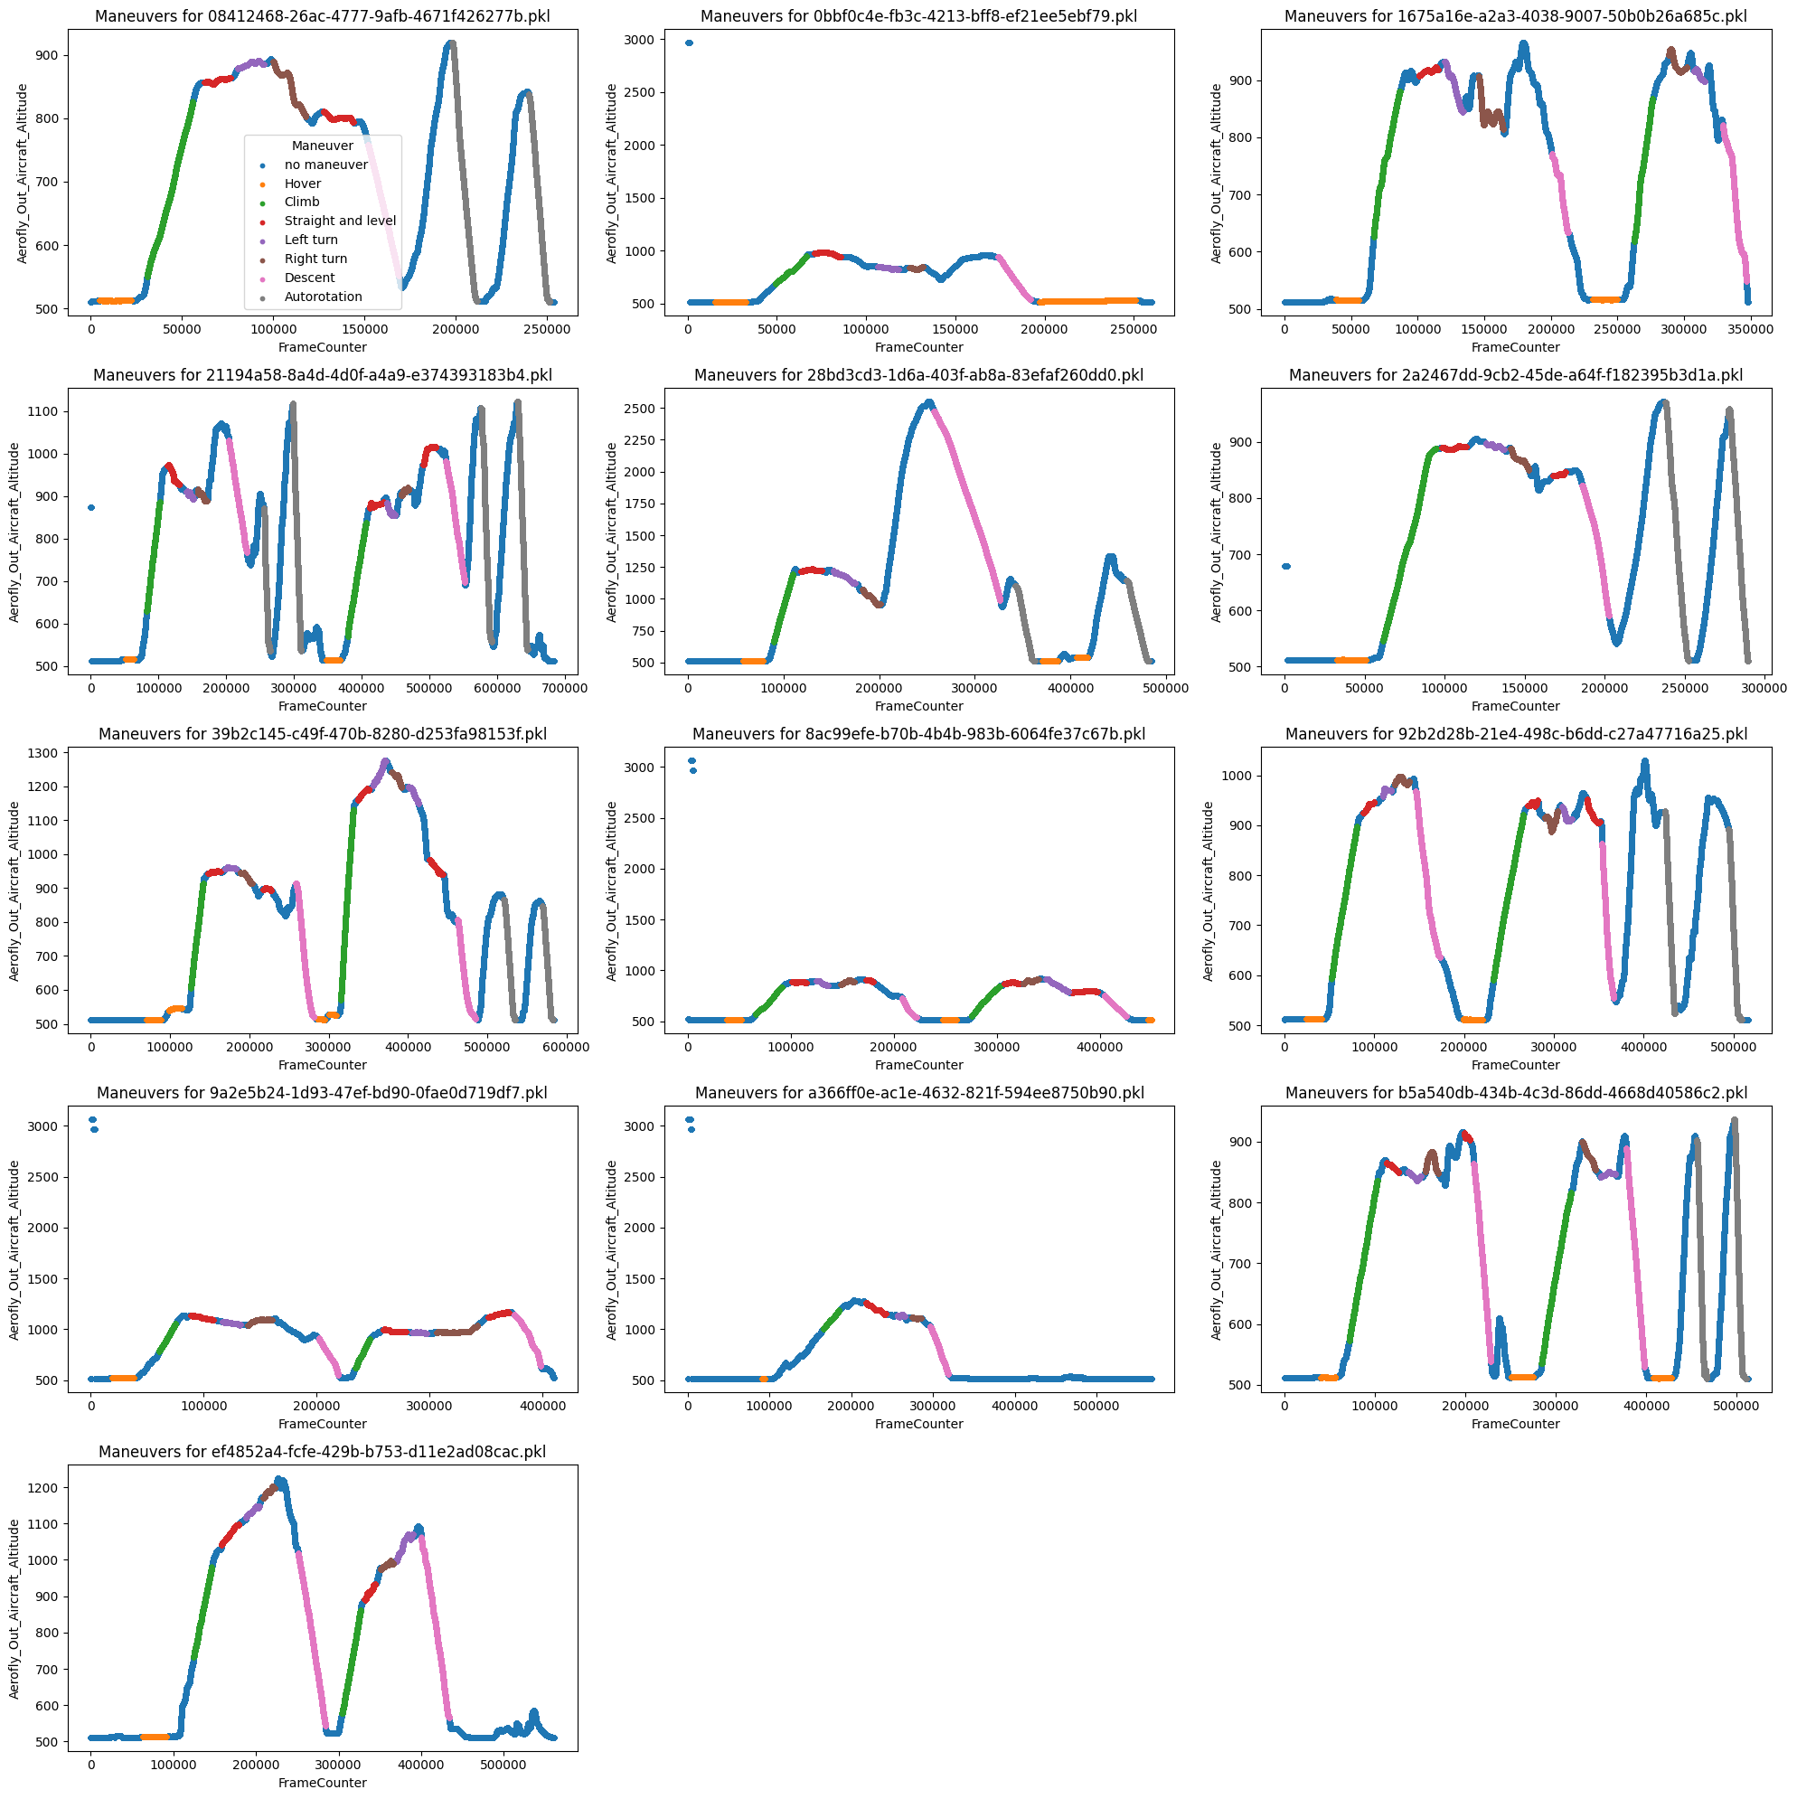
Pre-Processing
Combining flights to single dataframe:
63 shared columns out of 93
Figure: Overview Column Count

Slide 5
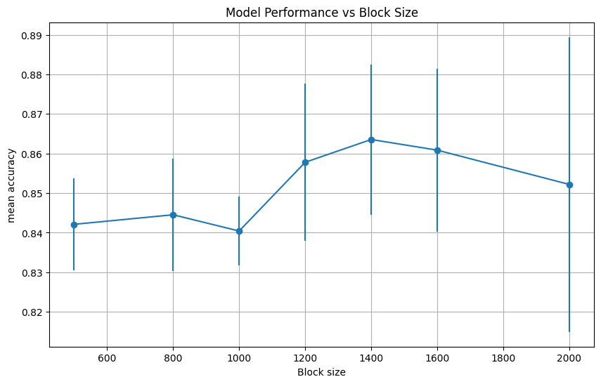
High level feature blocks
- Take random blocks out of dataframes with blocksize 1400
HIGH_LVL_FEATURE_FUNCTION_MAP = {
'Mean' : np.mean,
'StdDeviation' : np.std,
'Min' : np.min,
'Max' : np.max,
'Median' : np.median,
'Variance': np.var
}

Slide 6
Pipeline
PCA – reduction from 342 to 31 features
SVC model due to high dimensional feature space and fast training
Grid search with cross validation for optimal parameters
Preprocessing
High level feature extraction
StandardScaler
PCA
SVC

Slide 7
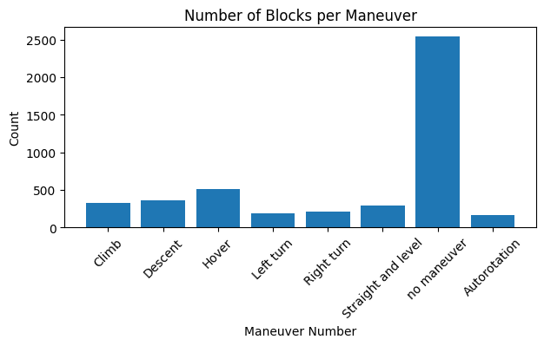
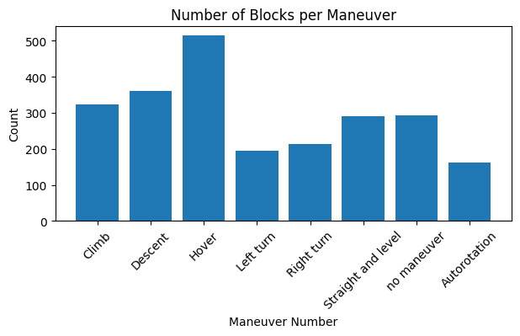
"no maneuver" difficulty
High number of "no maneuver" blocks
Approach 1: delete most of them
Approach 2: use weight_mode 'balanced'

Slide 8
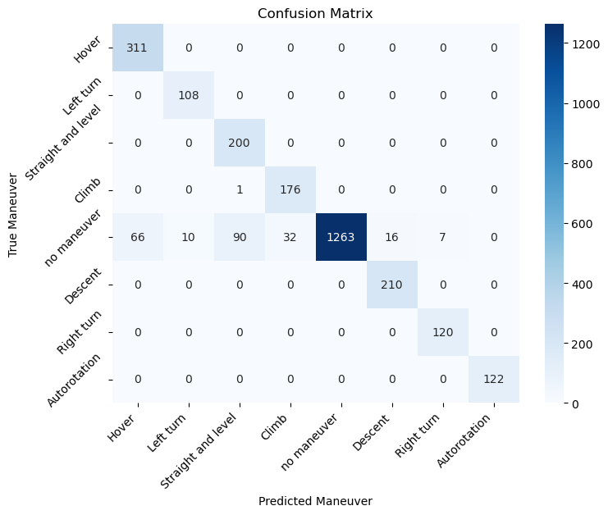
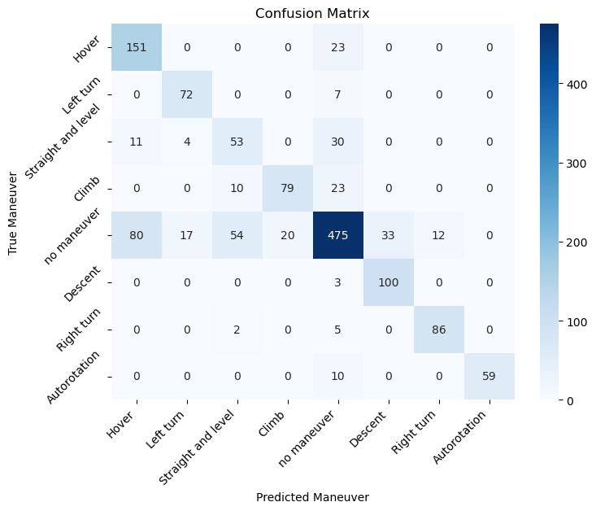
Results
Training
Accuracy: 0.92 Recall: 0.98
Testing
Accuracy: 0.76 Recall: 0.81

Slide 9
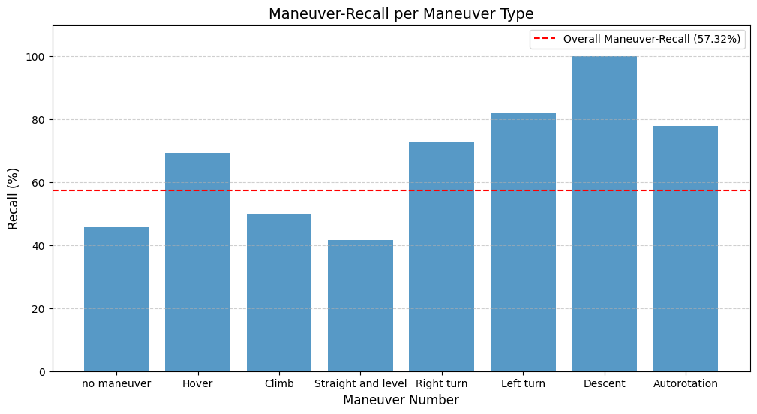
Maneuver-Recall
Maneuver recall: 0.573

Slide 10
Interpretation of results
Overfitting – results are notably better on training data than on test data
Introduction of more regularization reduces the overall performance
Misclassification – the classes ‘no maneuver’, ‘climb’ and ‘Straight and level’ get misclassified often
May be caused by poor data quality (error during preprocessing or human error while labeling) or not enough data

Slide 11
Questions?

