Slide 1
Student Welfare at NIT Sikkim
• Overview of student information and demographic data
• Suggested initiatives for student wellbeing
• Support systems for mental and physical health
• Proposed resources for student success
1

Slide 2
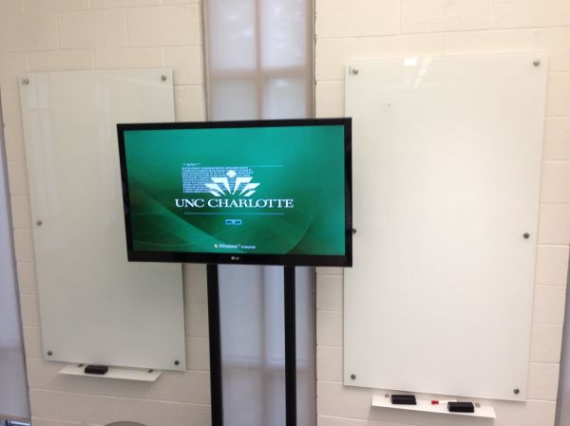
Campus Activities
• Suggested extracurricular programs and clubs
• Student engagement and community building
• Campus life and social integration
• Proposed events for student involvement
2

Slide 3
Image credits
UNC Charlotte campus: Active Learning classrooms + some signage — ghwpix; BY-SA 2.0;
https://www.flickr.com/photos/46844441@N00/21540563958; https://creativecommons.org/licenses/by-sa/2.0/

