Slide 1
Student Welfare at NIT Sikkim
• Overview of student information and wellbeing initiatives
• Suggested programs to support student mental health
• Proposed resources for personal development
• Initiatives to foster a supportive academic environment
1

Slide 2
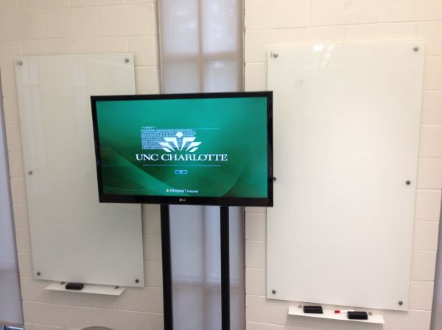
Campus Activities
• Suggested extracurricular programs and clubs
• Proposed student engagement events
• Opportunities for peer interaction and community building
• Suggested activities to enhance campus life
2

Slide 3
Image credits
UNC Charlotte campus: Active Learning classrooms + some signage — ghwpix; BY-SA 2.0;
https://www.flickr.com/photos/46844441@N00/21540563958; https://creativecommons.org/licenses/by-sa/2.0/

